Slide 1
Sea-Level “Bathtub” Inundation Mapping in Naples Mewcha Gebremedhin, Ahmed S. Elshall, Seneshaw Tsegaye U.A. Whitaker College of Engineering, FGCU 31 July 2026

Slide 2
Overview
According to Ocean Conservancy, Florida’s coastal communities may experience between 3 ft to 8 ft feet of SLR by the end of this century.
An estimated more than 30% of Florida’s population, live within 6 ft of current sea levels
SLR will make today’s king tides become the future’s everyday tides. These frequent king tides bring unusually high-water levels, and they can cause local tidal flooding.

Slide 3
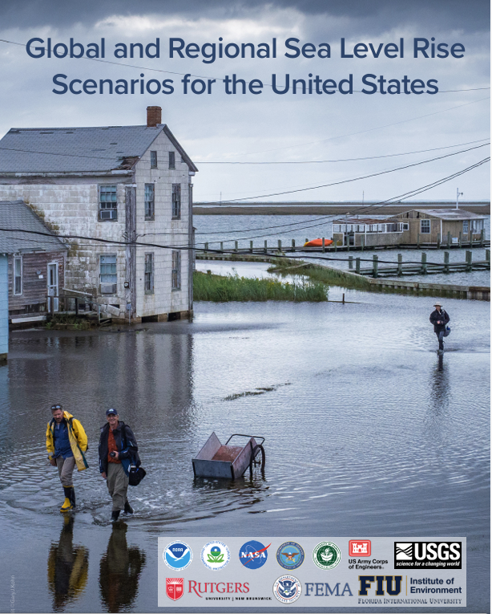
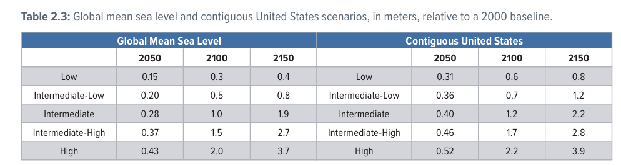
Sea level rise scenarios
Scenario projections of relative sea level along the contiguous U.S. (CONUS) coastline are about 0.6–2.2 m in 2100 and 0.8–3.9 m in 2150 (relative to sea level in 2000); these ranges are driven by uncertainty in future emissions pathways and the response of the underlying physical processes (Sweet et al. 2022).

Slide 4
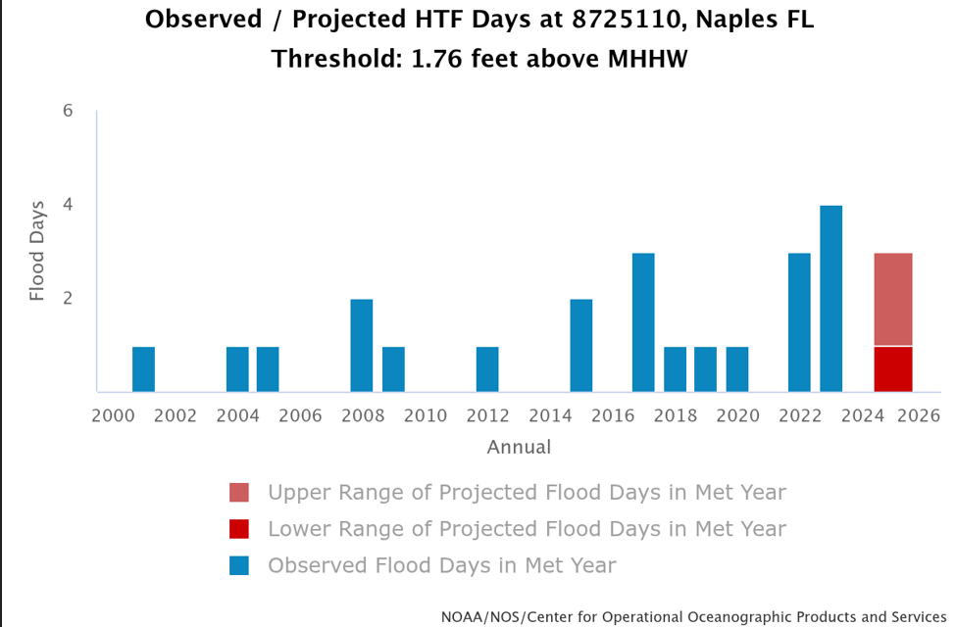
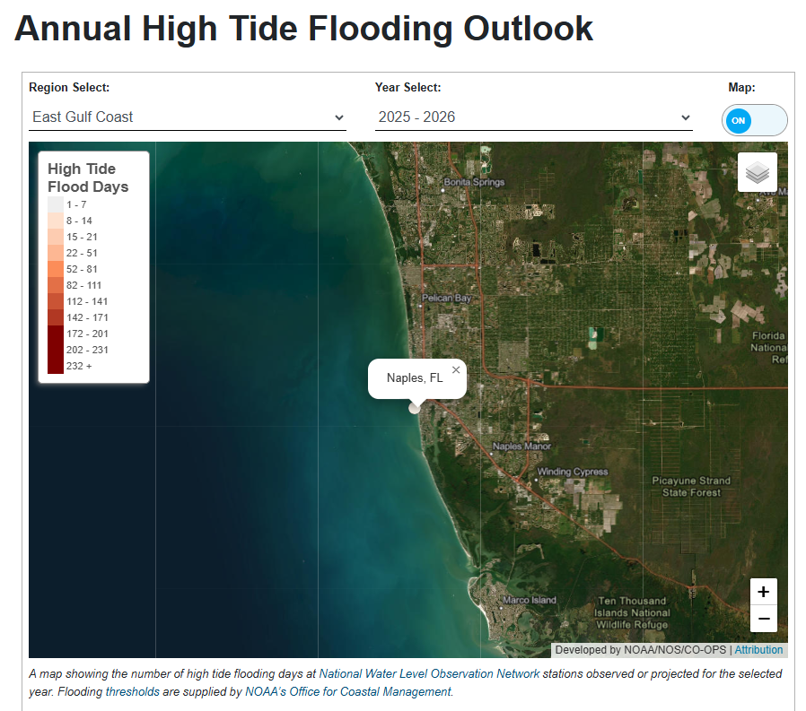
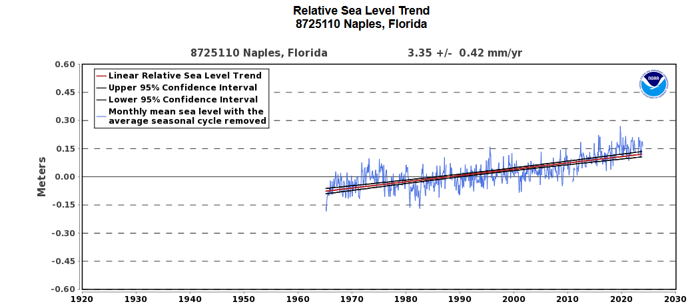
SLR and High Tide Flooding (HTF) in Naples
NOAA tide-gauge station 8725110
https://tidesandcurrents.noaa.gov/high-tide-flooding/annual-outlook.html?station=8725110
Notes:
NOAA tide-gauge station 8725110
8725110 is the NOAA tide-gauge station identification number for Naples, Florida.
HTF days means High Tide Flooding days—days when the measured water level reaches or exceeds NOAA’s local flooding threshold.
At this station, that threshold is 1.76 feet above MHHW.
MHHW (Mean Higher High Water) is the average height of the higher of the two daily high tides over NOAA’s standard 19-year tidal-datum period.

Slide 5
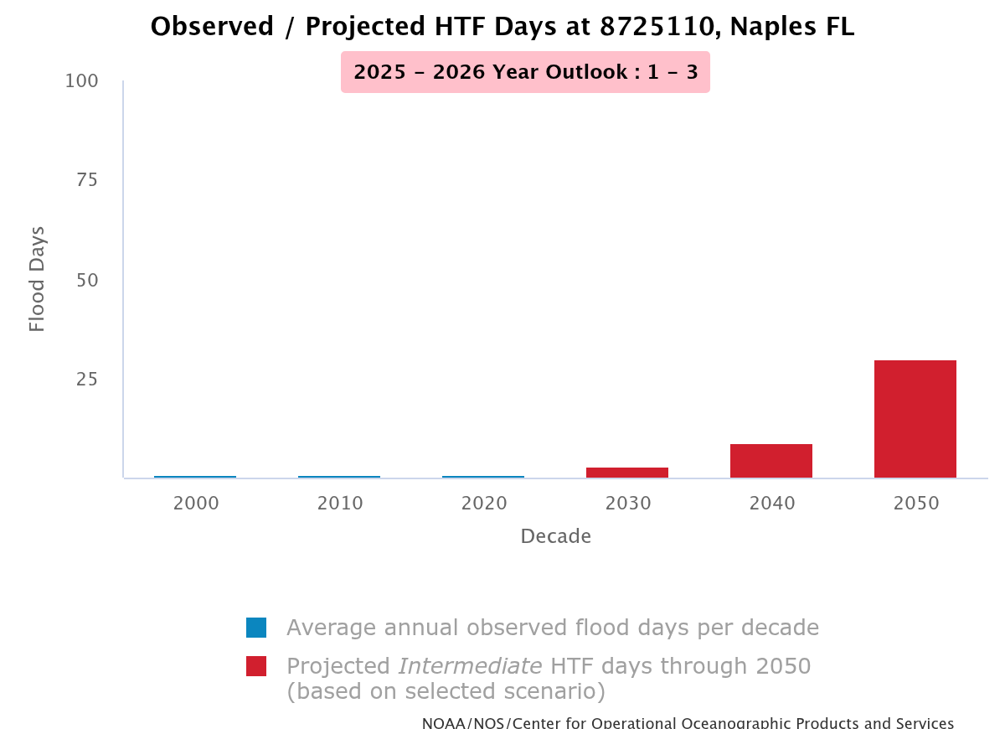
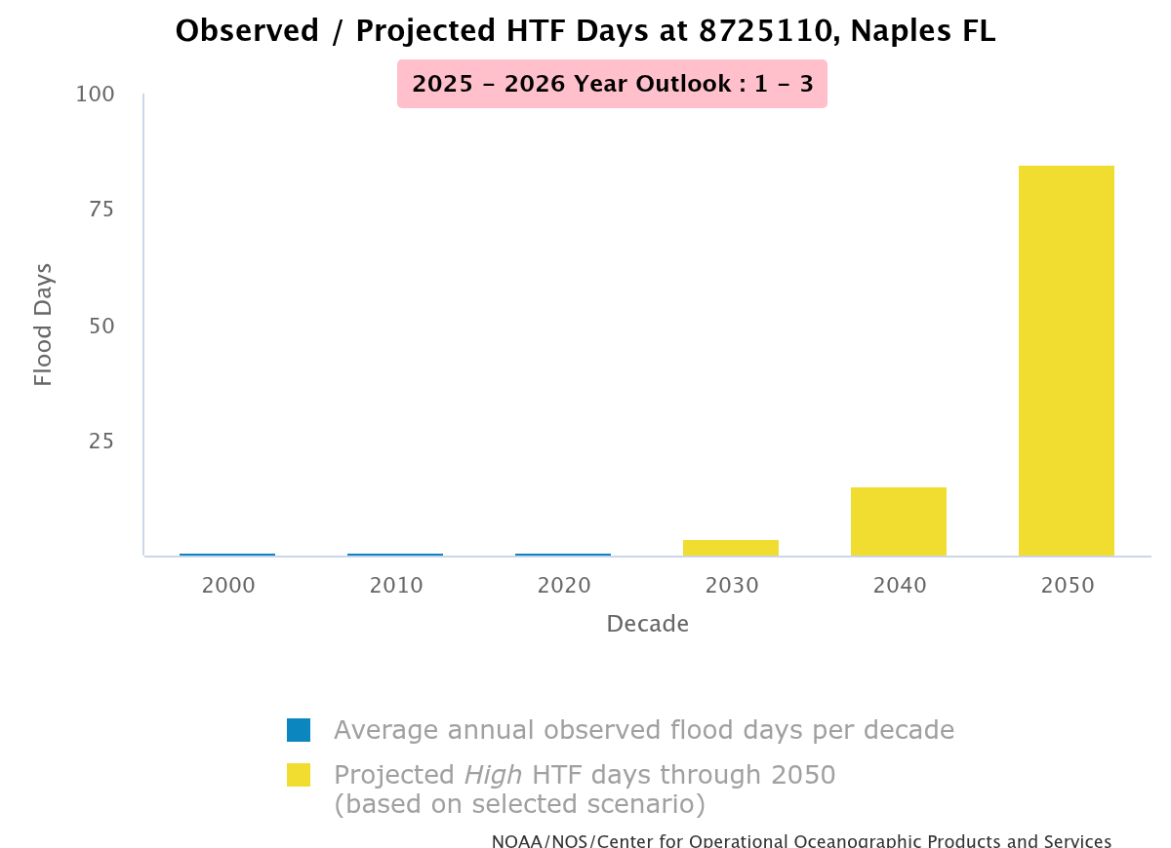
Observed/Projected HDF
Notes:
8725110 is the NOAA tide-gauge station identification number for Naples, Florida.
HTF days means High Tide Flooding days—days when the measured water level reaches or exceeds NOAA’s local flooding threshold.
At this station, that threshold is 1.76 feet above MHHW.
MHHW (Mean Higher High Water) is the average height of the higher of the two daily high tides over NOAA’s standard 19-year tidal-datum period.

Slide 6
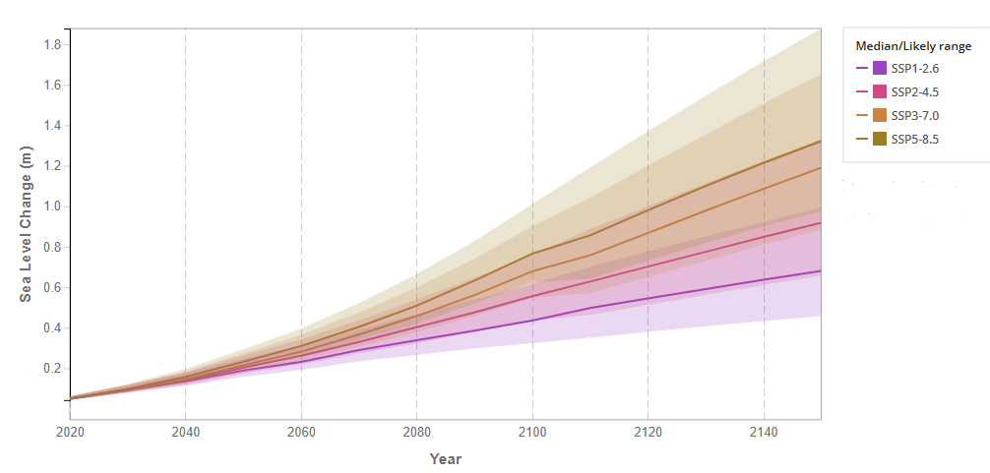
Projected Sea Level Rise Under Different SSP Scenarios at Naples (NASA IPCC AR6 Sea Level Projection Tool)
SSP1- Sustainability and green development
SSP2- “Middle of the road”-historical trends generally continue
SSP3- Regional rivalry, weak cooperation, and slow technological progress
SSP5-Rapid fossil-fuel-based economic development
https://sealevel.nasa.gov/ipcc-ar6-sea-level-projection-tool
Notes:
Common CMIP6 scenarios include:
SSP1-2.6: low emissions and strong climate action
SSP2-4.5: intermediate emissions
SSP3-7.0: high emissions
SSP5-8.5: very high emissions and extensive fossil-fuel use
IPCC 6th Assessment Report Sea Level Projections
Median projections of global and regional sea level rise, relative to a 1995-2014 baseline.
8725110 is the NOAA tide-gauge station identification number for Naples, Florida.
HTF days means High Tide Flooding days—days when the measured water level reaches or exceeds NOAA’s local flooding threshold.
At this station, that threshold is 1.76 feet above MHHW.
MHHW (Mean Higher High Water) is the average height of the higher of the two daily high tides over NOAA’s standard 19-year tidal-datum period.

Slide 7
Workflow
Digital elevation model and Gulf water boundary
represent the ground elevation and the ocean/tidal source, respectively
Coastal-connectivity constraint
to remove inland depressions that are below the SLR elevation but not hydraulically connected to the shoreline.
Flood inundation
All processing was implemented in a Python Jupyter Notebook environment
A cell is considered potentially flooded if DEM ≤ SLR
Flood depth values were retained only where a cell is connected continuously to the coast

Slide 8
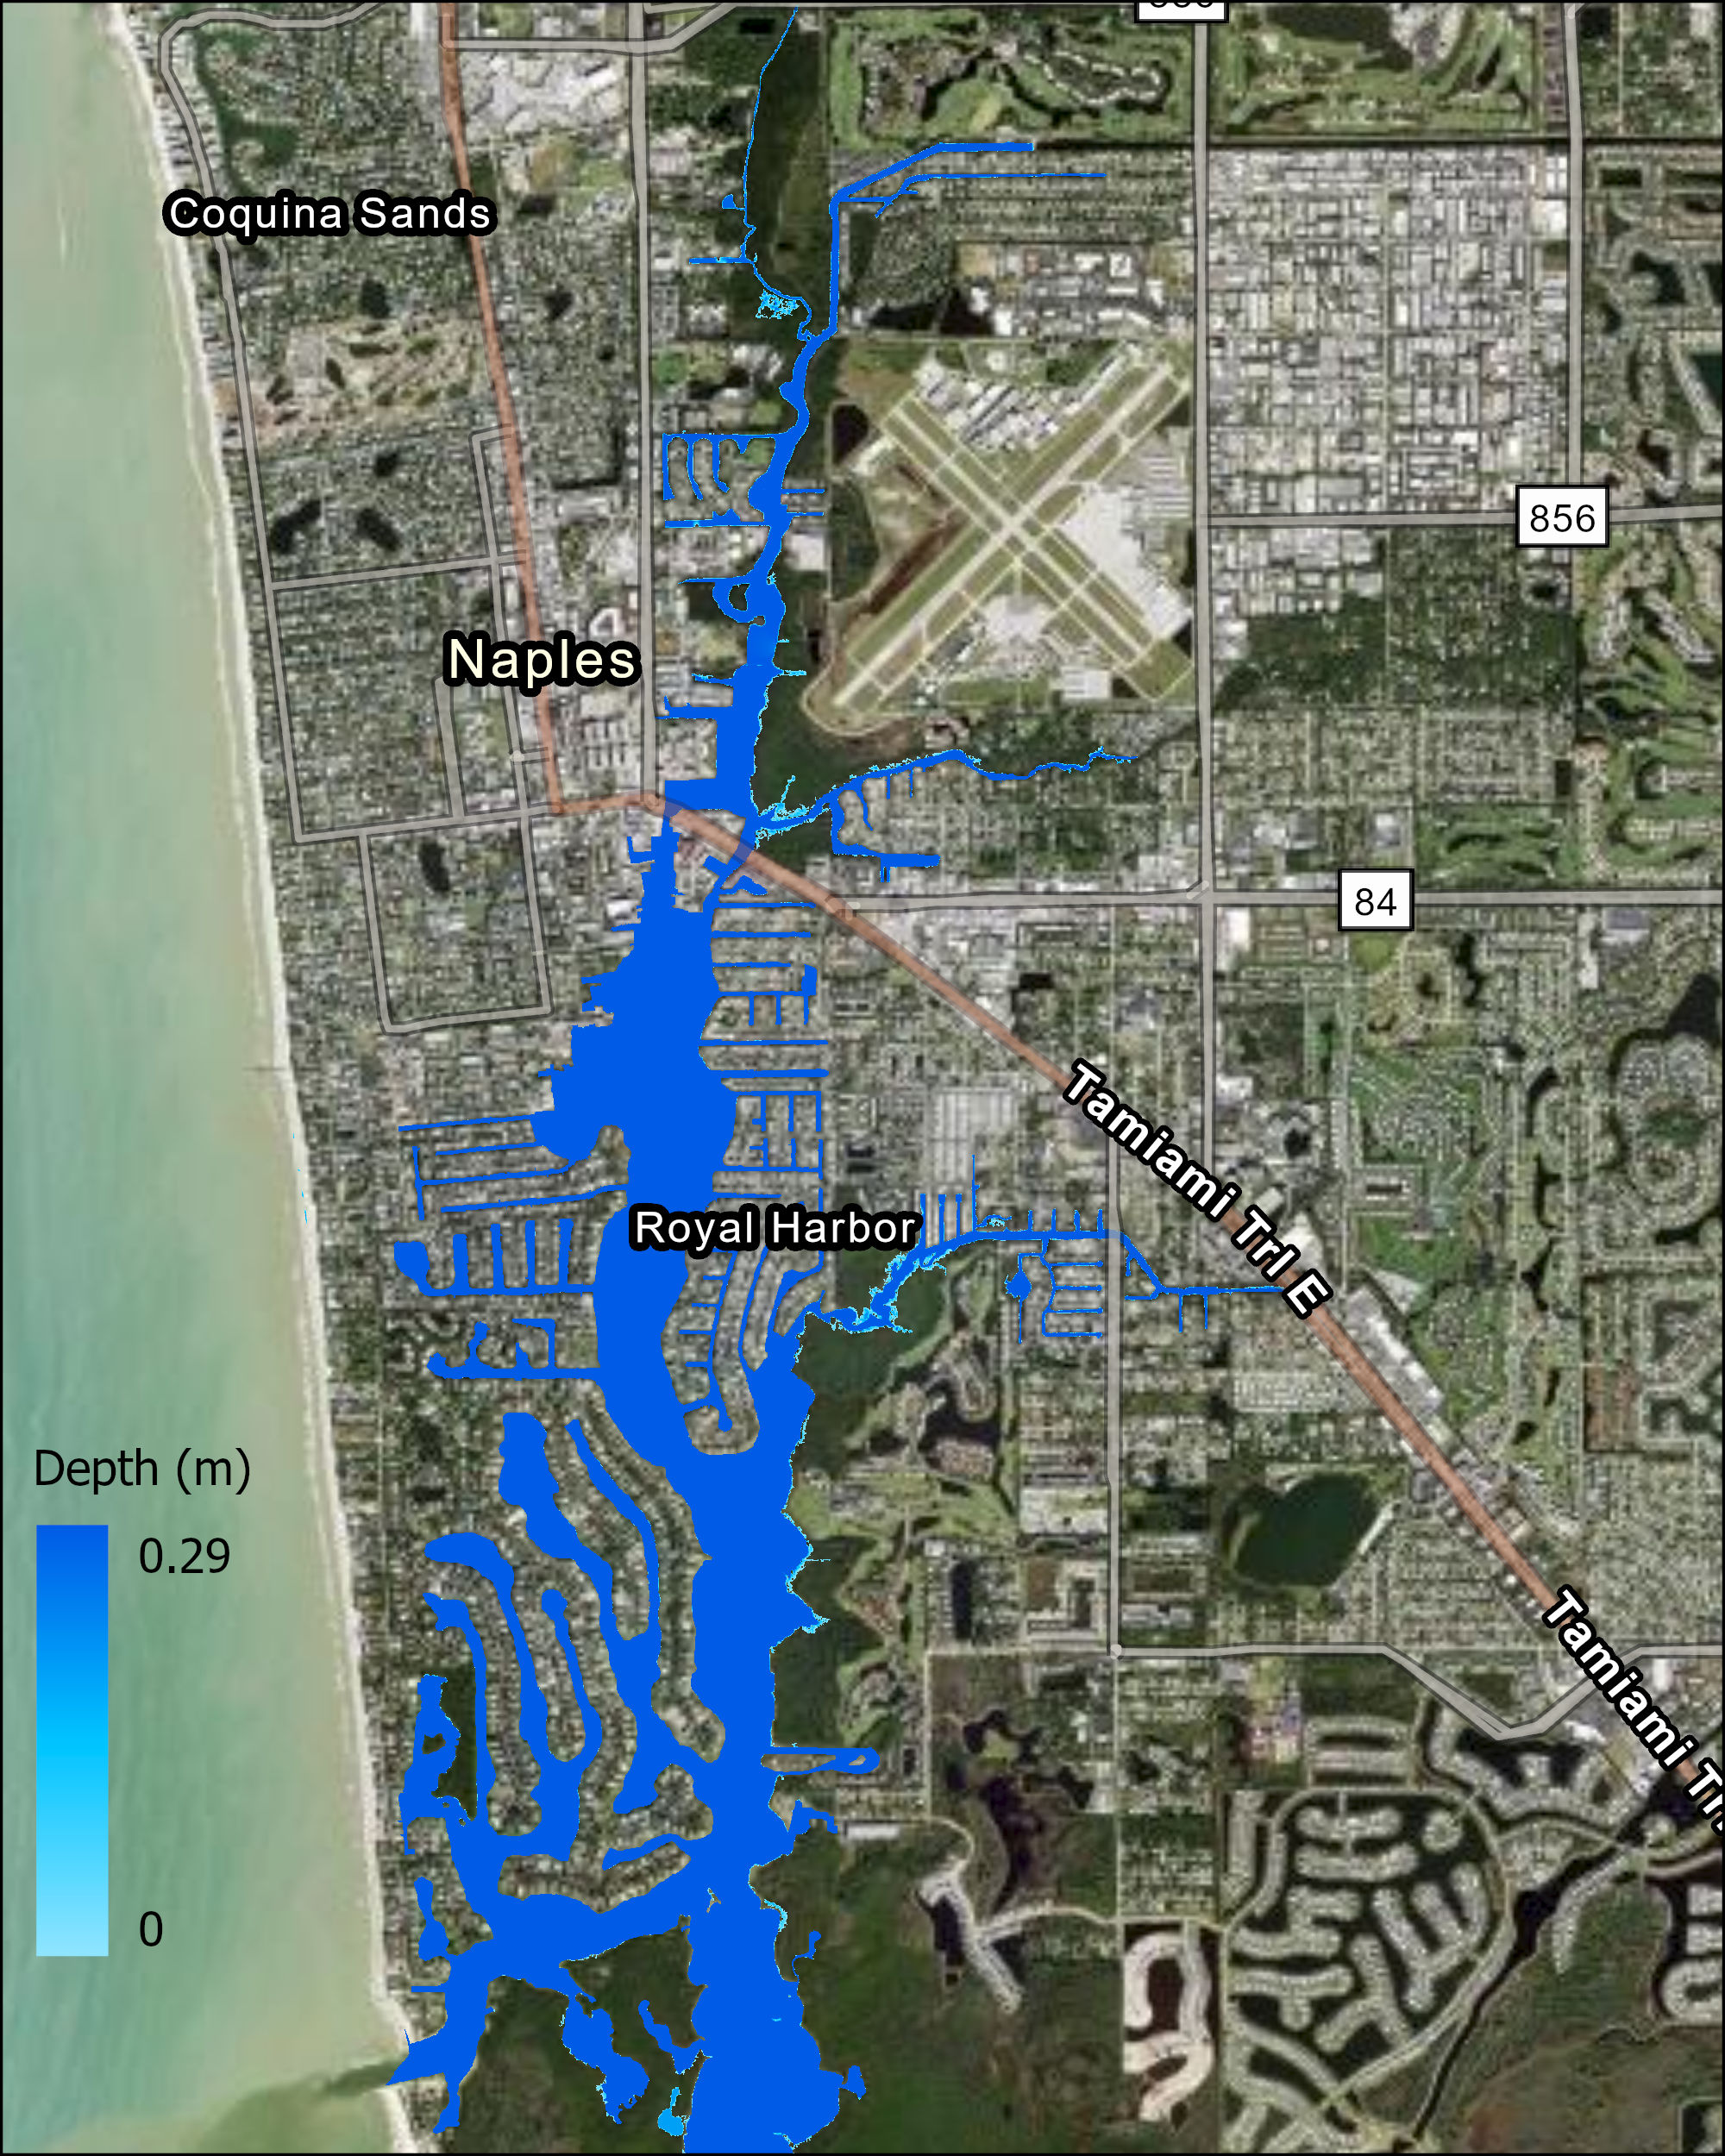
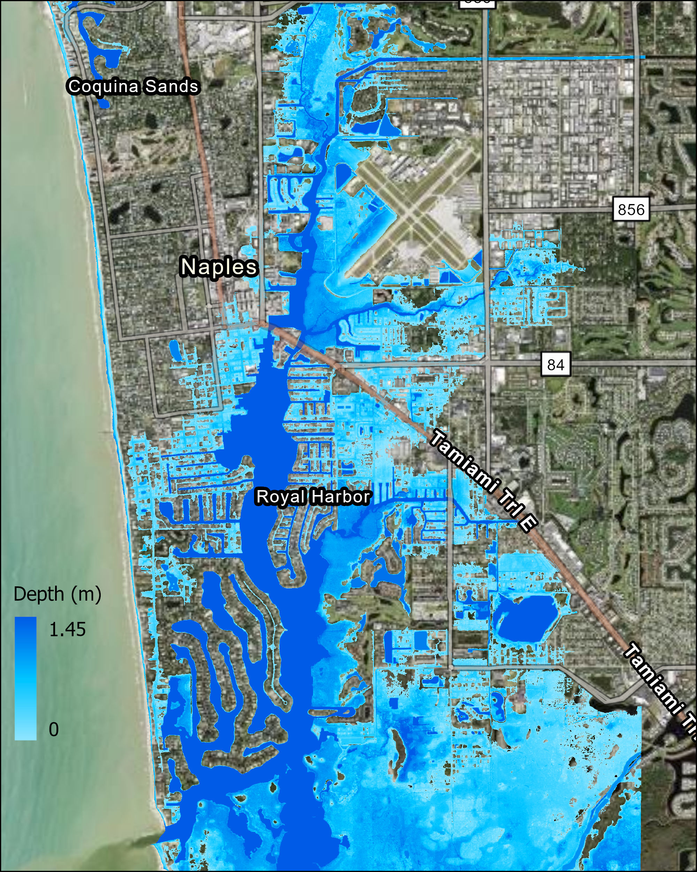
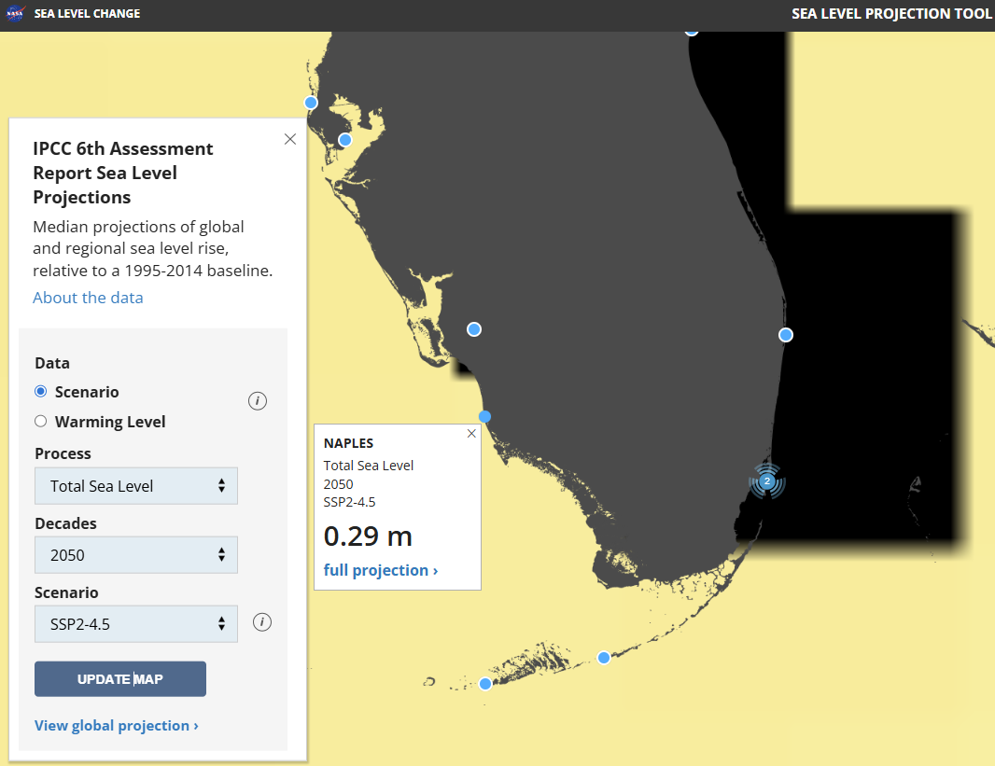
2050 inundation under medium emission scenario : SLR and Tide
SLR only
SLR and Tide
Naples Municipal Airport
Naples Municipal Airport
Notes:
high tide (3.83 ft=1.167m)

Slide 9
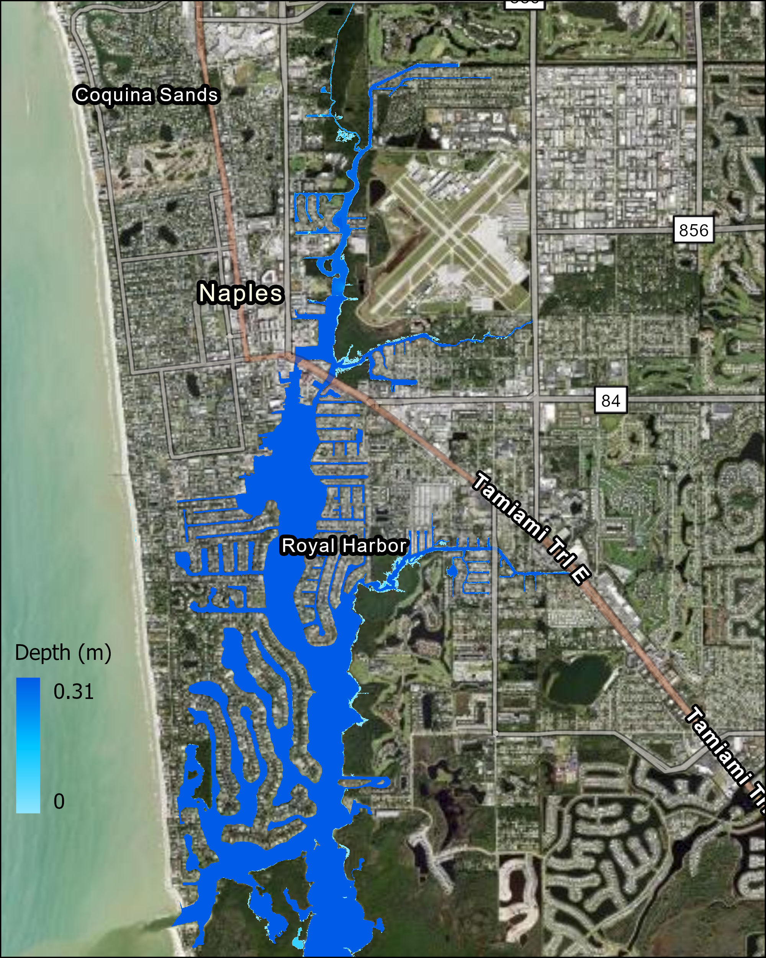


2050 inundation under high emission scenario : SLR and Tide (3.83 ft)
SLR only
SLR and Tide
Naples Municipal Airport
Naples Municipal Airport

Slide 10
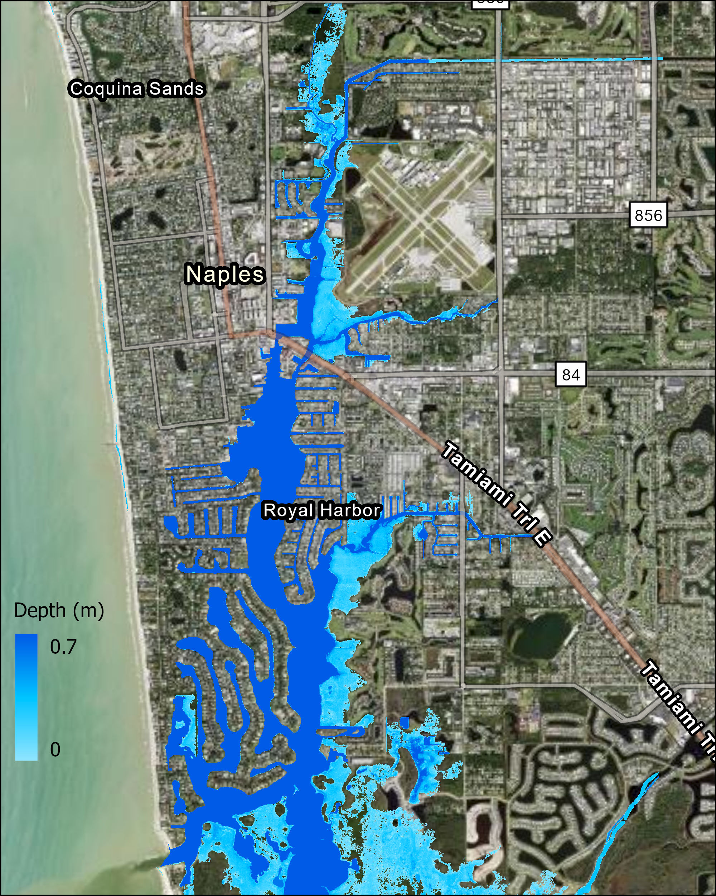
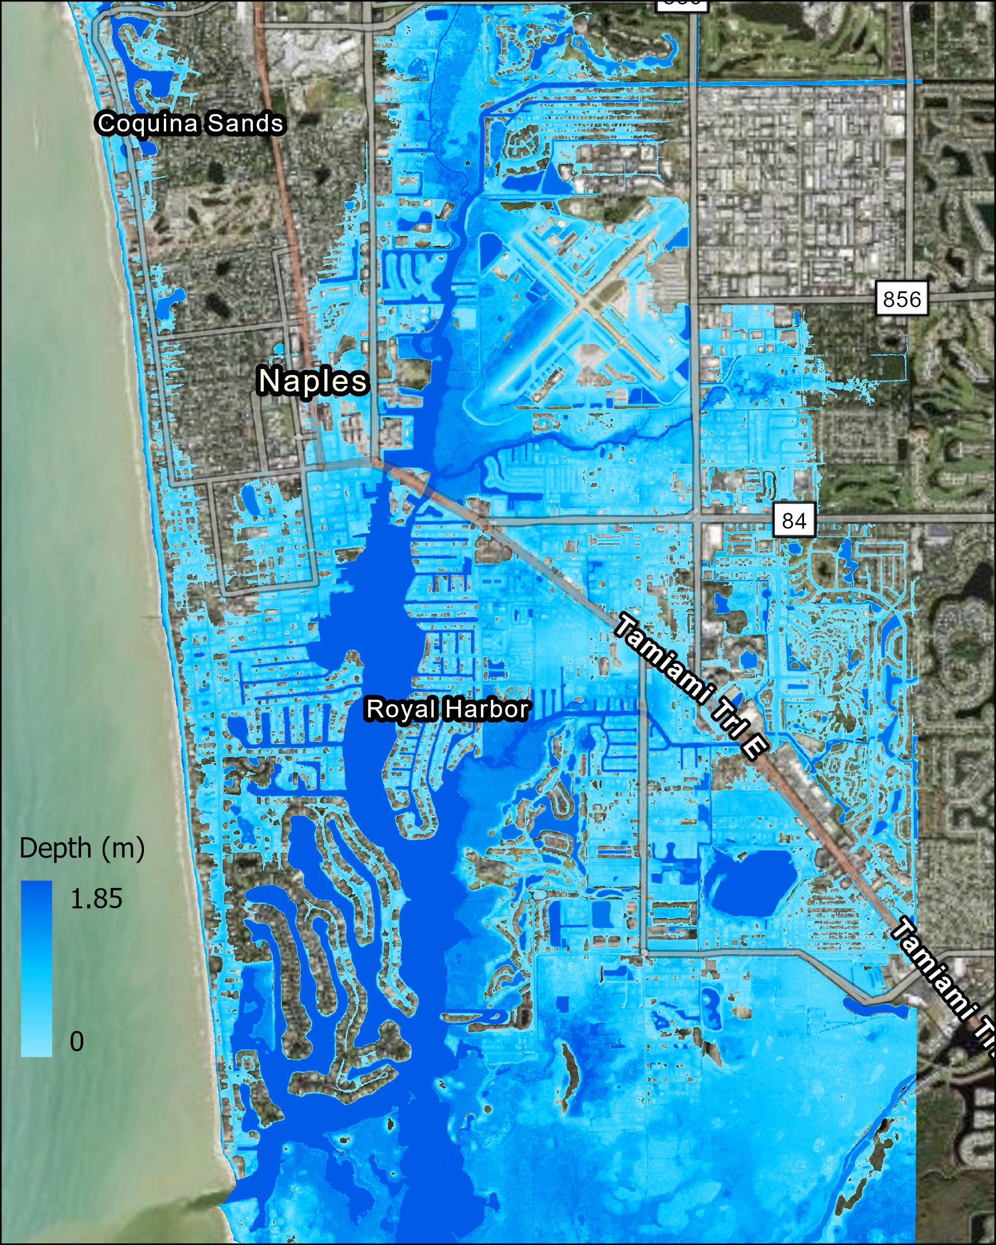
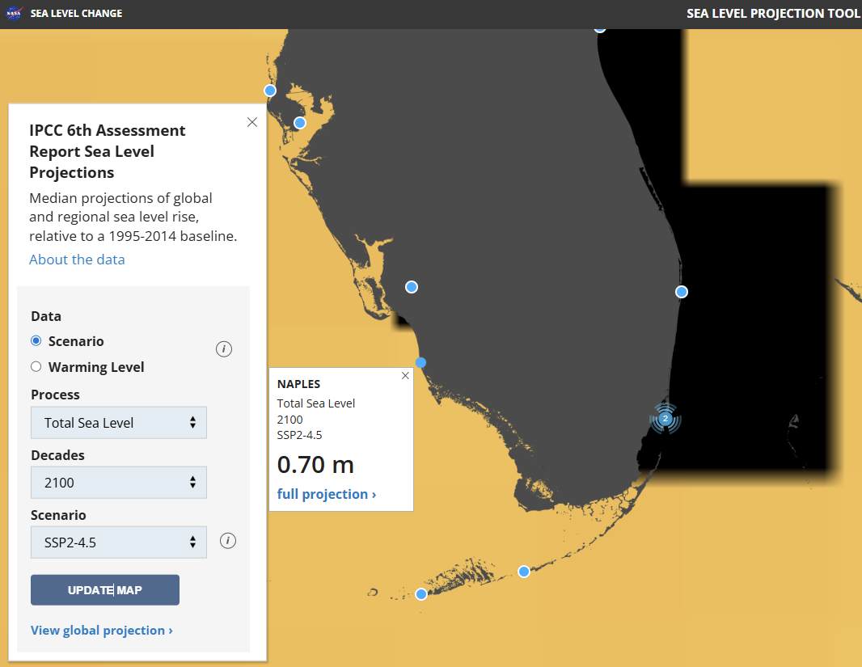
2100 inundation under medium emission scenario : SLR and Tide
SLR only
SLR and Tide
Naples Municipal Airport
Naples Municipal Airport

Slide 11
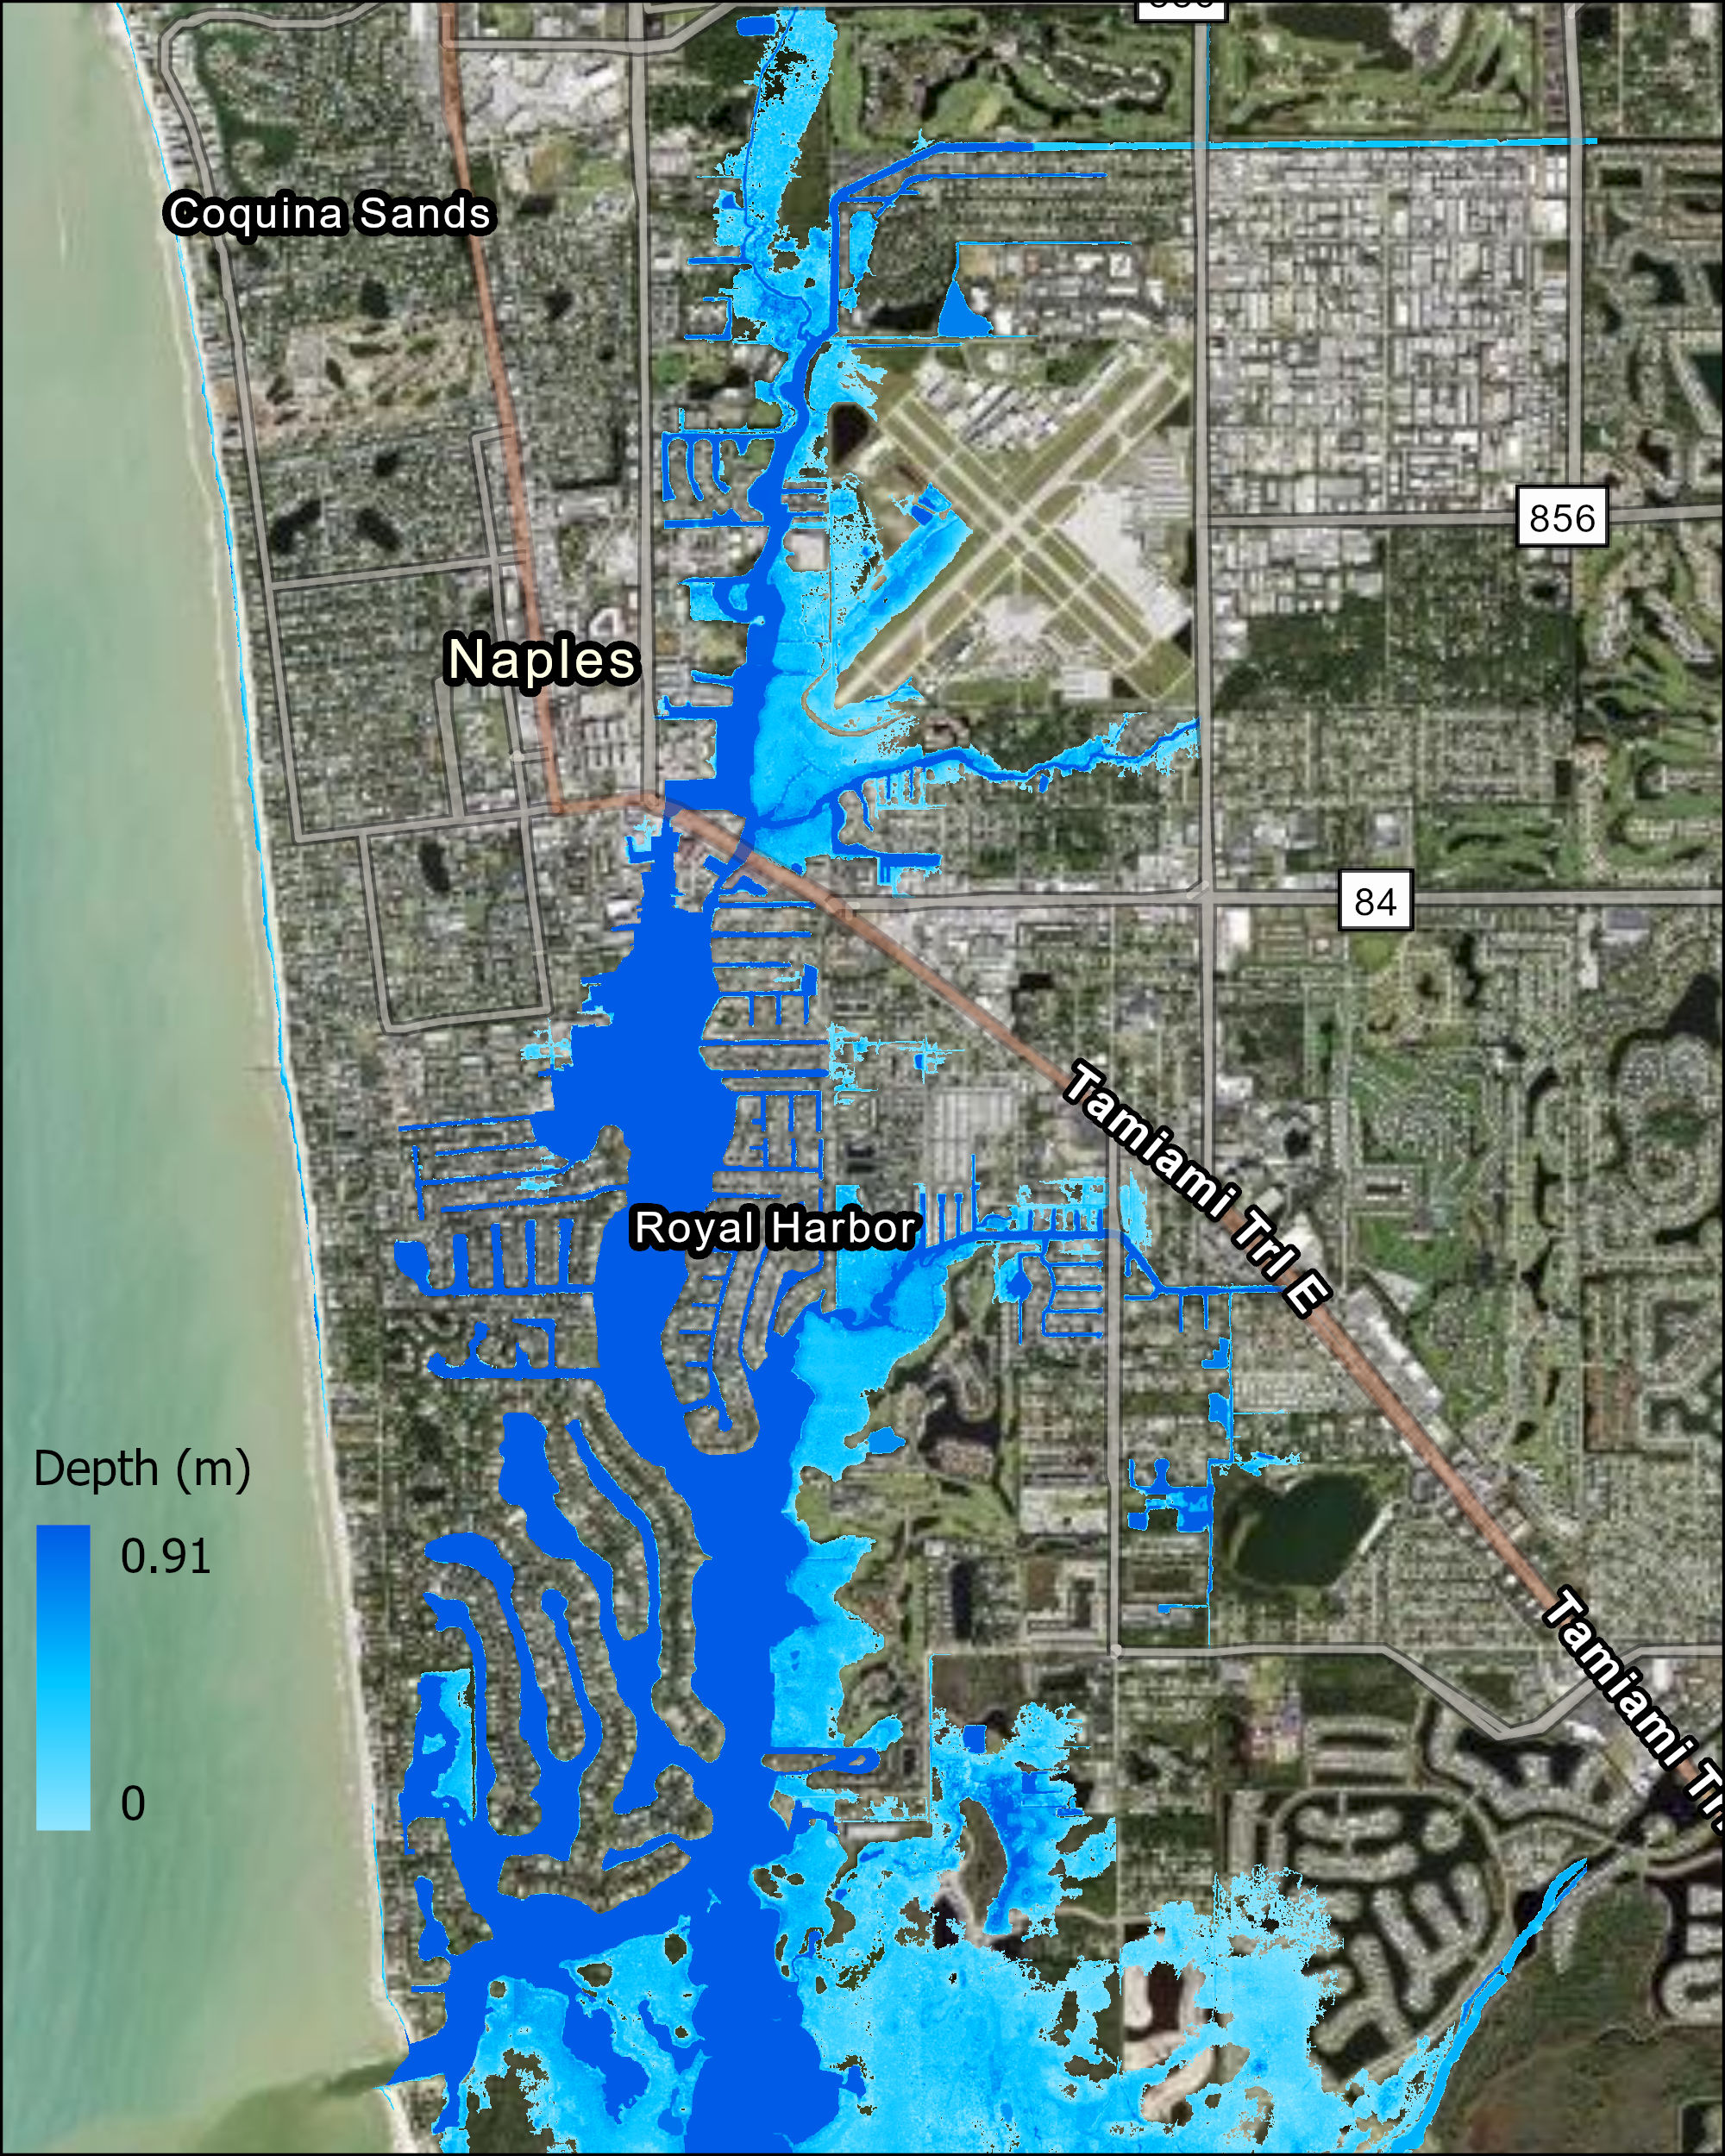
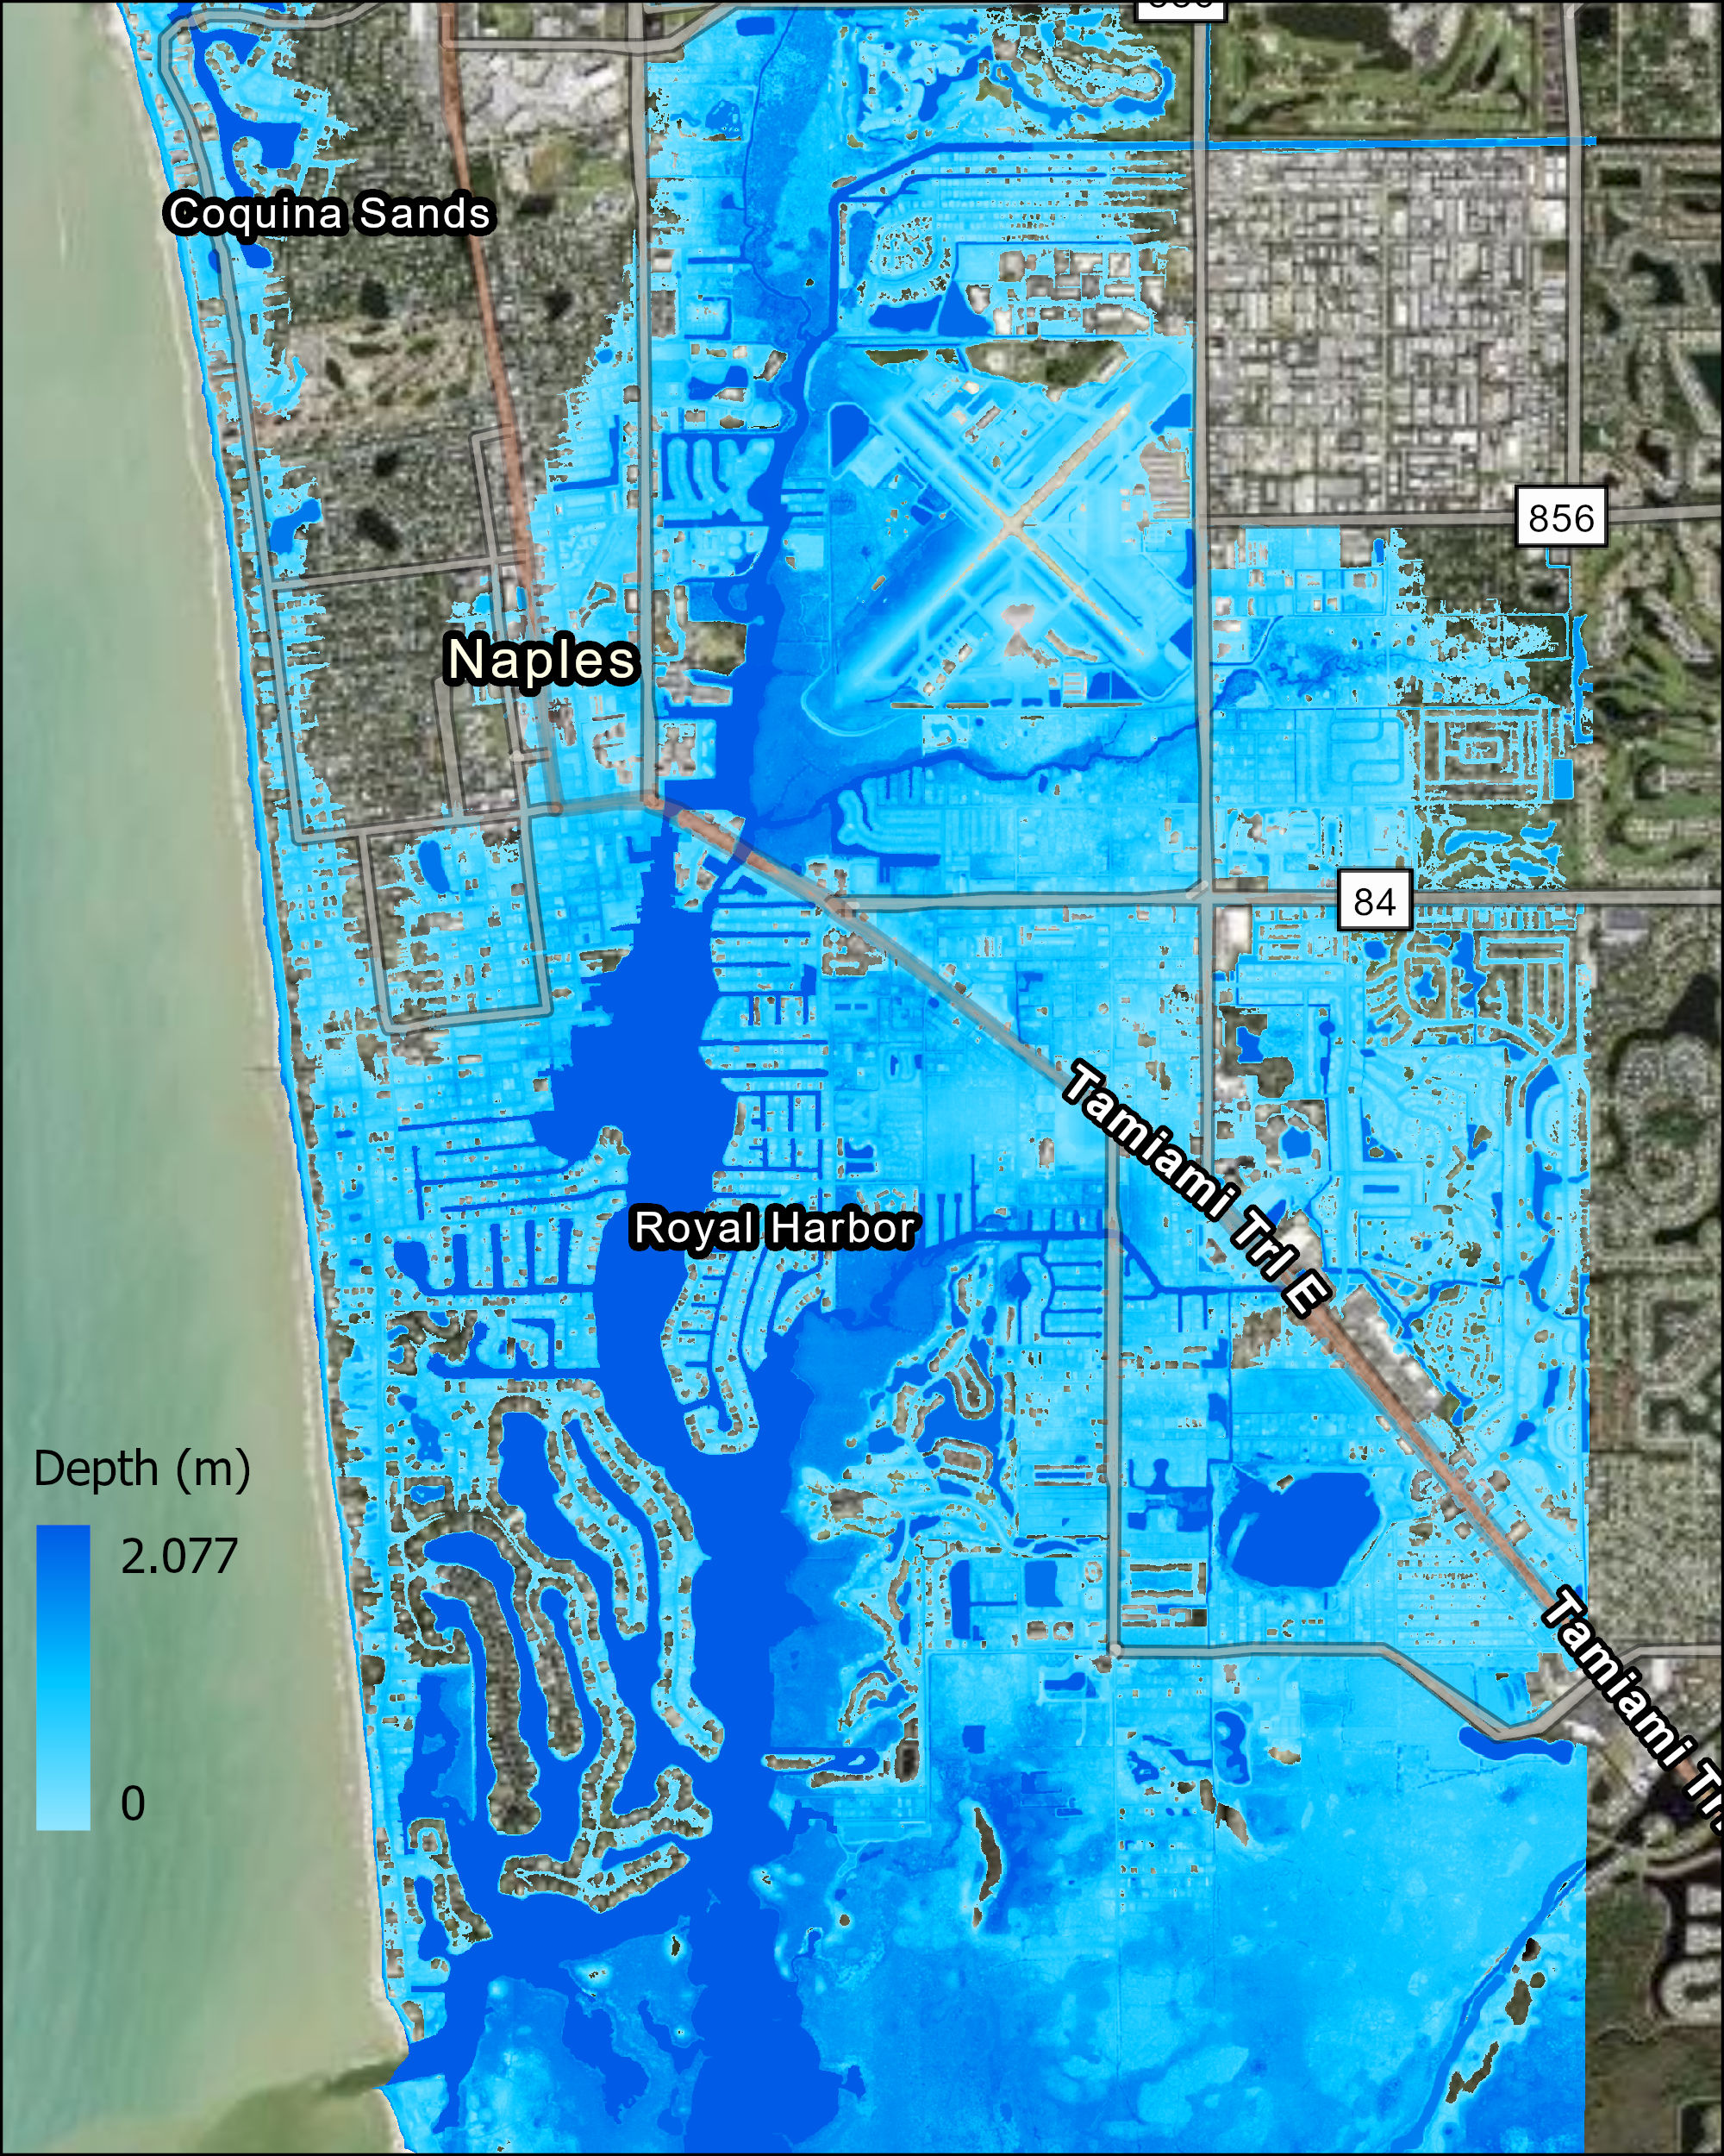
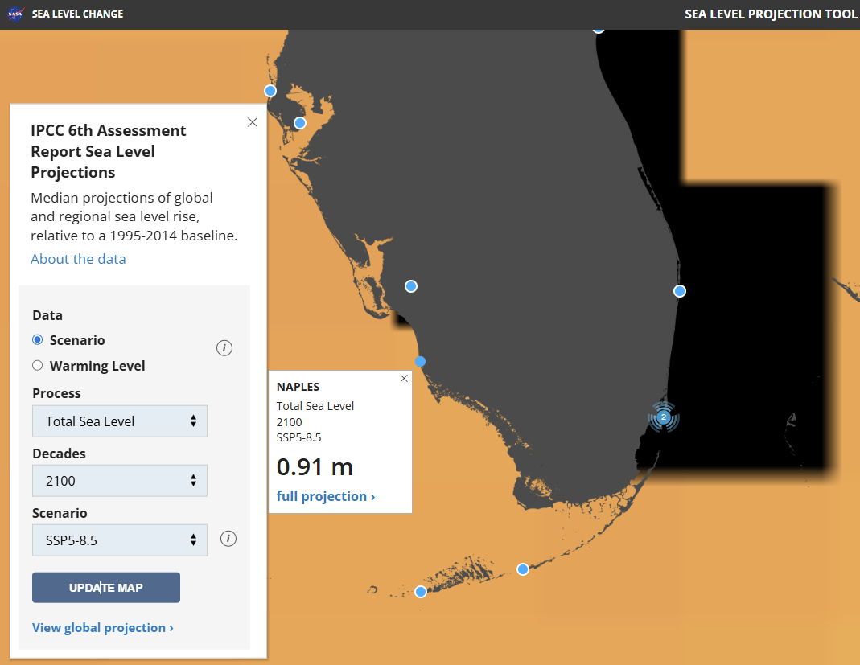
2100 inundation under high emission scenario : SLR and Tide
SLR only
SLR and Tide
Naples Municipal Airport
Naples Municipal Airport
Naples Flood Inundation Viewer

Slide 12
Assumptions and limitations
Uniform water level: Does not simulate time series tides, storm surge timing, wind setup, waves, or dynamic hydraulics.
No routing or infrastructure: Does not represent flow resistance, channels, culverts, stormwater systems, or groundwater effects.
Simplified connectivity: Raster neighborhood connectivity approximates pathways based on DEM and may not fully capture barriers (levees, roads) or small conveyance features.
Datum sensitivity: Results depend on consistency between the DEM vertical datum and the assumed SLR scenario datum.
Spatial resolution: DEM resolution influences representation of topography and barriers.
Prediction uncertainties: Uncertainty in the projected sea-level rise values due to differences in model physics, greenhouse-gas trajectories, ice-sheet responses, and regional climate processes.
Despite these limitations, the bathtub-plus-connectivity approach provides a first-order estimate of potential SLR-driven inundation patterns in coastal Naples.

Slide 13
Take home message
The bathtub-connectivity maps identify potential exposure.
A next-phase compound flooding study is required to combine coastal water levels, rainfall, groundwater, and drainage-system performance and to prioritize vulnerable infrastructure and adaptation strategies.

Slide 14


Thank you!

