Slide 1
视频生成相关论文汇报
张志冰
2025.11.15

Slide 2
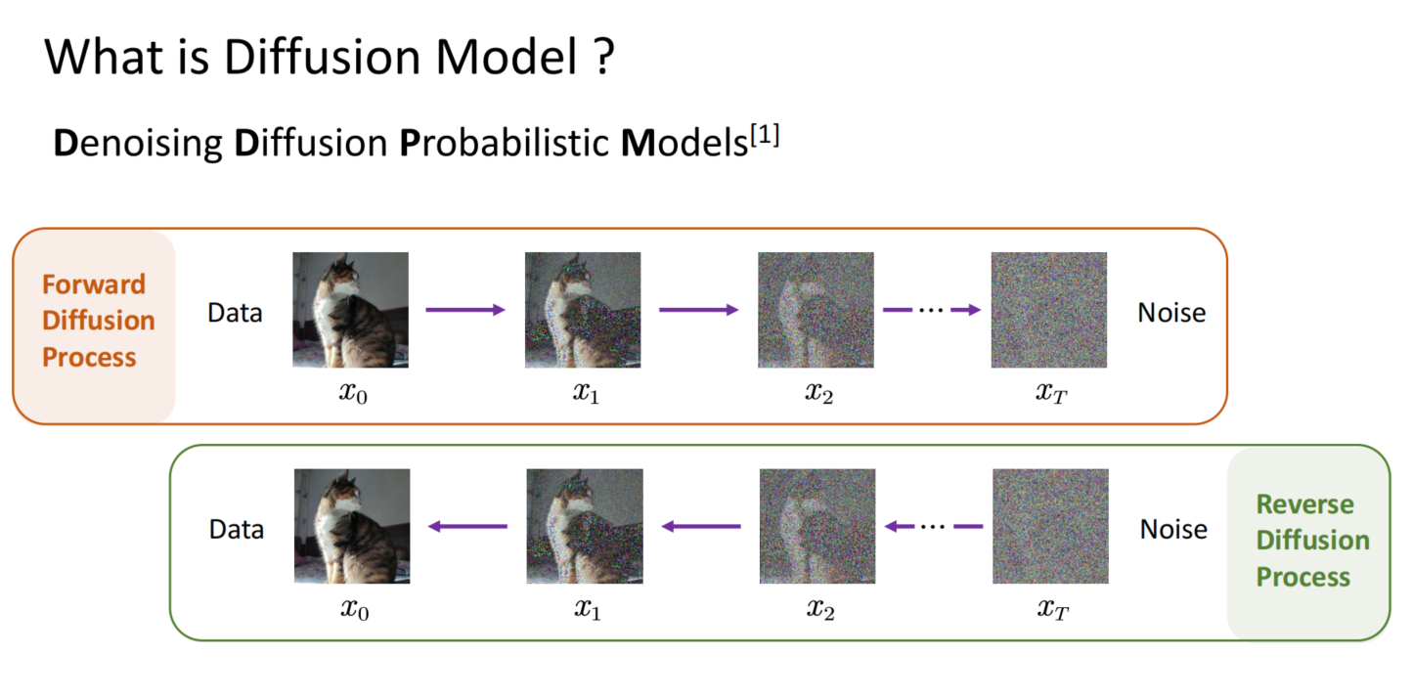

Slide 3
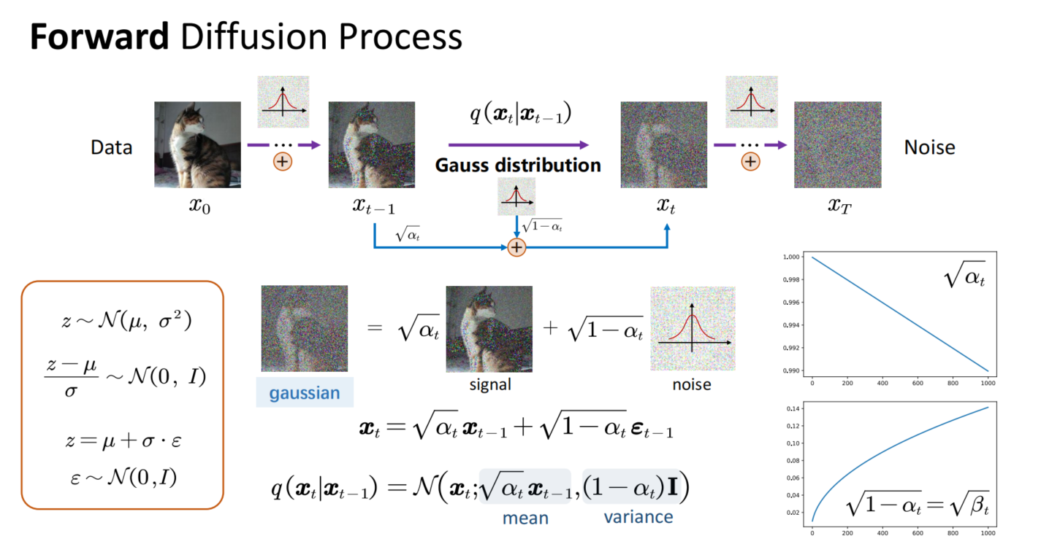
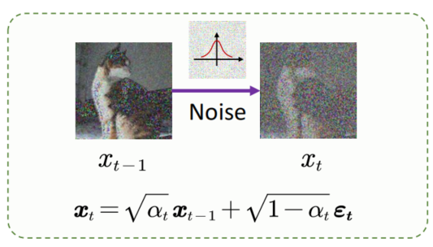
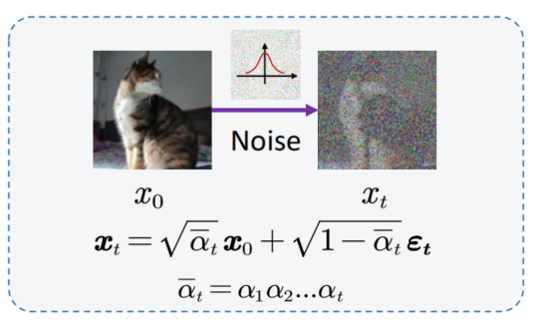
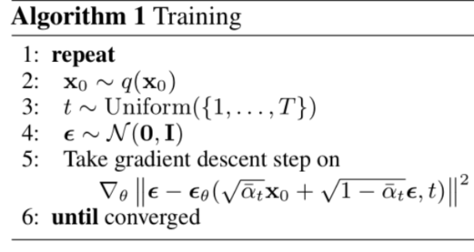

Slide 4
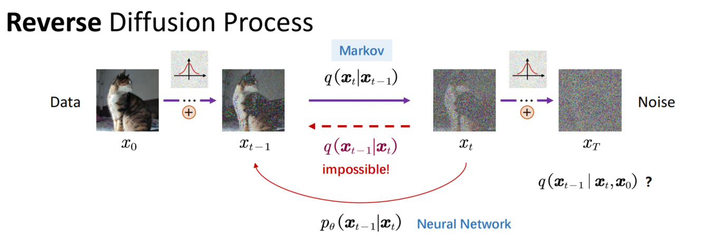
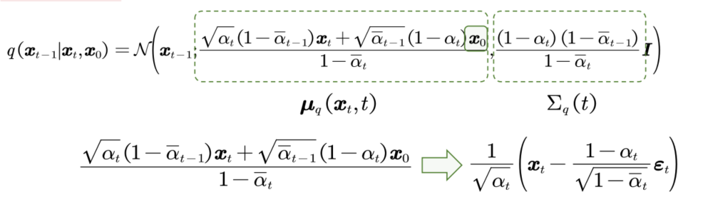
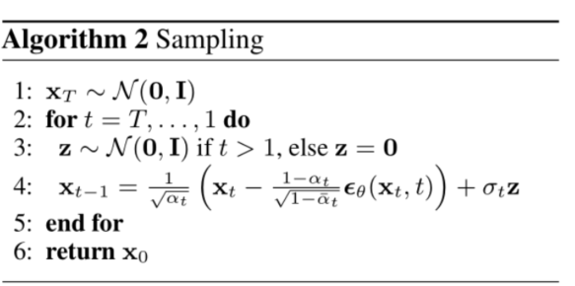

Slide 5
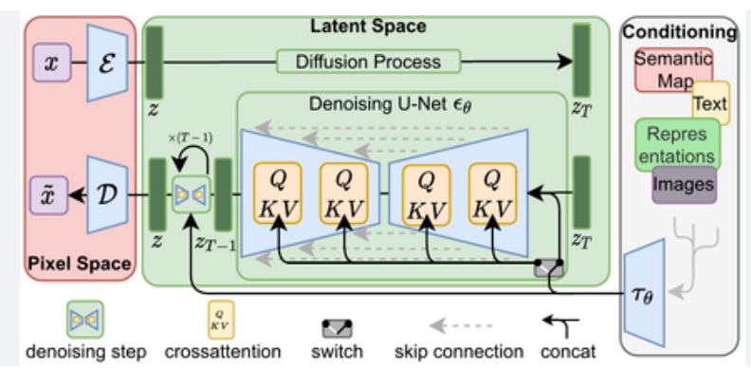
图像生成框架

Slide 6
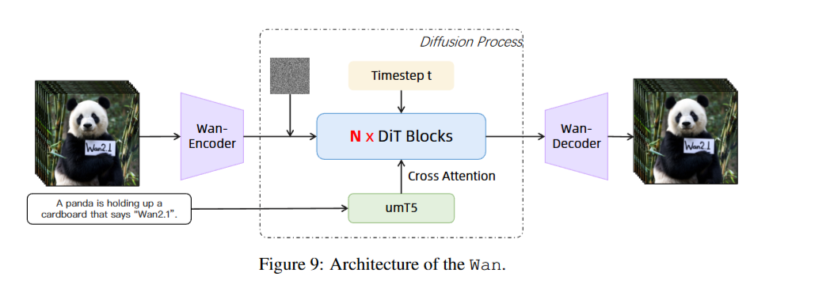
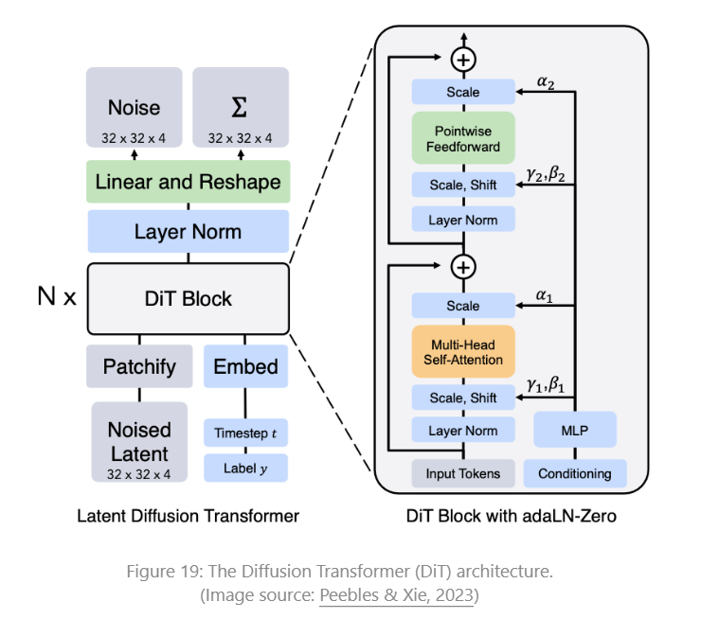
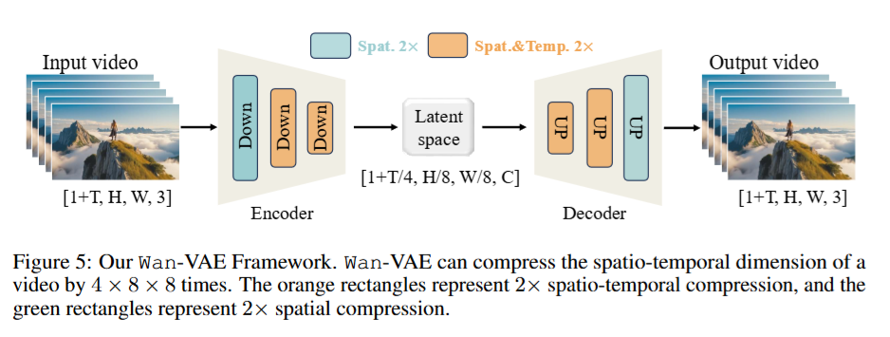
视频生成框架

Slide 7
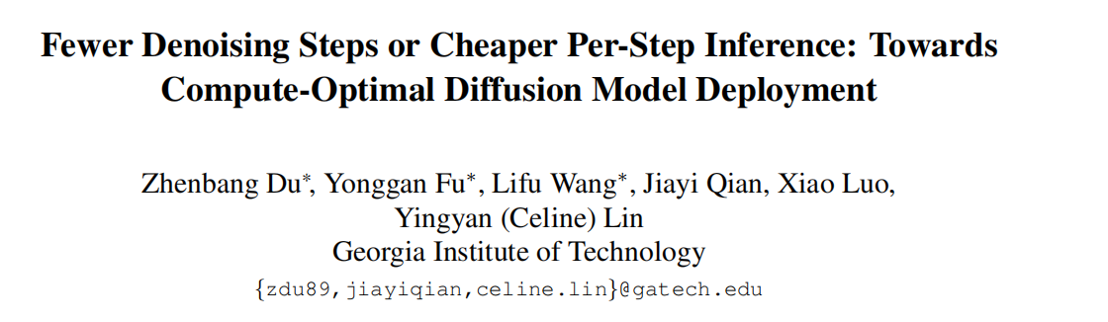
ICCV 2025

Slide 8
Motivation
Both the iterative nature and model complexity of diffusion models make them computationally intensive, posing a significant challenge for deployment on resource-constrained platforms, where computational resources, memory, and power are limited.
Under a post-training setting, is it more effective to optimize for fewer denoising steps or
to reduce the per-step inference cost?
This paper propose PostDiff: a training-free diffusion model compression framework designed to enhance the per-step inference efficiency of pre-trained diffusion models at both the input level(mixed-resolution denoising) and module level(existing module caching techniques)

Slide 9
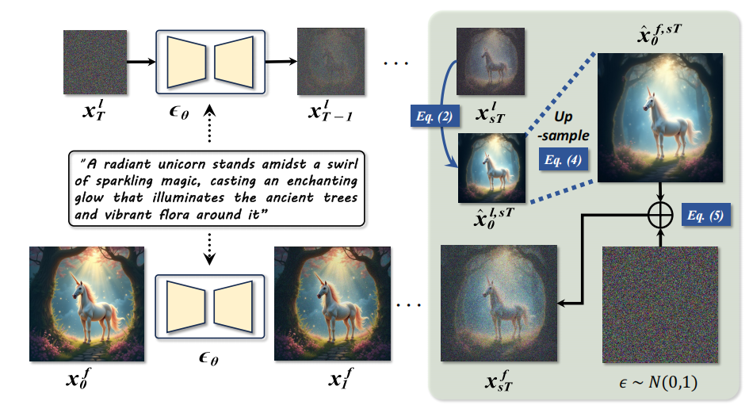
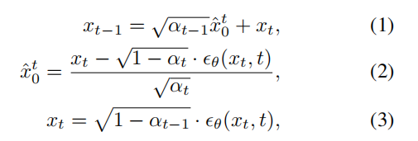


Method
Mixed-Resolution Denoising: Methodology

Slide 10
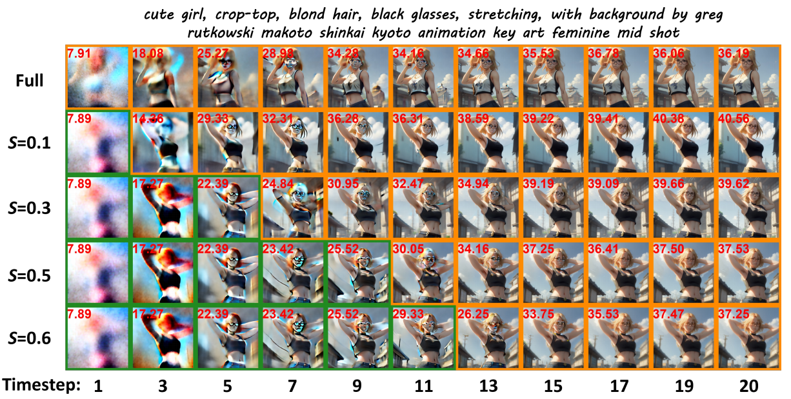
Case Study
Visualization: How Low-Resolution Denoising Contributes to Boosted Final Performance
reduced generation resolution in early denoising steps contributes to improved low-frequency components, thereby enhancing final generation quality;
Clip Score
s:低分辨率的步数

Slide 11
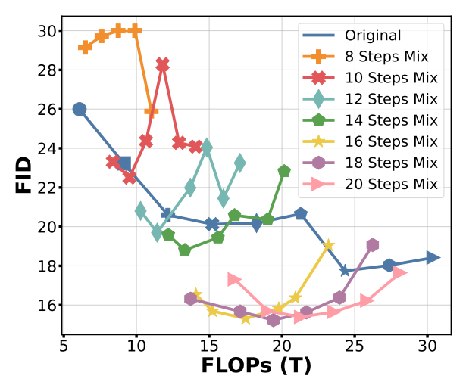
Evaluation
Mixed-Resolution Denoising: Evaluation
Model: Stable Diffusion (SD) V1.5
test set: evaluate text-to-image generation performance on the MS-COCO 2014 validation dataset
total denoising steps T = {8, 10, 12, 14, 16, 18, 20}
s = {0.1, 0.2, 0.3, 0.4, 0.5, 0.6} .
FID：lower is better
FLOPs：lower is better
后面的s比较小

Slide 12
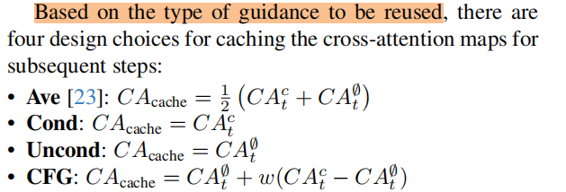
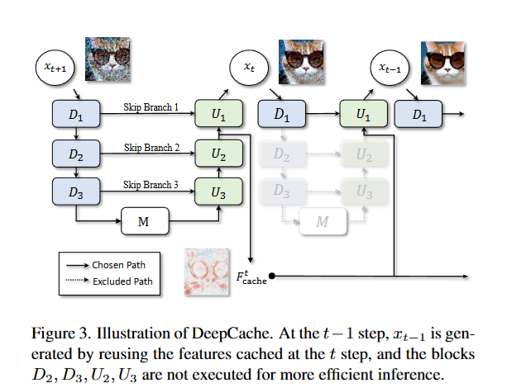
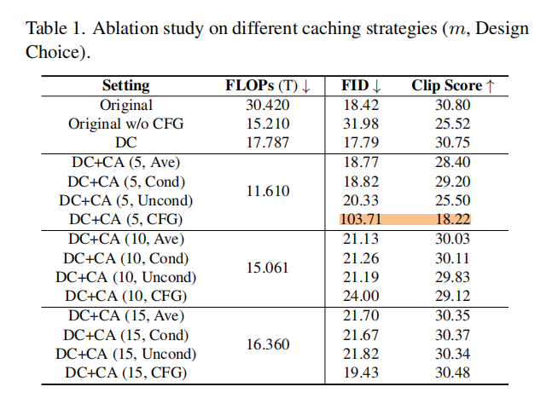
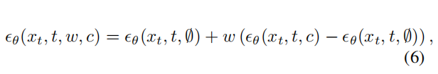
The Hybrid Module Caching Strategy
（1）DeepCache
Cache the cross attention layers at a specific denoising step and reuse them in all subsequent steps
（2）
Considering that CFG may be redundant in the later stages of inference, as the layout has already been organized in the early stages, we abandon CFG after a certain step m
Notes:
动机:Previous works have found that feature maps remain highly similar across all blocks throughout the entire denoising process, indicating the potential effectiveness of caching and reusing across steps.
因此:it is feasible to use the cached cross-attention feature map from early denoising steps, generated at a low resolution with our mixed-resolution denoising, for the later denoising phase, as the low-frequency information is determined early on
A major role of cross-attention is to introduce text guidance into the generation process. This is often achieved through classifier-free guidance (CFG)

Slide 13
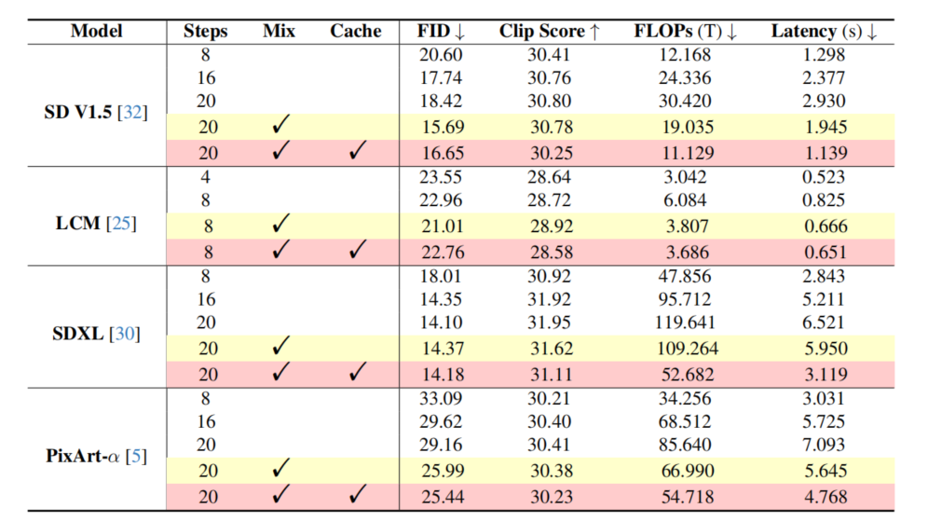
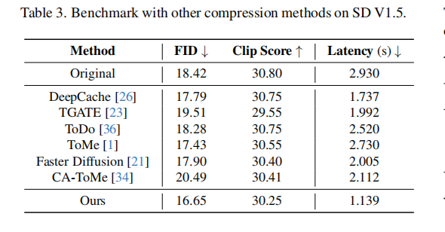
PostDiff: Combine All Techniques
Evaluation on SOTA Diffusion Models
Benchmark with Other Training-Free Compression Methods

Slide 14
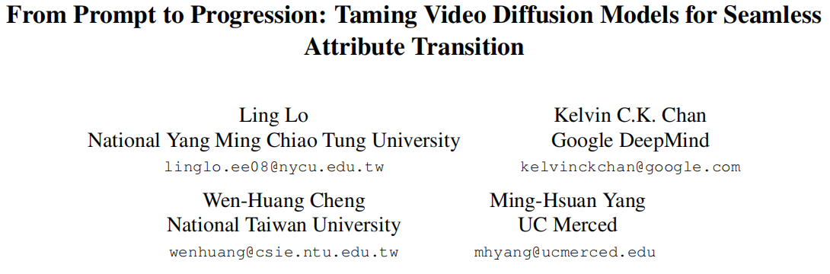
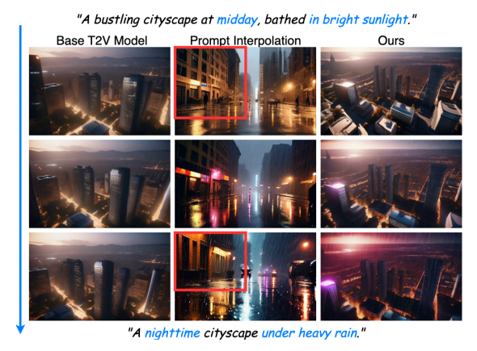
ICCV 2025
问题：Attribute transition
难点：Attribute transitions typically involve a more gradual process that unfolds over several frames.
这篇文章的目的：In this work, we focus on extending the base model to generate progressive attribute transitions without additional training.
贡献
Propose a simple yet effective approach for generating
videos with smooth and gradual attribute transitions.
Introduce a new benchmark designed to evaluate the
attribute transition in video generation, along with two novel metrics to quantitatively evaluate the smoothness and fidelity of attribute transitions
Notes:
prompt interpolation主要用在长视频生成中。The subtle changes between frames are difficult to capture accurately with textual descriptions.（尤其是在attribute transition中）

Slide 15
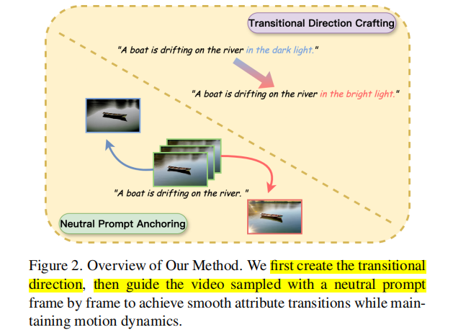



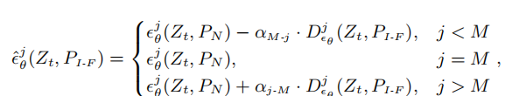
方法
1. Transitional Direction Crafting
2. Neutral Prompt Anchoring
Using the crafted transitional direction, we provide frame-wise guidance to the video throughout the denoising process to obtain smooth transitions of the desired attribute states
To stabilize generation, we propose neutral prompt anchoring, which anchors the generation to
a neutral prompt while applying the transitional direction.
3. Overall Sampling Flow

Slide 16
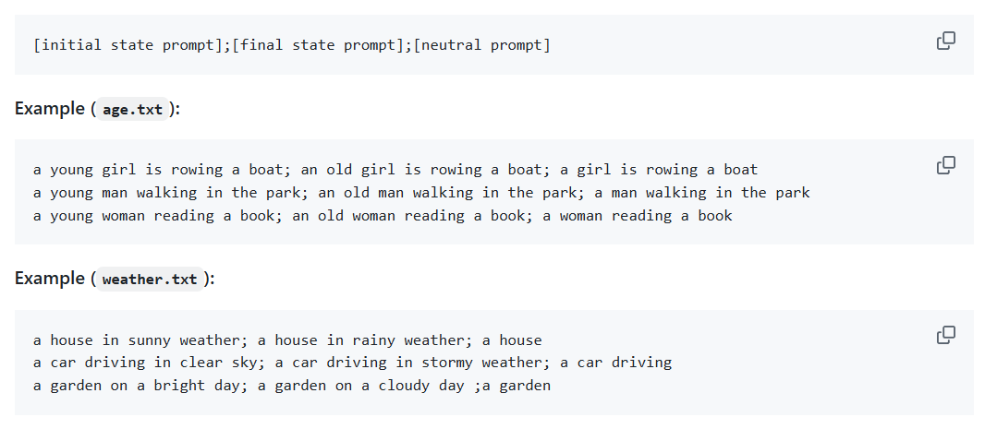


提出评估数据集 Controlled-Attribute-Transition Benchmark (CAT-Bench)
Define eight attribute categories for transitions: four focused on human attributes (age, beard, makeup, and hair), two on subject attributes (color and material), and two on background attributes (light conditions and weather conditions).
Evaluation Metrics
Wholistic Transition Score
Frame-wise Transition Score

Slide 17
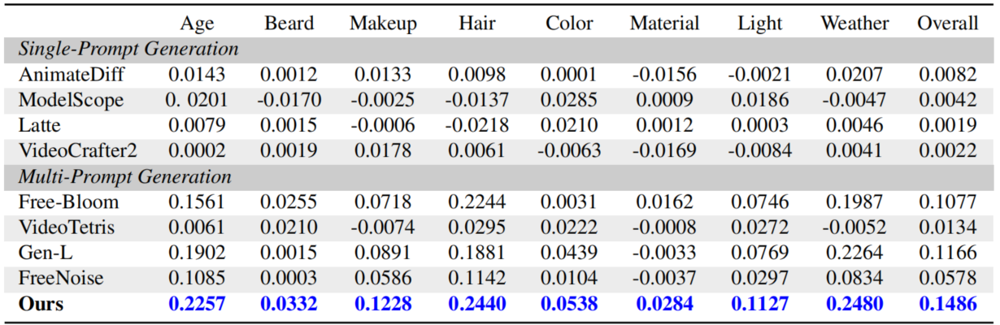
Experimental Results
base video generation model: VideoCrafter2
Baselines
single-prompt baselines(foundational T2V models)：AnimateDiff、ModelScope、Latte、VideoCrafter2
multi-prompt baselines:FreeBloom、GenL、Freenoise、VideoTetris
Benchmarks
CAT-Bench
Quantitative Evaluation
CAT-Bench:Wholistic
Transition Score

Slide 18
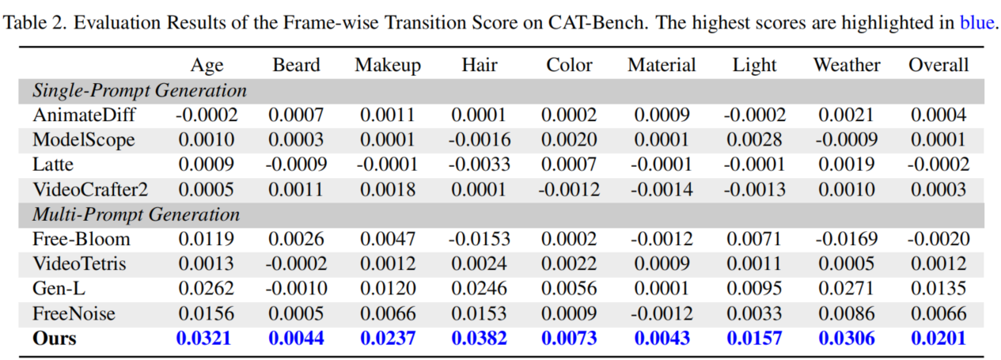
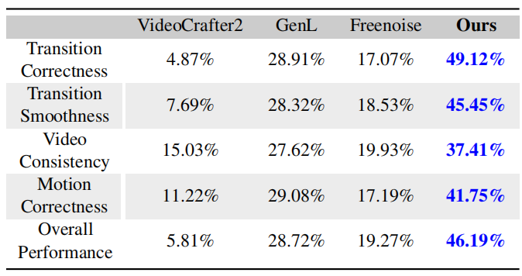
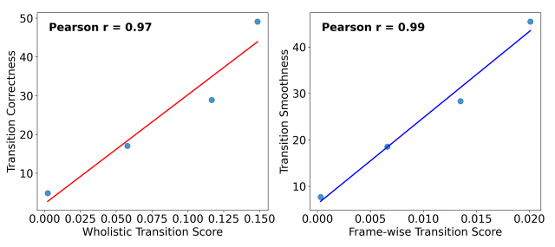
Quantitative Evaluation
CAT-Bench:Frame-wise Transition Score

Slide 19
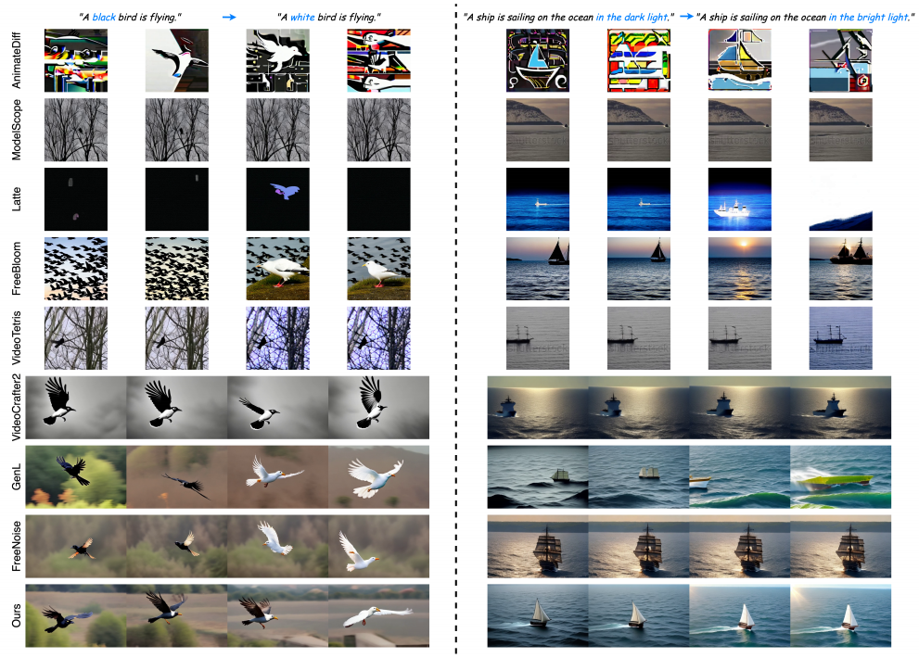

Slide 20
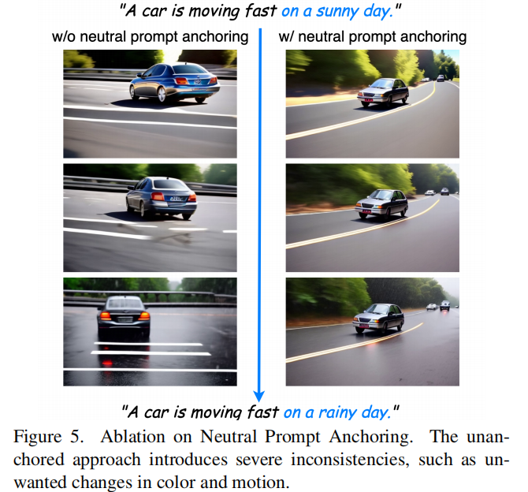
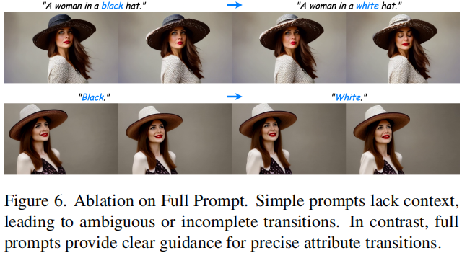
Ablation Study
Neutral Prompt Full Prompt

Slide 21
谢谢聆听

