Slide 1
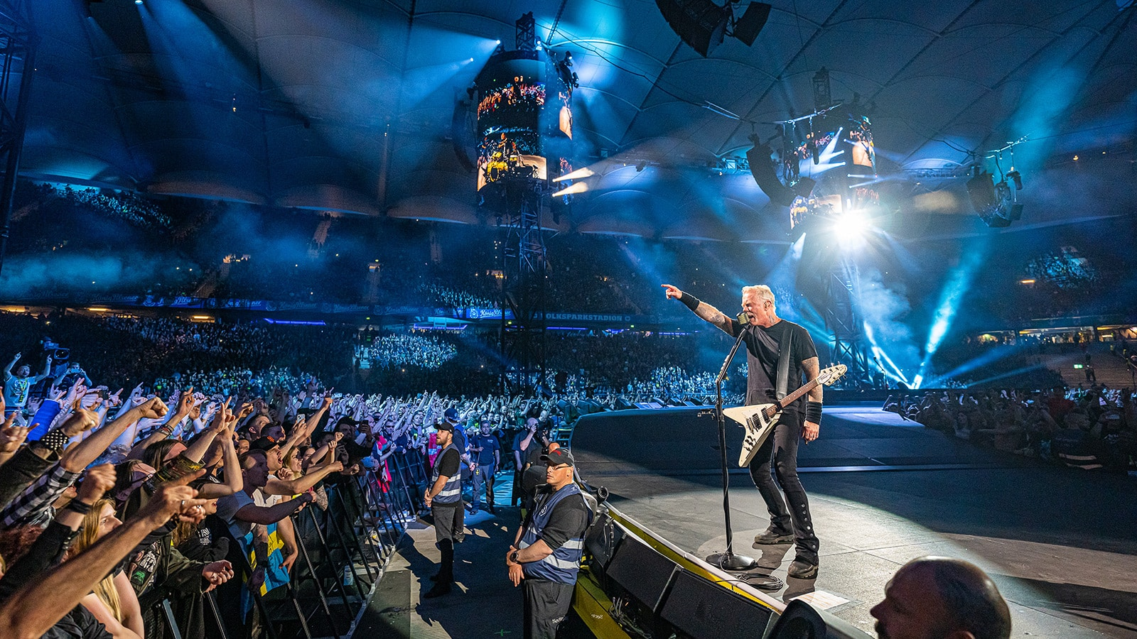
Metallica
Daniel Hajžman
IF1

Slide 2
Basic info
American heavy metal band
Formed in 1981 in Los Angeles by James Hetfield and Lars Ulrich
4 members
The Big 4

Slide 3
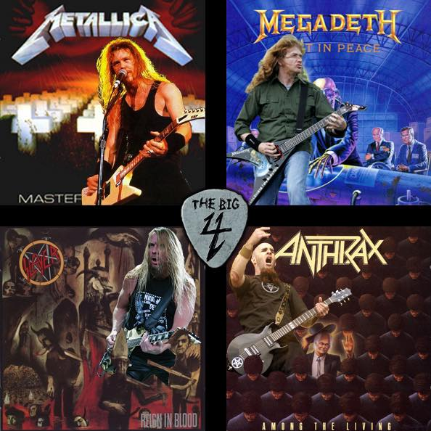
The Big 4

Slide 4
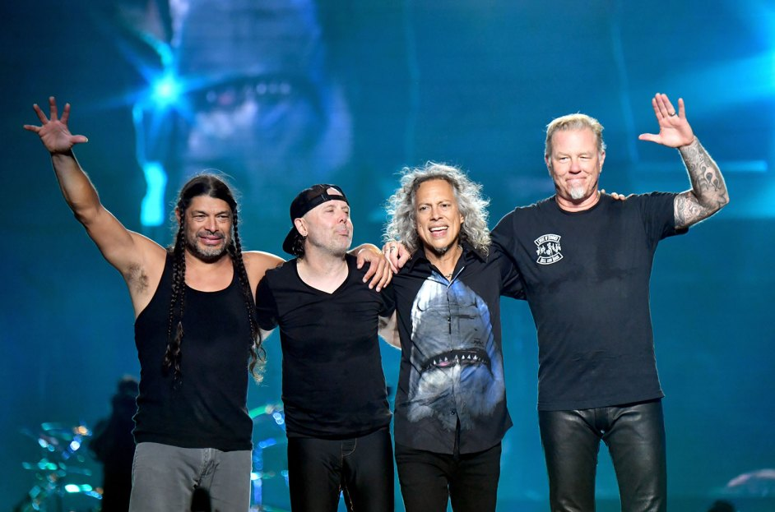
Members

Slide 5
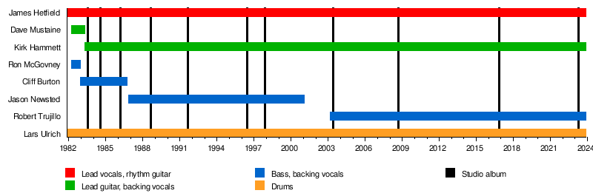
Timeline

Slide 6
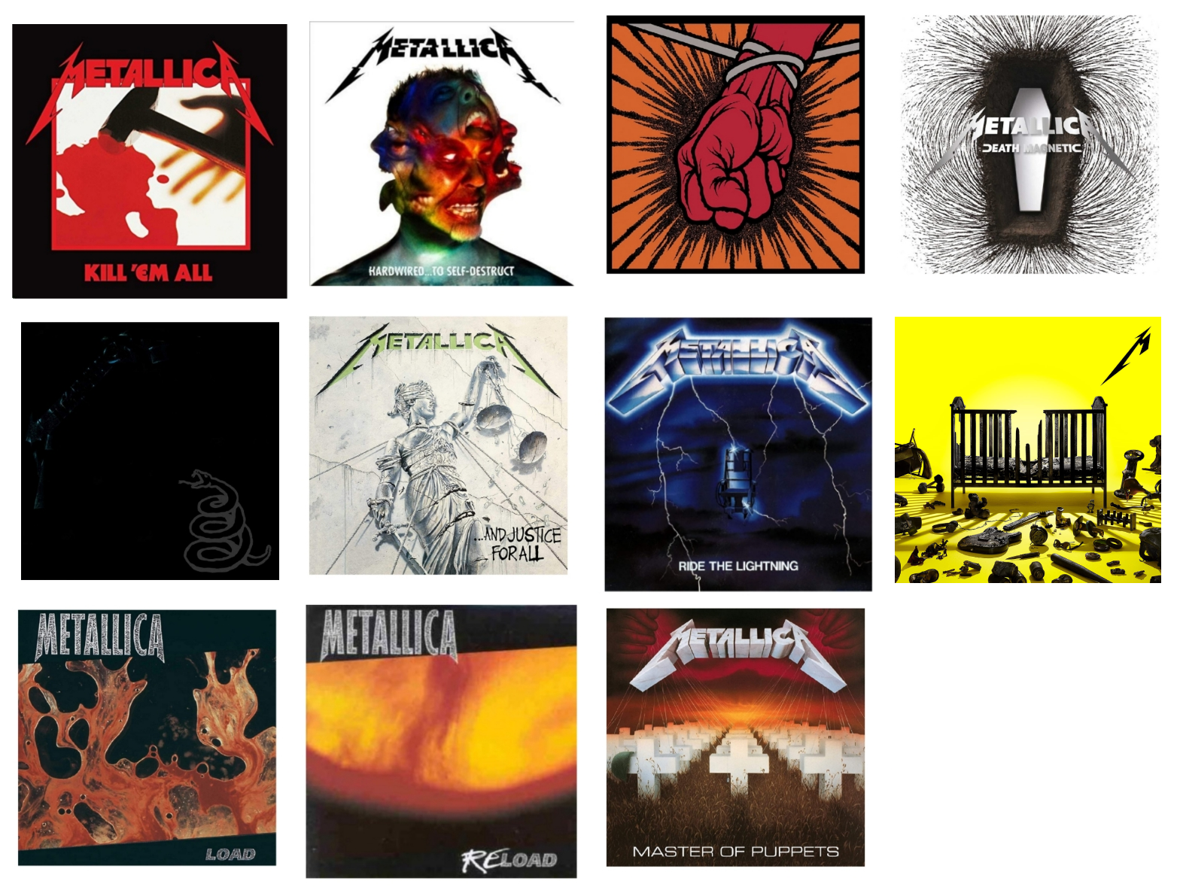
Discography
Kill 'Em All (1983)
Ride the Lightning (1984)
Master of Puppets (1986)
...And Justice for All (1988)
Metallica (1991)
Load (1996)
Reload (1997)
St. Anger (2003)
Death Magnetic (2008)
Hardwired... to Self-Destruct (2016)
72 Seasons (2023)

Slide 7
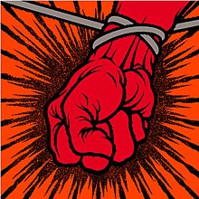
St. Anger incident
The Band Entered the Studio Empty-Handed
Jason Newsted Quit the Band
James Hetfield Entered Rehab
Hetfield Returned With Strict New Work Hours
Hetfield and Ulrich's Relationship Had Reached a Breaking Point
No Guitar Solos
Snare Drum Sound
https://youtu.be/3rFoGVkZ29w?t=24
https://www.tiktok.com/@fountane/video/7161200039916866822?lang=cs-CZ

Slide 8
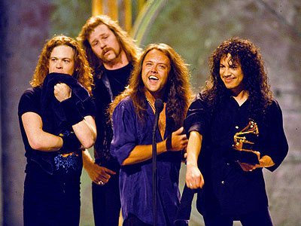
Awards
1990: Best Metal Performance – "One"
1991: Best Metal Performance – "Stone Cold Crazy"
1992: Best Metal Performance – Metallica
1999: Best Metal Performance – "Better than You"
2000: Best Hard Rock Performance – "Whiskey in the Jar"
2001: Best Rock Instrumental Performance – "The Call of Ktulu"
2004: Best Metal Performance – "St. Anger"
2009: Best Metal Performance – "My Apocalypse"
2009: Best Recording Package – Death Magnetic

Slide 9
Any questions?

