Slide 1



Artificial Intelligence Department
The Faculty of Computing & Artificial Intelligence
Helwan University, Cairo - Egypt, June 2025
Guarded Exam
Plagiarism Detection
&
Auto-Grading
Powered By:
Securing Success

Slide 2

This project made
By
Mahmoud Gamal Abo Sriee
Mahmoud Khaled Mahmoud
Mohamed Khaled Ahmed
Mahmoud Adel Ali
Mohamed Khaled Abd El-Badie
Soliman Mohamed Mohamed
Ali Abdrabo Ali
Under Supervision of
Dr. Salwa Osama
Project Presentation
Submitted to
The Faculty of Computers and Artificial Intelligence at Helwan University
In Partial Fulfillment of the Requirements
For the Degree of Bachelor of Computer Science
In
Artificial Intelligence
Faculty of Computers and Artificial Intelligence
June 2025

Slide 3
Agenda
Introduction
Literature Review
Proposed Solutions
Solution Design
Datasets
Deployment
Experiments & Results
Demo
Conclusion

Slide 4
Agenda
Introduction
Literature Review
Proposed Solutions
Solution Design
Datasets
Deployment
Experiments & Results
Demo
Conclusion
Problem Definition
Why online exams?
Academic Integrity Challenges in the Age of AI.
Limitations of Manual Answer Evaluation.
Why Guarded Exam?

Slide 5
Agenda
Introduction
Literature Review
Proposed Solutions
Solution Design
Datasets
Deployment
Experiments & Results
Demo
Conclusion
Summary of similar Stand-Alone Applications.
Similar AI models Approaches

Slide 6
Agenda
Introduction
Literature Review
Proposed Solutions
Solution Design
Datasets
Deployment
Experiments & Results
Demo
Conclusion
Solution methodology
Implemented methods
Scope details

Slide 7
Agenda
Introduction
Literature Review
Proposed Solutions
Solution Design
Datasets
Deployment
Experiments & Results
Demo
Conclusion
System Overview
Models Architectures
Fine-Tuning Methodologies

Slide 8
Agenda
Introduction
Literature Review
Proposed Solutions
Solution Design
Datasets
Deployment
Experiments & Results
Demo
Conclusion
Datasets Used

Slide 9
Agenda
Introduction
Literature Review
Proposed Solutions
Solution Design
Datasets
Deployment
Experiments & Results
Demo
Conclusion
Deployment Strategy

Slide 10
Agenda
Introduction
Literature Review
Proposed Solutions
Solution Design
Datasets
Deployment
Experiments & Results
Demo
Conclusion
Similarity Experiments
AI-Detection Experiments

Slide 11
Agenda
Introduction
Literature Review
Proposed Solutions
Solution Design
Datasets
Deployment
Experiments & Results
Demo
Conclusion
Admin View
Teacher View

Slide 12
Agenda
Introduction
Literature Review
Proposed Solutions
Solution Design
Datasets
Deployment
Experiments & Results
Demo
Conclusion

Slide 13
Introduction

Slide 14
Introduction
Literature Review
Proposed Solutions
Solution Design Datasets
Deployment
Experiments & Results
Demo
Conclusion
Problem Definition
Generative AI models like ChatGPT have enabled a new form of academic dishonesty like automated cheating through AI-generated text.
Traditional proctoring solutions are:
Invasive
Costly
Ineffective for detecting post-submission integrity violations
There is an urgent need in the education sector for:
Non-intrusive systems
Tools that can detect AI-generated content
Solutions that preserve student privacy

Slide 15
Introduction
Literature Review Proposed Solutions Solution Design Datasets
Deployment
Experiments & Results
Demo
Conclusion
Why online Exams?
Accessible anytime, anywhere
Easily scalable for many students
Fast, automated result delivery
Reduces costs on materials and venues
Securable with AI and lockdown measures
Maintains continuity during crises

Slide 16
Introduction
Literature Review Proposed Solutions Solution Design Datasets
Deployment
Experiments & Results
Demo
Conclusion
Academic Integrity Challenges in the Age of AI
AI tools like ChatGPT enable easy answer generation
Increased risk of plagiarism and cheating
Difficult to detect AI-generated content manually
Traditional exams struggle to maintain fairness
Need for advanced AI-detection methods
Threatens trust in student assessment
Raises ethical and educational concerns

Slide 17
Introduction
Literature Review Proposed Solutions Solution Design Datasets
Deployment
Experiments & Results
Demo
Conclusion
Limitations of Manual Answer Evaluation
Time-consuming and labor-intensive
Inconsistent grading between evaluators
Difficult to scale for large classes
Prone to human error and bias
Slow feedback delays learning
Resource-intensive and costly

Slide 18
Introduction
Literature Review Proposed Solutions Solution Design Datasets
Deployment
Experiments & Results
Demo
Conclusion
Why Guarded Exam?
Automates fast and consistent scoring
Detects AI-generated answers reliably
Enhances academic integrity
Scalable for any number of students
Saves time and reduces evaluator bias
Provides instant feedback to learners
Secure and easy-to-use platform

Slide 19
Literature Review

Slide 20
Introduction
Literature Review Proposed Solutions Solution Design Datasets
Deployment
Experiments & Results
Demo
Conclusion
Summary of similar Stand-Alone Applications
System/Approach | AI Detection | Similarity Scoring | Privacy-Friendly | Offline Support | Cost
Guarded Exam | ✅ Yes | ✅ Yes | ✅ Yes | ❌ No | Free
Turnitin | ❌ No | ✅ Yes | ❌ No | ❌ No | Medium
Proctorio | ❌ No | ❌ No | ❌ No | ❌ No | Medium
Digiexam Lockdown | ✅ Yes | ❌ No | ✅ Yes | ✅ Yes | Medium
SEB | ❌ No | ❌ No | ✅ Yes | ✅ Yes | Free
ProctorTrack | ❌ No | ❌ No | ❌ No | ❌ No | High

Slide 21
Introduction
Literature Review Proposed Solutions Solution Design Datasets
Deployment
Experiments & Results
Demo
Conclusion
Similar AI models Approaches
AI-Paraphrased Text Detection (BBC & ChatGPT)
Goal: Detect AI-paraphrased news using similarity metrics.
Result: 96.2% F1-score, outperforming deep learning models.
SimilarGPT: Code Similarity with GPT-4
Goal: Detect security vulnerabilities using semantic similarity.
Result: 40% fewer false positives.
MBO-DeBERTa for Fake Review Detection
Goal: Use DeBERTa + optimization for review classification.
Result: 98% accuracy, adversarial robustness.
DeBERTaV3 for Enhanced Efficiency
Goal: Improve similarity and classification performance.
Result: +4.8% improvement on low-resource tasks.
Hybrid RoBERTa & GPT Detection
Goal: Detect AI-written essays.
Result: F1-score of 94%.

Slide 22
Proposed Solutions

Slide 23
Introduction
Literature Review Proposed Solutions Solution Design Datasets
Deployment
Experiments & Results
Demo
Conclusion
Implemented methods
AI Detection
Fine-tune a RoBERTa open AI Detector model and a GPT-based discriminator.
Classifies answers as either human- or AI-written.
Trained on a combination of human-written and AI-generated datasets for better generalization.
Similarity Analysis
Fine-tune a DeBERTa cross-encoder model and DeBERTa Zero-shot.
Compares student responses with Teacher answers.
Produces context-aware similarity scores to inform grading.
Validation Techniques
Similarity model: Ensemble validation between DeBERTa cross-encoder and DeBERTa zero-shot helps detecting the syntactic and semantic meaning.
AI classifier: Ensemble validation between RoBERTa and GPT-2 helps minimize false positives.

Slide 24
Introduction
Literature Review Proposed Solutions Solution Design Datasets
Deployment
Experiments & Results
Demo
Conclusion
Scope details
In-Scope: Post-exam textual analysis, semantic similarity matching, AI classification, instructor dashboard.
Out-of-Scope: allow only 1 monitor, audio/video proctoring, and multimedia exams.

Slide 25
Solution Design

Slide 26
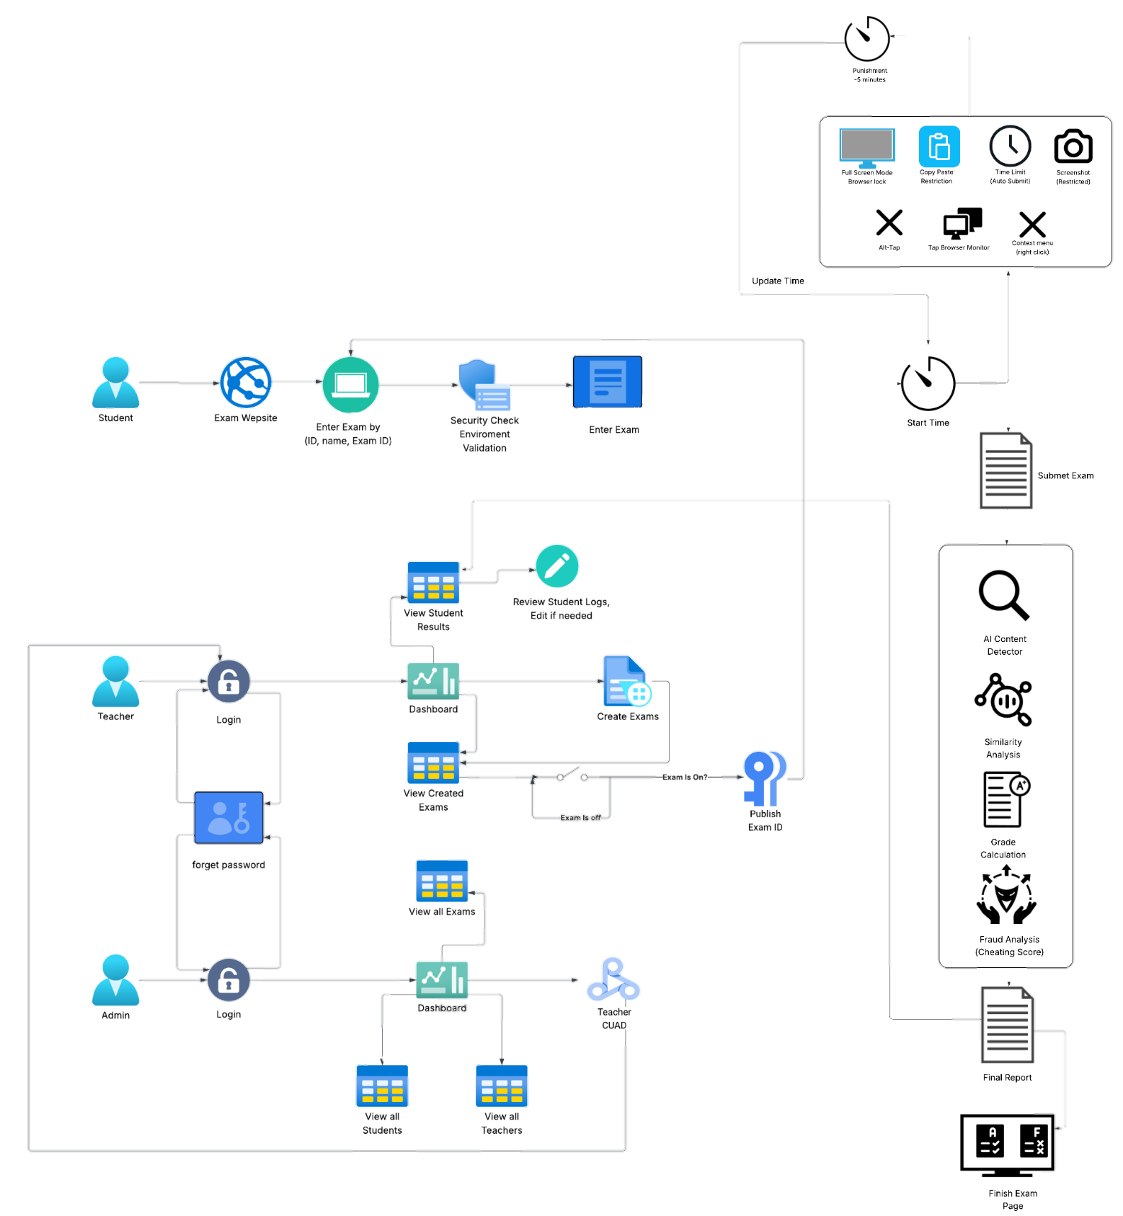
Introduction
Literature Review Proposed Solutions Solution Design Datasets
Deployment
Experiments & Results
Demo
Conclusion
System Overview

Slide 27
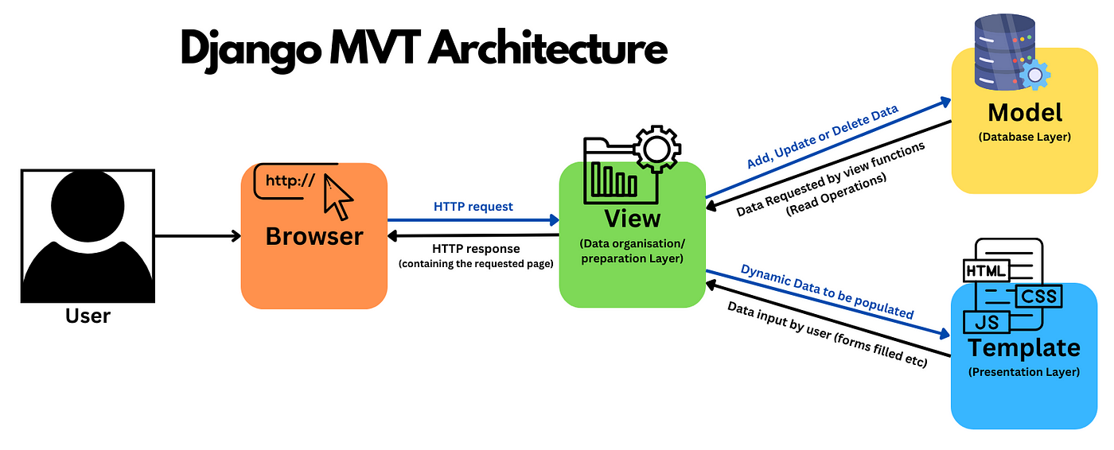
Introduction
Literature Review Proposed Solutions Solution Design Datasets
Deployment
Experiments & Results
Demo
Conclusion
Models Architectures
Django (Backend Web Framework)
Why we used it:
Django is a high-level Python web framework valued for its robustness, scalability, and security.
Enabled rapid development of a secure, maintainable backend integrated with our NLP models.
Strengths:
Offers built-in authentication, an ORM for easy database operations, and a scalable architecture.
Use in Guarded Exam:
Manages secure user actions, routes inputs to NLP models, handles async tasks, and generates instructor reports.

Slide 28
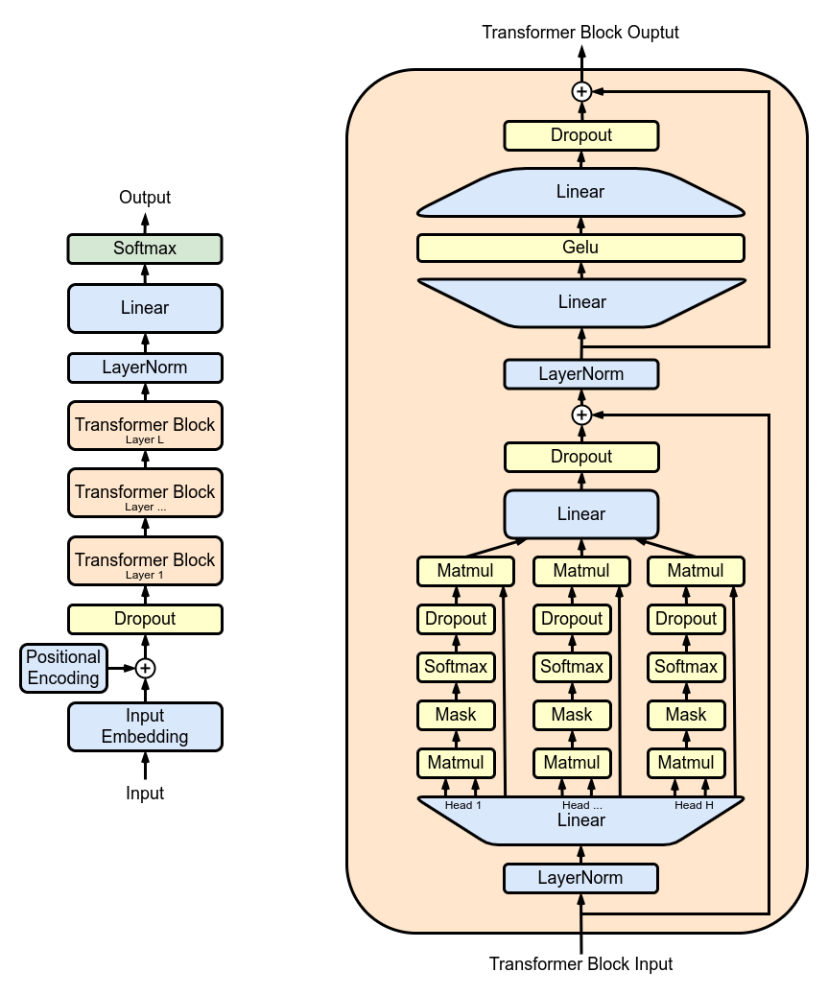
Introduction
Literature Review Proposed Solutions Solution Design Datasets
Deployment
Experiments & Results
Demo
Conclusion
Models Architectures Cont.
GPT-2 (for AI Detection)
Why we used it:
GPT-2 is an autoregressive model that understands and generates fluent text.
Fine-tuned and used as a discriminator for classification, not text generation.
Strengths:
Captures fluency and coherence differences between AI and human writing.
Outperformed RoBERTa in certain human recall cases.
Use in Guarded Exam:
Acts as a second discriminator in the AI detection ensemble.
Helps reduce false positives by better identifying human-written answers.
GPT-2

Slide 29
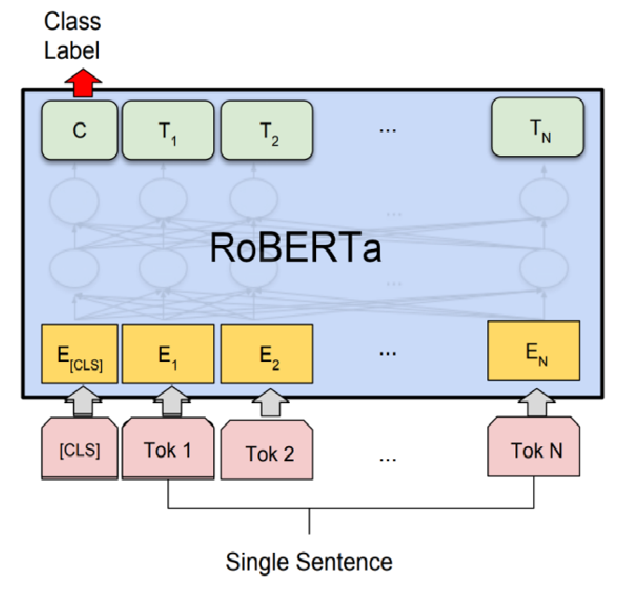
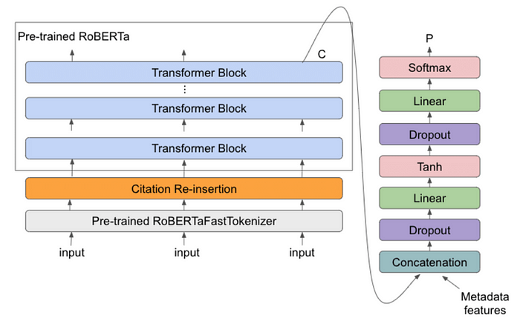
Introduction
Literature Review Proposed Solutions Solution Design Datasets
Deployment
Experiments & Results
Demo
Conclusion
Models Architectures Cont.
RoBERTa (for AI Detection)
Why we used it:
RoBERTa delivers strong performance in classification tasks.
Fine-tuned RoBERTa models accurately detect linguistic patterns common in AI-generated text.
Strengths:
Captures syntactic and semantic cues effectively.
Excels in benchmark NLP classification tasks.
Pre-trained on more data than BERT (without Next Sentence Prediction), enhancing context understanding.
Use in Guarded Exam:
Serves as one of the AI detectors in the ensemble.
Classifies student responses as AI-generated or human-written.

Slide 30
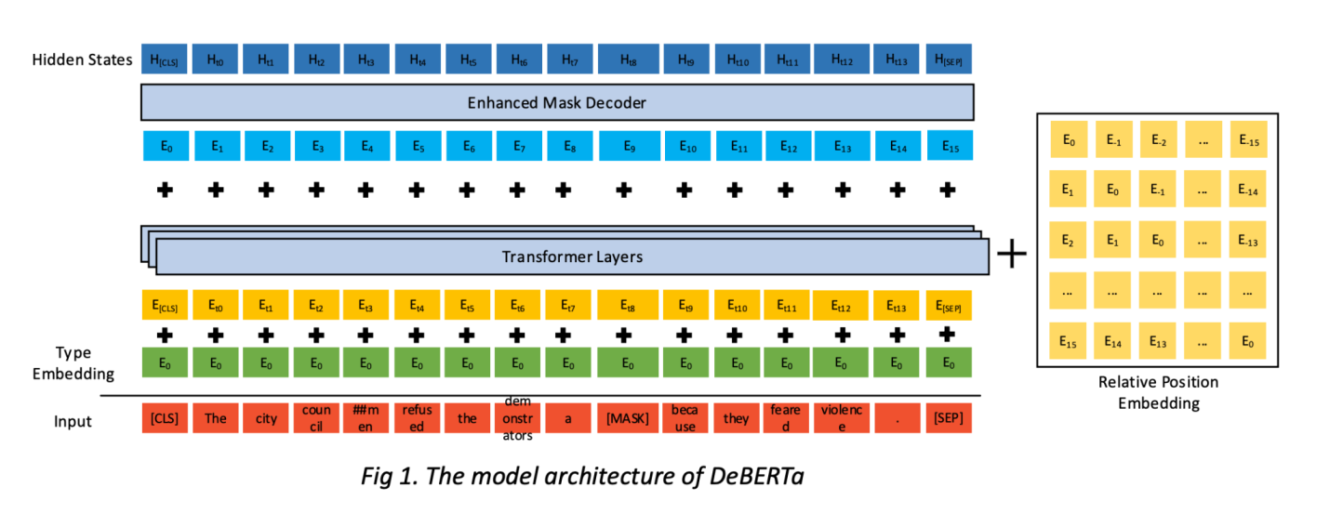
Introduction
Literature Review Proposed Solutions Solution Design Datasets
Deployment
Experiments & Results
Demo
Conclusion
Models Architectures Cont.
DeBERTa (for Similarity Scoring)
Why we used it:
DeBERTa improves on BERT and RoBERTa by disentangling position and content information.
Strengths:
Excels in semantic similarity and entailment tasks.
Generalizes well to paraphrased or knowledge-based similarities.
Use in Guarded Exam:
Powers the similarity model by comparing student and teacher answers.
Enables accurate grading through contextual understanding beyond exact word matches.

Slide 31
Introduction
Literature Review Proposed Solutions Solution Design Datasets
Deployment
Experiments & Results
Demo
Conclusion
Fine-Tuning Methodologies
Cross-Encoder Model
Architecture:
A Cross-Encoder processes both input sentences simultaneously with full attention.
Captures rich interactions between the student’s answer and the Teacher answer.
Why We Used It:
Direct interaction between sentences boosts performance on semantic tasks like similarity, paraphrasing, and entailment.
Our cross-encoder (cross-encoder/deberta-v3-large) consistently showed high accuracy and robustness across domains.
Training Strategy:
Fine-tuned on first Quora dataset the biggest benchmark for similarity tasks.
Used classification-style output 0 or 1.
Applied 70% layer freezing to retain general linguistic knowledge while adapting to the scientific domain.
Prevented overfitting with dropout, warmup learning schedules, and AdamW optimization.
Results:
Testing Accuracy by ~90%.
Achieved strong performance on abstract-summary similarity, ideal for academic QA grading.
Cross Encoder

Slide 32
Introduction
Literature Review Proposed Solutions Solution Design Datasets
Deployment
Experiments & Results
Demo
Conclusion
Fine-Tuning Methodologies Cont.
Zero-Shot Model
Architecture:
Large pre-trained transformers.
Generalize to unseen tasks/domains.
Why We Used It:
Exceptional generalization to new semantic structures
Pre-trained on broad, diverse corpora for robust understanding
Plug-and-play deployment with minimal compute/data
Training Strategy:
Fine-tuned on first Quora dataset the biggest benchmark for similarity tasks.
Used classification-style output 0 or 1.
Applied 80% layer freezing to retain general linguistic knowledge while adapting to the scientific domain.
Prevented overfitting with dropout, warmup learning schedules, and AdamW optimization.
Results:
Testing Accuracy by ~91%.
Achieved strong performance on abstract-summary similarity, ideal for academic QA grading.
Zeroshot

Slide 33
Introduction
Literature Review Proposed Solutions Solution Design Datasets
Deployment
Experiments & Results
Demo
Conclusion
Fine-Tuning Methodologies Cont.
Focal Loss for AI Detection Optimization
Why We Used It:
AI vs. human classification risks false positives, flagging genuine answers as
AI-written.
Applied Focal Loss to focus training on harder-to-classify examples and reduce false positives.
Strengths:
Reduces overfitting to easily classified examples.
Improves recall on underrepresented or ambiguous cases.
Balances learning in datasets with slight class imbalance.
Training Strategy:
Replaced cross-entropy loss with focal loss .
Used class weights to bias learning toward human-written text.
Combined with 70% layer freezing and dropout regularization.
Results:
Reduced false positives in Human Written.
Improved robustness on borderline AI-like real student inputs.
Integrated into the RoBERTa from openai and GPT-2 ensemble for final predictions.

Slide 34
Introduction
Literature Review Proposed Solutions Solution Design Datasets
Deployment
Experiments & Results
Demo
Conclusion
Fine-Tuning Methodologies Cont.
Ensemble Method using Logistic Regression
Method:
Combined DeBERTa (zero-shot) and Cross-Encoder DeBERTa predictions using a logistic regression meta-model.
The model learns to weight confidence scores to produce a final similarity score.
Applied the same approach for AI detection.
Justification:
DeBERTa zero-shot handles general, less structured input.
Ensemble balances precision and recall, promoting fair grading.

Slide 35
Datasets

Slide 36
Introduction
Literature Review Proposed Solutions Solution Design
Datasets
Deployment
Experiments & Results
Demo
Conclusion
Datasets Used
Similarity Datasets
STSb Multi‑MTThe
A multilingual Semantic Textual Similarity Benchmark with aligned sentence pairs across languages.
Each pair scored from 0 to 5 based on semantic similarity.
Useful for training and evaluating multilingual semantic similarity models.
Link: PhilipMay/stsb_multi_mt · Datasets at Hugging Face
AllenAI SciTLDRA
Dataset of scientific articles paired with TL;DR summaries.
Summaries treated as semantically similar to abstract or body sentences.
Repurposed for sentence-level similarity training in domain-specific contexts.
Link: allenai/scitldr · Datasets at Hugging Face
Quora Question Pairs
Large-scale dataset of question pairs labeled as duplicates or not.
Ideal for binary classification of semantic equivalence and paraphrase detection training.
Link: First Quora Dataset Release: Question Pairs

Slide 37
Introduction
Literature Review Proposed Solutions Solution Design
Datasets
Deployment
Experiments & Results
Demo
Conclusion
Datasets Used
AI Detection Datasets
AI vs Human Text
Dataset of ~500,000 essays, evenly split between AI-generated and human-written.
Used to train binary classifiers distinguishing the two.
Link: AI Vs Human Text
DAIGT-v2 Train
Mixed dataset of human- and AI-authored text.
Adds diversity to training corpora for AI detection models.
Link: daigt-v2-train-dataset
Human vs LLM Text Corpus
Contains ~800,000 texts labeled human-written or LLM-generated.
Enhances robustness in AI detection fine-tuning by covering diverse writing styles.
Link: Human vs. LLM Text Corpus

Slide 38
Deployment

Slide 39
Introduction
Literature Review Proposed Solutions Solution Design
Datasets
Deployment
Experiments & Results
Demo
Conclusion
Deployment Strategy
Docker
Containerized Django backend and NLP models
Ensured consistent environments across dev, test, and production
Kubernetes (KinD)
Deployed using KinD for local orchestration
Simulated production microservices with multi-pod architecture
Managed services, configs, and persistent volumes via YAML
Modular Components
Django API (backend logic & authentication)
NLP Inference Services (AI Detection, Similarity Grading)
SQLite Database with persistent volume storage
Access & Exposure
Exposed via NodePort on port 30007
Planned migration to cloud-managed K8s (e.g., GKE/AWS EKS)

Slide 40


Introduction
Literature Review Proposed Solutions Solution Design
Datasets
Deployment
Experiments & Results
Demo
Conclusion
Deployment Strategy Cont.
AWS Deployment
Launched EC2 Instance:
Created a new Ubuntu-based EC2 instance to host the application, configured security groups to allow HTTP (port 80) and SSH access.
Uploaded Docker Image to S3:
Due to the large size of the image (~15.8GB), we used S3 for efficient upload and transfer. This avoids the need for building the image directly on EC2.
Downloaded and Loaded Image on EC2:
Accessed the S3 bucket from EC2, downloaded the image .tar file, then loaded it into Docker using docker load.
Ran the Application in Docker:
Launched the container using the loaded image, exposed the app on a specific port (e.g., 8000), and ensured it was running correctly.
Configured Nginx as Reverse Proxy:
Installed and configured Nginx to forward traffic from port 80 (HTTP) to the internal Docker container port, enabling public access to the app via EC2’s public IP.

Slide 41
Experiments & Results

Slide 42
Introduction
Literature Review Proposed Solutions Solution Design
Datasets
Deployment
Experiments & Results
Demo
Conclusion
Similarity Experiments
Model | Accuracy | Training Time Per Epoch | Parameters | Results
All Mini llm L12 V2 | 77% | 40m | 33M | High False-Positive
All mpnet base V2 | 83% | 50m | 110M | High False-Positive
Cross-encoder DeBERTa V3 Large | 90% | 3:00 H | 435M | Low False-Positive
DeBERTa V3 Large | 85% | 3:00 H | 435M | Medium False-Positive
DeBERTa V3 Large zeroshot V2 | 91% | 3:10 H | 435M | Low False-Positive
Ensamble | 93% | - | - | Low False-Positive

Slide 43
Introduction
Literature Review Proposed Solutions Solution Design
Datasets
Deployment
Experiments & Results
Demo
Conclusion
Similarity Experiments Cont.

Slide 44
Introduction
Literature Review Proposed Solutions Solution Design
Datasets
Deployment
Experiments & Results
Demo
Conclusion
Similarity Experiments Cont.

Slide 45
Introduction
Literature Review Proposed Solutions Solution Design
Datasets
Deployment
Experiments & Results
Demo
Conclusion
Similarity Experiments Cont.

Slide 46
Introduction
Literature Review Proposed Solutions Solution Design
Datasets
Deployment
Experiments & Results
Demo
Conclusion
Similarity Experiments Cont.
Harmony Search Approach
Models Used
RoBERTa-Large) stsb-roberta-large)
Cross-Encoder (cross-encoder/stsb-roberta-base)
T5-Large (t5-large)
Dataset
Source: STS-B Multi-MT dataset (English split, test set)
Total Size:1,379 samples
Used for Optimization: 1,200 samples (due to memory constraints)
Batch Processing: 4 batches of 300 samples each
Labels: Similarity scores normalized to [0, 1] range
Harmony Search Algorithm
Population Size (HM_size) : 5 harmonies
Harmony Memory Considering Rate (HMCR): 0.9
Pitch Adjusting Rate (PAR): 0.3
Bandwidth (BW): 0.1
Maximum Iterations: 10 per batch
Objective Function
MAE = (1/N) × Σ|y_true - y_ensemble|

Slide 47
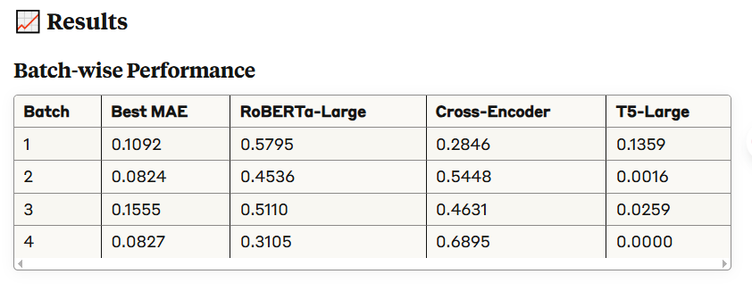
Introduction
Literature Review Proposed Solutions Solution Design
Datasets
Deployment
Experiments & Results
Demo
Conclusion
Similarity Experiments Cont.
Harmony Search Approach
Final Ensemble Weights (Average)
RoBERTa-Large: 46.37%
Cross-Encoder: 49.55%
T5-Large: 4.08%
Final Average MAE: 0.1075
Limitations
Memory Constraints: Only ~87% of the dataset was used due to computational limitations
Limited Iterations: Only 10 iterations per batch due to time constraints
Batch Processing: May not capture global optimal weights
T5 Encoding: The T5 encoding strategy might not be optimal for similarity tasks

Slide 48
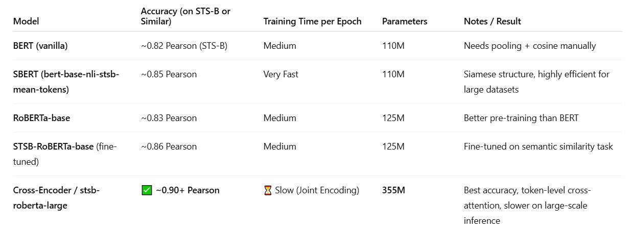
Introduction
Literature Review Proposed Solutions Solution Design
Datasets
Deployment
Experiments & Results
Demo
Conclusion
Similarity Experiments Cont.

Slide 49
Introduction
Literature Review Proposed Solutions Solution Design
Datasets
Deployment
Experiments & Results
Demo
Conclusion
Similarity Experiments Cont.
Model
Name: cross-encoder/stsb-roberta-large
Architecture: RoBERTa Large fine-tuned for semantic similarity
Type: Cross-Encoder (both sentences fed together as input(
Output: Single score representing similarity (regression)
Transformation
Converted source sentences + target summaries into sentence pairs → (sentence, target summary) with corresponding ROUGE score

Slide 50
Introduction
Literature Review Proposed Solutions Solution Design
Datasets
Deployment
Experiments & Results
Demo
Conclusion
Similarity Experiments Cont.
Model Setup & Training
Layer Freezing
Froze 70 %of the model layers:
Epochs: 15
Batch size: 16
Learning rate : 2e-5
Warmup steps : 10% of total steps
Loss : Mean Squared Error (regression)
📊 Model Performance Comparison (MSE)
Value | Metric
0.0896 | Before Fine-Tuning
0.0063 | After Fine-Tuning
+0.0832 | Δ MSE Improvement

Slide 51
Introduction
Literature Review Proposed Solutions Solution Design
Datasets
Deployment
Experiments & Results
Demo
Conclusion
Similarity Experiments Cont.
Goal
Automatically score student answers
Compare with tutor-provided model answers using semantic similarity
Models & Methods
DeBERTa-v3-large-zeroshot-v2.0
Fine-tuned on Quora with a classification head
Cross-Encoder DeBERTa-v3
Also fine-tuned on Quora using a classification head
Ensemble Strategy
Logistic regression on both models' outputs
Balances predictions for higher scoring reliability
Notable Techniques
Sentence normalization
Class balancing on Quora dataset
Freezing layers to retain pretrained linguistic structure
Metric
Precision and Recall are used for evaluation

Slide 52
Introduction
Literature Review Proposed Solutions Solution Design
Datasets
Deployment
Experiments & Results
Demo
Conclusion
Similarity Experiments Cont.
Results
Cross-Encoder: Best performance (~90%) Accuracy
Zeroshot: Best performance (~91%) Accuracy
Ensemble: ~93% Accuracy
Outcome: Strong generalization to real-world exam answers

Slide 53
Introduction
Literature Review Proposed Solutions Solution Design
Datasets
Deployment
Experiments & Results
Demo
Conclusion
AI-Detection Experiments
Model | Accuracy | Training Time Per Epoch | Parameters | Results
RoBERTa Large | 92% | 130m | 355M | Higher False-Positive
RoBERTa openai detector | 96% | 130m | 355M | Low False-Positive
GPT-2 | 97% | 100m | 117M | Low False-Positive
DeBERTa V3 Large | 98% | 150m | 435M | Higher False-Positive
Ensamble | 98.2% | - | - | Low False-Positive

Slide 54
Introduction
Literature Review Proposed Solutions Solution Design
Datasets
Deployment
Experiments & Results
Demo
Conclusion
AI-Detection Experiments Cont.

Slide 55
Introduction
Literature Review Proposed Solutions Solution Design
Datasets
Deployment
Experiments & Results
Demo
Conclusion
AI-Detection Experiments Cont.

Slide 56
Introduction
Literature Review Proposed Solutions Solution Design
Datasets
Deployment
Experiments & Results
Demo
Conclusion
AI-Detection Experiments Cont.

Slide 57
Introduction
Literature Review Proposed Solutions Solution Design
Datasets
Deployment
Experiments & Results
Demo
Conclusion
AI-Detection Experiments Cont.
Goal
Detect whether a student's exam answer is AI-generated or human-written
Prioritize high accuracy and low false positives
Models & Methods
GPT-2
Fine-tuned with high dropout (0.7)
70% freezing to preserve language understanding and boost generalization
OpenAI RoBERTa Detector
Pretrained on ChatGPT outputs
Further fine-tuned on a generalized dataset for broader LLM detection with the same approach as GPT-2
Ensemble Strategy
Logistic regression on model output probabilities
Combines strengths of GPT-2 and RoBERTa
Notable Techniques
Focal Loss: Reduces false positives
High freezing ratio (70%): Maintains pretrained structure
Metric
Precision and Recall used for evaluation

Slide 58
Introduction
Literature Review Proposed Solutions Solution Design
Datasets
Deployment
Experiments & Results
Demo
Conclusion
AI-Detection Experiments Cont.
Results
GPT-2: Higher recall for human-written text
RoBERTa: Better at detecting AI-generated text
Ensemble: 98.2% accuracy, With High Recall for human-written text
Outcome: Fewer false alarms, strong detection performance

Slide 59
Demo

Slide 60
Introduction
Literature Review Proposed Solutions Solution Design
Datasets
Deployment
Experiments & Results
Demo
Conclusion
Admin View

Slide 61
Introduction
Literature Review Proposed Solutions Solution Design
Datasets
Deployment
Experiments & Results
Demo
Conclusion
Teacher View

Slide 62
Conclusion

Slide 63
Introduction
Literature Review Proposed Solutions Solution Design
Datasets
Deployment
Experiments & Results
Demo
Conclusion
Conclusion
AI-generated text is becoming nearly indistinguishable from human writing, posing challenges for academic integrity.
Combines cutting-edge NLP models with scalable web technology to analyze answer content intelligently.
Achieves 98.2% accuracy in AI detection and 93% in semantic grading.
Demonstrates that combating misconduct can be ethical, precise, and innovative.
Represents a vision for smarter, fairer, and more responsible education in the AI era.
Guarded Exam offers a privacy-preserving, fair solution without invasive monitoring or lockdowns.

Slide 64

Thanks
Any Questions?
Or
Comments
Securing Success

