Slide 1
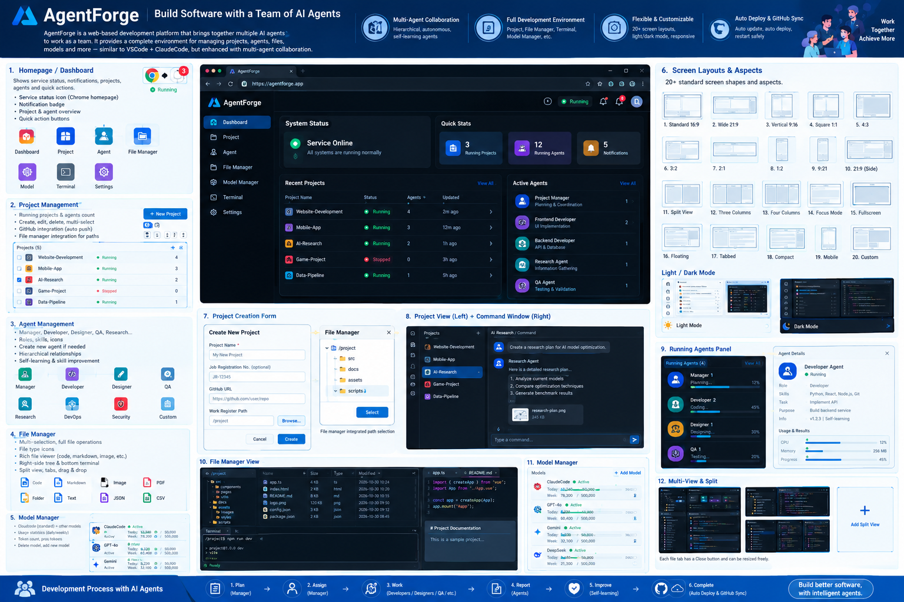
TECHNICAL BLUEPRINT
AGENT FORGE
Building a collaborative AI software engineering organization
Contract-Driven Agent Forge (CDAF)
A practical operating model for Claude Code and a multi-agent development platform
PEOPLE + AGENTS
VISIBLE WORK
SAFE DELIVERY
One team. Shared outcomes.
Tasks, artifacts, reviews.
Tests, GitHub, deploy gates.
Presentation blueprint • 30 October 2026

Slide 2
The central idea
02
Do not build a crowd of chatbots. Build a coordinated engineering organization.
ONE SHARED MISSION
SPECIALIZED OWNERS
EVIDENCE-BASED DELIVERY
A project manager agent turns a product goal into small, verifiable work packages.
Developers, designers, QA, research, DevOps and security agents own clear domains.
Every task ends with artifacts, tests, review evidence and a clear handoff.
Human engineers remain accountable for product direction, architecture, risk acceptance and production release.
AI agents accelerate execution; they do not remove the need for engineering judgment.
AGENT FORGE • CONTRACT-DRIVEN AGENT ENGINEERING
2

Slide 3
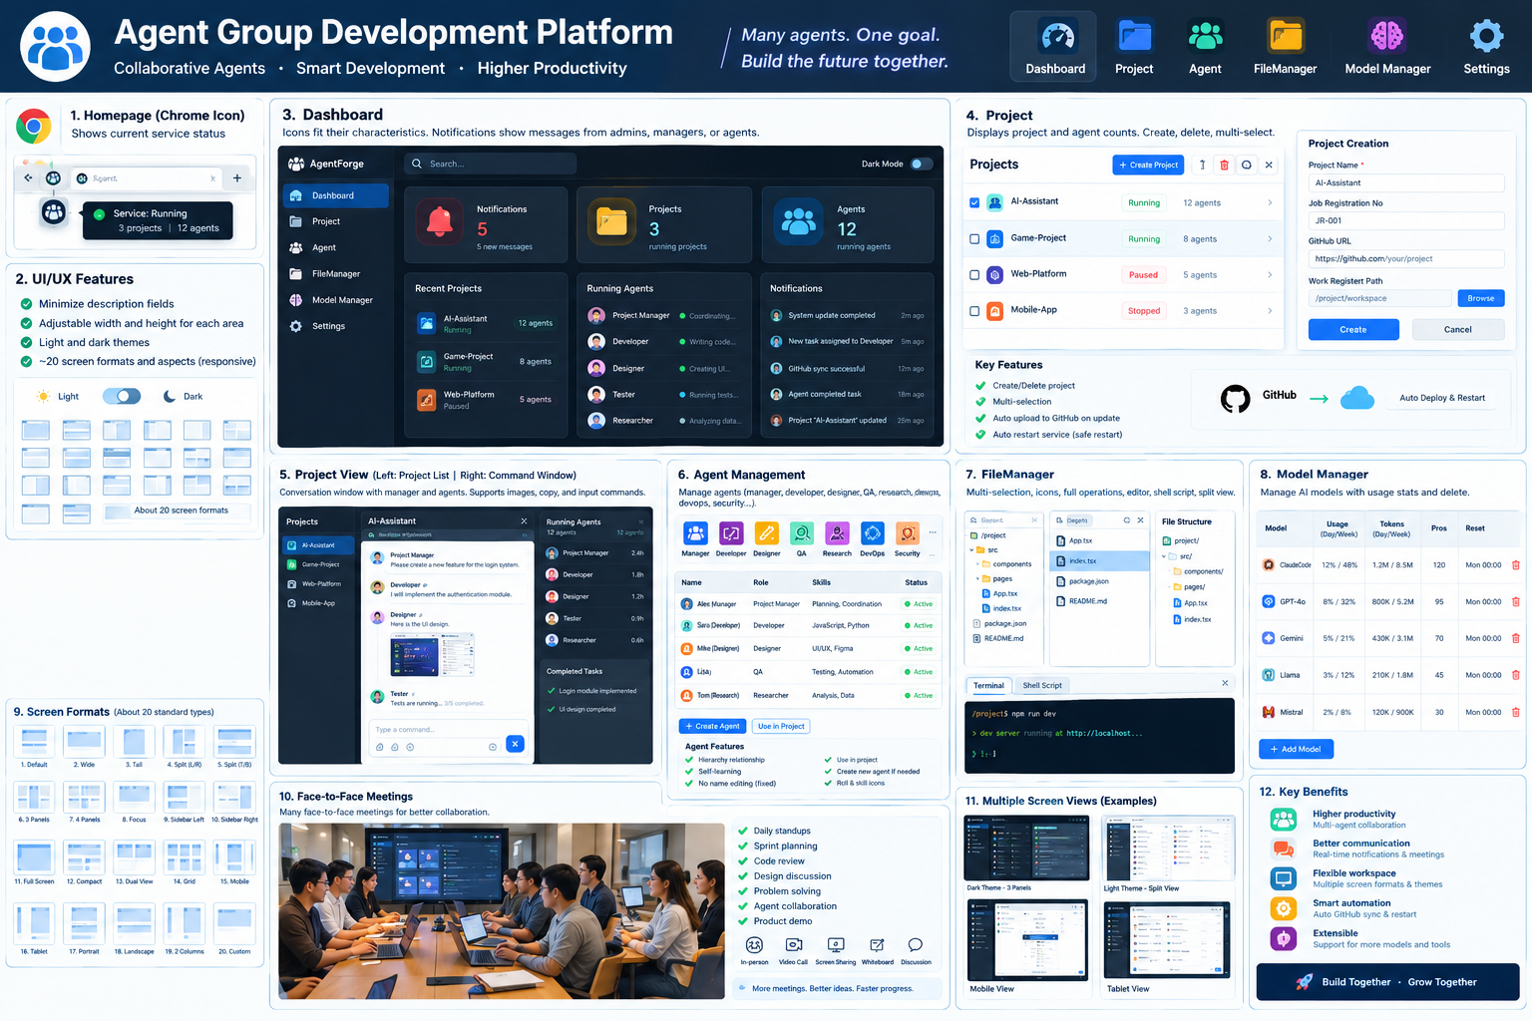
The platform we are building
03
The uploaded requirements describe a VS Code + Claude Code-inspired control room.
DASHBOARD
Service health, alerts, active projects and running agents.
PROJECT WORKSPACE
Project list, manager conversation, agent activity and image input.
AGENT + MODEL CONTROL
Roles, skills, hierarchy, model usage and task status.
FILE + DELIVERY
File manager, terminal, GitHub sync and safe restart.
AGENT FORGE • CONTRACT-DRIVEN AGENT ENGINEERING
3

Slide 4
The agent organization
04
Use role specialization, but keep one accountable owner for each deliverable.
Human Product Owner
Priorities • acceptance • risk
Project Manager Agent
Plan • delegate • integrate
Architect
Researcher
UX / Product Designer
Frontend Developer
System design
Evidence & options
Flows & visual specs
UI implementation
Backend Developer
QA Engineer
Security Agent
DevOps Agent
API & data
Tests & verification
Threats & controls
CI/CD & operations
AGENT FORGE • CONTRACT-DRIVEN AGENT ENGINEERING
4

Slide 5
Hierarchy without silos
05
Agents report upward, collaborate laterally, and can propose work—with policy controls.
Project Manager
Single accountable coordinator
Research Lead
Engineering Lead
Design Lead
Quality Lead
Findings + citations
Code + architecture
UX + assets
Tests + release evidence
Lateral collaboration: Research ↔ Engineering ↔ Design ↔ QA
REPORTING
PROPOSALS
ESCALATION
Status, blockers, artifacts and confidence.
Agents may suggest improvements; manager validates scope.
Human approval for sensitive actions and release decisions.
AGENT FORGE • CONTRACT-DRIVEN AGENT ENGINEERING
5

Slide 6
The original method: CDAF
06
Contract-Driven Agent Forge makes delegation explicit, testable and repeatable.
1. INTENT
2. CONTRACT
3. ASSIGN
4. EXECUTE
5. VERIFY
6. MERGE
Goal + constraints
Inputs + outputs
Role + owner
Tools + workspace
Tests + review
Artifact + handoff
TASK CONTRACT
SHARED MEMORY
QUALITY GATES
Every task has a bounded scope, owner, dependencies, acceptance criteria and output path.
Decisions, architecture notes, conventions and current project state are discoverable.
No completion without evidence: tests, review, security and integration checks.
AGENT FORGE • CONTRACT-DRIVEN AGENT ENGINEERING
6

Slide 7
How one request becomes working software
07
A manager decomposes work until tasks are small enough to execute and verify.
User request
Manager plan
Task contracts
Parallel work
Integration
Natural language + files
Break down + sequence
Owners + acceptance
Code / design / research
QA + human review
DECOMPOSITION RULE
DEPENDENCY GRAPH
DONE MEANS VERIFIED
Split by independently testable outcome—not merely by file or job title.
Run independent tasks in parallel; serialize conflicting edits and migrations.
Acceptance criteria pass, artifact exists, reviewer signs off, status is reported.
If one agent is overloaded, clone a role instance only when work can be safely partitioned.
AGENT FORGE • CONTRACT-DRIVEN AGENT ENGINEERING
7

Slide 8
Face-to-face is the coordination engine
08
Make in-person collaboration the default for alignment, ambiguity and high-risk decisions.
HUMAN TEAM
AGENT TEAM
JOINT SESSIONS
Daily stand-up, planning, architecture, design critique, code review and retrospective.
Manager-agent syncs, specialist handoffs, blocker triage and live review of agent output.
Humans and agents inspect the same artifacts, ask questions and agree on next actions.
Meeting rule: every meeting produces a decision, an owner, and a timestamped action.
Stand-up
Planning
Architecture
Design critique
15 min
45–60 min
45 min
30 min
Code review
QA triage
Demo
Retro
30 min
30 min
30 min
45 min
AGENT FORGE • CONTRACT-DRIVEN AGENT ENGINEERING
8

Slide 9
A meeting-rich operating rhythm
09
Schedule regular in-person checkpoints; use async messages only for simple updates.
MON
TUE
WED
THU
FRI
Sprint planning
Daily stand-up
Daily stand-up
Daily stand-up
Demo & acceptance
Team
Team
Team
Team
Team
Architecture review
Design critique
Integration review
Security / performance
Retrospective
Decision
Decision
Decision
Decision
Decision
Agent task kickoff
Pairing / live build
QA test triage
Release rehearsal
Next sprint prep
Action
Action
Action
Action
Action
Every day: 15-minute stand-up • two short manager/lead syncs • open collaboration time
AGENT FORGE • CONTRACT-DRIVEN AGENT ENGINEERING
9

Slide 10
Face-to-face meeting formats
10
Use the right room, participants and artifacts for each decision.
Daily stand-up
Sprint planning
All team + manager agent
Yesterday / today / blockers
15 min
PO + PM + leads
Priorities, capacity, task contracts
45–60 min
Architecture review
Design critique
Architect + backend + DevOps + security
ADRs, dependencies, failure modes
45 min
Designer + PO + frontend + users
Flows, prototypes, accessibility
30–45 min
Pairing / swarm
QA triage
Relevant specialists
Live debugging or complex task
25–50 min
QA + developer + PM
Repro steps, severity, owner
30 min
Demo / acceptance
Retrospective
Whole team + stakeholders
Working increment + evidence
30 min
Whole team
Keep / stop / start actions
45 min
AGENT FORGE • CONTRACT-DRIVEN AGENT ENGINEERING
10

Slide 11
The agent coordination meeting
11
The project manager runs a structured sync; agents bring evidence, not vague status.
1. Open
2. Round-robin
3. Resolve
4. Commit
Manager states goal + risks
Each agent reports
Dependencies + conflicts
Owners + due points
AGENT REPORT TEMPLATE
DECISION LOG
MEETING OUTPUT
Status • completed artifact • evidence • blocker • next action • confidence.
Record decision, rationale, owner, date and impacted tasks.
Updated task board, dependency graph, risks and next sync agenda.
Keep meetings short and frequent; escalate unresolved technical conflicts to a focused workshop.
AGENT FORGE • CONTRACT-DRIVEN AGENT ENGINEERING
11

Slide 12
Project workspace: one control room
12
Left: project list • Center: manager conversation • Right: live agents and results.
PROJECTS
PROJECT MANAGER CHAT
RUNNING AGENTS
▣ Website
▣ Mobile App
▣ AgentForge Core
▣ Game Prototype
+ Create project
Multi-select • Rename • Delete
User: Add secure sign-in and account recovery.
Manager: I will split this into API, UI, test and security tasks.
Backend Agent: API endpoints and token validation implemented. Tests: 18/18 passed.
Frontend Agent: Sign-in and reset flows ready for review.
QA Agent: Two edge cases found; tickets opened.
[ Attach image ] [ Type a command… ]
● Manager — planning
● Backend — coding
● Frontend — coding
● Designer — review
● QA — testing
Completed today: 7
Blocked: 1
Tokens / tools: live
Select agent → details
AGENT FORGE • CONTRACT-DRIVEN AGENT ENGINEERING
12

Slide 13
Agent management: identity, skills, learning
13
Role and skills are fixed attributes; display name is system-managed and not editable.
Role
Skills
Hierarchy
Learning
Developer / QA / Designer
Languages / tools / domain
Supervisor / peers / reports
Feedback + approved memory
CREATE / ASSIGN
OBSERVE
IMPROVE SAFELY
Search role catalog; create a specialist if none fits; attach to project.
Status, mission, tool calls, token usage, artifacts and blockers.
Curate lessons into versioned playbooks; evaluate before promoting changes.
Never let an agent silently rewrite its own permissions, identity, or production policy.
AGENT FORGE • CONTRACT-DRIVEN AGENT ENGINEERING
13

Slide 14
A task contract: the unit of reliable delegation
14
Use a structured contract in the orchestrator instead of passing vague prompts.
{
"task_id": "AUTH-042",
"project_id": "agentforge",
"role": "backend_developer",
"goal": "Implement password-reset API",
"inputs": ["API_SPEC.md", "auth_schema.sql"],
"constraints": ["Do not log secrets", "Keep API backward-compatible"],
"dependencies": ["AUTH-031"],
"outputs": ["src/auth/reset.ts", "tests/reset.test.ts"],
"acceptance": [
"Valid token resets password",
"Expired token is rejected",
"Rate limit is enforced",
"All tests pass"
],
"report_to": "engineering_lead",
"status": "assigned"
}
WHY IT WORKS
Bounded scope reduces ambiguity.
WHY IT SCALES
Contracts make tasks routable and auditable.
WHY IT IS SAFE
Acceptance checks stop unsupported “done” claims.
AGENT FORGE • CONTRACT-DRIVEN AGENT ENGINEERING
14

Slide 15
Reference technical architecture
15
Recommended stack for the requested web-based agent operations platform.
Web UI
React / Next.js + TypeScript
Backend API
Node.js + TypeScript (NestJS)
PostgreSQL
Redis
Object Storage
Agent Runtime
Projects, users, tasks, audit
Queues, locks, live status
Artifacts, images, logs
Claude Code + tool adapters
WHY TYPESCRIPT
WHY POSTGRESQL
WHY REDIS
Shared types across UI, API and orchestration.
Relational integrity for tasks, projects and audit history.
Fast coordination, queueing and ephemeral state.
AGENT FORGE • CONTRACT-DRIVEN AGENT ENGINEERING
15

Slide 16
Agent runtime: tools, permissions and traceability
16
Treat every agent as a controlled worker, not an unrestricted shell process.
Orchestrator
Agent worker
Tool gateway
Workspace
Task + policy
Prompt + context
Allow-listed tools
Isolated repo / branch
LEAST PRIVILEGE
OBSERVABILITY
RECOVERY
Read-only by default; scoped write access; explicit approval for deploy and destructive actions.
Log prompt/version, model, tool calls, latency, token cost, output and reviewer.
Timeouts, retries, idempotency, cancellation and human takeover.
Never expose raw production secrets to prompts or store credentials in agent-visible files.
AGENT FORGE • CONTRACT-DRIVEN AGENT ENGINEERING
16

Slide 17
GitHub integration and safe deployment
17
Every approved change is traceable; every restart is guarded by health checks.
Agent branch
Pull request
CI pipeline
Human approval
Deploy
Feature branch
Diff + summary
Lint / test / scan
Review + merge
Health-check restart
AUTOMATIC SYNC
SAFE RESTART
PROTECTED CORE PROJECT
Push project updates to GitHub through commits and pull requests; avoid direct main-branch writes.
Build → backup/config check → restart → readiness probe → rollback on failure.
AgentForge itself is a protected project; no delete action, restricted deploy permissions.
AGENT FORGE • CONTRACT-DRIVEN AGENT ENGINEERING
17

Slide 18
Developer workspace: files, terminal and models
18
Treat file operations and model usage as first-class engineering tools.
FILE MANAGER
TERMINAL
MODEL MANAGER
Tree + type icons • multi-select • create/copy/move/delete • drag/drop • preview/edit • Markdown rendering • split panes.
Path-aware shell • tab completion • multiple terminals • closeable tabs • resizable panes • command history.
Claude Code default • add/remove providers • daily/weekly tokens • reset time • usage and cost.
FILE TREE + PREVIEW
MODEL USAGE PANEL
📁 src
📁 agents
📄 orchestrator.ts
📄 task-contract.ts
📄 README.md
Preview uses syntax highlighting; Markdown uses rendered view.
Model | Today | Week | Tokens | Reset
Claude Code | usage meter | tokens
Other models | usage meter | tokens
Show units, timezone and reset countdown consistently.
AGENT FORGE • CONTRACT-DRIVEN AGENT ENGINEERING
18

Slide 19
Core data model
19
Keep the operational record relational; store large artifacts separately.
Project
Agent
Task
id, name, repo_url, root_path, protected
id, role, skills, model_id, supervisor_id
id, project_id, parent_id, owner_id, contract, status
Run
Artifact
Meeting
id, task_id, model, tokens, duration, trace
id, task_id, uri, checksum, version
id, project_id, agenda, decisions, actions
AuditEvent
actor, action, target, timestamp
Use migrations, foreign keys, indexes, soft-delete policy and immutable audit events for critical actions.
AGENT FORGE • CONTRACT-DRIVEN AGENT ENGINEERING
19

Slide 20
Implementation roadmap
20
Deliver a dependable control plane before adding advanced autonomy.
PHASE 1 • FOUNDATION
Auth, projects, protected AgentForge project, dashboard, PostgreSQL schema.
PHASE 2 • AGENT CONTROL
Agent registry, roles/skills, hierarchy, task contracts, run status.
PHASE 3 • WORKSPACE
Project chat, image attachments, file manager, terminal, split panes.
PHASE 4 • MODEL + GITHUB
Provider adapters, usage meters, branch/PR workflow, CI checks.
PHASE 5 • OPERATIONS
Meetings, audit, metrics, deployment health checks, rollback.
PHASE 6 • LEARNING
Curated memory, agent evaluations, playbook versioning, controlled improvement.
AGENT FORGE • CONTRACT-DRIVEN AGENT ENGINEERING
20

Slide 21
How we know the agent organization is working
21
Measure delivery quality and coordination—not just the number of agents.
Lead time
First-pass acceptance
Defect escape rate
Blocked time
Request → accepted change
Tasks accepted without rework
Issues found after release
Time waiting on dependencies
Agent cost per outcome
Review latency
Meeting action closure
Deployment recovery
Tokens + runtime per accepted task
Time from ready → reviewed
Actions completed by due date
Time to restore service after failure
Baseline first; set targets after 2–3 delivery cycles. Never optimize token cost at the expense of quality.
AGENT FORGE • CONTRACT-DRIVEN AGENT ENGINEERING
21

Slide 22
Non-negotiable operating rules
22
These rules protect quality as the number of agents and parallel tasks grows.
• One accountable owner per task; collaborators are explicitly listed.
• No task is complete without an artifact and acceptance evidence.
• Shared files have ownership boundaries; avoid concurrent writes to the same files.
• Every agent reports blockers early and escalates conflicts to its supervisor.
• Human approval is required for production deploys, destructive actions and security exceptions.
• Learning is curated, evaluated and versioned—not silently self-modified.
• Meetings end with decisions, owners and due dates.
• AgentForge core project cannot be deleted; deployment must support rollback.
AGENT FORGE • CONTRACT-DRIVEN AGENT ENGINEERING
22

Slide 23
Start with a pilot team
23
A small, disciplined agent team is better than a large, uncoordinated swarm.
1. Product Owner
2. Manager Agent
3. 3–5 Specialists
4. Human Review
Define one measurable goal
Decompose into contracts
Build, design, research, QA
Accept, learn, iterate
PILOT SCOPE
PILOT MEETINGS
PILOT EXIT
Choose one bounded feature that touches UI, API and tests.
Daily stand-up + planning + design/architecture + QA triage + demo/retro.
Working increment, passing tests, cost baseline and lessons learned.
Build together. Verify together. Improve together.
Based on the supplied AgentForge platform requirements; technical choices are recommendations for implementation.
AGENT FORGE • CONTRACT-DRIVEN AGENT ENGINEERING
23

