Slide 1
The acquisition of words during the first years of life
Claudia Cecilia Zuniga Montanez

Slide 2
Vocabulary learning
Language acquisition
When do infants start talking?
Which words do they learn first?
New born - sounds
15 to 24 months old – 50 to 300 words
3 year olds - highly skilled word learners

Slide 3
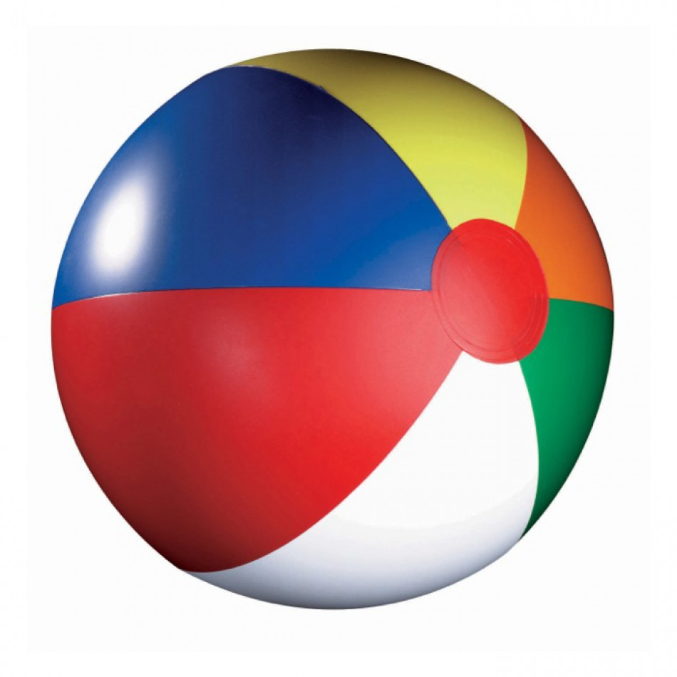

Vocabulary learning
Context flexible – generalization

Slide 4
Shape bias
Objects that are called the same have the same shape (Perry & Samuelson, 2011).
“This is a gaz”
“Where is the other gaz?”
Notes:
Shape bias trajectory:
At 24 months - fragile concept (Hupp, 2015; Vlach, 2016).
Next couple of years - shape is dominant (Perry & Samuelson, 2011)
5 years old – shape bias well stablished (Landau, Smith & Jones, 1998)

Slide 5
Shape bias
Preference to organize, name and generalize by shape and not colour, texture, size (Dansereau, 2016).
Based in real life experiences
Assumption – but not a conscious decision
Visible at 24 months (Hupp, 2015; Vlach, 2016).

Slide 6
Shape bias
Why shape?
Availability and easier to perceive (Landau, et al.,1988)
Does not require experience (Graham, Williams, & Huber, 1999)
Objects of the same category usually have the same shape (Graham, et al.,1999)

Slide 7
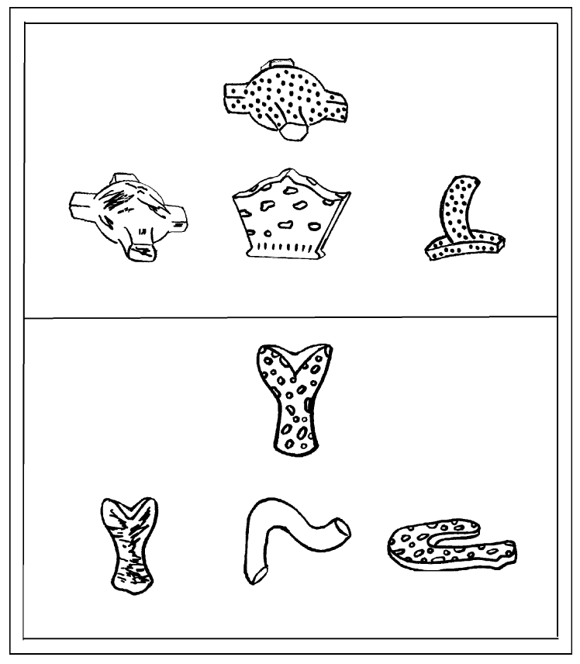
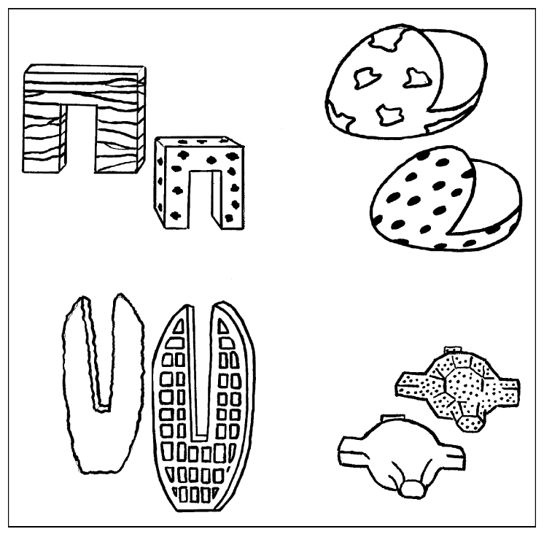
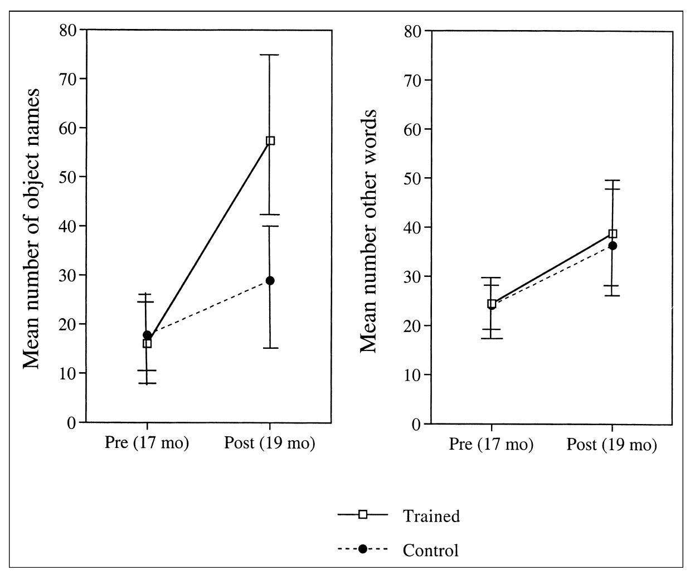
Vocabulary growth – shape bias training (Smith, et al., 2002)

Slide 8
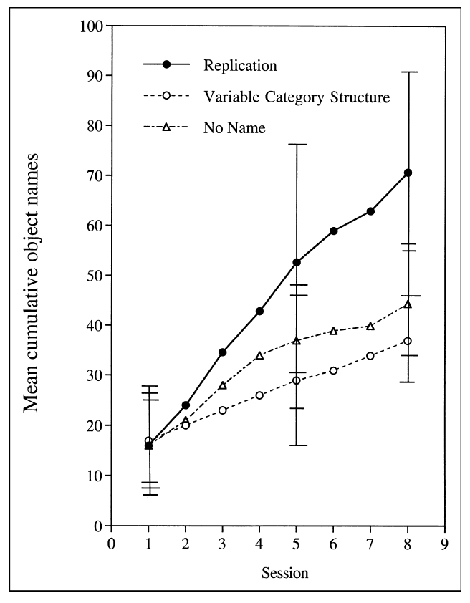
Vocabulary growth – shape bias training (Smith, et al., 2002)
Color and texture
Why not?
Color and texture – confusing
In real life, is this useful?

Slide 9


Slide 10
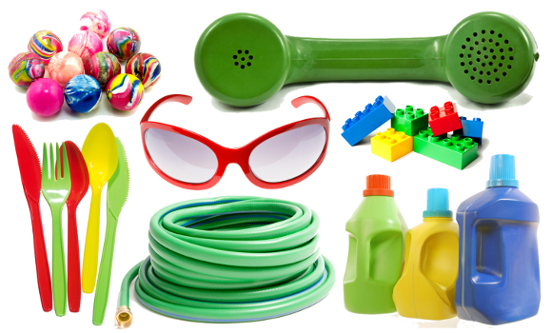

Slide 11
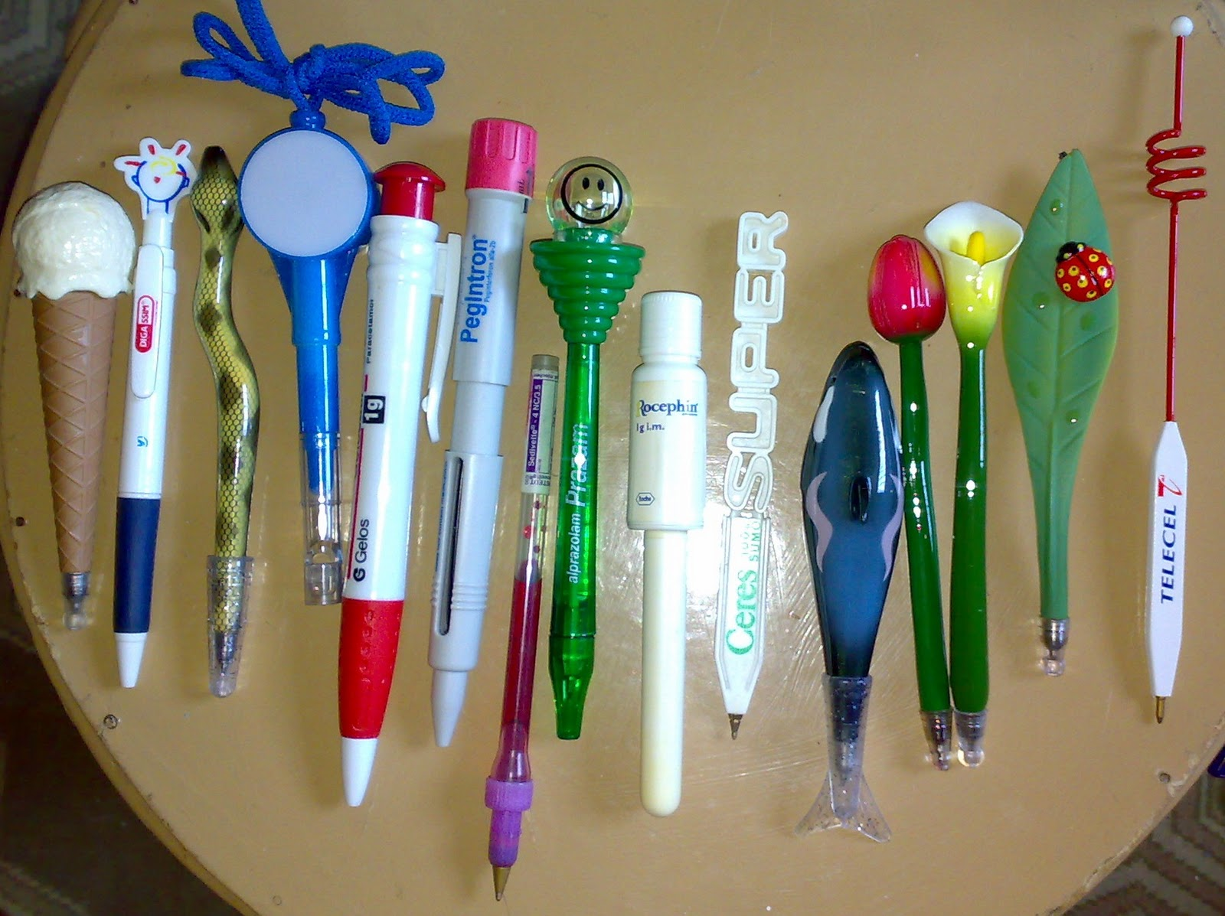
And function?
Objects can also be classified by their function
Used by older children and adults (Diesendruck, Markson& Bloom, 2003).

Slide 12
Attention to function
Objects can be used for the same purpose and have different properties
Function can be more difficult to understand - less intuitive and not obvious
When and under which conditions a successful function mapping occurs?
Contradictory results
Different methodologies and stimuli
Notes:
Two perspectives
Skill developed later than the shape bias – around 6 years old (Imai, Gentner, & Uchida, 1994)
Shape and function - different influence at different times
Requires certain cognitive development
Early stages can be observed even at 2 years old in specific conditions (e.g. Diesendruck, Markson & Bloom, 2003, Graham, et al., 1999)
Stronger with age

Slide 13

Can infants learn to attend to shape or function when learning and generalizing novel words?
Can infants transfer/generalize this knowledge?
Attending to shape or function can boost infant´s vocabulary?
Training is better than no training?
Which training is better?

Slide 14
Objectives
Teach infants to focus either on shape or function when learning and generalizing novel words.
Assess the effects the two strategies have in vocabulary growth.

Slide 15
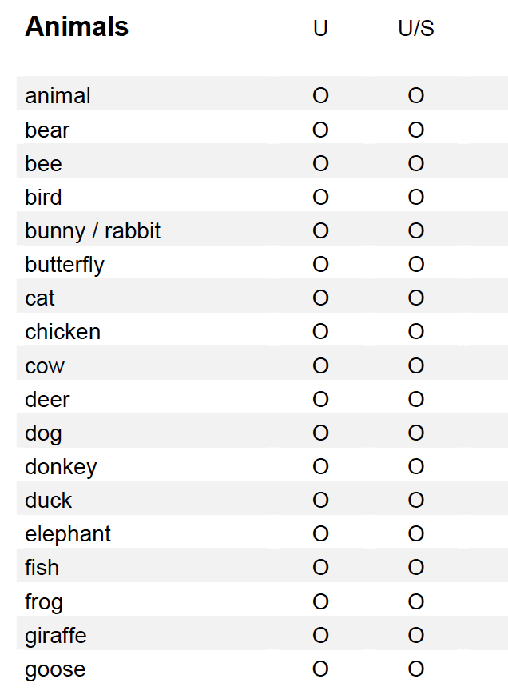
Methodology
Participants
32 infants - 17 month-olds
4 conditions
Shape training condition
Function training condition
Control shape condition
Control function condition
Initial and final vocabulary assessment - CDI

Slide 16
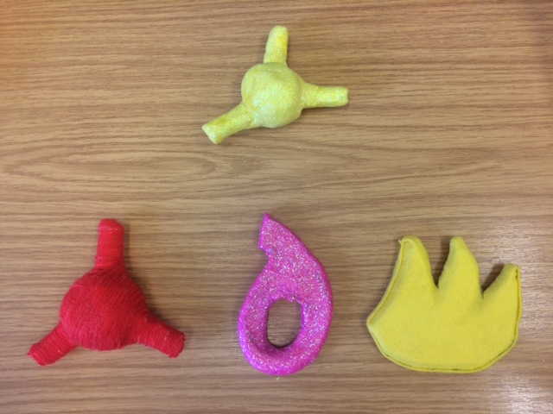
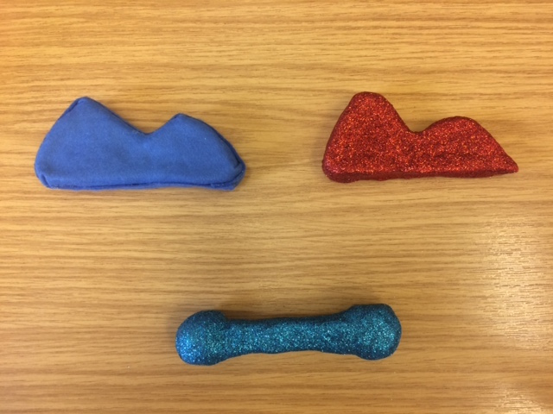
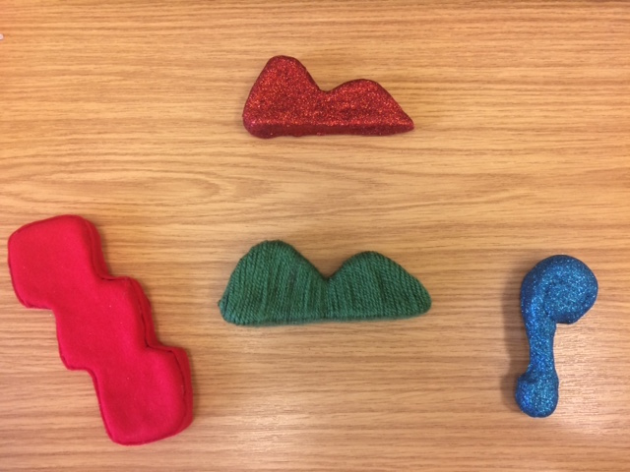
Shape training condition
9 sessions: 7 training sessions and 2 test sessions

Slide 17
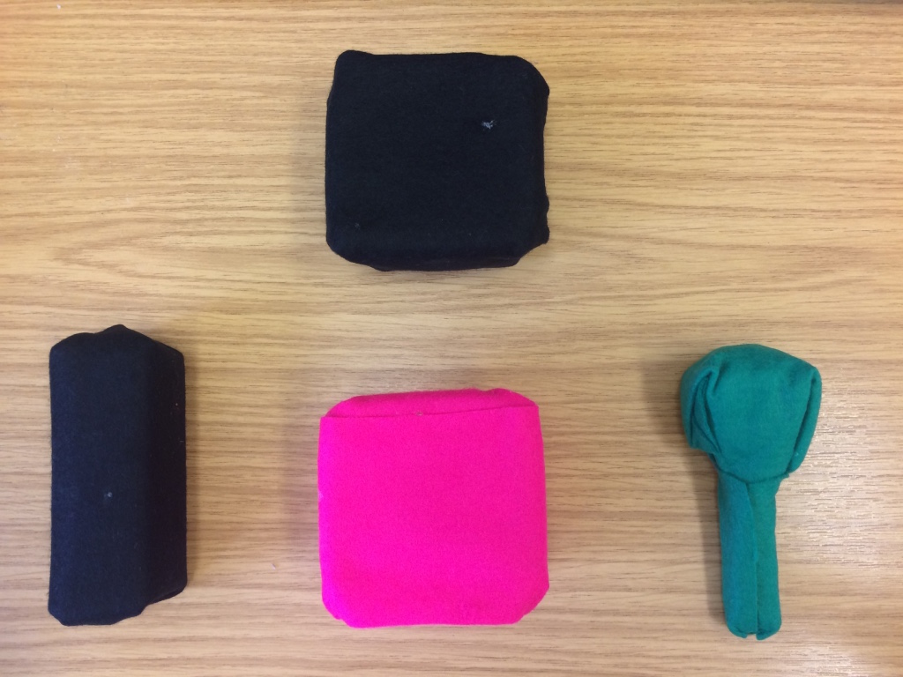
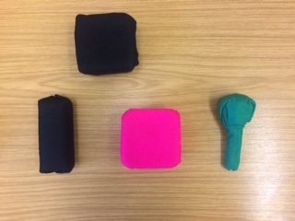
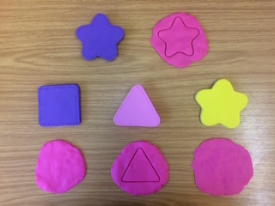
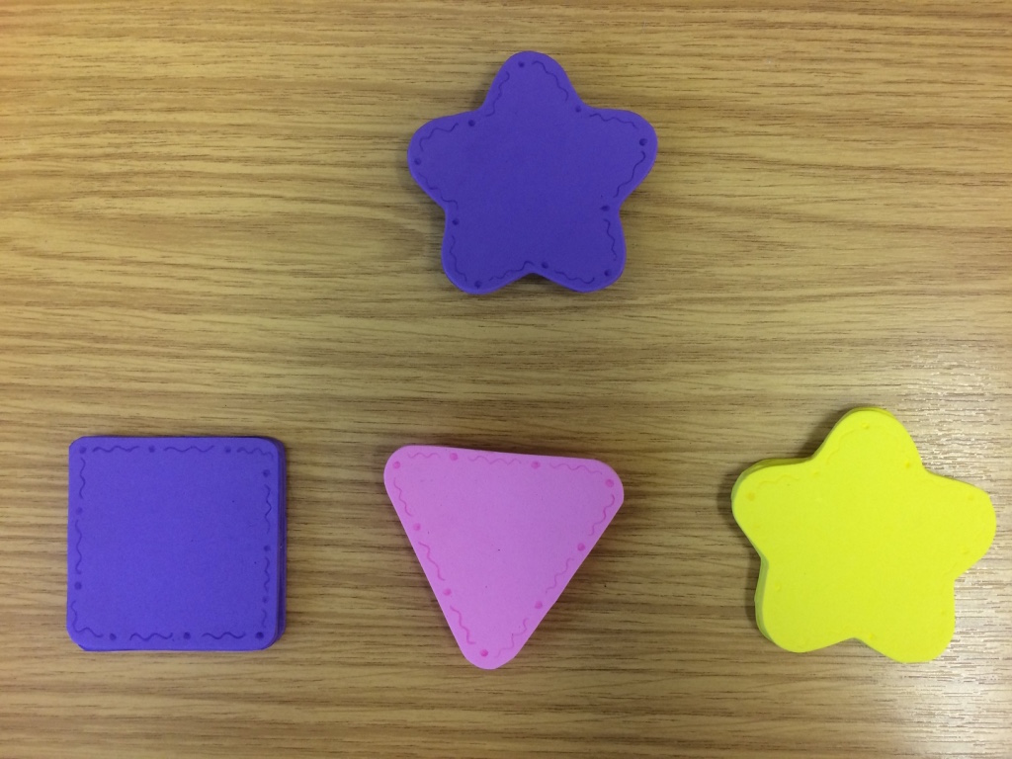
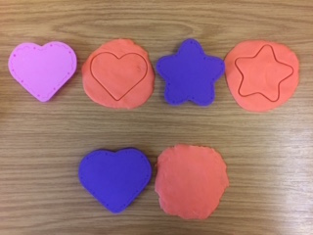
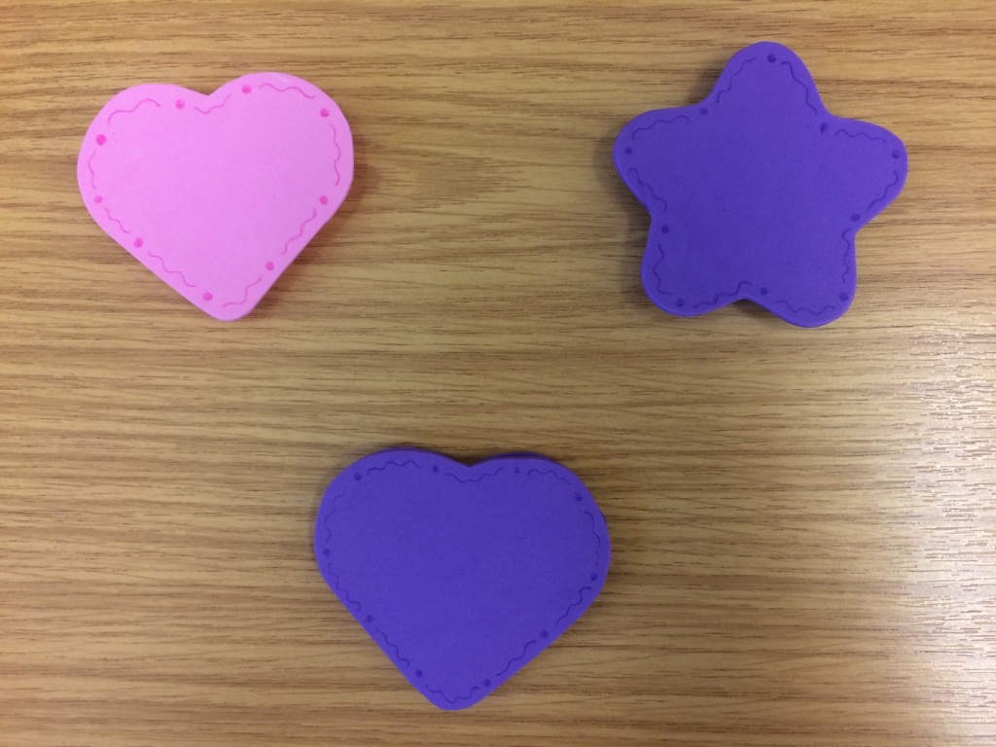


Function training condition
9 sessions: 7 training sessions and 2 test sessions

Slide 18
Control conditions
Free play during 7 sessions
Same tests during session 8 and 9 than training conditions

Slide 19
Hypotheses/Expected results
Shape training condition
Prefer shape matching objects
Significant productive vocabulary growth - higher than other conditions
Function training condition
Prefer function matching objects
Significant vocabulary growth?
Shape vs function?
Control shape condition and control function condition
Random selection
Reduced significant vocabulary growth compared to training conditions

Slide 20
Future directions
Results will provide information regarding techniques to boost the vocabulary of typically developed infants, and potentially infants with language delays.
Study 2 : Late talkers and the use of shape bias as a language intervention

Slide 21
References
Bloom, P. (2000). How children learn the meaning of words. Cambridge, MA: MIT Press.
Dansereau, D. R. (2016). Young children, sound-producing objects, and the shape bias. Psychology of Music,030573561665346. doi:10.1177/0305735616653465
Diesendruck, G., Markson, L., & Bloom, P. (2003). Children's reliance on creator's intent in extending names for Artifacts. Psychological Science,14(2), 164-169. doi:10.1111/1467-9280.t01-1-01436
Graham, S. A., Williams, L. D., & Huber, J. F. (1999). Preschoolers' and Adults' Reliance on Object Shape and Object Function for Lexical Extension. Journal of Experimental Child Psychology,74(2), 128-151. doi:10.1006/jecp.1999.2514
Hoff, E. (2014). Language development. Belmont, CA: Wadsworth/Thomson Learning.
Hupp, J. M. (2015). Development of the Shape Bias During the Second Year. The Journal of Genetic Psychology,176(2), 82-92. doi:10.1080/00221325.2015.1006563
Landau, B., Smith, L. B., & Jones, S. S. (1988). The importance of shape in early lexical learning. Cognitive Development,3(3), 299-321. doi:10.1016/0885-2014(88)90014-7
Perry, L. K., & Samuelson, L. K. (2011). The Shape of the Vocabulary Predicts the Shape of the Bias. Frontiers in Psychology,2. doi:10.3389/fpsyg.2011.00345
Smith, L. B., Jones, S. S., Landau, B., Gershkoff-Stowe, L., & Samuelson, L. (2002). Object name Learning Provides On-the-Job Training for Attention. Psychological Science,13(1), 13-19. doi:10.1111/1467-9280.00403
Vlach, H. A. (2016). How we categorize objects is related to how we remember them: The shape bias as a memory bias. Journal of Experimental Child Psychology,152, 12-30. doi:10.1016/j.jecp.2016.06.013

Slide 22
Thank you

