Slide 1



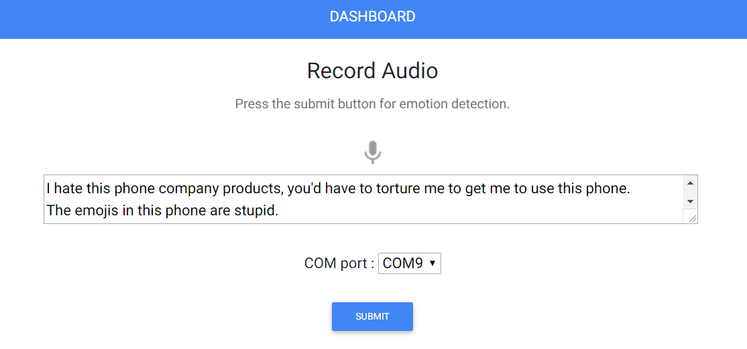
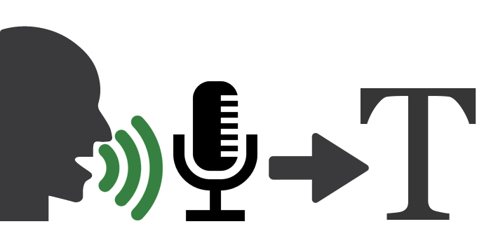

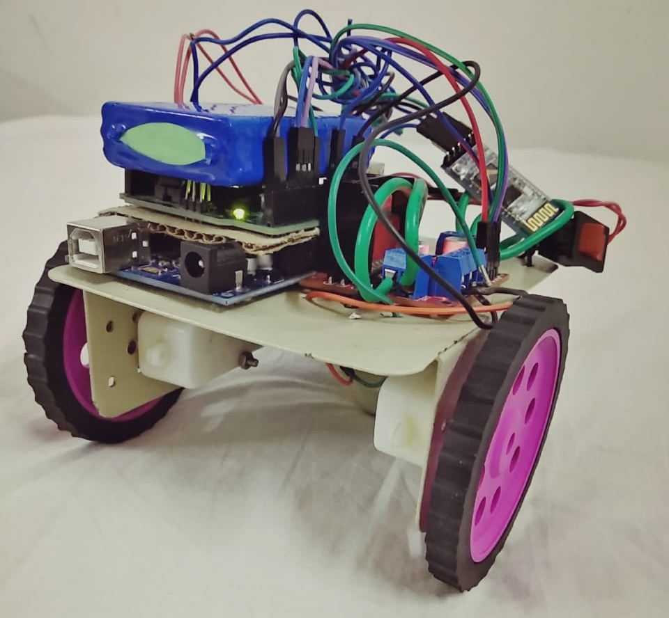
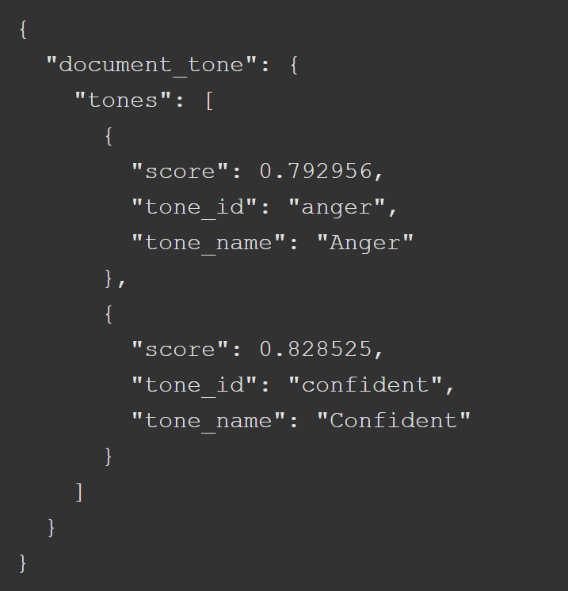
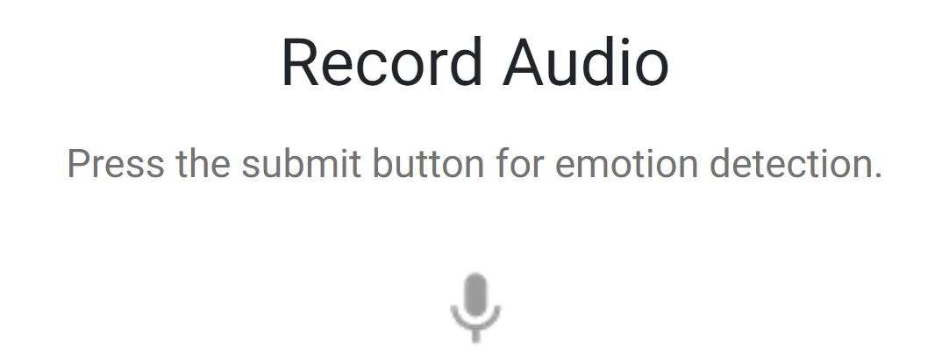
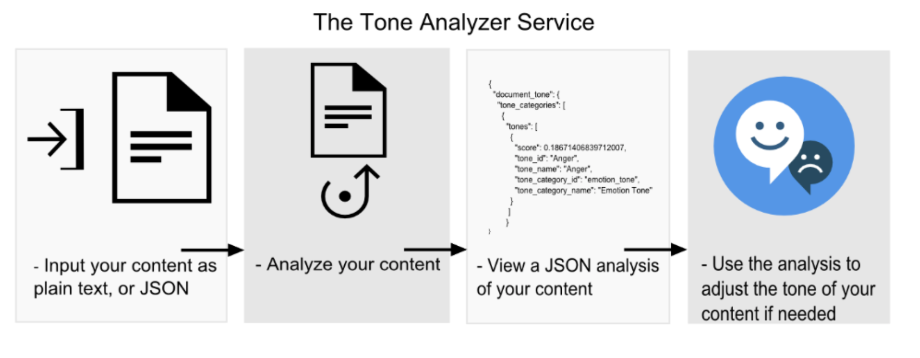

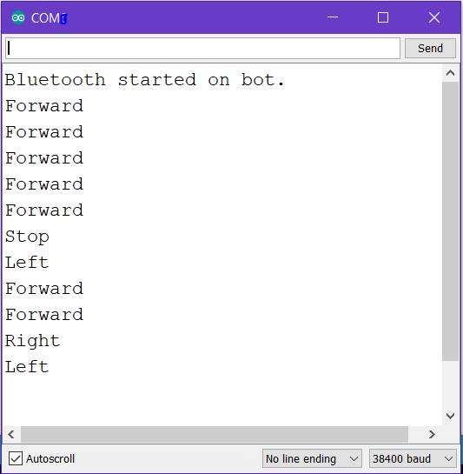

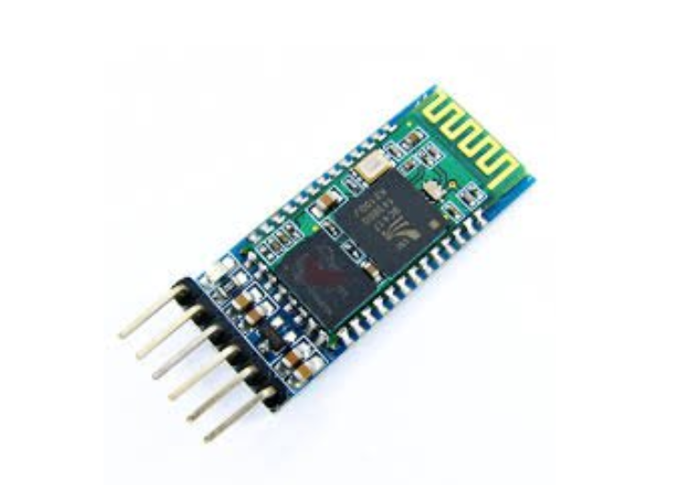
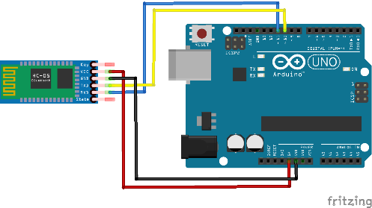
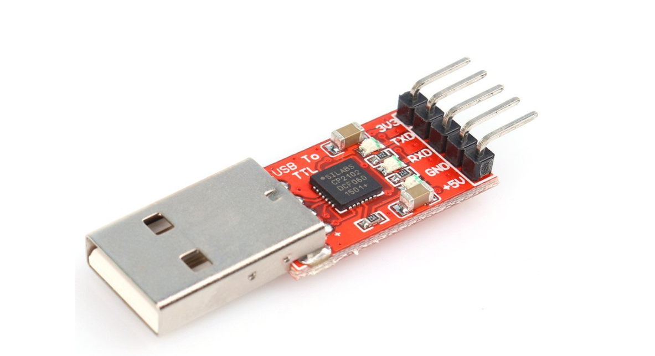
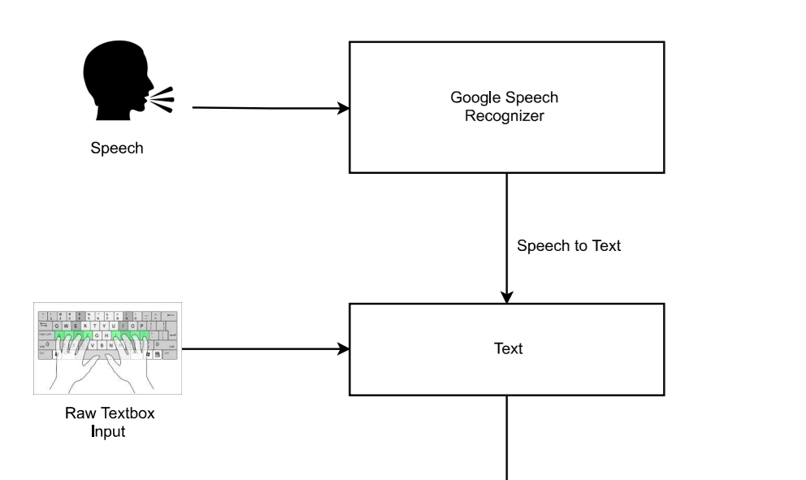
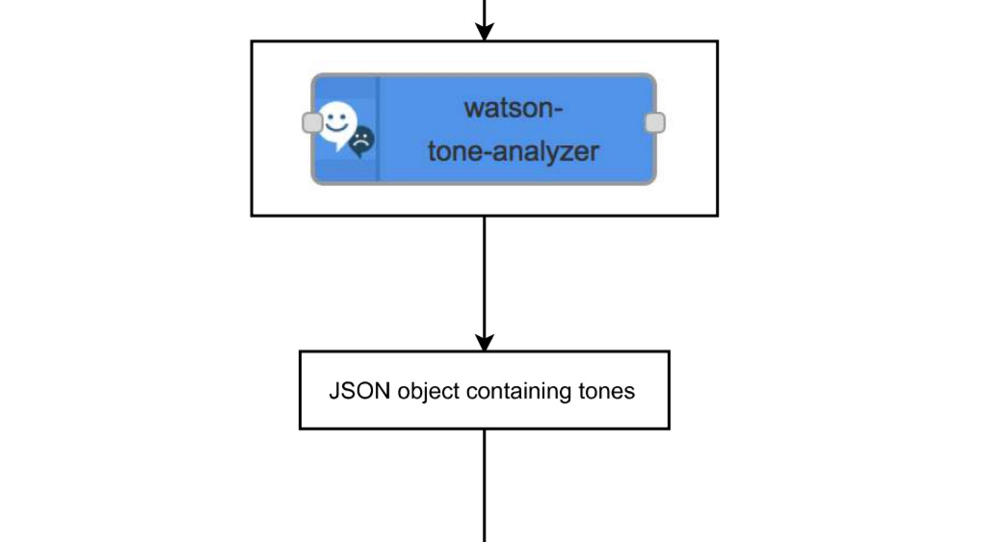
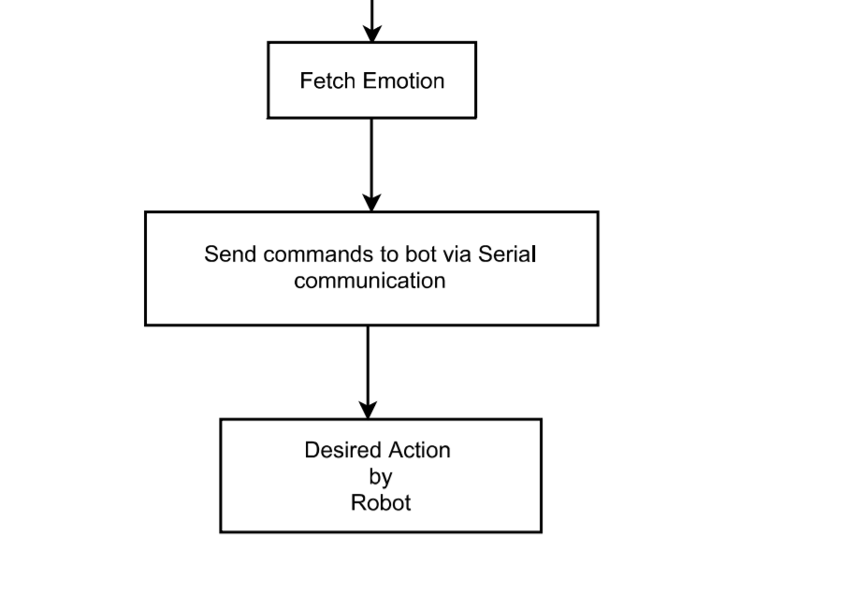

Emotion Controlled Robot using IBM Watson Tone Analyzer
Team Members:
Kaustubh Prabhu
Mexson Fernandes
Dinesh Sharma
Sandeep Singh
Mentors:
Dr. Madhushi Verma
Dr. Arpit Bhardwaj
Project repository:
http://bit.ly/EmotionControlledBot
Abstract
Experimental Results and Discussion
The field of text mining has evolved over the past few years to help analyze the vast amount of textual resources available online. In this project, we are particularly interested in controlling the movement of arduino robot. We, by using Google Speech Recognizer, convert the audio to the text and detect the emotions using IBM Watson Tone Analyzer. This system can be used to control a real robot by sending normal text as the input to Tone Analyzer.
Django web app dashboard :
To record the audio
Converted text from
the audio sample
Module connected to
Port Number 9
Speech to text
Tone Analyzer
Mobile Bot
JSON output from
tone analyzer API
Introduction
Google Speech Recognizer is used to convert speech to text. It is integrated inside the client side of users browser.
Emotion detected
as anger
From table, Anger is mapped to
Right movement.
Pressing the mic button will record the audio and convert it to text. Extracted text is shown in the text area.
Now the text can be fed to IBM Watson tone analyzer to fetch emotions. We can then map the emotions accordingly to control the bot.
front-end output
Arduino serial com port output:
Output when
bot moved forward
Status of
slave HC-05 module
when started
Commands sent to robot are
shown in table.
Table 1.1 Emotion mapping table.
Master module HC-05
Arduino Uno
Emotions | Movement
Fear | Forward
Sad | Backward
Joy | Left
Anger | Right
Others | Stop
Slave module
HC-05
Stop movement
for rest emotions
USB-to-TLL Serial Converter
Right movement
for anger emotion
Proposed Method
Google Speech
Recognizer
front-end part
Left movement
for joy emotion
Baud rate for
Bluetooth communication
Extracting text
for analysis
On the client side
Limitations:-
Google Speech Recognizer for JavaScript works only on Google Chrome browser.
Wave Features of voice are not used. Thus actual emotion might not be found.
Future Scope:-
The project can be linked to a operation by spies.
We can control a robot without any coded language.
We can analyze the wave features of voice for a more accurate answer.
Django Server on
localhost
IBM Watson
Tone Analyzer
API Call
Conclusions
IBM Watson Tone analyzer API is descent text analysis tool for emotion detection. We can analyze the audio wave features for a more accurate emotion detection from voice. End result of our project can be used for various applications like remotely controlling a robot, guiding someone in a confidential area or can be used in secret missions.
Commanding the Robot
based on fetched emotions
References
https://github.com/watson-developer-cloud/python-sdk/
https://tone-analyzer-demo.ng.bluemix.net/
https://shapeshed.com/html5-speech-recognition-api/
Team No. - 15

