Slide 1
DIVE INTO DPLYR: Manipulating & exploring your data
library(dplyr)
rladies_global %>%
filter(city == 'Auckland')

Slide 2

Hello!
Welcome to R-Ladies

Slide 3
1.
Introduction
R language, RStudio, tidyverse

Slide 4
Three things
you’ll need to install
Install R -- this is the open-source programming language we’ll use (download via CRAN -- Comprehensive R Archive Network)
Install RStudio -- this is the most popular IDE for R and will make your life a lot easier (download from rstudio.com/download)
Install dplyr -- this is the package we’ll use within R to work with data. Install with one line of code in R: install.packages(“dplyr”)

Slide 5
What is
the tidyverse?
Collection of R packages based on tidy data principles
Designed to work together
An easier way to code!
AKA “Hadleyverse” (most packages written by Hadley Wickham)
Dplyr is one of the main packages

Slide 6
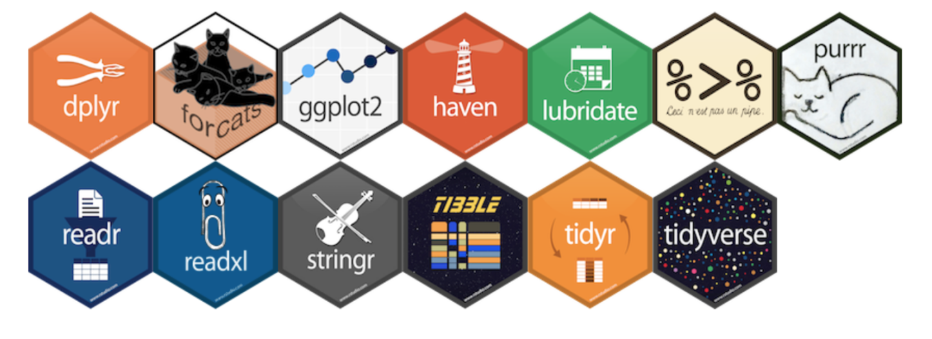
What is
the tidyverse?

Slide 7
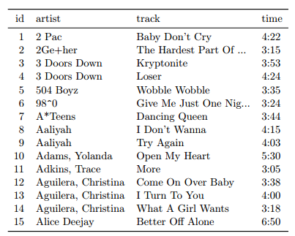
What is
tidy data?
Each variable is a column
Each observation is a row
Each type of observational unit is a table

Slide 8

2.
dplyr
Let’s get started!

Slide 9
What is
dplyr?
Grammar of data manipulation:
select() picks variables (columns) based on their names
arrange() changes the ordering of rows
filter() allows row selection based on given criteria
mutate() creates new variables (columns) from existing ones
summarise() reduces multiple values down to a single summary
group_by() performs any of the above on a group-by-group basis

Slide 10
dplyr
syntax
All calls to dplyr verbs follow the same format: 1. The first argument is a dataframe 2. The subsequent arguments describe what to do to that dataframe, using unquoted variable names.
Each call returns a new dataframe (rather than overwriting the ‘old’ one)
Example: filter(.data = iris, Species == “setosa”)

Slide 11

Quick aside: iris dataset
Included in R (iris to view)
150 observations of 5 variables: Iris type, sepal length + width, and petal length + width

Slide 12
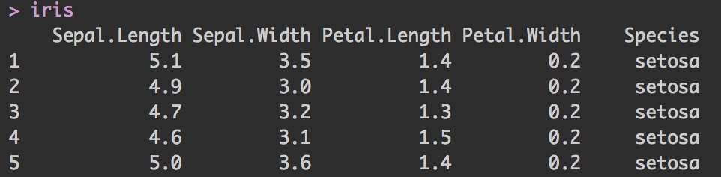
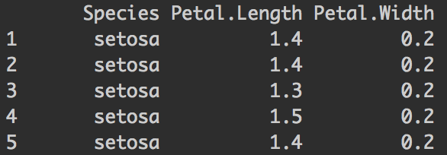
select()
Picks variables (columns) based on their names
First argument is dataframe; subsequent arguments represent columns to select select( .data = iris , Species, Petal.Length, Petal.Width)

Slide 13
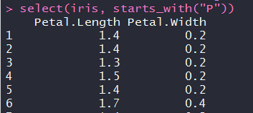
select() +
helper functions
Helper functions you can use within select():
starts_with(“a”) matches names that begin with “a”
ends_with(“z”) matches names that begin with “z”
contains(“lady”) matches names that contain “lady”
matches(<regex>) allows you to do regex matching on names

Slide 14
You do it!
Select the first 3 columns of iris
Select Petal.Width and Petal.Length
Select columns with Sepal in them
Select all columns BUT Species

Slide 15
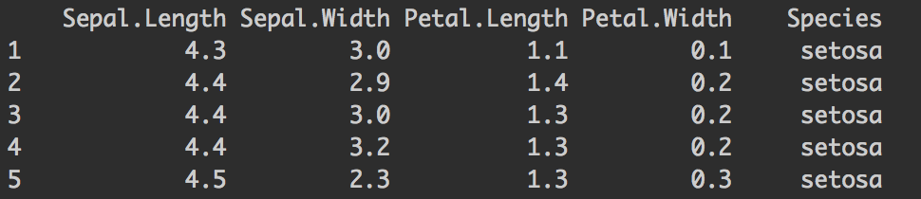
arrange()
Changes the ordering of rows
First argument is the dataframe, subsequent arguments are columns and/or expressions used to re-arrange the dataframe
Note: default is ascending order, and NA’s are always at the end arrange( .data = iris, Sepal.Length, Sepal.Width)

Slide 16
You do it!
Sort iris by column Petal.Width
Sort by Petal.Width descending
Sort by Petal.Width and then Petal.Length

Slide 17
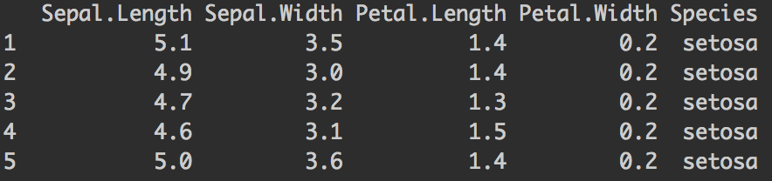
filter()
Allows pointed row selection based on given criteria
First argument is the dataframe, subsequent arguments are logical expressions used to filter the dataframe filter( .data = iris, Species == “setosa”)
nrow = 150 nrow = 50

Slide 18
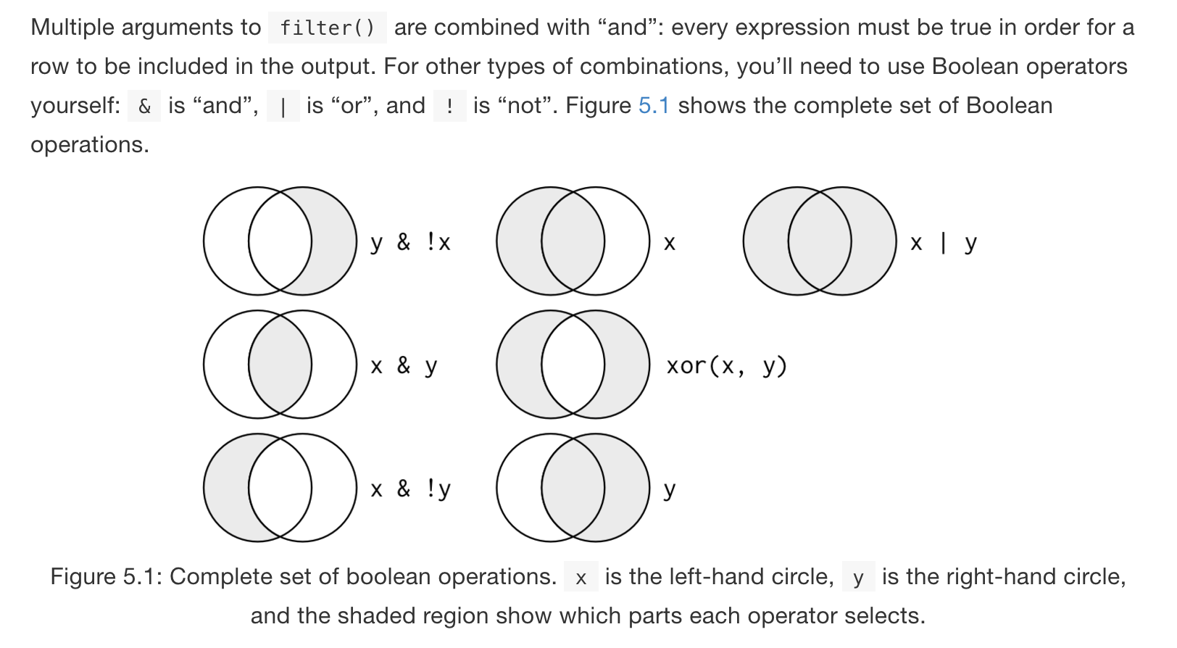
filter() + booleans
Notes:
Image from R4DS.

Slide 19
You do it!
Find the rows where Petal.Width > 1
Find the rows where Petal.Width > 1 and Species is versicolor
Find the rows where Species is not setosa

Slide 20

3.
magrittr
What?!?

Slide 21

What is
magrittr?
Simplifying R code with pipes (%>%)
Easy way to pass data through functions without nesting
First argument of each function is “piped” in to reduce redundancy
f(x) is the same as x %>% f()
f(x, y) is the same as x %>% f(y)
https://en.wikipedia.org/wiki/The_Treachery_of_Images

Slide 22


dplyr + magrittr
example
Before
After

Slide 23
You do it!
Find the rows where Petal.Width > 1 and select the first 3 variables
Select the columns that contain Petal and sort by Petal.Width and then only the first 6 rows
Find the rows for Species setosa and order rows by descending Sepal.Width
Select the rows where Petal.Width > 1 and view in the panel
Find the unique values of Petal.Width for the setosa Species

Slide 24
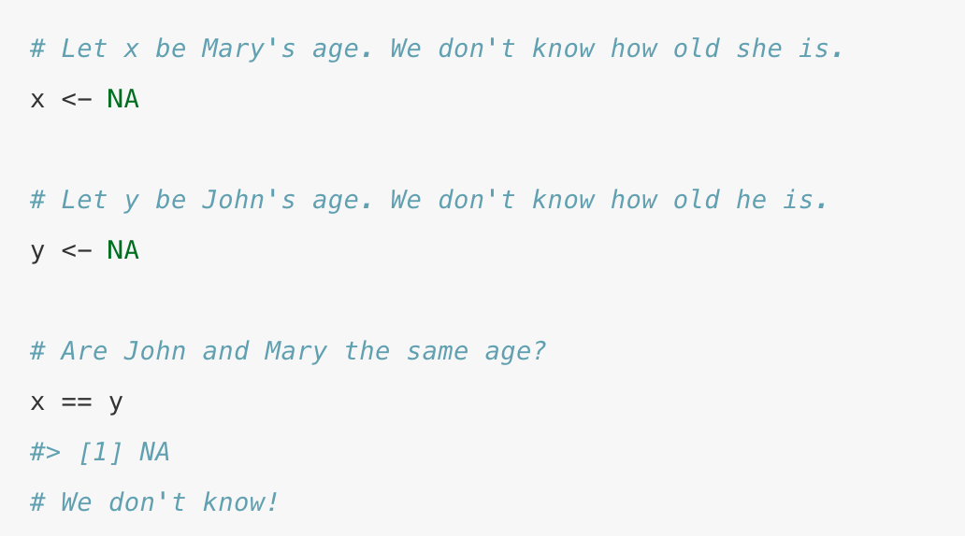
Quick aside: Missing values
NA represents a missing (unknown) value
Comparisons involve unknown values typically result in unknown values
To see whether a value is missing, use is.na()
filter() only includes rows where the condition is true (not false or NA)
Notes:
Image from R4DS.

Slide 25
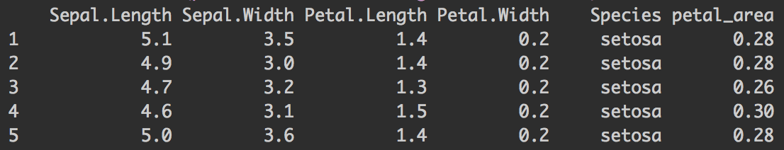
mutate()
Creates new variables (columns) from existing ones
Note: columns created with mutate() are always added to end of dataset iris %>% mutate( petal_area = Petal.Length * Petal.Width)

Slide 26
mutate() Useful functions
Arithmetic operators (+, -, *, /, ^)
Log functions (like log10())
Offsets like lead() and lag()
Logical comparisons (<, <=, >, >=, !=)
ifelse statements (if this, then this, else this)
Or when more than 1 logical split then use case_when
Cumulative and rolling aggregates
Ranking (like ntile())

Slide 27
You do it!
Create a new column with a flag showing Petal.Width > Petal.Length
Create a new column with Petal.Width + Sepal.Length
Create a new column with the mean of Sepal.Length and then another new column with a flag stating if each row’s Sepal.Length is greater than the mean
Create a new column with Sepal.Length buckets (use cut)
Create a new column stating Low when Petal.Width < 0.2, Medium when Petal.Width is between 0.2 and 0.6 and High when Petal.width > 0.6 (use case_when)

Slide 28
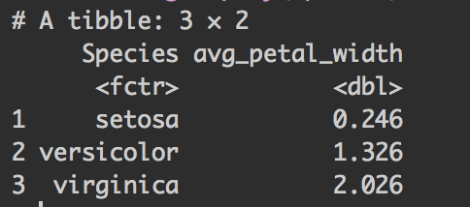
group_by() and summarise()
group_by applies dplyr verbs by group
summarise reduces multiple values down to a single summary iris %>% group_by(Species) %>% summarise(avg_petal_width = mean(Petal.Width))

Slide 29
summarise()
Useful functions
Counts (n(), n_distinct())
Measures of location (mean(), median())
Measures of spread (sd(), IQR())
Measures of position (first(), last())

Slide 30
You do it!
Find the mean of the Petal.Length and the sd of Petal.Width
Create a new column with the mean of Sepal.Length per species
Create a table with the mean Sepal.Length per species
Find how many observations there are for each species and Petal.Length combination

Slide 31
Tips &
Tricks
If you don’t have the result of a dplyr chain to a dataframe, it will print
Include arguments for inner functions like na.rm = TRUE
rename() is a cool function to clean up messy column names
slice() will give you rows by row number
After grouping with group_by(), you can ungroup() to remove groupings
There is a cheat sheet for data wrangling!
If you want to print and save, wrap assignment in parenthesis
Example: (iris_names <- iris %>% filter(Species == “setosa”))

Slide 32
4.
Scoped verbs
More dplyr goodness . . .

Slide 33
Scoped Verbs
Terminology: we have been using “single table verbs”
Now we can affect multiple variables simultaneously with the scoped verbs
Three extensions
_if pick variables based on a predicate function like is.numeric()
_at pick variables using the same syntax as select().
_all operates on all variables

Slide 34

summarise_all()
Scoped verbs
apply the function to all variables
summarise_all( .tbl, function)
Multiple functions summarise_all( .tbl, funs(f1, f2))
Combine functions: summarise_all( .tbl, ~f1(f2(.)))

Slide 35
You do it!
Find the mean of the first 4 variables
Find the mean and min of the first 4 variables
Find how many unique observations there are for each of the variables

Slide 36

summarise_at()
Scoped verbs
apply the function to variables using their names like select
summarise_at( .tbl, vars(...), function)

Slide 37
You do it!
Find the mean of the first 4 variables
Find the mean and min of the variables with Petal in their names

Slide 38

summarise_if()
Scoped verbs
apply the function to variables using logical conditions based on some property of the column
summarise_if( .tbl, condition, function)

Slide 39
You do it!
Find the sd of the numerical variables
Find the number of unique observations of all the categorical variables

Slide 40
mutate & filter
My frequent examples
mutate_if( .tbl, is.character, as.factor)
filter_all() used with all_vars() or any_vars()
filter_all(data, any_vars(is.na(.)))

Slide 41
You do it!
Turn numerical variables into characters
Round the Petal variable to 0dp
Find the rows of the airquality dataset where there is at least 1 NA value

Slide 42
5.
Wrap-up
Announcements, upcoming events, etc.

Slide 43
R-Ladies Auckland
Upcoming Events
Lessons and highlights from the rOpenSci project [Feb 20]
useR! [Brizzie Jul 10-13]
Looking for presenters!

Slide 44
BIG THANKS TO
R-Ladies Austin
https://github.com/rladiesaustin/R4DS_workshop_series
Hadley Wickham vignettes and Stanford material
https://dcl-2017-04.github.io/curriculum/manip-scoped.html

