Slide 1

Datathon
Climate Change

Slide 2


Team
Techionista
Brenda Loznik
Meyke van den Bos

Slide 3

Climate Change Challenge

Slide 4
Climate Change Challenge
Building Characteristics
Residential / Commercial
Facility type (e.g. Warehouse_non_refrigerated, Lodging_hotel)
State number
Floor area
Year built
Climate & Weather
January min temp
Heating Degree Days
Snowfall inches
Days with fog

Slide 5
Our Approach
Step 1
EDA
Missing data
Bias between train and test
Zero variance features
Highly correlated features

Slide 6
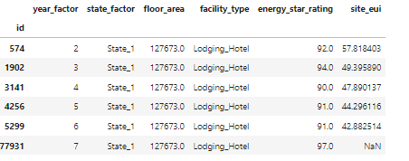
Our Approach
Step 1
EDA
Building ID
Step 2
Data Cleaning
Missing data
Bias between train and test
Zero variance features
Highly correlated features

Slide 7
Our Approach
Step 1
EDA
Building ID
Step 2
Data Cleaning
Step 3
Missing data
Bias between train and test
Zero variance features
Highly correlated features
Feature Engineering
Create a Base Model

Slide 8
Our Approach
Step 4
Feature Selection
E.g. VIF (variance inflation factor)

Slide 9
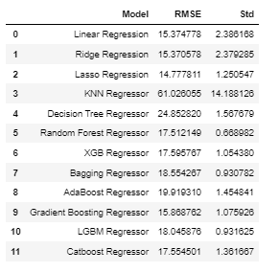
Our Approach
Step 4
Step 5
Feature Selection
Modelling
E.g. VIF (variance inflation factor)

Slide 10
Take Aways
We had a lot of fun and learned many new things
We used Miro and Google spreadsheets to align
Taking the time for EDA and feature engineering pays off
If we had even more time (and energy)
Spend even more time on feature engineering
Train different models on different parts of the data

Slide 11
https://github.com/BrendaLoznik https://github.com/MeykeBos

