Slide 1

SRI CHANDRASEKHARENDRA SARASWATHI VISWA MAHAVIDHYALAYA
(Deemed to be university u/s 3 of UGC act 1956) (Accredited with “A” by NAAC) Enathur, Kanchipuram – 631561. Tamilnadu www.kanchiuniv.ac.in
DEPARTMENT OF COMPUTER SCIENCE AND ENGINEERING
Cloud Computing
Cloud Architecture
Presented by:
GHIRIDHARAN s – 11229A013
MEYRINA D – 11229A026
Vibhu shreesh h s - 11229a050

Slide 2
What is Cloud Architecture
Cloud architecture refers to the design and structure of computing systems that are built using cloud computing technologies.
It defines how various components and services like storage, servers, databases, networking, security, and applications interact and work together in a cloud environment, such as AWS, Azure, or Google Cloud.
It's essentially the blueprint for building a cloud environment and ensures resources are scalable, performant, and seamlessly integrated.

Slide 3
Project Scope & Objectives
Host a reliable and scalable web application
Ensure secure communication and failover readiness
Monitor performance and manage resources effectively

Slide 4
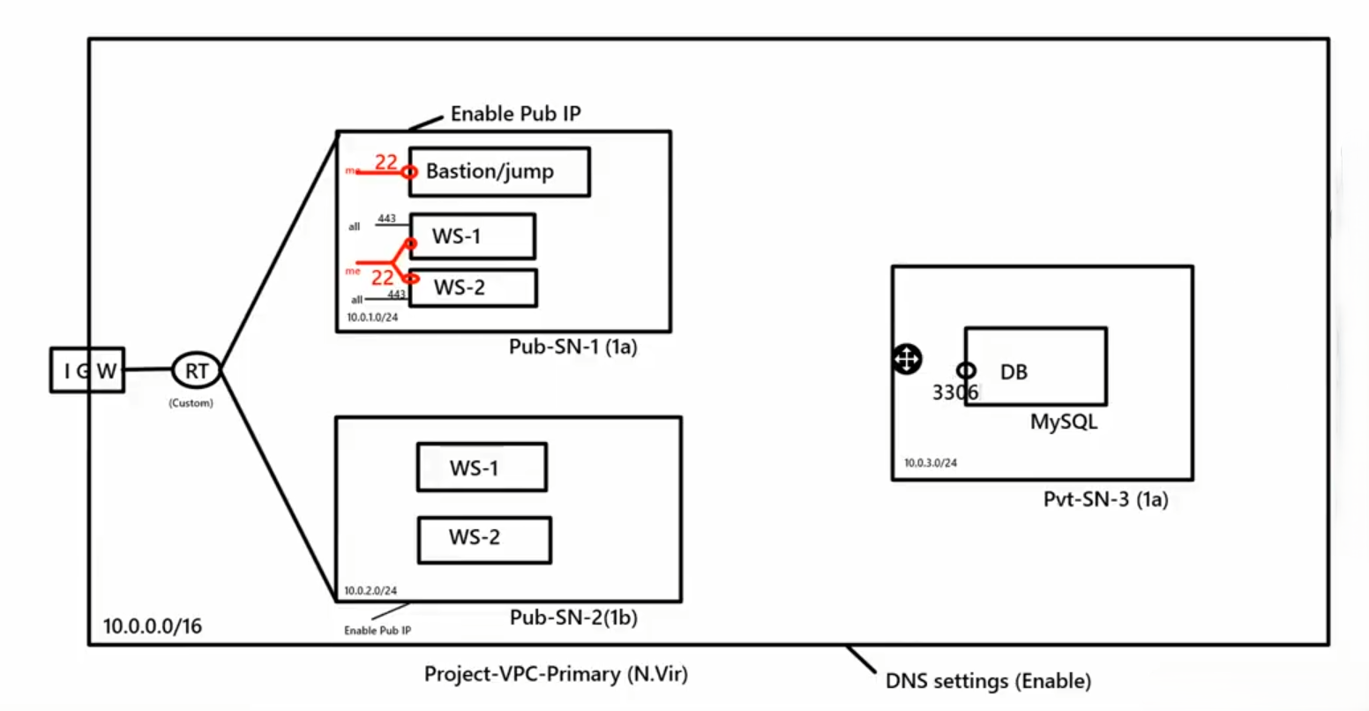
VPC - Public & Private Subnets

Slide 5
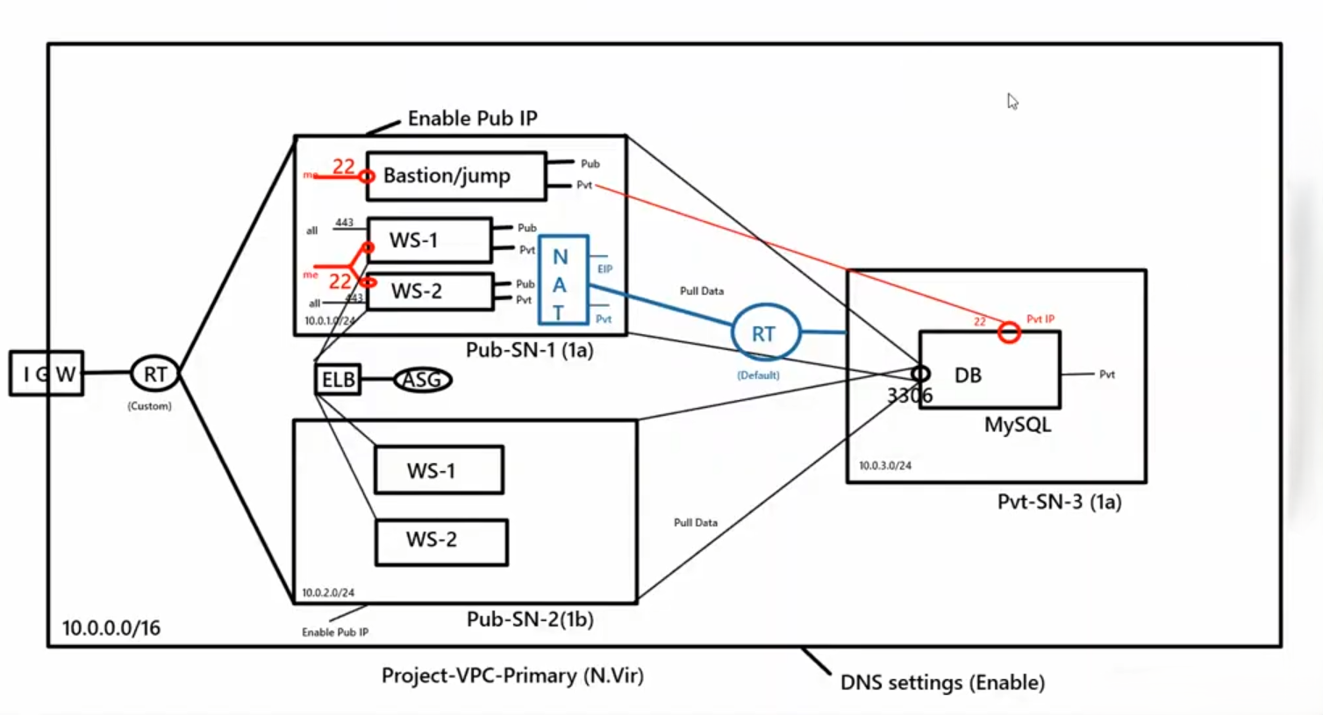
Gateways

Slide 6
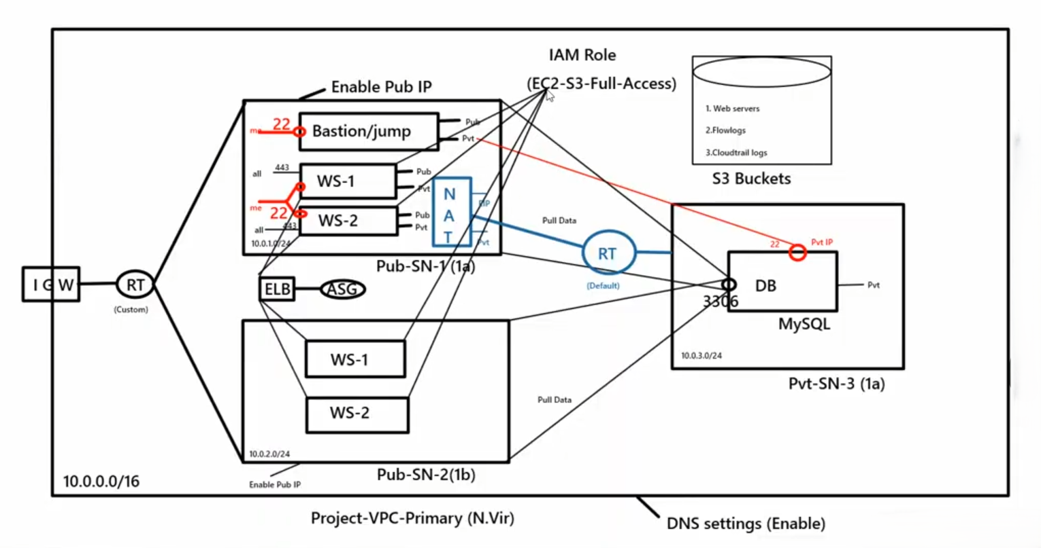
IAM & S3 Buckets

Slide 7
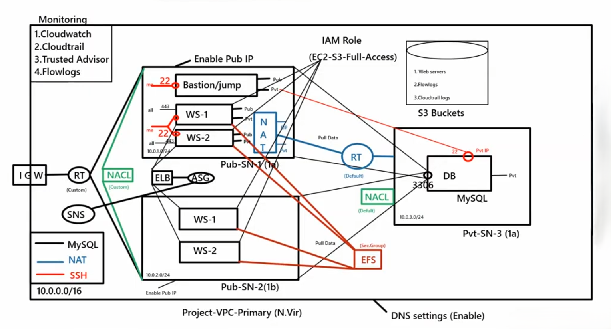
EFS & NACL

Slide 8
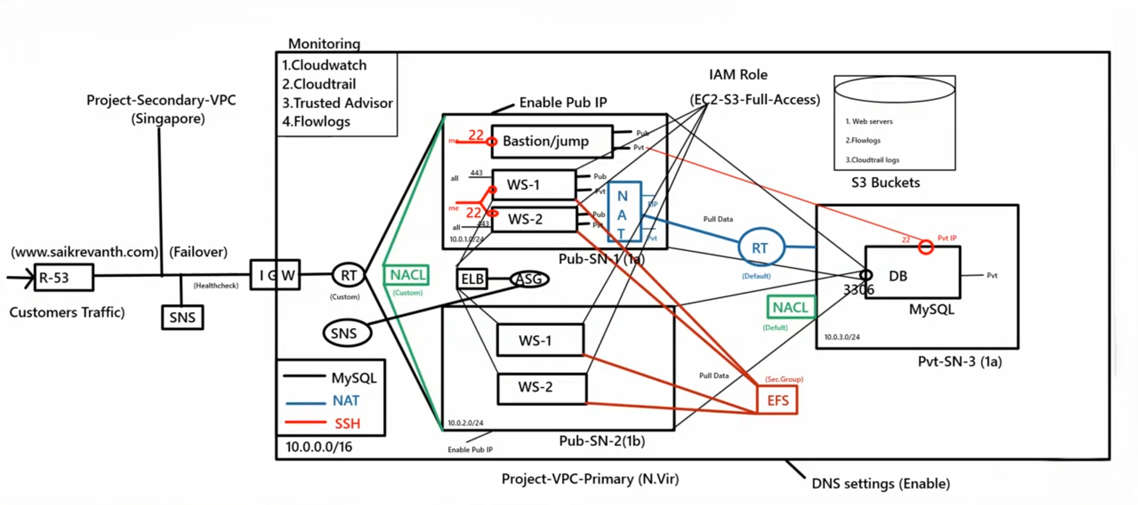
End - To - End Infrastructure

Slide 9
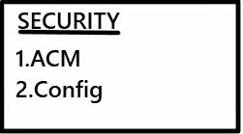
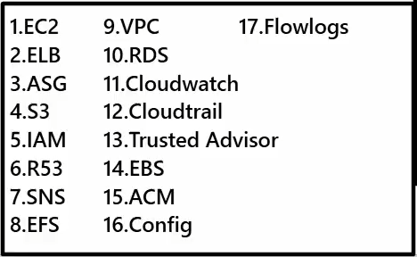
Security and Components

Slide 10
Conclusion
This architecture ensures secure, scalable, and highly available cloud infrastructure by separating public and private subnets with Bastion, NAT, and load balancers.
It supports centralized logging, monitoring, and alerting via CloudWatch, S3, and SNS for better visibility and management.
The setup enhances data security with private MySQL access, IAM roles, and shared EFS storage across instances.

Slide 11
Thank You

