Slide 1
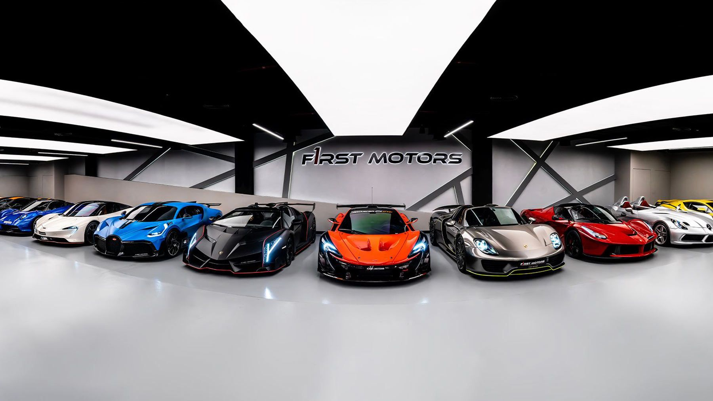
Explore Data Analysis Car sale
Presentor By: Senghour Mey

Slide 2
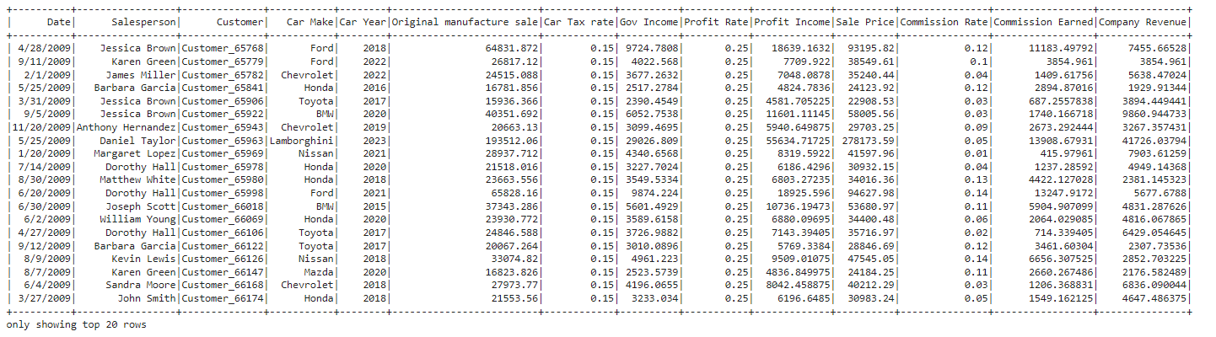
Intro. Dataset of Sale car
The sale car dataset has parameter such as: Date,Salesperson, Customer,Car Make, Car Year, Original manufacture sale, Car Tax rate, Gov Income, Profit Rate,Profit Income,Sale Price, Commission Rate, Commission Earned, Company Revenue.

Slide 3
Intro. Dataset of Sale car
The Unique Customers has 12375.
The Uniques Salesperson has 30.
The Unique Car type has 10 cars.
Gov Tax Rate: 15%
Profit Rate after Tax: 25%
Commission rate from 0.01 to 0.15. Avg commission rate: 0.08

Slide 4
Formula of car sale
Original Car price
The product from manufacturers sale price to final sale are difference. In this dataset was shown that
Gov Tax 15%
Formula Example:
Original car price: 10000$
Gov Tax(15%): 10000 x 0.15 = 1500$
Price car after tax = 10000 + 1500 = 11500$
Company rate(25%) = 11500 x 0.25 = 2875$
Final sale price = 11500 + 2875 = 14375$
Commission rate(ex: 5%) = 14375 x 0.05 = 719$
Company Revenue = 14375 - 10000 - 719 = 3656$
Company 25%
Final sale price
Exclude commission
Company Revenue

Slide 5
Objective
We aim to conduct investigate about the sale car data from 2005 to 2023.
Revenue Company for each year
Number of sale car for each year
Find on the year has increase & drop revenue
How many years to reach the target sale (2800 car/year)

Slide 6
Find # of sold car as Average Year, Month, Day
The average of number of sold car from 2005 to 2023 has:
Average Year: 651 car
Average Month: 54 car
Average Day: 3 car
Average Company Revenue: 8.7M $

Slide 7
Find salesperson
Q: who sale a lot of car?
A: The salesperson who sold the most cars is David Williams with 455 cars sold.
Q: who earn a lot of commission?
A: The salesperson who earned the highest commission is Michael Jones with a total commission of 2482300.68$.
Q: Who earn a lot of company revenue?
A: The salesperson who is highest company revenue is John Smith with a total revenue of 6450990.67$.

Slide 8
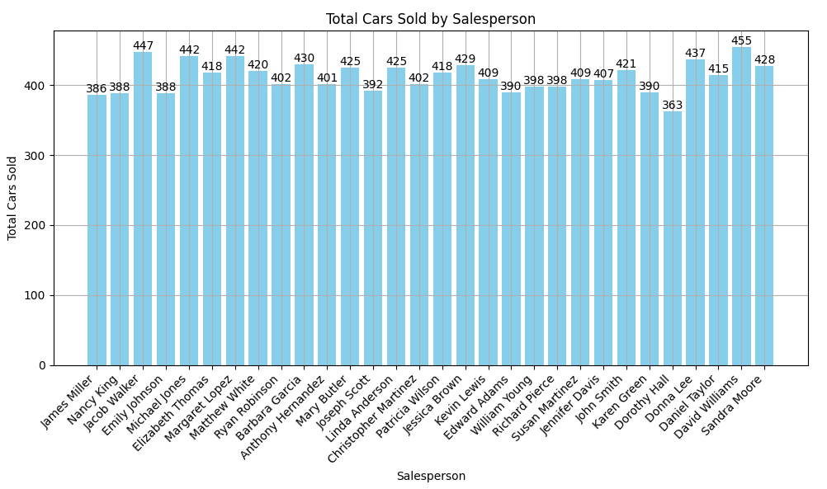
Find salesperson in highest car sale
The uniques salesperson has 30 people. And David Williams with 455 cars sold

Slide 9
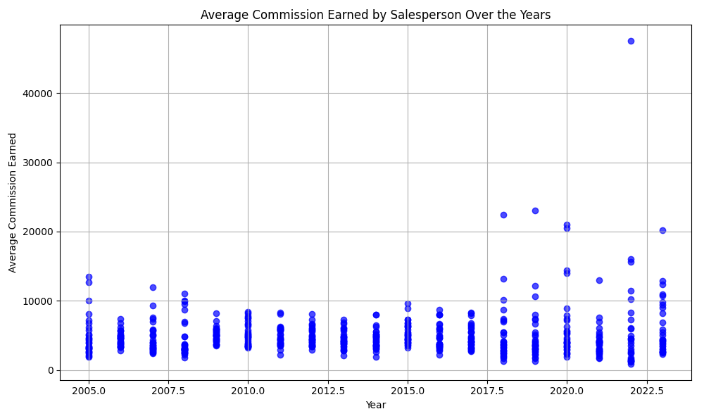
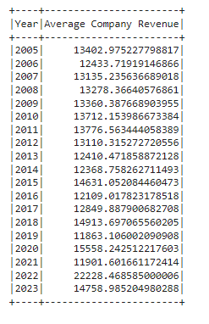
Average Commission Earned
The Average: 13779$

Slide 10
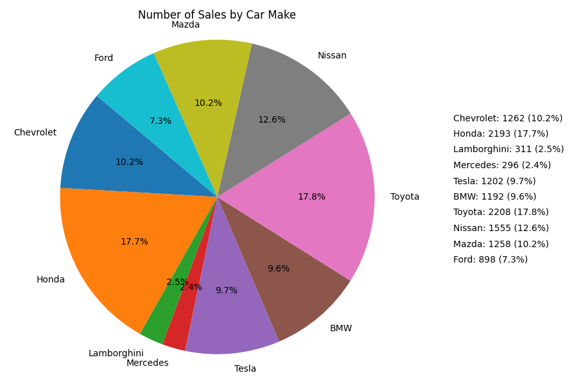
Number of sale and Car type

Slide 11
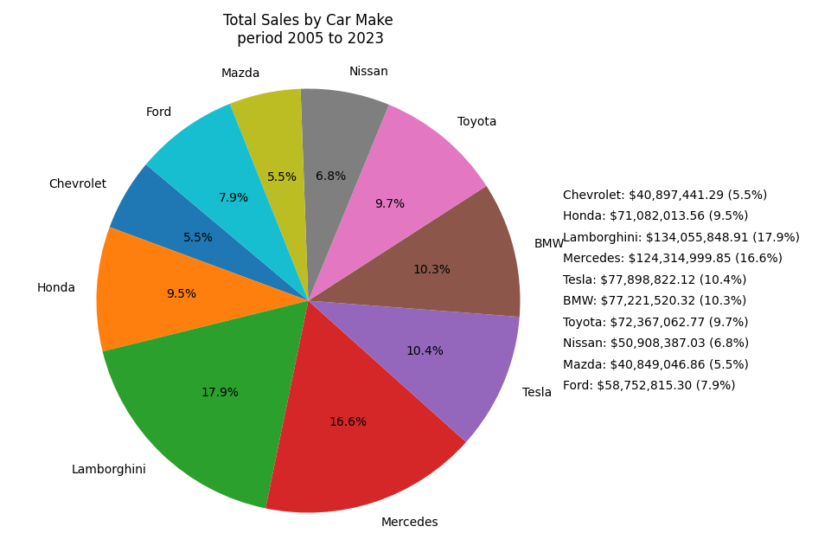
Total Sales and Car type

Slide 12
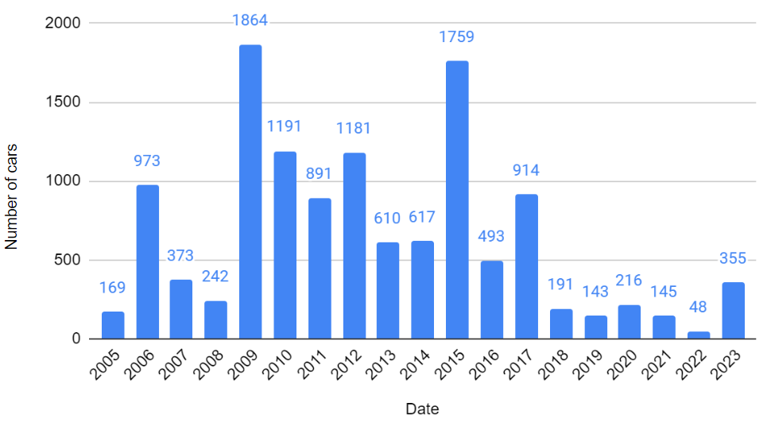
Number of sale car for each year

Slide 13
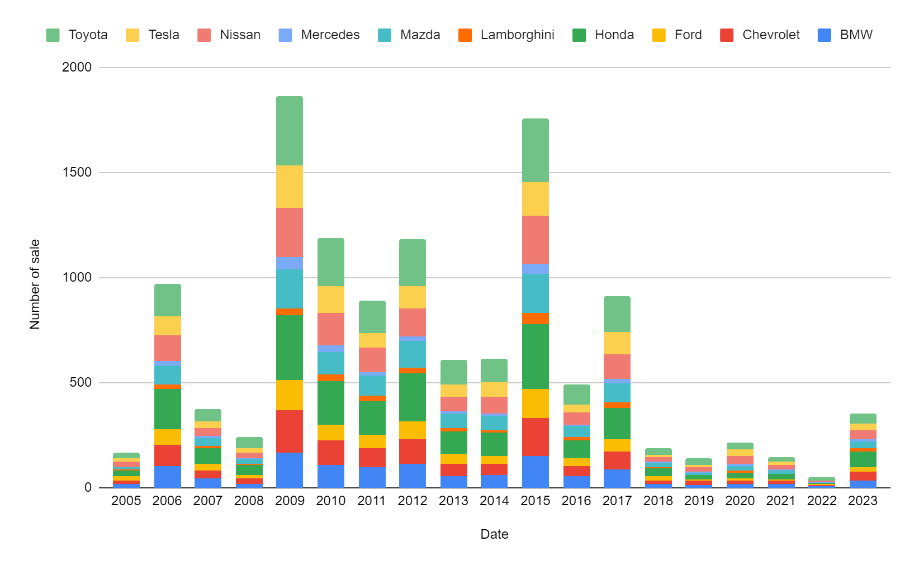
Number of sale car for each year

Slide 14
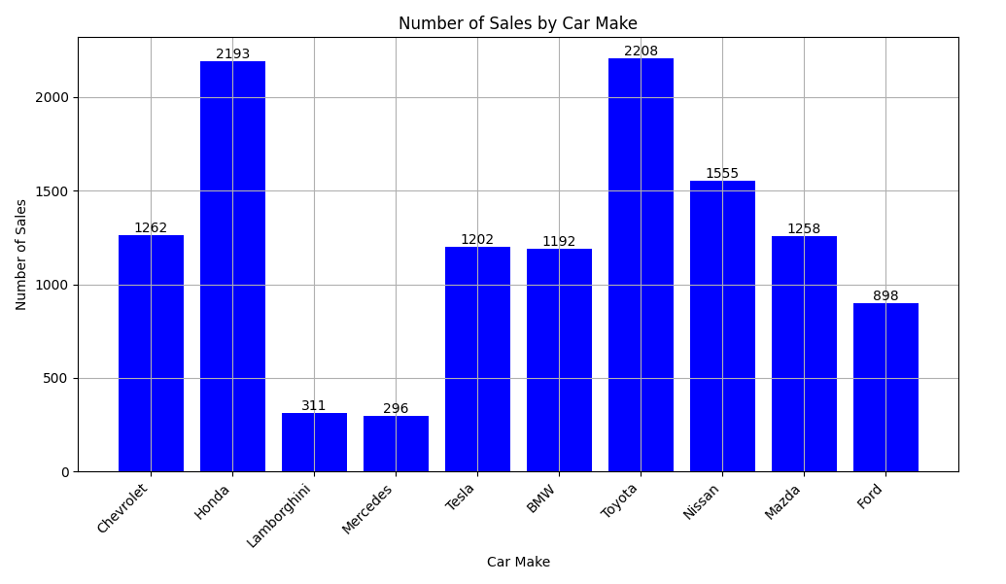
Number of sale car for each year

Slide 15
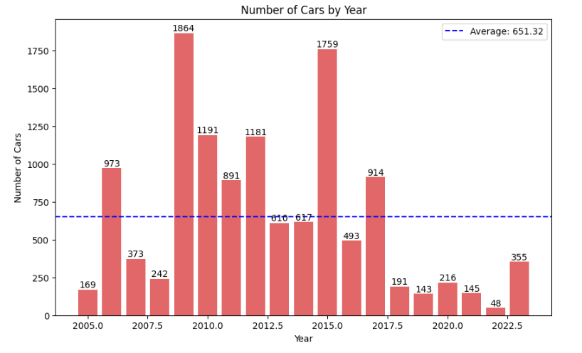
Number of car for each year

Slide 16
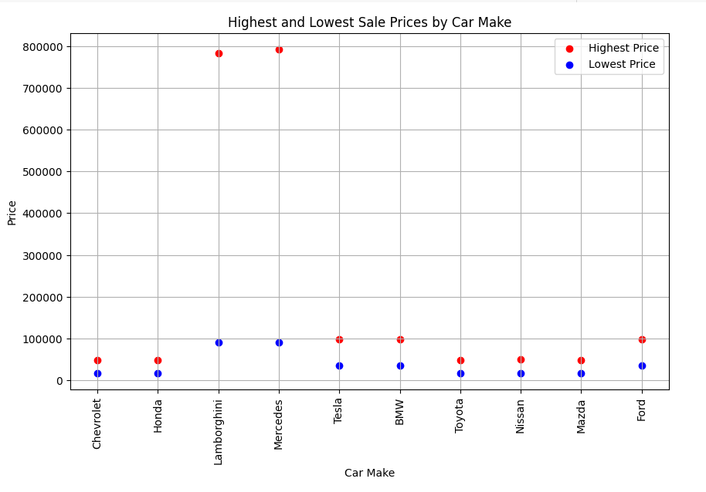
Find sale prices by car Make

Slide 17
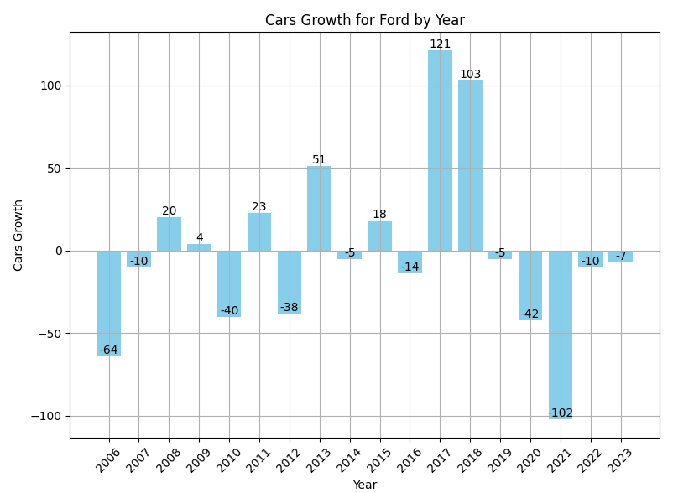
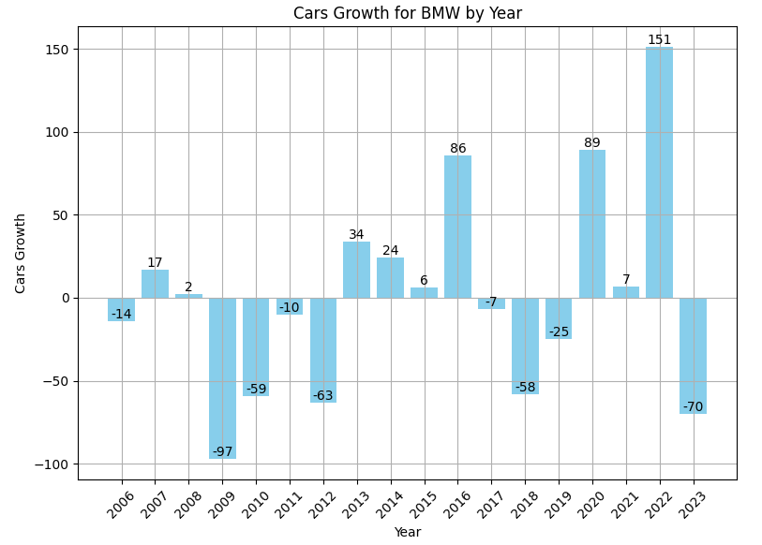
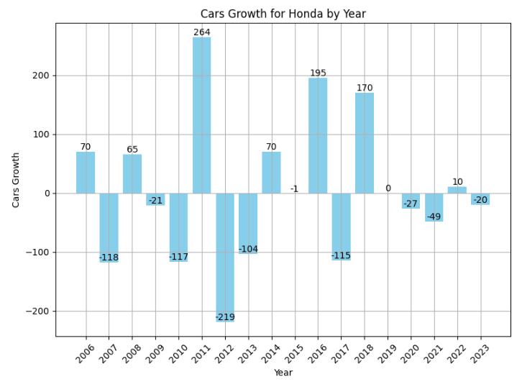
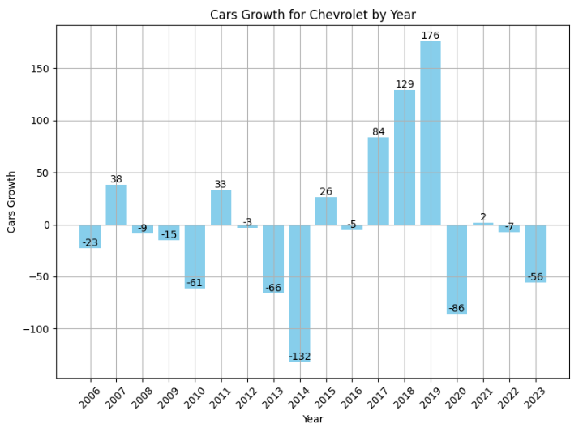
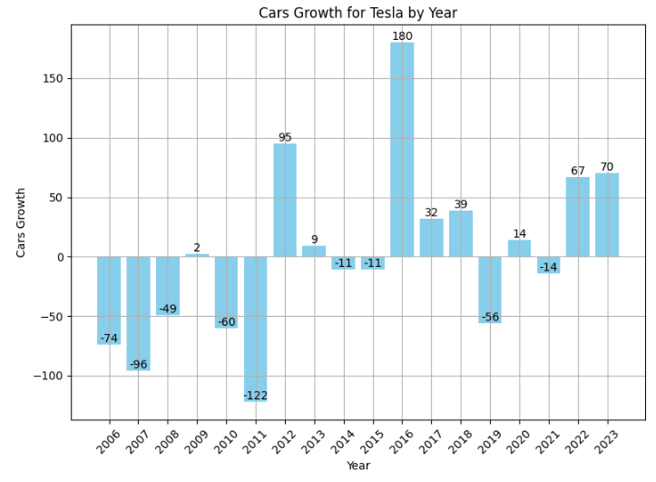
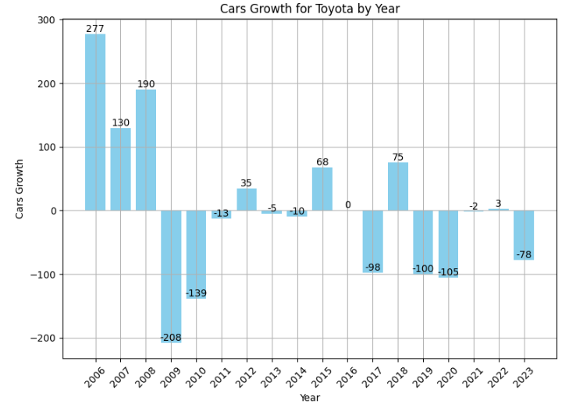
Find the number of growth for each Car Make

Slide 18
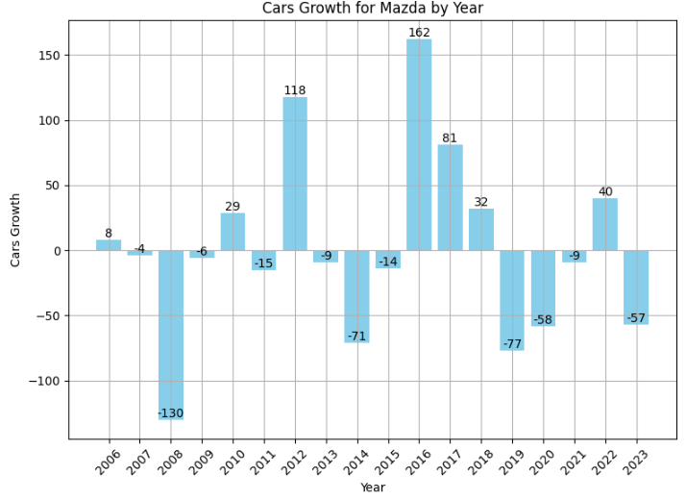
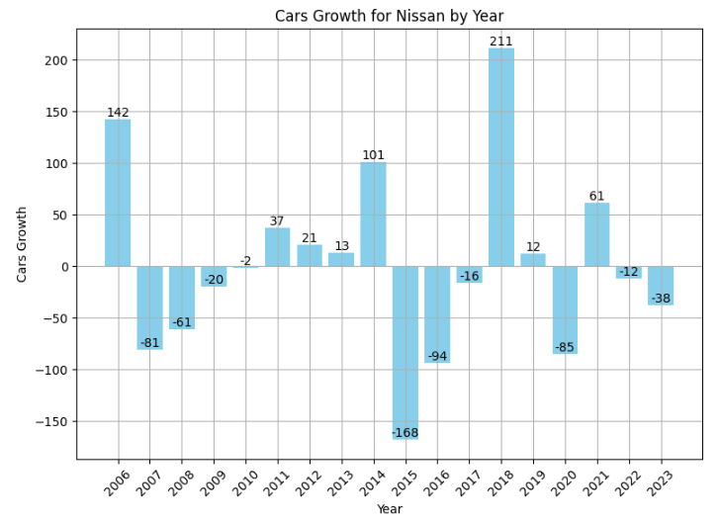
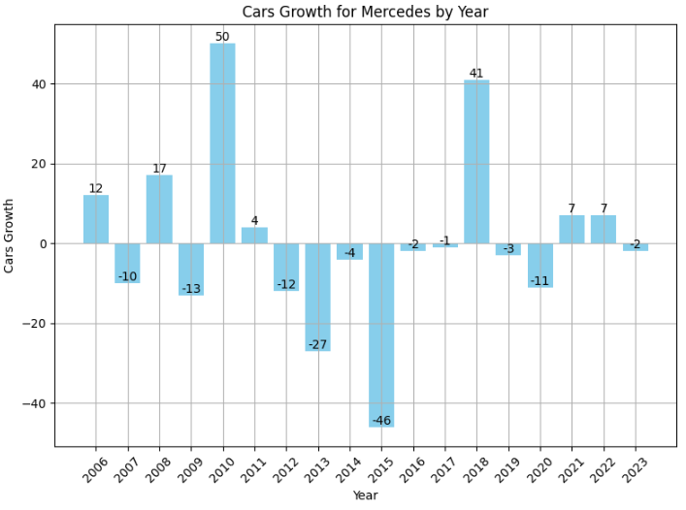
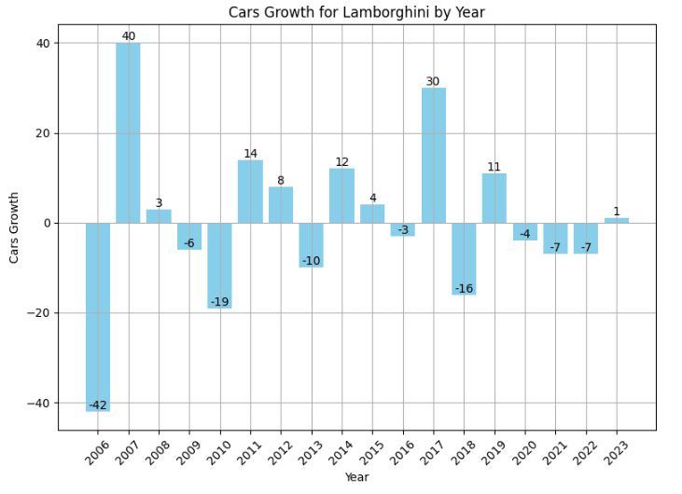

Slide 19
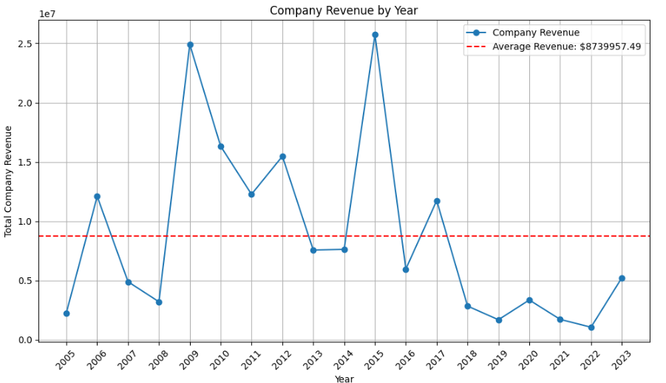
Revenue Company for each year

Slide 20
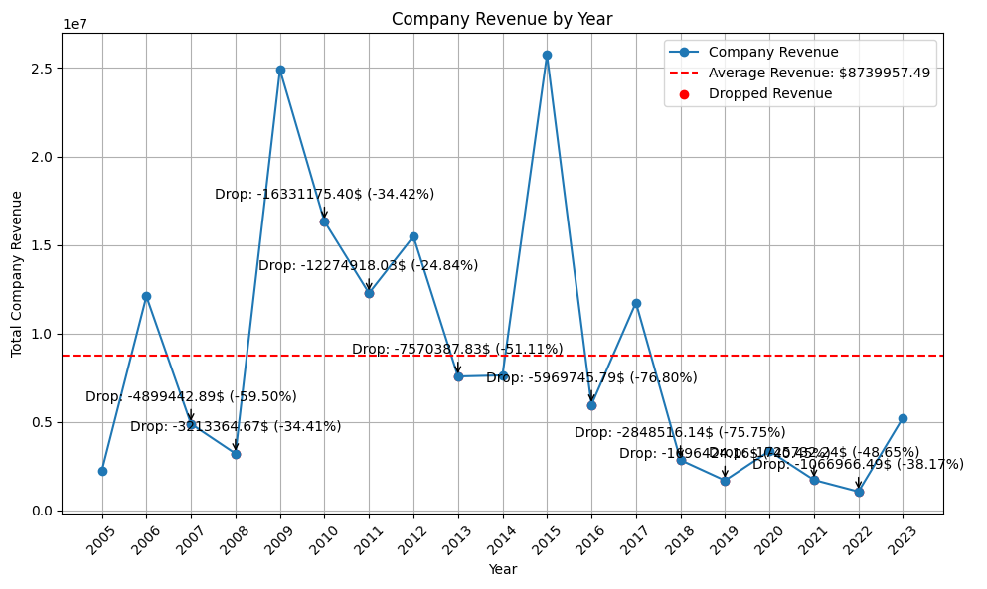
Find the year has drop revenue

Slide 21
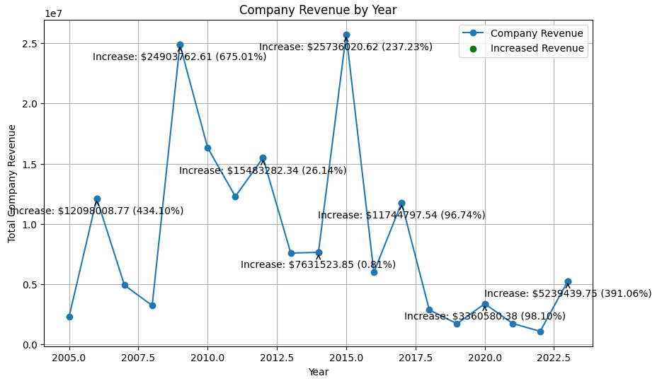
Find the year has increase revenue

Slide 22
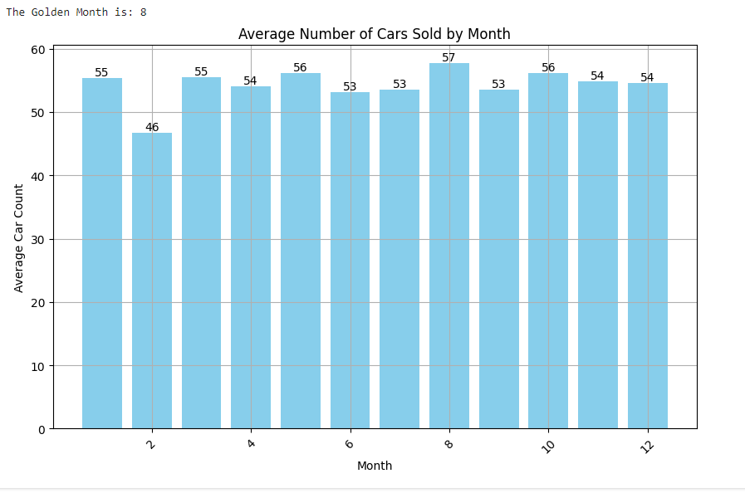
Find Golden Month
The Highest cars sold Month is August

Slide 23
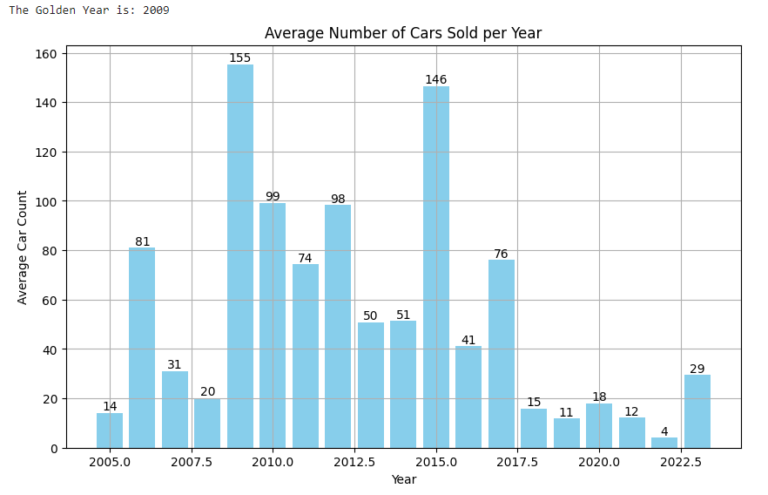
Find Golden Year
The highest cars sold Year is: 2009

Slide 24
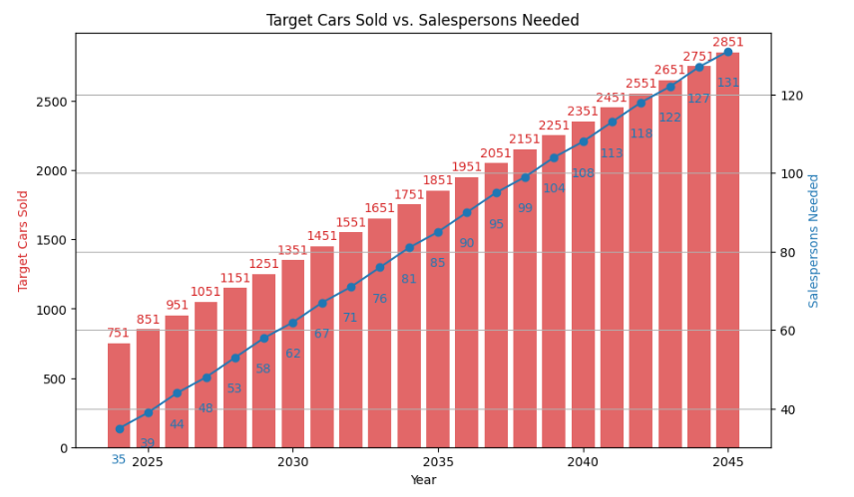
Predict target sale per year
Currently, we have average sold out car 651 per year with salesperson 30 people.
Recommandation to recruit to increase salesperson from 30 to 131 to reach sale car 2851

Slide 25
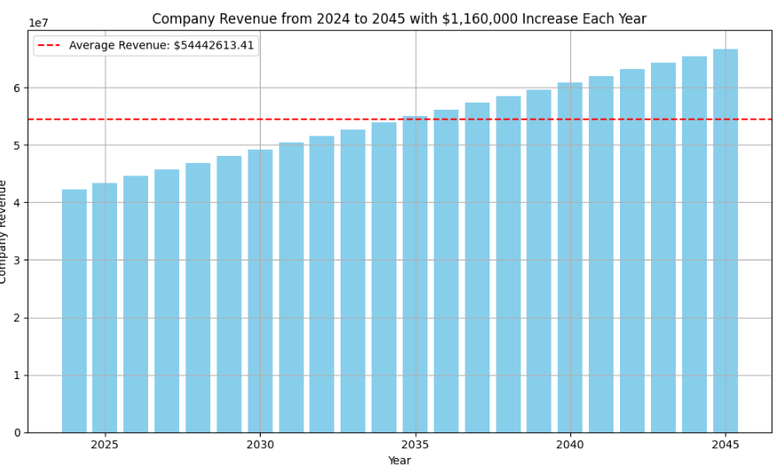
Predict Company Revenue 2024 to 2045
Revenue Growth rate 15.3% (1.1M) every year from 2024 to 2045

Slide 26
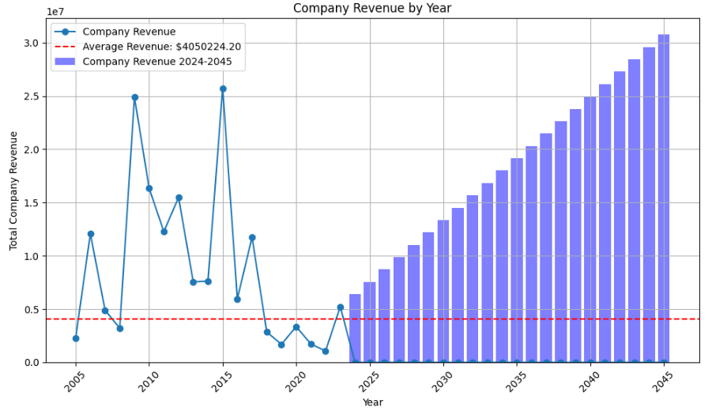
Predict Company Revenue in Big picture

Slide 27
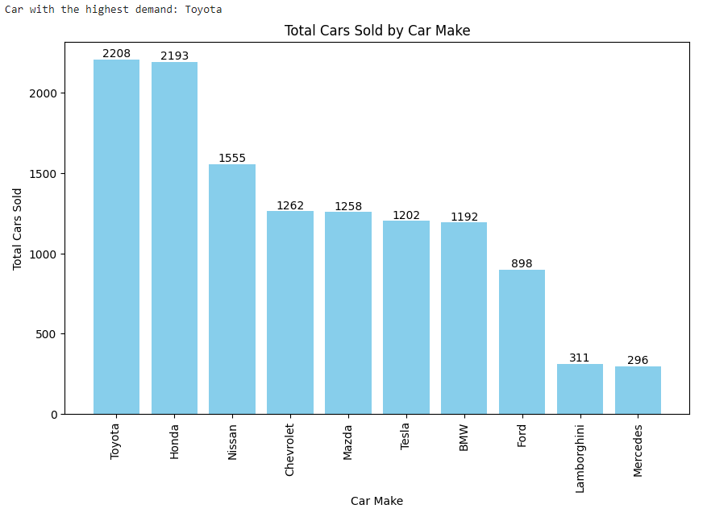
Recommandation best seller
Car with highest Demand is Toyota

Slide 28
Conclusion
Increase Toyota inventory to meet demand.
Maintain target sales of 2,831 cars annually.
Expand sales team reach to 131 members for better service.
Launch marketing campaigns with accessories and 3-year warranty, including lucky draw incentives.
Expand with new branches for wider market reach.
Implement balanced commission structure in 8% for salespersons to drive performance and profitability.

Slide 29
Reference
https://www.kaggle.com/datasets/suraj520/car-sales-data

Slide 30


