Slide 1
The Sequoia Project
High Level Design

Slide 2

The Objective: Review of All Dependencies

Slide 3
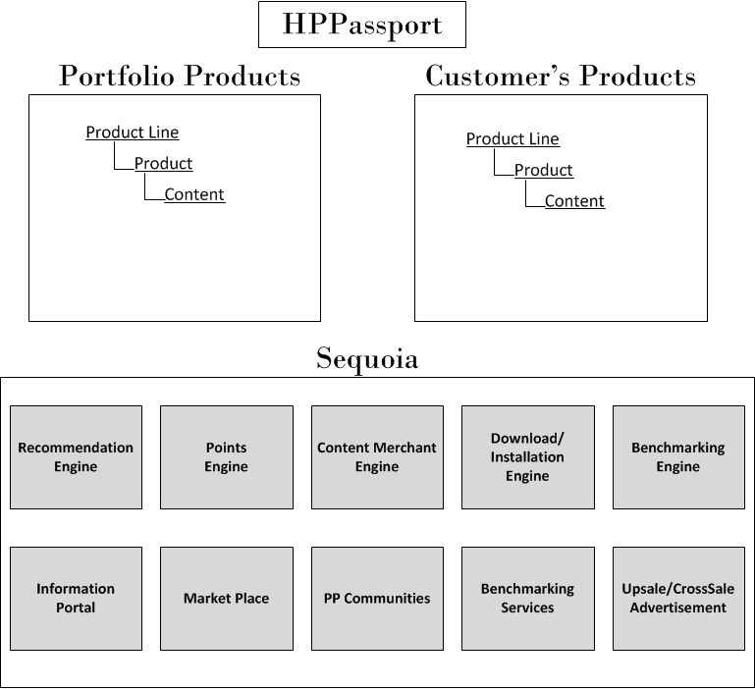
Component Overview

Slide 4
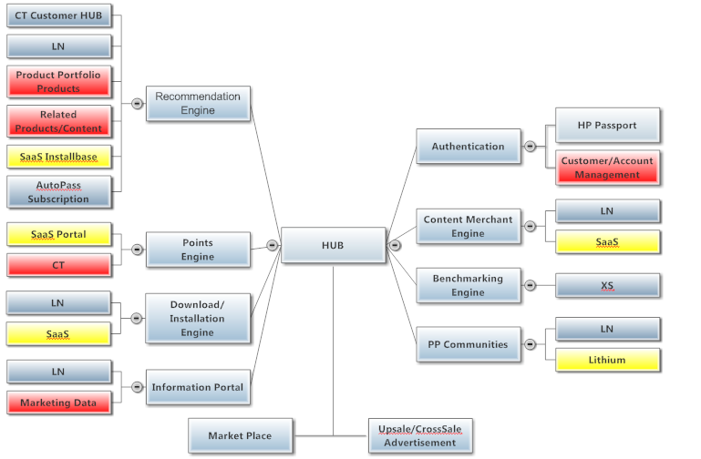
Dependencies

Slide 5
Next Steps
SaaS Group:
Installbase: what was installed for each customer
Portal: points management
Subscription management
Installation
Find source for:
Portfolio Products management
Related Products
Customer/Accounts management
Detailed design for each dependency

