Slide 1
Deblur Images via ADMM
Xiyao Shi, Zexuan Zhong, Zongyi Wang

Slide 2
Intuition
Now cellphones deblur images and get depth of images via dual camera (i.e. Iphone)
We try to recover depth of image via multiple shots of the same scene with different focus length.

Slide 3
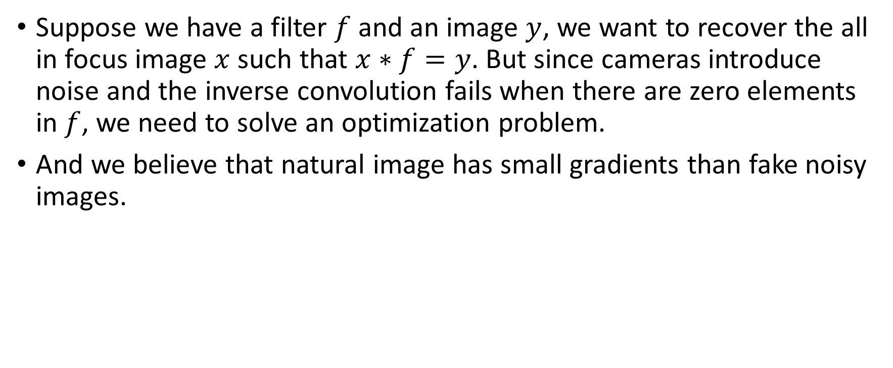
Image with Gaussian prior [Image and Depth from a Conventional Camera with a Coded Aperture Anat Levin Rob Fergus Fredo ´ Durand William T. Freeman]
Suppose we have a filter $f$ and an image $y$, we want to recover the all in focus image $x$ such that $x∗f=y$. But since cameras introduce noise and the inverse convolution fails when there are zero elements in $f$, we need to solve an optimization problem.
And we believe that natural image has small gradients than fake noisy images.

Slide 4
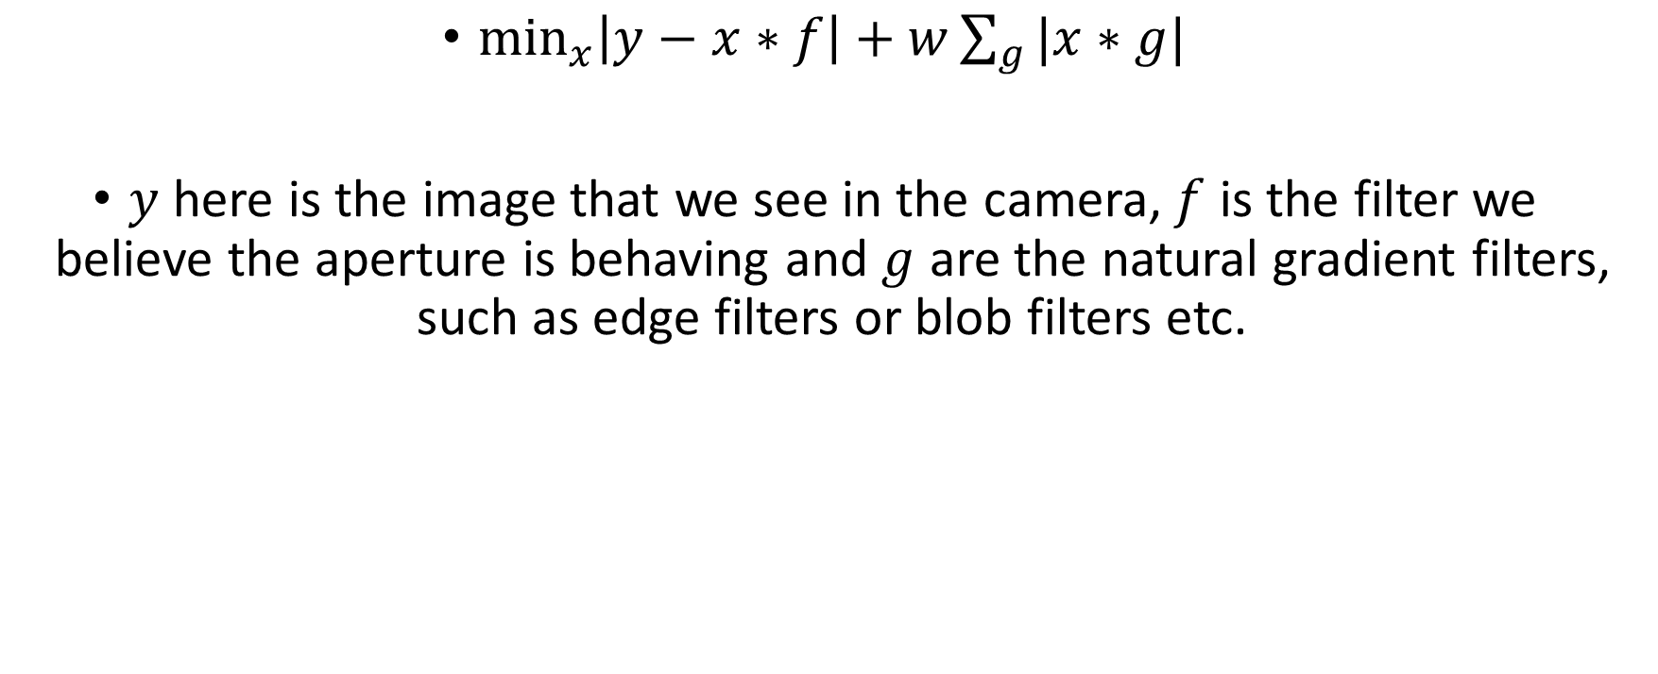
Formulation for a single image
$\min_{x}\left|y−x∗f\right|+w\sum_{g}{|x∗g|}$
$y$ here is the image that we see in the camera, $f$ is the filter we believe the aperture is behaving and $g$ are the natural gradient filters, such as edge filters or blob filters etc.

Slide 5
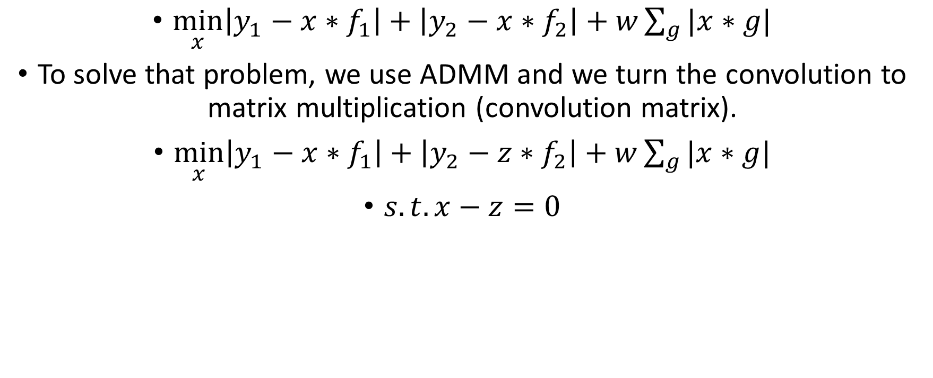
Formulation for two images
$\min_{x}\left|y_{1}−x∗f_{1}\right|+\left|y_{2}−x∗f_{2}\right|+w\sum_{g}{|x∗g|}$
To solve that problem, we use ADMM and we turn the convolution to matrix multiplication (convolution matrix).
$\min_{x}\left|y_{1}−x∗f_{1}\right|+\left|y_{2}−z∗f_{2}\right|+w\sum_{g}{|x∗g|}$
$s.t. x−z=0$

Slide 6
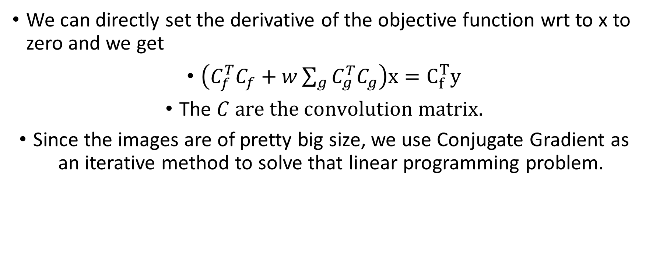
Math for singe image
We can directly set the derivative of the objective function wrt to x to zero and we get
$\left(C_{f}^{T}C_{f}+w\sum_{g}{C_{g}^{T}C_{g}}\right)x=C_{f}^{T}y$
The $C are the convolution matrix.$
Since the images are of pretty big size, we use Conjugate Gradient as an iterative method to solve that linear programming problem.

Slide 7
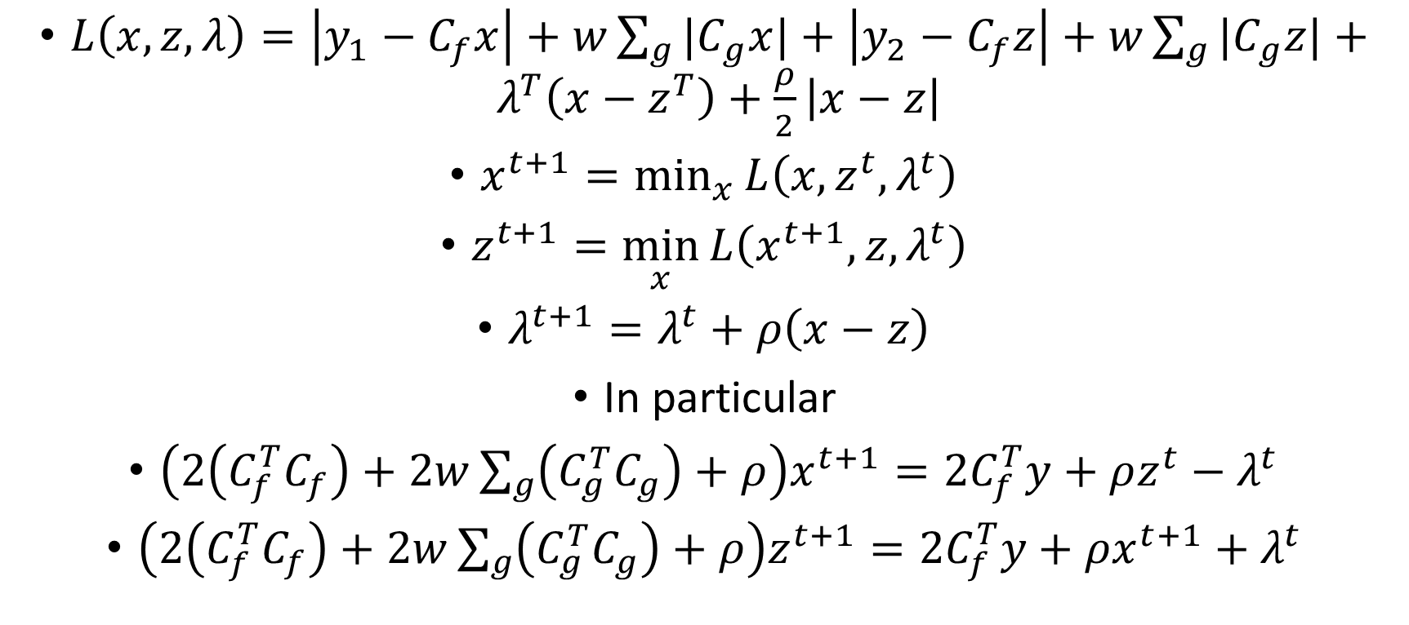
Math for multiple images
$L\left(x,z,λ\right)=\left|y_{1}−C_{f}x\right|+w\sum_{g}{{|C}_{g}x|}+\left|y_{2}−C_{f}z\right|+w\sum_{g}{{|C}_{g}z|}+λ^{T}\left(x−z^{T}\right)+\frac{ρ}{2}\left|x−z\right|$
$x^{t+1}=\min_{x}{L\left(x,z^{t},λ^{t}\right)}$
$z^{t+1}=\min_{x}{L\left(x^{t+1},z,λ^{t}\right)}$
$λ^{t+1}=λ^{t}+ρ\left(x−z\right)$
In particular
$\left(2\left(C_{f}^{T}C_{f}\right)+2w\sum_{g}{\left(C_{g}^{T}C_{g}\right)}+ρ\right)x^{t+1}=2C_{f}^{T}y+ρz^{t}−λ^{t}$
$\left(2\left(C_{f}^{T}C_{f}\right)+2w\sum_{g}{\left(C_{g}^{T}C_{g}\right)}+ρ\right)z^{t+1}=2C_{f}^{T}y+ρx^{t+1}+λ^{t}$

Slide 8



Slide 9



Slide 10


Slide 11

Analysis
Hard to align photos together since adjusting the focus length results in slightly change of alignment.
We can initialize $ρ$ small and quickly grow larger.
Somehow large dual residual though the result looks plausible.

