Slide 1
MySQL vs PostgreSQL vs SQL SERVER : A comparison between 3 popular relational database management systems
In this Presentation, i first introduce MySQL, PostgreSQL, and SQL SERVER, Then i explain their pros and cons and i compare them and indicate when one should use them.

Slide 2
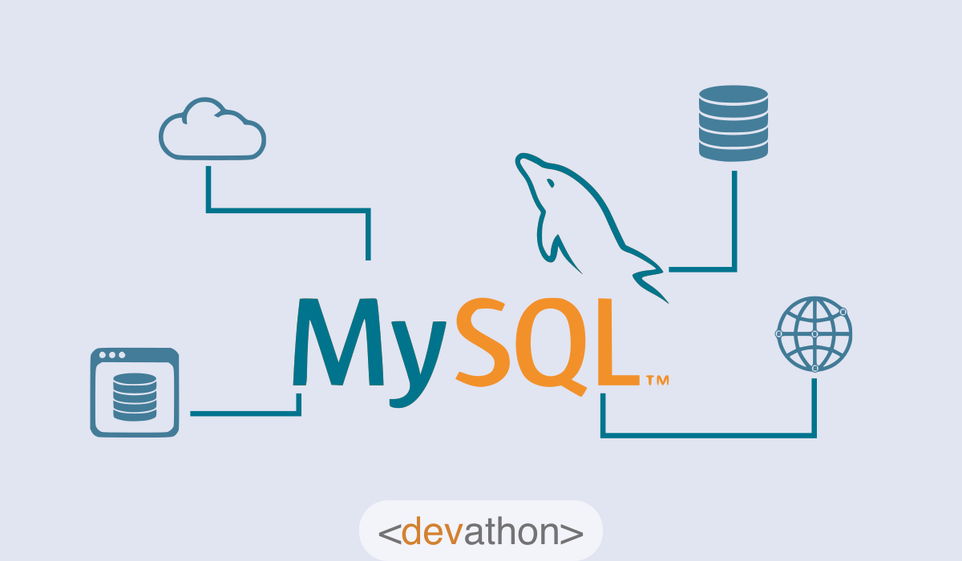
MySQL: An overview
MySQL
occupies a prominent place among open-source RDBMSs. Many prominent companies use it since MySQL offers several key advantages

Slide 3
Key features of MySQL
As an RDBMS, MySQL is based on SQL. The key features of MySQL are as follows:
The creators of this RDBMS used C and C++ to create MySQL.
MySQL uses a client-server architecture.
This RDBMS works with a wide range of operating systems like Windows, Linux, Unix, OS/2, FreeBSD, etc.
You can install and run MySQL on all key platforms.

Slide 4
Pros and cons of MySQL :
Apart from being an open-source and free RDBMS, MySQL offers the following advantages:
The ease of installation: On all key operating systems, you can download and install MySQL easily.
Lightweight: MySQL doesn’t consume too much computing resources since it’s lightweight.
Tooling support: Data modelers and DBAs can use a wide range of tools for creating and modeling databases. You can access easy-to-use tools for development, import, export, etc. Architects, DBAs, and developers can use “MySQL Workbench”, a very helpful GUI tool.
Compatibility: As we already mentioned, MySQL supports all key operating systems/platforms.
The ease of use: Developers need SQL skills to use MySQL. Most developers have this skill, and they can easily use this RDBMS.

Slide 5
BUT also
Security: MySQL employs a robust security layer. Its other features like encrypted passwords, etc. ensure that your sensitive data is safe. You can take advantage of the “Dual Password” feature in MySQL Server 8.0 onwards. This feature includes a current password, furthermore, it allows a secondary password.
Performance: Multiple benchmarking exercises have consistently confirmed that MySQL offers very good speed. The storage engine architecture delivers cost advantages, furthermore, it loads fast. MySQL supports partitioning, which improves the performance of a large database.
Scalability: MySQL supports multi-threading, which makes it a highly scalable RDBMS.
Availability: MySQL offers excellent availability.
High productivity: A versatile RDBMS, MySQL uses stored procedures, triggers, views, etc., which delivers high productivity to developers.
Efficiency: This popular RDBMS allows the commit and rollback of transactions. MySQL supports recovery from crashes. This RDBMS experiences very little memory leakage, which makes it more efficient.
Support: MySQL has a large and vibrant developer community to support it. Oracle provides considerable support to it too.
MySQL has a few disadvantages too, which are as follows:

Slide 6
Limitations vis-a-vis embedding in an application: You can install MySQL as a server database, however, you can’t embed it easily in a portable application. You need to use complex tools for this.
Business logic-related limitations: MySQL can support simple-to-medium complexity business logic very well. However, it’s not the best database for implementing complex business logic.
Stability issues: Using MySQL sometimes results in a few stability issues. This can cause issues with handling transactions. You might also experience the corruption of data.
The dependency on add-ons: You can support complex functionalities using MySQL, however, this has a heavy dependency on add-ons.
Limitations concerning tools when compared to paid databases: While MySQL provides good tooling support, paid databases to provide better tools. This RDBMS doesn’t support SQL check constraints.
MySQL isn’t very efficient when handling large databases.
MySQL versions prior to 5.0 don’t support commits and stored procedures.

Slide 7
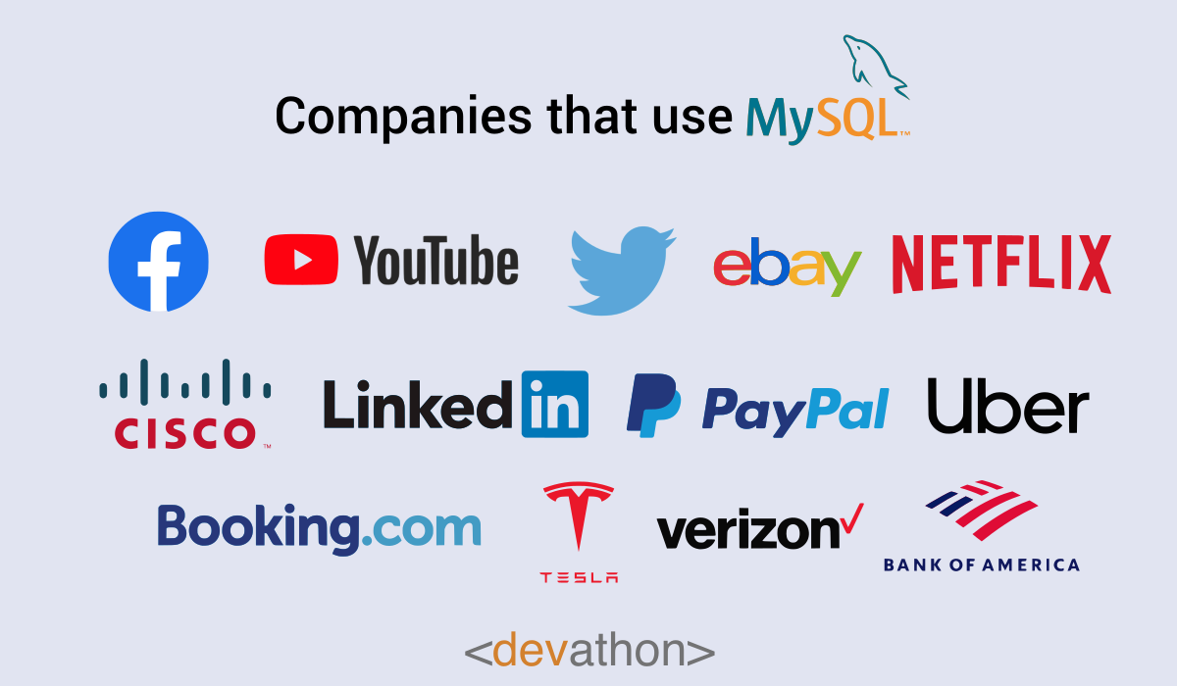
What is MySQL used for :

Slide 8
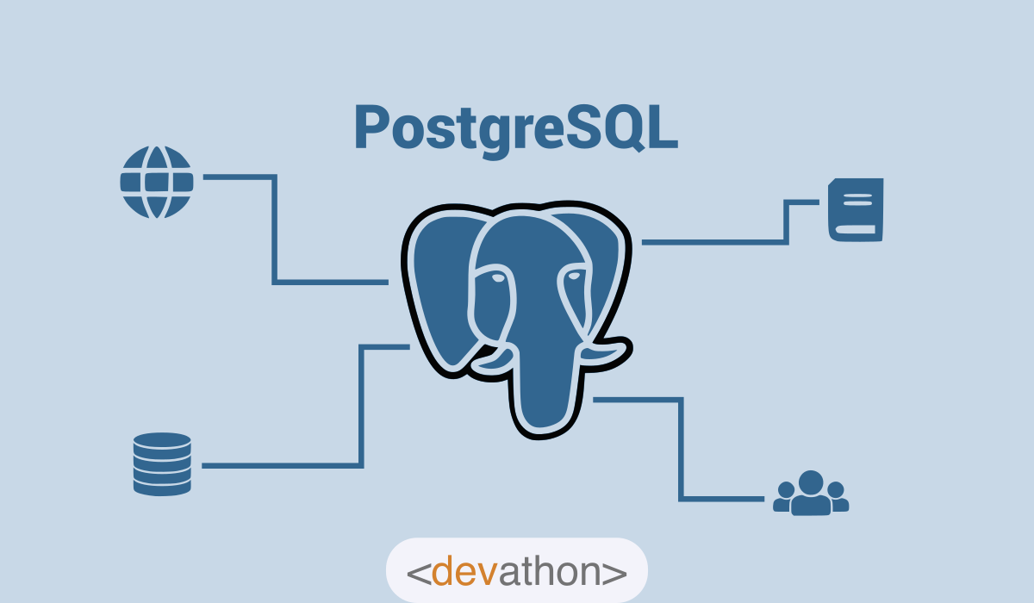
PostgreSQL: An overview
Among the established open-source RDBMSs, PostgreSQL enjoys a lot of prominences. This RDBMS is also known as “Postgres”, and it enjoys high popularity.

Slide 9
Key features of PostgreSQL
The following are the noticeable features of PostgreSQL:
This open-source RDBMS is free.
Its creators used the C language to develop PostgreSQL.
PostgreSQL supports all the key platforms like Windows, Linux, Mac, etc.
This RDBMS uses SQL and offers features similar to traditional RDBMSs like Oracle and DB2.
PostgreSQL offers noticeable extensibility. You can use it along with other popular RDBMSs like Oracle and MySQL. Furthermore, you can use it along with popular NoSQL databases like MongoDB.
PostgreSQL supports all popular languages like Java, Python, C, C++, C#, JavaScript, Ruby, Go, etc.

Slide 10
Pros and cons of PostgreSQL :
PostgreSQL offers the following advantages:
Powerful features: The PostgreSQL developer community claims that it’s a very advanced RDBMS. Its features support the claim. PostgreSQL supports a wide range of features like “Multi-version concurrency control” (MVCC), nested transactions, asynchronous replication, user-defined types, etc.
The ease of handling transactions: Traditional RDBMSs like Oracle provide SQL statements like INSERT, UPDATE, and DELETE for handling transactions. However, PostgreSQL provides DDL (Data Definition Language) statements for transactions too. This makes transaction-handling easier.
“Code comments”: When you code an application using PostgreSQL, this RDBMS provides you with “code comments”. This helps you to understand what the code would do. You can then modify your code.
Parameters: You can adjust several parameters when you use PostgreSQL, which helps you to gain better productivity.
Extensibility: You can create a new feature and add it to PostgreSQL. This extensibility is a powerful aid to developers.

Slide 11
Let’s not also forget that :
Security: Several experts in the field of databases consider PostgreSQL highly secure. PostgreSQL provides security features at the level of the application, database, environment, and users.
“Rich” SQL: PostgreSQL supports a wide range of SQL syntaxes. A few examples are common table expressions and “Windows functions”, furthermore, this RDBMS handles unstructured data.
Flexibility: Developers can code stored functions in popular programming languages like Java, Python, etc. This helps them to add powerful capabilities to their apps.
Performance: PostgreSQL 10 and above releases can utilize all the cores of modern computer processors. This helps PostgreSQL deliver a robust performance. You can implement partitioning in PostgreSQL, which further improves the performance of the database.
Popularity: The high popularity of PostgreSQL delivers multiple advantages. Most of the popular tools for database management or development support PostgreSQL. You will find that most developers have experience in PostgreSQL.
Support: You can find excellent community support for PostgreSQL. The vibrant developer community is diverse, and PostgreSQL receives regular enhancements.
PostgreSQL has a few disadvantages, which are as follows:

Slide 12
The lack of data compression: PostgreSQL lacks data compression capabilities. This can adversely impact performance in high-volume application systems.
Analytics-related limitations: Many developers use PostgreSQL for data science projects. However, it has a few limitations in this area. PostgreSQL doesn’t store tables as columns. It stores tables as rows. Analytics projects benefit from tables stored as columns, which also enables data compression. The lack of powerful “Machine Learning” (ML) libraries in PostgreSQL is another example. Analytics projects require powerful ML libraries. In the case of PostgreSQL, you will need to use an external library if you need a powerful ML library.
Performance-related limitations: PostgreSQL has a few performance issues. This is noticeable in the case of large databases.
Administration-related challenges: Certain tasks like back-up and recovery can be hard when you use PostgreSQL.

Slide 13

What is PostgreSQL used for :

Slide 14
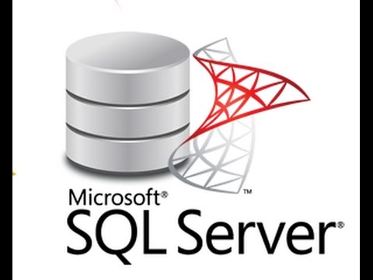
SQL server overview :
SQL Server is a data engine introduced by Microsoft. It provides an environment used to create and manage databases. It allows secure and efficient storage. It provides other components and services that support the business intelligence platform to generate reports and help analyze the data.

Slide 15
Key features of SQL server :
Scalability: It allows distributing data in the large tables into different file groups. The server can access the file groups simultaneously.
CLR integration: It allows user to use the CLR features of the .NET Framework into the server database.
Service oriented architecture: It provides distributed, asynchronous application framework for large scale applications.
Web services support: It allows direct access to the data from web services by implementing the HTTP endpoints.
High security: It implements high security by adding policies for log on and passwords.
Support for data migration and analysis: It provides tools to migrate data from data sources to a common database.
Policy based management: It is used to define a set of policies for configuring and managing data.
Resource governor: It is used to manage the workload of the server by allocating and managing resources.

Slide 16
Pros and cons of SQL server :
Plenty of career opportunities. Are you interested in database administration, performance tuning, or T-SQL programming? Would you like to design and implement data cleansing and extract, transform, and load operations? Are you keen on data mining and online analytical processing? Or do you see yourself as a dashboard and interactive reports designer or developer? As we mentioned in our list of pros and cons of Microsoft SQL Server, the platform gives you many possibilities to suit your career aspirations.
Free Developer edition. The SQL Server Developer edition is completely free and includes all enterprise SQL Server features. You can just download, install, and configure your own development environment and explore all features and functionalities of the latest SQL Server version.
A growing community. SQL Server has a thriving community. There are many community-hosted global events, like SQL Saturday, as well as conferences, educational materials, and a great network of highly skilled professionals who are always ready to help you (the hashtag #sqlhelp works very well on Twitter).
4. Useful online documentation. Personally speaking, I find the online documentation for Microsoft SQL Server very detailed and well structured. There are also plenty of whitepapers and useful demos that help you to understand a specific topic in greater detail.

Slide 17
Drawbacks of SQL server :
Complex performance tuning. Query optimization and performance tuning can be difficult for data specialists who don’t have deep, specialized knowledge. However, this isn’t really a problem if you’re a beginner, as you won’t be performing much query optimization anyway (unless you operate on very large data sets).
Lack of native support for source control. The closing point of our list of pros and cons of Microsoft SQL Server is related to source control: it is not native in SQL Server. To maintain all changes made to database objects, you’ll need to use third-party tools.

Slide 18
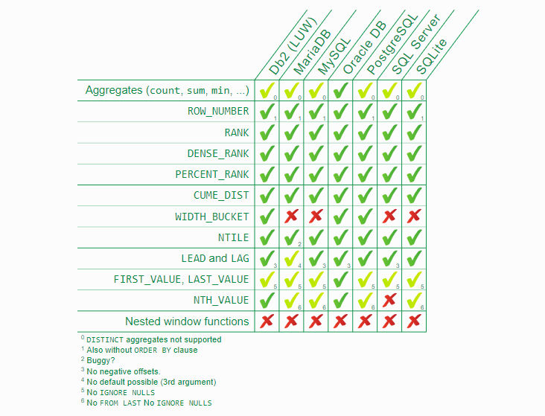
The best RDBMS ?
As you can see in the alongside table that compares most of the popular RDBMSs , there is no exclusive winner between MySql , posgreSQL and SQL server, it’s mostly depends on the need.

Slide 19
So ??
The choice between the three most popular databases ultimately boils down to the comparison of the functionality, use cases, and ecosystems. Companies that prioritize flexibility, cost-efficiency, and innovation usually choose open-source solutions. They can be integrated with multiple free add-ons, have active user communities, and are continuously updated.
For corporations that prefer traditional commercial solutions, software like SQL Server backed up by a big corporation and compatible with an extensive infrastructure, is a better bet. They have access to constant technical support, personalized assistance, and professional management tools.

Slide 20
Thank you for your attention
Mezlini Hamza

