Slide 1
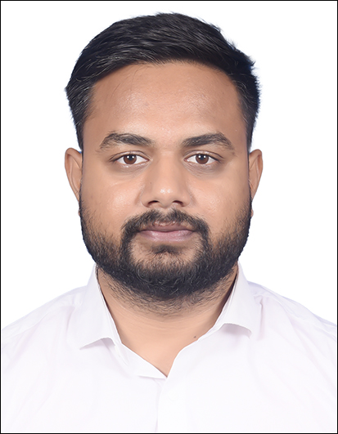
Sunny Savita
Generative AI Engineer
Education Qualifications
B.Tech – Computer Science
Certifications:
Microsoft AI Fundamentals (AI -900)
Multiagent AI system with Lang graph
Build LLM apps using OpenAI
Introduction
Sunny is an experienced consultant with 5 years of hands-on expertise in Generative AI and Large Language Models. He specializes in fine-tuning, Retrieval-Augmented Generation (RAG), Multimodal RAG, Agentic AI, and multi-agent systems, with a strong foundation in Python, Machine Learning (ML), Deep Learning (DL), and Natural Language Processing (NLP). He has successfully built and deployed RAG and Multimodal RAG pipelines using open-source frameworks and AWS services such as Amazon Bedrock, Amazon SageMaker, Amazon OpenSearch Service, and Amazon ECS/EKS (Fargate). In the agentic AI domain, Sunny has designed and implemented supervisor-agent and collaborative workflows using LangGraph and Crew AI.
Select experience
Autonomous Scientific Report Generation with Multi-Agent AI:
This AI-powered system automates the generation of scientific reports based on molecular research outputs. It leverages advanced NLP and LLM techniques to synthesize experimental data, analysis results, and domain-specific findings into structured, high-quality scientific reports.
Developed a retrieval-augmented pipeline with a Maximum Marginal Relevance (MMR) reranker to ensure diverse and contextually relevant information retrieval from internal research documents.
Built a multi-agent system using LangChain and LangGraph, where each agent specialized in parsing and synthesizing different data modalities — text, tables, and images — for report generation.
Integrated LangChain tool-calling capabilities, enabling agents to access external resources (e.g., literature APIs, document parsers) as part of their workflows.
Designed and implemented an automated rendering system to export the final reports in both DOCX and PDF formats using python-docx and templating logic for professional, publication-ready formatting.
SDLC Copilot System With Agents and Advance RAG:
This AI-driven copilot system automates and enhances the Software Development Life Cycle (SDLC) by integrating intelligent agents and advanced retrieval-augmented generation (RAG) techniques. It assists teams across requirement analysis, design, coding, testing, and deployment phases through context-aware automation and knowledge synthesis.
Designed and developed an AI-powered Copilot to automate and optimize the Software Development Life Cycle (SDLC) across requirement analysis, design, coding, testing, and deployment stages.
Built a multi-agent architecture using LangChain and LangGraph, where specialized agents performed tasks such as requirement interpretation, code review, test-case generation, and release validation.
Implemented an Advanced Retrieval-Augmented Generation (RAG) pipeline leveraging FAISS vector search, Maximum Marginal Relevance (MMR) reranking, and hybrid (semantic + keyword) retrieval for high-precision contextual insights.
Integrated tool-calling and workflow orchestration capabilities enabling agents to interact with JIRA, Git repositories, and CI/CD pipelines, providing real-time development assistance and governance.
LLM-Enhanced Document Parsing System
Developed an Intelligent Document Processing (IDP) pipeline with LLMs (GPT-4o, Gemini Vision Pro) to automate extraction, classification, and summarization of unstructured DOCX, PDFs, and scanned forms.
Built a modular parser using python-docx, Unstructured.io, and Whisper to handle text, tables, images, and multimodal transcription.
Applied visual + textual content understanding via Gemini Vision Pro for complex tables and diagrams.
Stored parsed data in AWS OpenSearch to enable semantic search and RAG-based contextual responses.
Optimized for enterprise-scale document workflows, experimenting with OCR+LLM hybrids (Cradl AI, Whisper LLM) for robust performance.
Relevant Expertise
Vector Database
RAG and MM RAG Architecture
Hugging Face Models
Lang chain, Llama index, Haystack
FastAPI
AI Agents
Technology Experience
Python
Generative AI
Agentic AI
Machine Learning
NLP
AWS Cloud
Prior Experience
Generative AI Engineer, PwC India Data Scientist, iNeuron.ai
Contact details
The Millenia, Tower D1 &2 Murphy Road, Ulsoor Karnataka - 560008
Mob: +91 8770203258
E-mail: sunny.savita@pwc.com
MLOPS tool experience
Git, Docker, GitHub Action
Pytest
Cloud experience
Azure CloudFormation
AWS ECS, Fargate
AWS Lambda
AWS SageMaker
Amazon EC2, S3
AWS Bedrock
AWS OpenSearch
AWS Glue, Redshift

