Slide 1
Regression Analysis
Predicting Company Popularity
& Employee Satisfaction
Matias Beeck

Slide 2
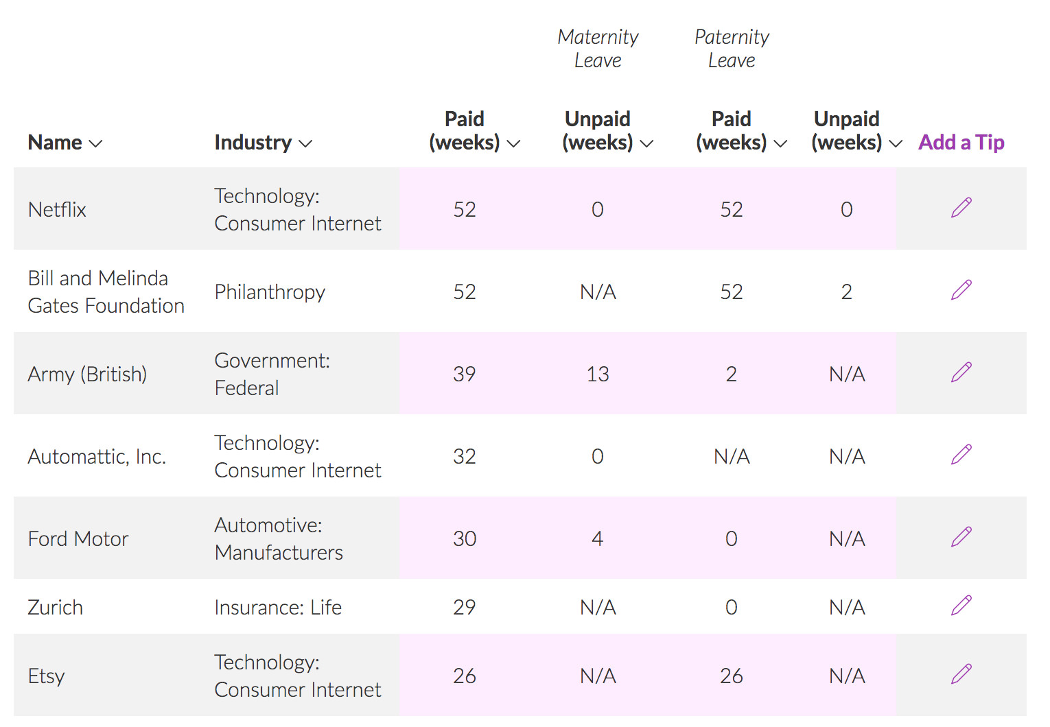
The Questions
How does the amount of maternity leave offered by a company affect it’s reputation, popularity or employee satisfaction?
What other company data could play into employee satisfaction?
*Fairygodboss.com crowd sourced maternity leave data

Slide 3
The Data

Slide 4
Scraping Company Data
Fairygodboss.com dataset:
Maternity leave info for ~1700 companies
Paid Maternity Leave (weeks)
Unpaid Maternity Leave (weeks)
Paid Paternity Leave (weeks)
Unpaid Paternity Leave (weeks)
Industry
Linkedin Followers
HQ Population data
Glassdoor data:
Company Glassdoor rating (1-5)
Revenue per year
Employee number
# of employee reviews
CEO approval %
Interview difficulty
Interview experience (% of positive, neutral or negative)
Year Founded (age)
Headquarter Location
Notes:
1.0=very dissatisfied
3.0=OK
5.0=very satisfied.
CEO approval ratings are based on the percentage of employees who approve of their CEO. Employees have the option to rate their CEO during the company review process.

Slide 5
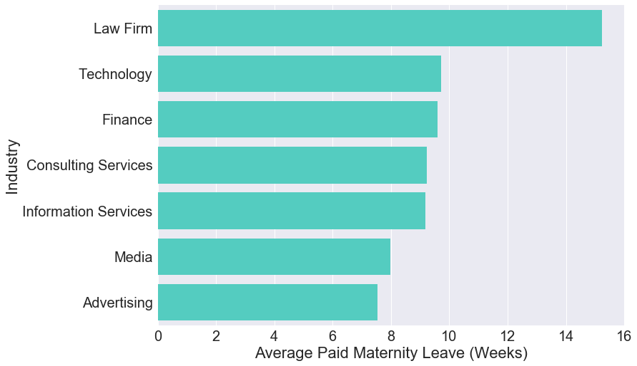
Exploring Dataset
Notes:
Of 20 industries, these were the top 7

Slide 6
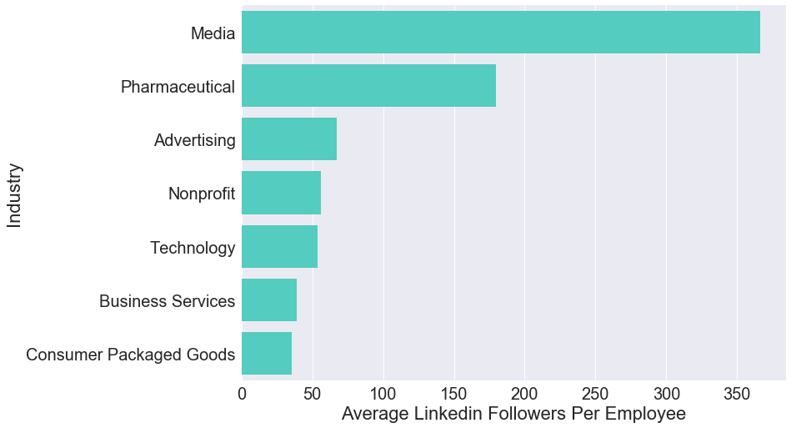
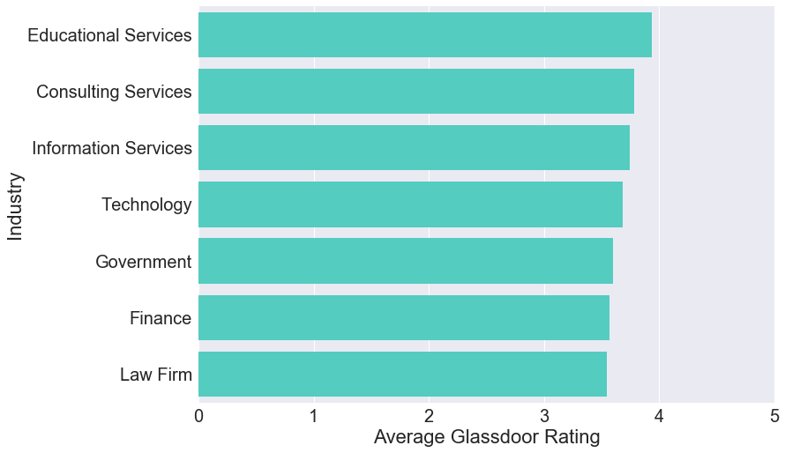
Exploring Dataset: Dependent Variables
Notes:
3 of 7 shared with top mat leave dataset for linkedin followers
5 of 7 shared with top mat leave dataset for gd rating
For linkedin followers it’s more of a popularity contest
But I said hey, lets try it anyway

Slide 7
Linear Regression

Slide 8
Linear Regression: Kitchen Sink
Predicting “popularity” of companies
Dependent variable = Log of Linkedin followers per employee
Adjusted R² = .174
Predicting employee satisfaction
Dependent variable = Glassdoor rating (1-5)
What factors play into employees liking a company?
Adjusted R² = .611
Notes:
-After converting my categorical variables and assuring normality in my potential dependent variables I ran a few kitchen regressions
-Even using kitchen sink of all predictor variables when trying to predict linkedin popularity, my model was terrible and it seemed pretty hard to predict this.
-I believe this can be attributed to the many biases associated with linkedin followers. Even though I removed some of the "size of company" bias by including the number of employees in the independent variable, there are other biases such as industry and marketing/media dollars associated with driving more linkedin followers (which we saw in barchart where ”trending” industries clearly had most linkedin followers)
-Focus on predicting glass door company ratings as those are averaged employee ratings and thus are less bias and are a better/more important representation of a company’s reputability, not just it’s social popularity

Slide 9
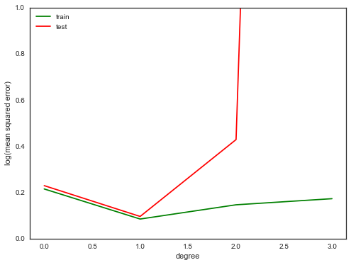
Linear Regression: Predicting GD Rating
Using all features
Adjusted R² = .611
Polynomial analysis using test, train ->
Cross Validation (K-fold)
5 folds = .609 R²
10 folds = .601 R²
Notes:
Again, adjusted R squared for GD rating kitchen sink model was .611
Polynomial analysis for this fit suggested 2nd degree and above would not improve the model fit
Tested out all kinds of interactions, but they all yielded lower r-squared

Slide 10

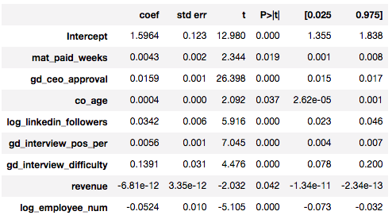
Linear Regression: “Improved” Model
Removed:
Industry dummy variables
Number of employee reviews
HQ population
Transformed:
Log of employee count
Adjusted R² = .545
Cross Validation (K-fold)
5 folds = .545 R²
10 folds = .54 R²
Notes:
Improved model by eliminating insignificant predictors. This led to only a slight drop in R^2.
Again, tested interactions out but they all yielded drops in r-squared

Slide 11
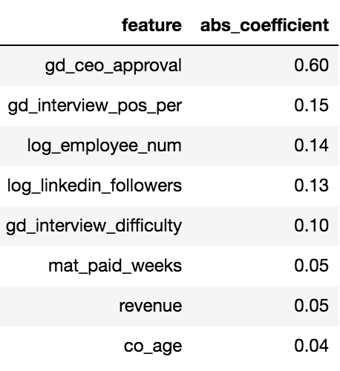
Linear Regression: Interpretation
Predicting Glassdoor Rating
Surprising:
Variation in paid maternity leave, company age & revenue explained little of variation in GD rating
Interview stats were somewhat important
Most predictive power in model from CEO approval rate
Adjusted R² drops to .225 without it
Notes:
-Paid maternity leave and company age had little to no effect
-Interview stats were somewhat important
-For a one unit increase in interview difficulty level (on a scale 1-5), gd_rating increased by .1391 (1-5 scale)
-For a 1 unit increase in the positivity of interview experience, gd_rating went up .0056 (might seem small, but on same comparison to interview difficulty level (one unit is 20% of scale), for every 20 unit (20%) increase in positivity of interview experience, gd rating went up .112 (similar to interview difficulty coefficient)
Take those with a grain of salt though since most of our predicting power came from CEO approval rate which makes sense.
Without ceo approval rate in model, our R2 drops down to .225
Without interview data, not much of a difference in R2
1% increase in linkedin followers means coefficient/100 unit increase in gd_rating

Slide 12
Linear Regression
Tech Industry Focus
Notes:
Seeing as though industries were all on completely different spectrums and included all kinds of biases, I wanted to fit my model using a subset of my data where I was only looking at one industry. As Tech had the most observations I chose this and refit my model on the new dataset.

Slide 13

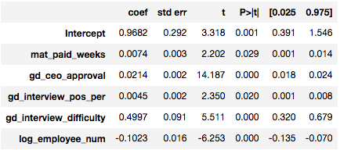
Linear Regression: Tech Industry
Removed:
Company age
Revenue
Linkedin followers
Adjusted R² = .74
Cross Validation (K-fold)
5 folds = .73 R²
10 folds = .72 R²
Most predictive power comes from CEO approval rate
Adjusted R² drops to .323 without it
Notes:
Again CEO approval carried most of the weight in my model while interview difficulty level also had a strong coefficient value influencing the model
Cross Validation (K-fold)
5 folds = .73 R²
10 folds = .72 R²

Slide 14
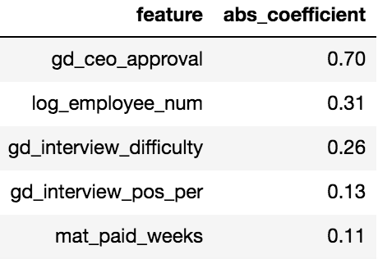
Linear Regression: Tech Industry Lasso Coefficients
Notes:
Again CEO approval carried most of the weight in my model while interview difficulty level also had a strong coefficient value influencing the model
Cross Validation (K-fold)
5 folds = .73 R²
10 folds = .72 R²

Slide 15
Next Steps

Slide 16
Challenges & Next Steps
Explore the tech industry subset for potential interaction features
Gather more companies for dataset
Eliminate maternity leave data altogether
Companies in dataset could be highly bias
Notes:
I restricted myself to that dataset as I wanted to include maternity leave data, which is already scarce, but in the end, the maternity leave features did not yield much predictive power at all.
Would be nice to gather more data on hundreds more tech companies to see what factors take importance in predicting a company’s glassdoor rating, i.e. employee satisfaction with the company
Explore the tech industry subset for potential interaction features
Gather more companies for dataset
Eliminate maternity leave data altogether
Companies in my dataset could be highly bias since people are more likely to submit maternity leave data if it is great or terrible, not mediocre
Take deeper dive into Lasso & Ridge regularization
Predict company age based on current revenue, glassdoor rating, number of glassdoor reviews, linkedin/facebook followers

Slide 17
Thanks!

