Slide 1

IAP301 Policy Development in Information Assurance
Lecture 2. Risk Mitigation and Business Support Processes

Slide 2
Learning Objective
Analyze how security policies help mitigate risks and support business processes in various domains in the information technology (IT) infrastructure.

Slide 3
Key Concepts
Business challenges in each IT domain
Risk mitigation in seven IT domains
Organizational hurdles to policy implementation
Policy implementation issues related to humans in the workplace
Executive management

Slide 4
EXPLORE: CONCEPTS

Slide 5
Risk Mitigation and the Role of Security Policies
Each of the seven IT domains have different types of risks associated with them, and policy creation seeks to reduce or mitigate these risks.
Each policy created for the seven IT domains must address as many risks in that domain as possible.

Slide 6
A Sample of Security Policies
Security policies template
https://www.sans.org/security-resources/policies/

Slide 7
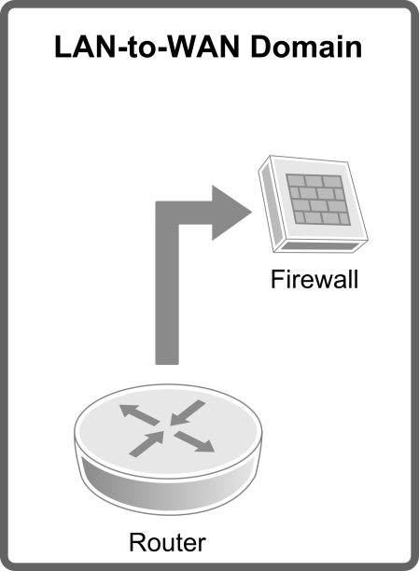
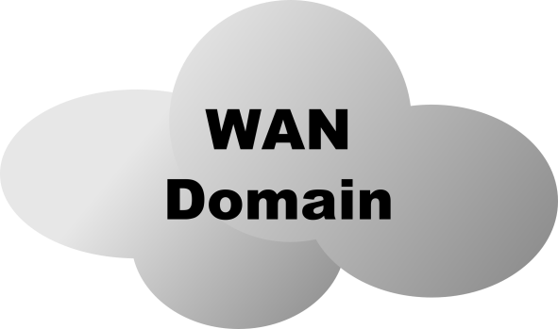
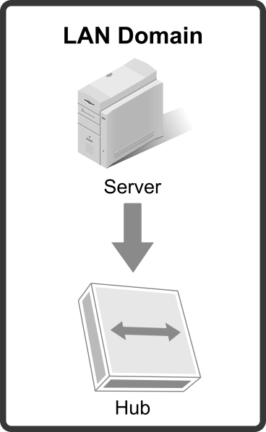
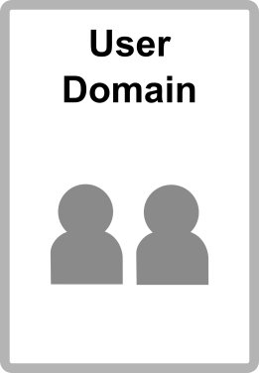
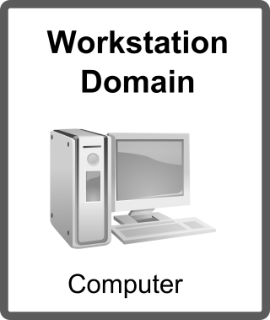
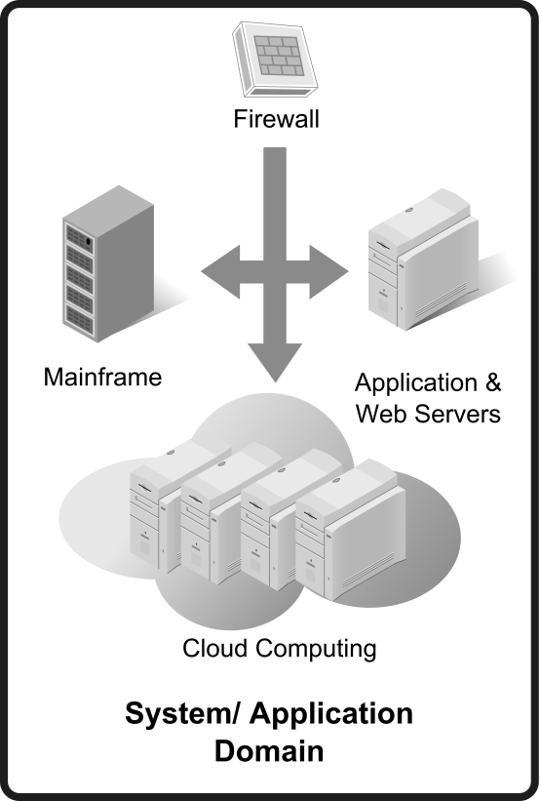
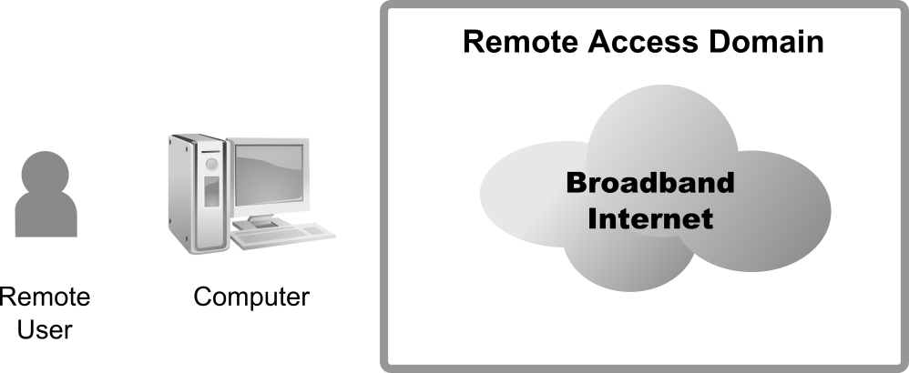
Seven Domains of a Typical IT Infrastructure
Switch

Slide 8
Policy Failure Issues
The most common reasons that policy implementation efforts fail to get senior management support are:
Unclear purpose
Doubt
Insufficient support
Organizational baggage
Lack of incentives
Lack of candor
Low tolerance for bad news
Unmanageable complexity

Slide 9
Unclear Purpose
Unclear purpose happens when a policy’s business value hasn’t been clearly delineated.
It’s important to demonstrate how policies will reduce risk.
It’s equally important to demonstrate how the policies were derived in a way that kept the business cost and impact low

Slide 10
Doubt
Doubt occurs when there is disagreement about the need for change.
Change is perceived as a distraction from the core business.
You need to convince the executive that the benefits outweigh disruption.
Doubt may also be a factor if an organization has had several false starts.
Even when the message and benefits are clear, it is also a matter of credibility with the executive.

Slide 11
Insufficient Support
Most leaders doesn’t like surprises and want to know they are not alone in their support for an idea.
To avoid surprises, be sure to articulate any pushback you are getting from other leaders.
This will allow the executive to be an advocate and sway his or her peers.
When problems are encountered, be sure to anticipate where your support will emerge or evaporate.

Slide 12
Organizational Baggage
Organizational baggage refers to how the organization executes based on past unsuccessful efforts.
Unlike doubt, which is a personal credibility issue, this category focuses on the organization’s ability to execute.
If an organization has problems implementing policies of any kind, security policies won’t likely be any different.
Organizations that reorganize frequently fall within this category.

Slide 13
Lack of Incentives
Lack of organizational incentives refers to the inability to motivate behavior.
Value is only derived from policies when they are enforced.
An organization must have the will and process to reward adherence.
The organization must have a low or zero tolerance for security policy violations.

Slide 14
Lack of Candor
Lack of candor refers to not having open, candid conversations.
In the case of policies, you need to be clear what can and cannot be achieved.
You need to listen and explain how the business’s input was considered and adopted or rejected.
Executives need a sense that they were part of a process and not just the recipients of the result.

Slide 15
Low Tolerance for Bad News
Low tolerance for bad news refers to how executives react to missteps.
You can count on an error in judgment at some point in implementing security policies.
You need to prepare executives for the inevitable.
You also need to gauge how they will react.

Slide 16
Unmanageable Complexity
Unmanageable complexity refers to how complex and realistic the project is.
The ability of the organization to support the security polices will be an important topic of conversation.

Slide 17
Relevance of Executive Management Support
Data supporting policy implementation aligned with business objectives
Business objectives identified align with compliance laws or regulations required to conduct business
Security Policy implementation can expect executive management support

Slide 18
Lack of Executive Management Support
Data supporting policy implementation not aligned with business objectives
Business objectives identified do not align with compliance laws or regulations required to conduct business, or are unclear and have insufficient support from leadership
Security Policy implementation can expect to fail without executive management support

Slide 19
Organizational Issues
Two important organizational issues that affect the implementation of security policies are:
Division of labor: who is responsible for what?
Span of control: how much responsibility does one individual have?
Hierarchical
Flat

Slide 20
Flat Organizations
Management structure is cross-functional and more open to employee input.
Dialogue and communications between employees may occur across organizational functions.
Employees tend to be more open and communicative.
Employees tend to be more creative and involved in business decisions.
Employees are not as constrained within their role or function and can see and interact across the organization more freely.

Slide 21
Hierarchical Organizations
Departments are separated by function, creating multiple functional silos.
Business decision-making performed at the executive management level.
Dialogue and communications is more top-down.
Employees tend to be less communicative and more isolated within their business functions.
Employees find it difficult to offer additional creativity or input to business decisions.
Employees are constrained within their roles and cannot interact outside of their business functions without going through a chain of command.

Slide 22
EXPLORE: PROCESS

Slide 23
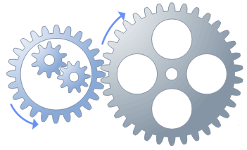
Policy Implementation Steps
Informal Discussions
Transition
From
Informal to Formal
Implementation
Tasks
Formal Implementation Project
Build Support for Policy
Implement Security Policy
Step Four: Communicate the Vision
Step Five: Remove Obstacles
Step One: Create Urgency
Step Six: Create Short-Term Wins
Step Two: Form a Powerful Coalition
Step Seven: Build on the Change
Step Three: Create a Vision for Change
Step Eight: Anchor the Changes in Corporate Culture
Adapted from “Kotter’s Eight-Step Change Model.”

Slide 24
Policy Implementation Issues
Each organization has many different types of personal traits, each affecting the organization in its attempt to implement a policy in the workplace.
The most common workplace personality types include:
Commanders
Attackers
Performers
Analyticals
Drifters
Pleasers
Avoiders
Achievers

Slide 25
Commanders
Commanders are demanding and not tactful.
They come across at best as impolite, at worst rude and abrupt.
They are forceful in an attempt to achieve stated goals.
They can break through barriers that have prevented past success.

Slide 26
Drifters
Drifters are uncomfortable with structure and deadlines.
They may have great soft skills but might not follow up and take a more laid-back attitude toward work assignments.
What they lack in discipline may be offset by their creativity and thinking out of the box.
Drifters are often at odds with Commanders.

Slide 27
Attackers
Attackers may seem angry or even hostile toward ideas and others on the team.
They are critical of others’ ideas and are egotistical.
Although their biting attacks other team members can be disruptive, they can also take on very unpopular tasks.

Slide 28
Pleasers
Pleasers are very kind and thoughtful to others.
They want everyone to “feel good” and will put their own self-interest aside for the good of the whole.
They may shy away from enforcing rules that offend others, but they promote the concept of collaboration and teamwork.

Slide 29
Performers
Performers like to be on center stage.
They like to entertain and be the center of attention.
They develop over time a wit and charm to capture people’s attention.
They may not be the highest producer and may be in the habit of self-promotion.
They are often excellent public speakers and can establish new relationships important to the business.

Slide 30
Avoiders
Avoiders like to fly under the radar and be in the background.
They tend not to take chances or do anything that brings attention on them.
They will do precisely what’s asked of them but not much more.
However, they are very dependable and their work quality is consistent.

Slide 31
Analyticals
Analyticals like structure and deadlines.
They measure their success in precise terms of the number of widgets produced in a given time at a given quality level.
They tend to be obsessed with precision and attention to detail.
They may not be the best at understanding human dynamics, so working with customers and emotions may be a problem.
They are very comfortable with lots of information and have the ability to analyze issues and evaluate different types of risk.

Slide 32
Achievers
Achievers are very result oriented.
They may have several traits of the other personality types.
For example, they may be self-confident but not at the expense of others.
They genuinely want the best result and may seek different ways to achieve it.
Achievers can make good leaders.

Slide 33
Summary
In this presentation, the following were covered:
Seven domains of a typical IT infrastructure
Importance of executive management support to implement security policy
Policy implementation steps
Policy implementation issues related to humans in the workplace

Slide 34
Discussion and Assignments
Discussion 2: Risk Mitigation
Assignment 2: Good Policy Implementation

Slide 35
Lab Activities
Lab is in the lab manual on cms
Lab 2: Develop an Organization-Wide Policy Framework Implementation Plan
Reading Assignment 2, Chapter 4, 5
Assigned Reading: - How will Brexit affect the cyber-security industry in UK and Europe?; The Social Dilemma of Self-Driving Cars; ISO/IEC27001 for Mobile Devices, Access Controls

