Slide 1

IAP301 Policy Development in Information Assurance
Lecture 3. Policies, Standards, Procedures, and Guidelines

Slide 2
Learning Objective
Describe the components and basic requirements for creating a security policy framework.

Slide 3
Key Concepts
Key building blocks of security policy framework
Types of documents for a security policy framework
Information systems security (ISS) and information assurance considerations
Process to create a security policy framework
Best practices for policy management and maintenance

Slide 4
EXPLORE: CONCEPTS

Slide 5
Security Controls
Defines how an organization performs and conducts business functions and transactions with a desired outcome.
Policy
Standards
An established method implemented organization-wide.
Procedures
Steps required to implement a process.
Guidelines
A parameter within which a policy, standard, or procedure is suggested.

Slide 6
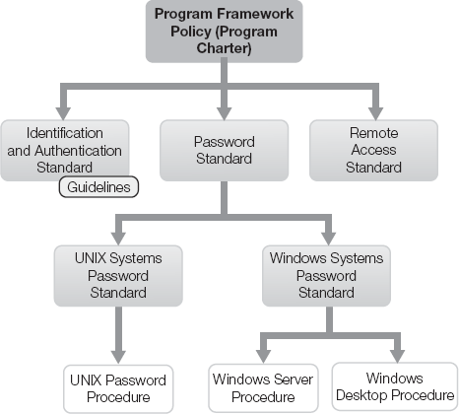
Security Controls

Slide 7
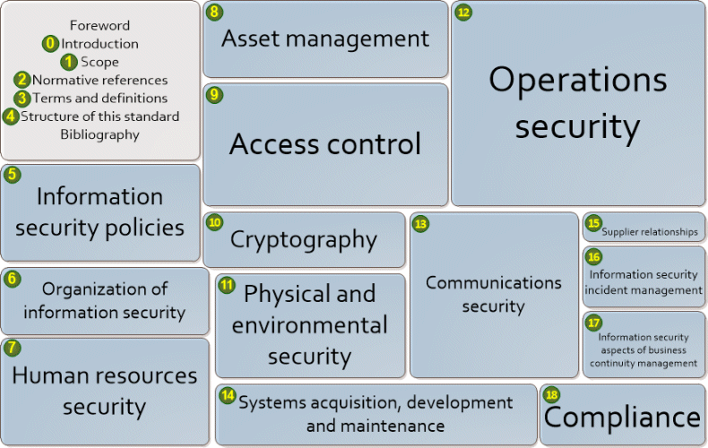
ISO 27002:2013 - IT - Security techniques - Code of practice for information security controls

Slide 8
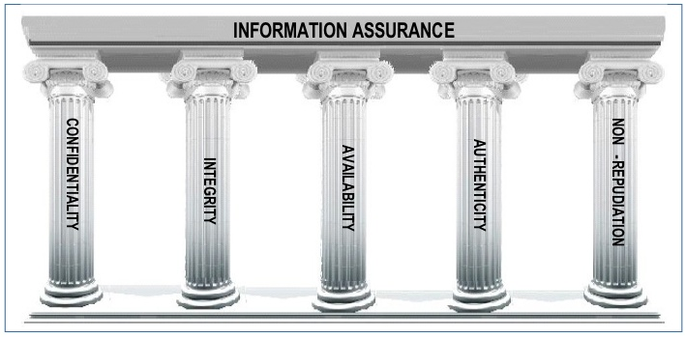
Five Pillars of Information Assurance

Slide 9
Information Systems Security and Information Assurance
Information Assurance
Protecting information during processing and use
The 5 Pillars
Implementation of appropriate accounting and other integrity controls
Development of systems that detect and thwart attempts to perform unauthorized activity
ISS
Protecting information and the systems that store and process the information
Automation of security controls, where possible
Assurance of a level of uptime of all systems
Security Policy Framework

Slide 10
EXPLORE: PROCESS

Slide 11
Three Areas of Policy Planning and Implementation.
Creating security policy
Changing security policy
Maintaining security

Slide 12
Creating Security Policy
Security policies provide vital support to security professionals, yet few organizations take the time to create decent policies
Many organizations just download examples from the web and cut and paste as they see fit.
But this create problems later on ie: Vulnerabilities.

Slide 13
A good policy
should be:
short as possible
relevant to the audience
aligned to the needs of the business
aligned to the legislation and regulatory frameworks in which you operate
should add value to the employee and the overall outcomes and behaviors you are looking to promote

Slide 14
Process to Create a Security Policy Framework
Case Study
Private Sector
Case Study
Public Sector
Case Study
Critical Infrastructure Protection
HealthCare w/7000 devices
Incomplete Inventory
No easy way to classify assets
Health Insurance Portability and Accountability Act (HIPPA)
Used NIST SP 800-53 to establish the framework
State of Tennessee
Used ISO/IEC 17799 (27002)
Policies and frameworks covered all information asset owned, leased, or controlled by the State of Tennessee
Verizon Inc.
The network stopped working and the financial markets stopped operating as well
85% of network was privately held
Used National Infrastructure Protection Plan (NIPP) framework

Slide 15
Best Practices for Policy Framework Creation
Your policies need to be highly visible if they are to be effective.
To spread the word, you might use:
Presentations
Videos
Panel discussions
Guest speakers
Road shows
Summits
Question/answer forums
Newsletters

Slide 16
Policy Framework-Outline
The typical information security policy may have the following headings:
Document Control
Document Location
Revision History
Approvals
Distribution
Document History

Slide 17
Policy Framework-Outline (cont’d)
Enquiries
Introduction and Purpose
Scope
Your Responsibilities
Our Responsibilities
Where to find more information
Equal Opportunities Impact Assessment

Slide 18
Activity
Within an assigned group, research and report on one of the policy framework case studies from the textbook as listed below:
Group 1: Private Sector (147)
Group 2: Public Sector (148)
Group 3: Critical Infrastructure Protection (149)
In a PowerPoint presentation (5-7 slides), describe the case, define the security concerns it raises, outline the steps taken to implement a policy framework, and identify any additional steps you would recommend.

Slide 19
EXPLORE: ROLES

Slide 20
The Policy Change Control Board
The Policy Change Control Board should include representation from the following functional areas of the organization and include (in random order):
Security
Compliance Management
Auditing
Human Resources
Legal
Project Management
Functional Management

Slide 21
Board Responsibilities
Each member is responsible for reviewing and approving or rejecting changes to the policies, reflecting alignment to business objectives in their sphere of influence.
Each functional area oversees policies pertaining to their respective areas of responsibility, while they also play a role in the approval of policy changes that effect the organization as a whole.

Slide 22
Members of the Policy Change Control Board
Possible Members come from functional areas of the organization and include (in random order):
Security
Compliance Management
Auditing

Slide 23
Members of the Policy Change Control Board (cont’d)
Human Resources (HRs)
Leadership from the key information business units
Project Managers (PMs)

Slide 24
Members of the Policy Change Control Board (cont’d)
The roles for each member would be to approve changes to the policies, reflecting alignment to business objectives
Each functional area oversee policies pertaining to their perspective area of responsibility, while they also play a role in the approval of policy changes that effect the organization as a whole

Slide 25
EXPLORE: CONTEXT

Slide 26
Policy Change Control Board
Assess policies and standards and make recommendations for change
Coordinate requests for change (RFC’s)
Ensure that changes to existing policies and standards support the organization’s mission and goals
Review requested changes to the policy framework
Establish a change management process for policies and standards

Slide 27
Best Practices for Policy Maintenance
Updates and revisions
Exceptions and waivers
Request from users and management
Changes to the organization

Slide 28
External and Internal Factors Affecting Policies
Policies must align with the business model or objective to be effective
External factors: Regulatory and governmental initiatives
Internal factors: Culture, support, and funding

Slide 29
Summary
In this presentation, the following were covered:
Considerations for information assurance and information security
Process to create a security policy framework
Policy change control board and its members
Factors that affect polices and the best practices to maintain policies

Slide 30
Discussion and Assignments
Discussion 3: Business Considerations
Assignment 3: Security Policy Frameworks

Slide 31
Lab Activities
Lab is in the lab manual on cms
Lab 3 Define an Information Systems Security Policy Framework for an IT Infrastructure
Reading Assignment 3, Chapter 6, 7

