Slide 1

IAP301 Policy Development in Information Assurance
Lecture 4. Information Systems Security Policy Framework

Slide 2
Learning Objective
Describe the different methods, roles, responsibilities, and accountabilities of personnel, along with the governance and compliance of security policy framework.

Slide 3
Key Concepts
Different methods and best practices for approaching a security policy framework
Importance of defining roles, responsibilities, and accountability for personnel
Separation of duties (SOD)
Importance of governance and compliance

Slide 4
EXPLORE: CONCEPTS

Slide 5
Information Systems Security Policy Frameworks
Choosing the framework that works in your organization is not easy
The one selected will be based on the organizational type, risk, and view from top management
A simplified security policy framework domain model
Federal Information Security Management act of 2002 (FISMA)
Committee of Sponsoring Organizations (COSO)
Control Objectives for Information and related Technology (COBIT) (public organization only as this is for SOX 404)
ISO 17799 (27002), 20000 (ITIL), NIST, OCTAVE, PCI DSS (if you process payments electronically)
Frameworks are flexible and allow an organization to adopt constructs that fit their overall governance and compliance planning requirements

Slide 6
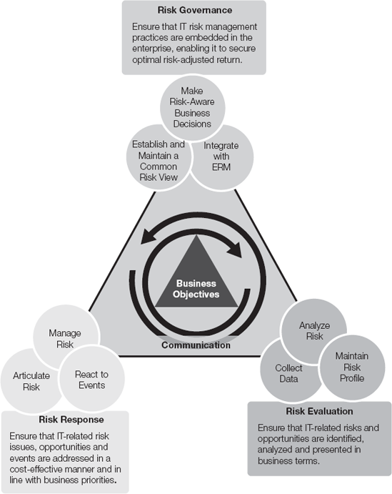
The Three-Domain Model

Slide 7
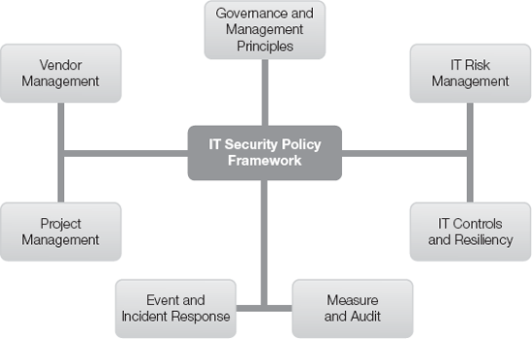
The Seven-Domain Model

Slide 8
Information Technology (IT) Security Controls
IT security controls are a function of IT infrastructure that an organization has in its control and the regulatory and business objectives that need to be controlled
You can have too many IT security controls, impeding the organization from operating at optimal capacity, thus reducing its revenue potential
Organizations often combine elements of different
frameworks in order to ensure that selected controls
offer maximum benefit.

Slide 9
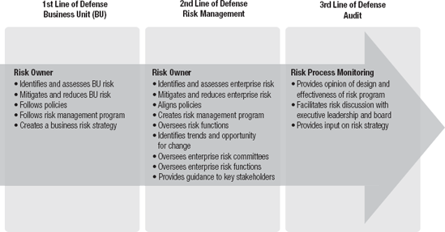
Three-lines-of-defense model

Slide 10
Information Technology (IT) Security Controls (cont’d)
Generic IT security controls as a function of a business model
Deploy a layered security approach
Use SOD approach
This applies to transactions within the domain of responsibility
Conduct security awareness training annually

Slide 11
Information Technology (IT) Security Controls (cont’d)
Apply the 3 lines of defense model
First line: The business unit
Second line: The risk management team
Third line: Use independent auditors

Slide 12
GRC & ERM
Governance, Risk management, and Compliance (GRC)
A discipline formally bringing together risk and compliance
GRC best practices
ISO 27000 series
COBIT
COSO
Enterprise Risk Management (ERM)
Follows common risk methodologies

Slide 13
Similarities and Differences between GRC and ERM
Main Similarities
Defines risk in terms of business threats
Applies flexible frameworks to satisfy multiple compliance regulations
Eliminates redundant controls, policies, and efforts
Proactively enforces policy
Main Differences
GRC focuses on technology, a series of tools and centralized policies
ERM focuses on value delivery, takes a broad look at risk based on the adoption driven by the organizations leadership, and shifts the discussion from what the organization should spend to how the organization spends money, in mitigating risk.
Seeks line of sight into the entire population of risks

Slide 14
EXPLORE: PROCESS

Slide 15
Best Practices-Security Policy Framework
Using a risk management approach to framework implementation reducing the highest risk to the organization
The ISACA COBIT framework for SOX 404 requirements for publically traded organizations
Aligning the organization’s security policy with business objectives and regulatory requirements

Slide 16
Best Practices-Security Policy Framework (cont’d)
The use of a best practice methodology will best be answered based on organizational requirements and governmental regulations

Slide 17
EXPLORE: ROLES

Slide 18
Roles and Responsibilities
Executive Management
Responsible for governance and compliance requirements, funding, and policy support
Chief Information Officer (CIO)/Chief Security Officer (CSO)
Responsible for policy creation, reporting, funding, and support
Chief Financial Officer (CFO)/Chief Operating Officer (COO)
Responsible for data stewardship, owners of the data

Slide 19
Roles and Responsibilities (cont’d)
System Administrators/Application Administrators
Responsible for custodianship of the data, maintaining the quality of the data, and executing the policies and procedures pertaining to the data, like backup, versioning, updating, downloading, and database administration
Security Administrator
Responsible for granting access and assess threats to the data, IA program

Slide 20
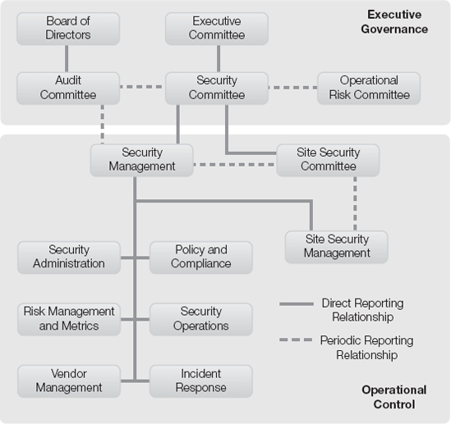
Security Organizational Structure

Slide 21
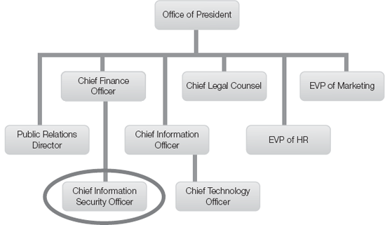
CISO reporting directly to CFO

Slide 22
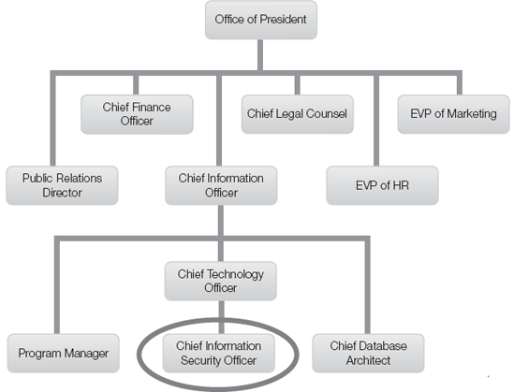
CISO organizational chart - CISO role appears several layers deep

Slide 23
EXPLORE: CONTEXT

Slide 24
Importance of Governance and Compliance
Implementing a governance framework can allow the organization to identify and mitigate risks in an orderly fashion
This can be a cost reduction move for organizations as they can easily respond to audit requests
A well-defined governance and compliance framework provides a structured approach
It can provide a common language

Slide 25
Importance of Governance and Compliance (cont’d)
It is also a best-practice model for organizations of all shapes and sizes
Controls and risks become measurable with a framework. Thus, organizations that have a governance and compliance framework can operate more efficiently
If you can measure the organization against a fixed set of standards and controls you have won

Slide 26
Security Policy Framework-Business Risks
Strategic risks is a broad category focused on an event that may change how the organization operates
Strategic
risks
Compliance risks relate to the impact of the business failing to comply with legal obligations
Financial risks is the potential impact when the business fails to have adequate liquidity to meet its obligations
Operational risks is a broad category that describes any event that disrupts the organization’s daily
activities
Compliance risks
Financial risks
Other risks is a broad category that relates to all other non-IT specific events
Operational risks
Other risks

Slide 27
EXPLORE: RATIONALE

Slide 28
Separation of Duties (SOD)
Layered security approach
Using layered security provides redundancy of layers, so if one fails to catch the risk, another layer should. Thus, the more layers the better the chance that a risk will be mitigated. However, one must remember that cost and restrictions are also present with each layer deployed
Domain of responsibility and accountability
These SOD duties fall within each individual domain and applying SOD can and will reduce both fraud and human errors

Slide 29
Summary
In this presentation, the following were covered:
Information systems security policy frameworks and IT security controls
Difference between GRC and ERM
Business risks associated with security policy framework
Roles and responsibilities associated with information systems security policy framework and SOD

Slide 30
Discussion and Assignments
Discussion 4: Separation of Duties (SOD)
Assignment 4: Security Policy Creation

Slide 31
Lab Activities
Lab is in the lab manual on cms
Lab 4: Craft a Layered Security Management Policy - Separation of Duties
Reading Assignment 4, Chapter 8

