Slide 1

IAP301 Policy Development in Information Assurance
Lecture 7. Risk Management

Slide 2
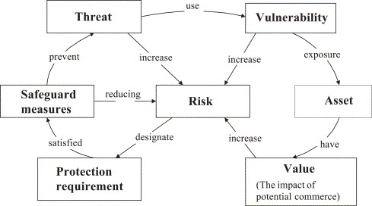
Learning Objective
Describe the different information security systems (ISS) policies associated with risk management.

Slide 3
Key Concepts
Business risks related to information systems
Risks associated with the selected business model, and describe policies related to business impact analysis (BIA)
Policies specific to risk assessment, business impact analysis (BIA), and business continuity planning (BCP)
Policies connected with disaster recovery planning (DRP)
Differences between public and private examples of risk management policies

Slide 4

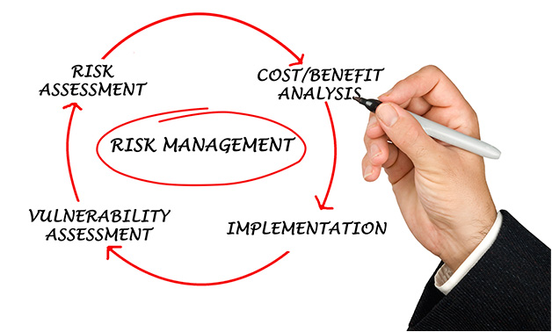
Group discussion.
What is data classification an why is it important?
Different between Risk Management and Risk Assessment?
What is meant by Business Impact Analysis (BIA), Business Continuity Plan (BCP), and Disaster Recovery Plan (DRP)

Slide 5
EXPLORE: CONCEPTS

Slide 6
Data Classification
Of all risk management policies, perhaps none is more likely to be missing from a company’s portfolio than the Data Classification Policy.
A data classification policy must address the following issues:
  Definition of classes
  Discovery of data
    Default classification
    Initial classification
    Reclassification
    Declassification
  Assignment of documents to classes
  Monitoring and enforcing the policy
  Making adjustments as necessary

Slide 7
Military Classification Scheme
The U.S. military classification scheme is defined in National Security Information document Executive Order (EO) 12356.
  Top Secret - Data that the unauthorized disclosure would reasonably expect to cause grave damage to the national security
  Secret - Data that the unauthorized disclosure would reasonably expect to cause serious damage to the national security
  Confidential - Data that the unauthorized disclosure would reasonably expect to cause damage to the national security

Slide 8
Military Classification Scheme (cont’d)
This type of data has two classification levels:
  Sensitive but unclassified - Confidential data not subject to release under the Freedom of Information Act
  Unclassified - Data available to the public

Slide 9
Commercial Data Classification Scheme
Although there is no universally accepted commercial data classification scheme, the following is typical:
  Highly Sensitive - Data that is mission critical or highly regulated. Unauthorized disclosure would have a serious impact on business operations or organizational reputation.
  Sensitive - Data that is important but not vital to the organization. Unauthorized disclosure would have some impact on business operations or organizational reputation.
  Internal - Propriety data use for internal purposes only. Unauthorized disclosure would have little to no impact on business operations or organizational reputation.
  Public - Data available to the public.

Slide 10
Risk Management Policies
Risk avoidance is primarily a business decision, typically defined by an organization’s risk appetite and risk threshold.
Public and private differ in how they approach this risk decision:
  Public organizations cannot avoid high risk, such as police departments
  Private organizations can avoid risk with strategic decisions as to where to place their data centers, out of storm paths

Slide 11
Risk Management Policies (cont’d)
The power to choose what risk to accept is the main difference between public and private organizations

Slide 12
EXPLORE: ROLES

Slide 13
Roles and Responsibilities
Risk Manager
  Manages risk, creates the BIA
Auditor
  Conducts Assurance functions relating to data classification policies, assists in the BIA
Data Owners
  Own the data responsible for data creation, access, use, transmission, classification process, develops data retention, disposal policies

Slide 14
Roles and Responsibilities (cont’d)
Information Technology (IT) Management
  Develops BCP, DRP, works with data owners to determine what data needs to be backed-up based on data classification process, manages data storage and transmission.
Security Manager
  Supports BCP, DRP process, allocates full-time employees (FTEs) to be part of teams set up to manage BCP, DRP functions.
Executive Management
  Supports policy creation functions, BCP and DRP effort, and allocates funding

Slide 15
EXPLORE: CONTEXT

Slide 16
Data Handling Policies
Policies, Standards, and Procedures must be defined regarding data during:
  Creation - During creation, data must be classified. That could be simply placing the data within a common storage area
  Access - Access to data is governed by security policies. Special guidance is provided on separation of duties (SoD)
  Use - Use of data includes protecting and labeling information properly after its access
  Transmission - Data must be transmitted in accordance with policies and standards

Slide 17
Data Handling Policies (cont’d)
    Storage—Storage devices of data must be approved. This ensures that access to the device is secured and properly controlled
    Physical Transport—Transport of data must be approved. This ensures that the data leaves the confines of the private network and is protected and tracked
    Destruction—Destruction of data is sometimes called “disposal.” When an asset reaches its end of life, it must be destroyed in a controlled procedure

Slide 18
EXPLORE: RATIONALE

Slide 19
Incident Management Policies
A minimum of four policy frameworks must be defined to manage an organization’s response to “out-of-bounds” conditions.
  Incident Response - manages the initial response to all “out-of-bounds” conditions.
  Business Impact - establishes a mechanism for prioritizing the data and systems of an organization based on business need.
  Business Continuity - specifies a strategy for minimizing the likelihood that any out-of-bounds conditions will interrupt normal business operations.
  Disaster Recovery - defines a means for restoring data and systems to normal operations following a severe out-of-bounds condition.

Slide 20
BIA, BCP, and DRP Policies
BIA (Business Impact Analysis) policy- The BIA is used to develop business continuity plans to minimize losses
BCP (Business Continuity Plan) Policies - The BCP policies outline the guidance for building a plan such as key assumptions, accountabilities, and frequency of testing
Notes:
Business Continuity Plan
(c) ITT Educational Services, Inc.

Slide 21
BIA, BCP, and DRP Policies (cont’d)
DRP (Disaster Recovery Plan) Policies - The policies and documentation needed for an organization to recover their IT assets such as software, data, and hardware during a disaster

Slide 22
Summary
In this presentation, the following were covered:
  Data classification based on military scheme
  Risk management policies for private and public sector
  Roles and responsibilities associated with risk management policies
  Data handling policies
  BIA, DRP, and BCP policies

Slide 23
Discussion and Assignment
Discussion 7: Fear of Hacking Survey
Assignment 7: Risk Management in a Business Model

Slide 24
Lab Activities
Lab is in the lab manual on cms
Lab 7: Identify Necessary Policies for Business Continuity - BIA & Recovery Time Objectives, Focusing on Three Additional Security Requirements Identified in ref.[3]:
  Incident Response (3.6)
  Risk Assessment (3.11)
  Security Assessment (3.12)
Reading Assignment 7, Chapter 11

