Slide 1
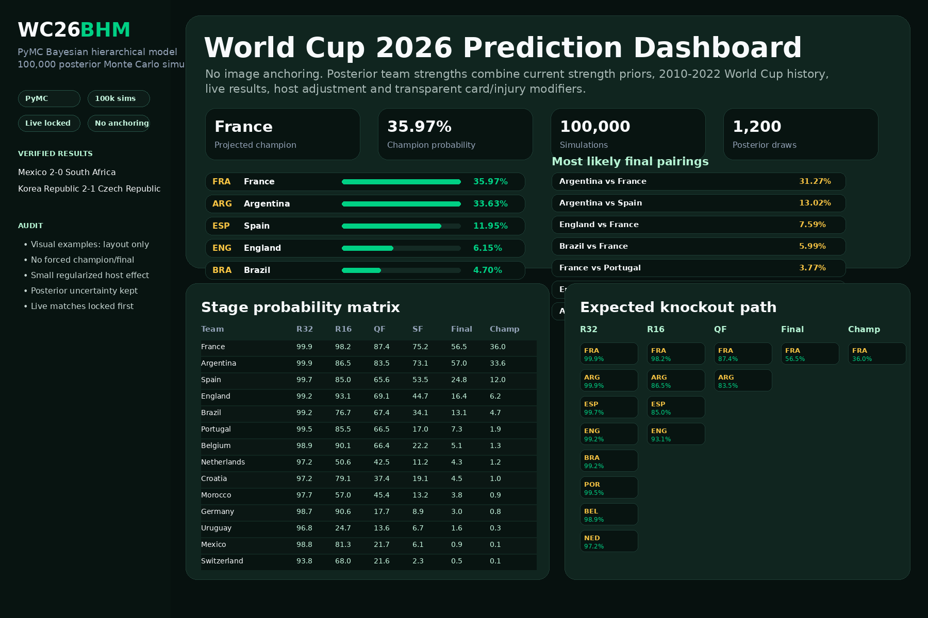
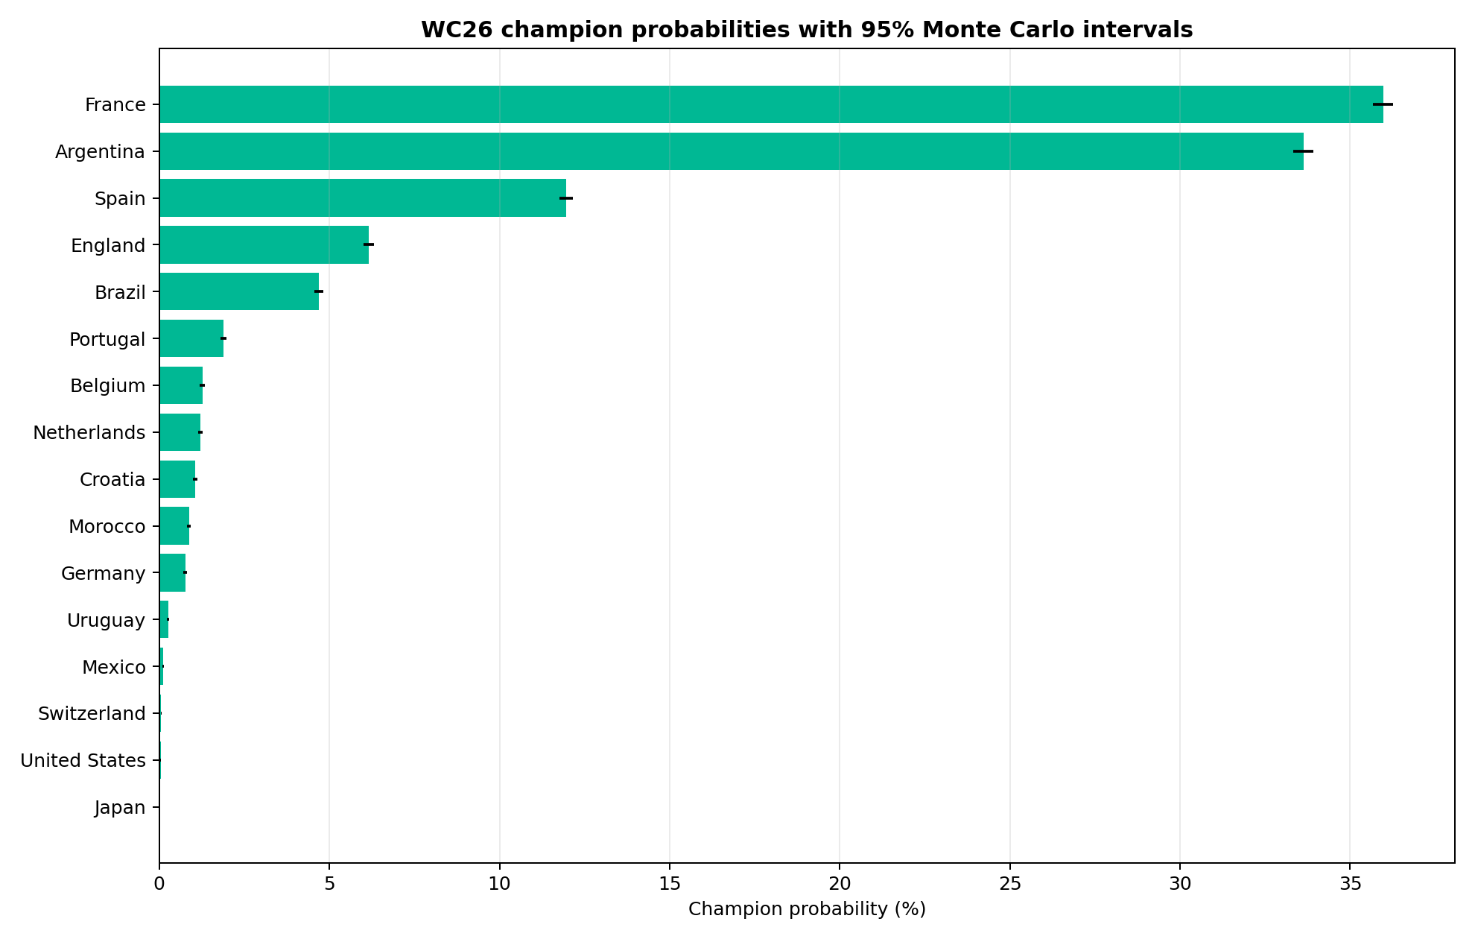
WC26 Bayesian Hierarchical Simulation
PyMC BHM + 100,000 posterior Monte Carlo tournaments + dashboard-ready outputs

Slide 2
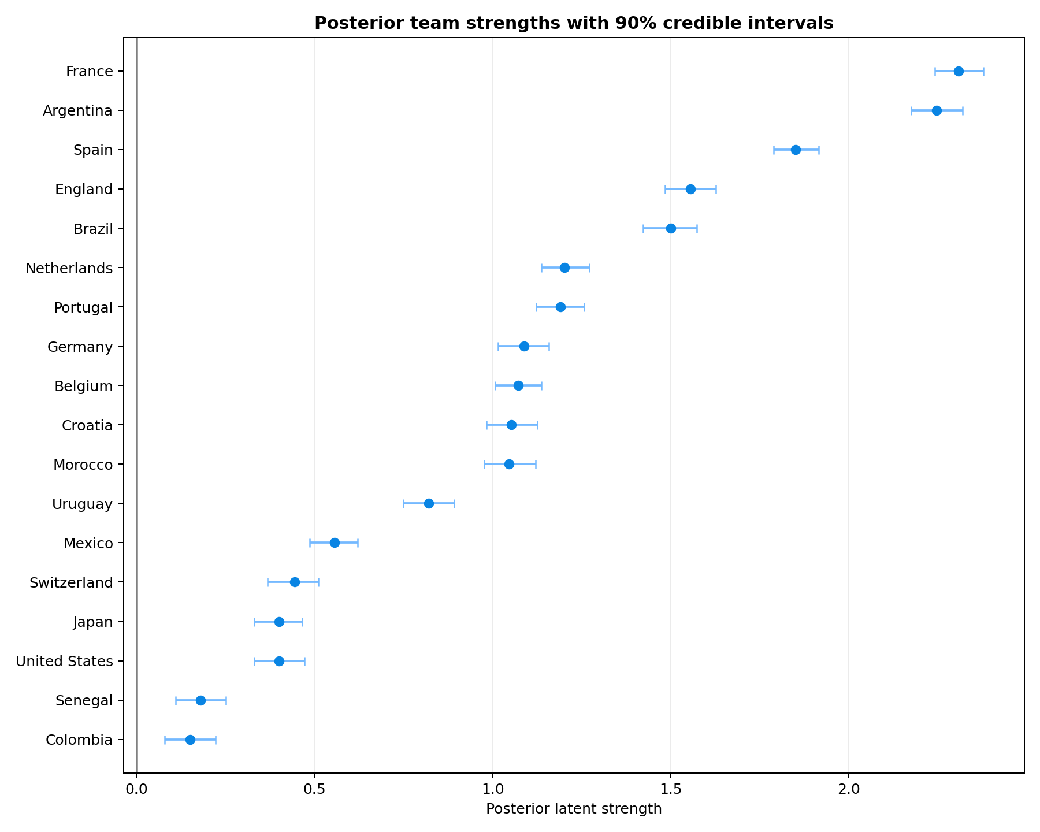
Model architecture
No hand-picked champion; predictions come from posterior simulation.
PyMC Bayesian hierarchical model
Current-strength prior + WC history
Live results locked before simulation
Regularized host effect
Card/injury adjustment layer
100,000 tournament simulations

Slide 3
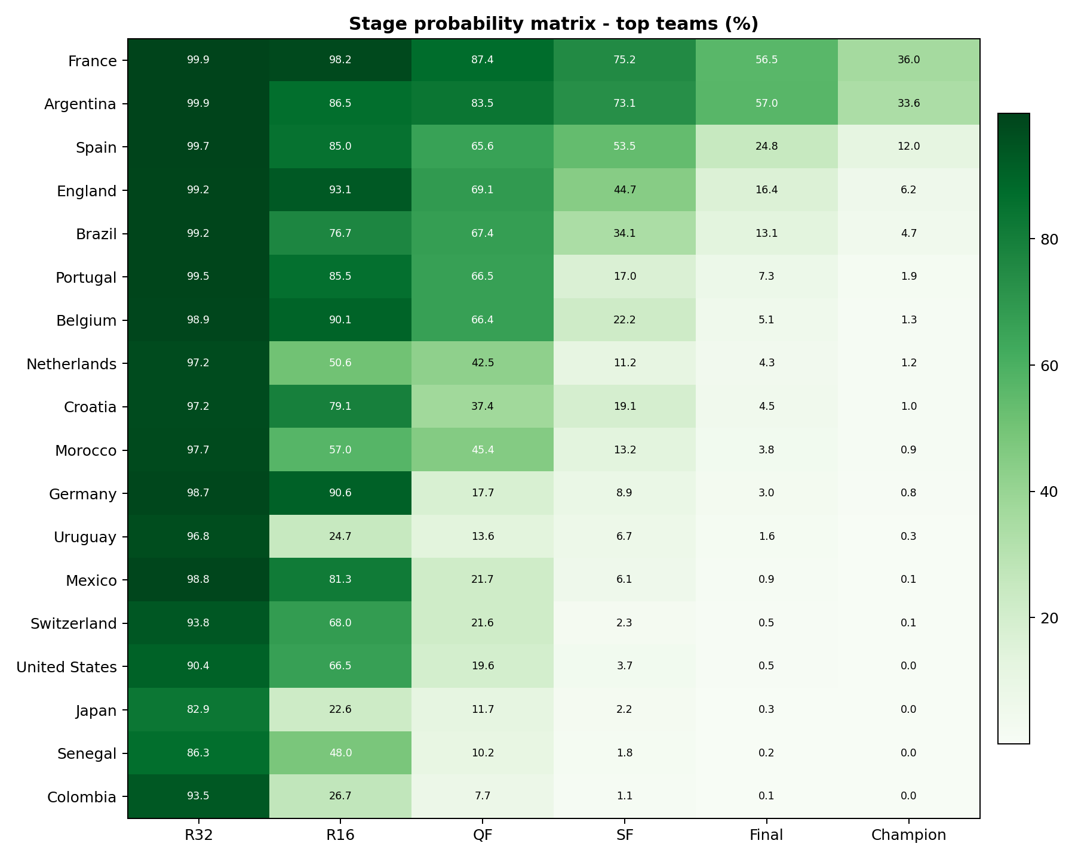
Stage probability matrix
Uncertainty is tracked round-by-round.

Slide 4
Dashboard view
Rendered from local dashboard files and local SVG flag assets.

Slide 5
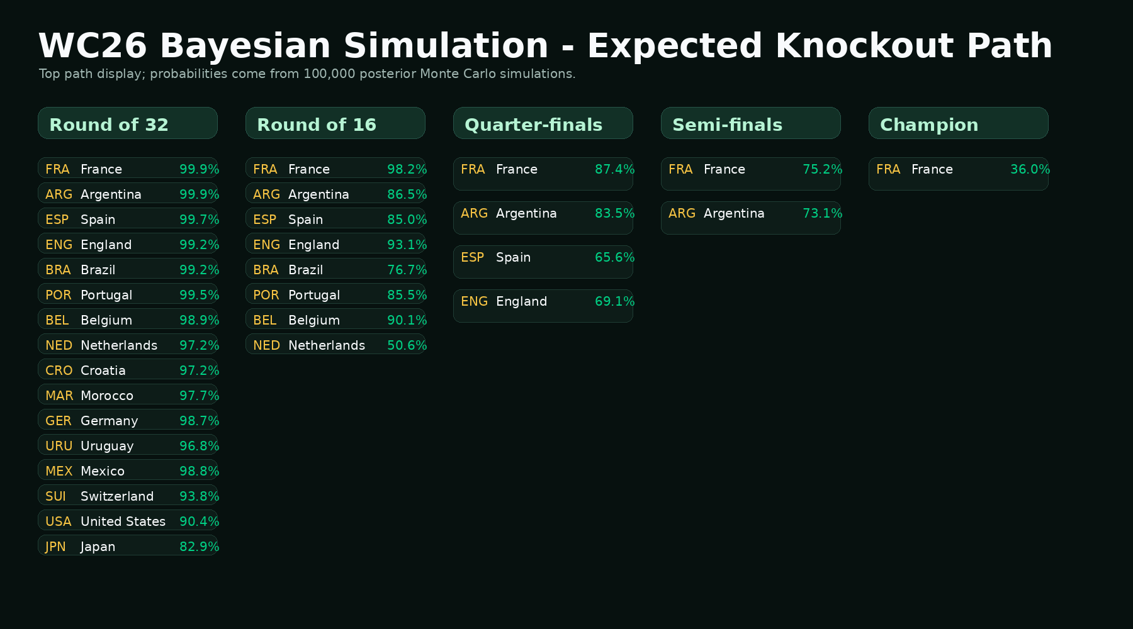
Expected knockout path
Bracket-style reporting view.

Slide 6
Bias audit
Visual examples are layout references only.
• No sample-image outcomes used as model input
• No finalist or champion manually forced
• Host advantage controlled and small
• Live results verified before inclusion
• Uncertainty reported with posterior and MC intervals

