Slide 1







Current Technology Usage and Future Trends
Mike G
08/08/2024

Slide 2



OUTLINE
Executive Summary
Introduction
Methodology
Results
Visualization – Charts
Dashboard
Discussion
Findings & Implications
Conclusion
Appendix

Slide 3

EXECUTIVE SUMMARY
Competitive Nature of IT Industry: The IT industry is dynamic and competitive, necessitating continuous updates to programming skills and database knowledge.
Project Objective: This project aims to analyze and identify key trends within the IT industry.
Key Areas of Analysis:
Current Technology Usage: Assessing the current state of programming languages, databases, and platforms used.
Future Technology Trends: Predicting upcoming trends in programming languages, databases, and platforms.
Demographics in IT Industry: Understanding the distribution of gender, age, and education levels in IT.
Goals:
Identifying top Programming Languages in the industry.
Top Database Skills in high demand.
Popular IDEs among professionals.

Slide 4

INTRODUCTION
Emerging Trends and Future Skills:
Top Programming Languages in Demand
Top Database Skills in Demand
Popular IDEs
Data Collecting Sources:
Job Postings
Training Portals
Surveys
Role of Data Analyst:
Context: Working in a global IT and business consulting firm known for expertise in IT solutions.
Objective: Regularly analyze data to identify future skill requirements and keep pace with changing technologies.

Slide 5

METHODOLOGY
Data Sources:
Stack Overflow
Survey Data Technologies:
Current Trends: Based on Language, Database, Platform & Web Frame used or worked.
Future Trends: Interest in learning new Language, Database, Platform & Web Frame.
Demographics Data:
Gender (Man and Woman), Age, Formal Education Level & Countries
Data Filtering:
Cleaned empty or Null entries
Filtered to include only Man and Woman
Illustration and Analysis Tools:
Python Libraries: Numpy, Matplotlib, Pandas & Seaborn
IBM Cognos Analytics Dashboard
Jupyter Notebook:
Data Cleaning
Data Science Analysis

Slide 6
RESULTS
Comparison Results:
Programming Language Trends
Compare current and future trends in programming languages.
Database Trends
Analyze current versus future database usage trends.
IDE Trends
Evaluate the changes in popularity of IDEs over

Slide 7
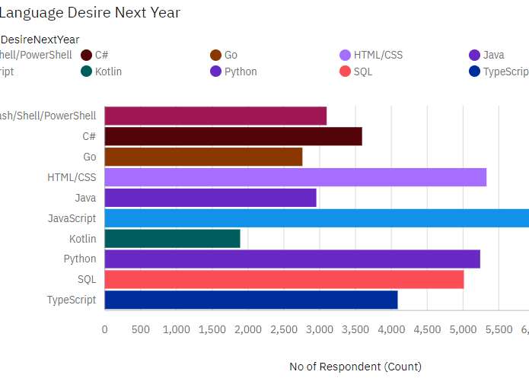
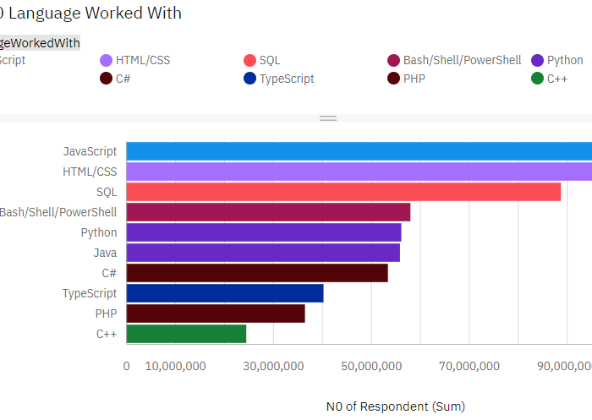
PROGRAMMING LANGUAGE TRENDS
Next Year
Current Year

Slide 8
PROGRAMMING LANGUAGE TRENDS - FINDINGS & IMPLICATIONS
Findings
JavaScript is the top most demanded for current and future programming language.
Significantly Increasing desire for Python
The trends of programming language has shifted
Top 5 language:
JavaScript, Python, HTML, SQL, TypeScript
Implications
JavaScript is still most popular and widely used in programming language in IT industry.
Python has become a new desired and required skills in IT industry.
The Desire Skill for programming language has certainly Shifted.
Top 5 desired language:
JavaScript, Python, HTML/CSS,SQL, TypeScript

Slide 9
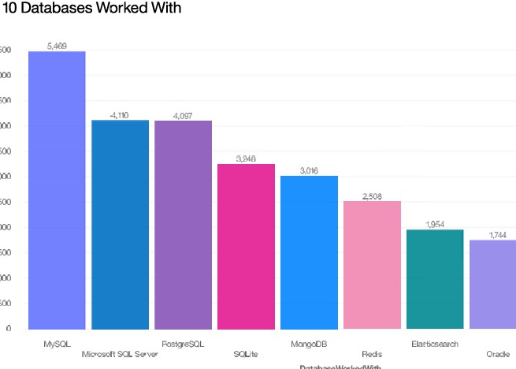
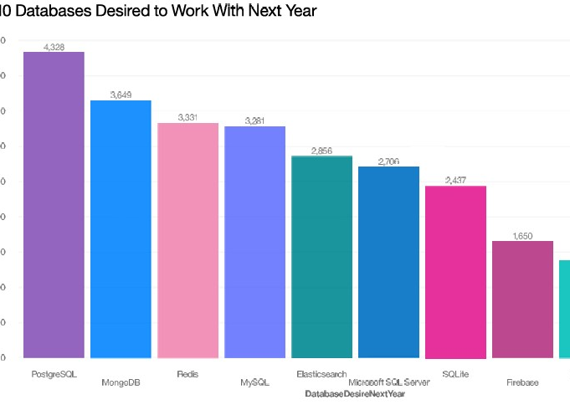
DATABASE TRENDS
Next Year
Current Year

Slide 10
DATABASE TRENDS - FINDINGS & IMPLICATIONS
Findings
PostgreSQL, MongoDB, Redis have become the most desired Database.
MongoDB, Redis, Elasticsearch are becoming increasingly popular for desiredDatabased roughly 10,000 increased in respondants.
Oracle Database has become less popular and less desired
Drastic increase in the desire database skills especially for MongoBD and DynamoBD
Implications
PostgreSQL, MongoDB,Redis,MySQL,Elasticsearch are the desired and most used Database.
MongoDb, Redis,Elasticsearch have new and better functionalities or services.
Oracle Database is to avoid
Usage of DynamoBD more research may needed.

Slide 11
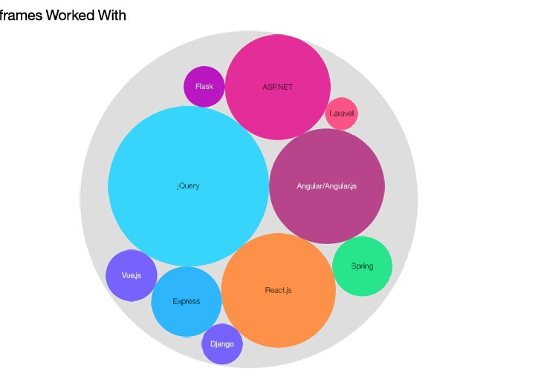
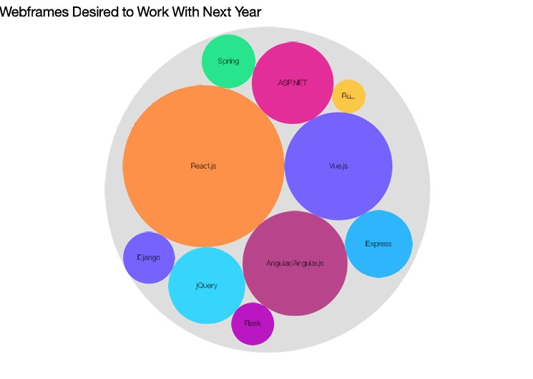
IDE TRENDS
Next Year
Current Year

Slide 12
IDE TRENDS - FINDINGS & IMPLICATIONS
Findings:
There shows a trend in IDEs:
The user for jQuery has drastically decreased.
React.js and Vue.js have dramatically increase for the desire IDE as compared to current WebFrame worked with as illustrated in the hierarchy buble.
Implications:
People are shifting to use a better webframe such as React.js or Vue.js
jQuery might be lacking of some functionality as compare to webframe competitors
jQuery can be omitted from the new requirements of new technological skills

Slide 13

DASHBOARD GITHUB LINK
https://github.com/Mg2024coursera/IBM-Capstone-Project/tree/main

Slide 14
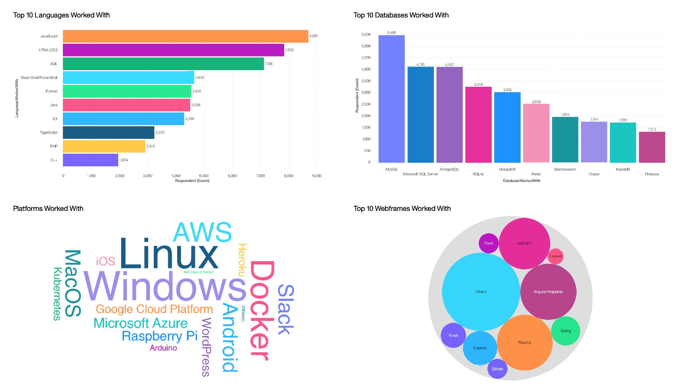
DASHBOARD TAB 1 – Current Technology Usage

Slide 15
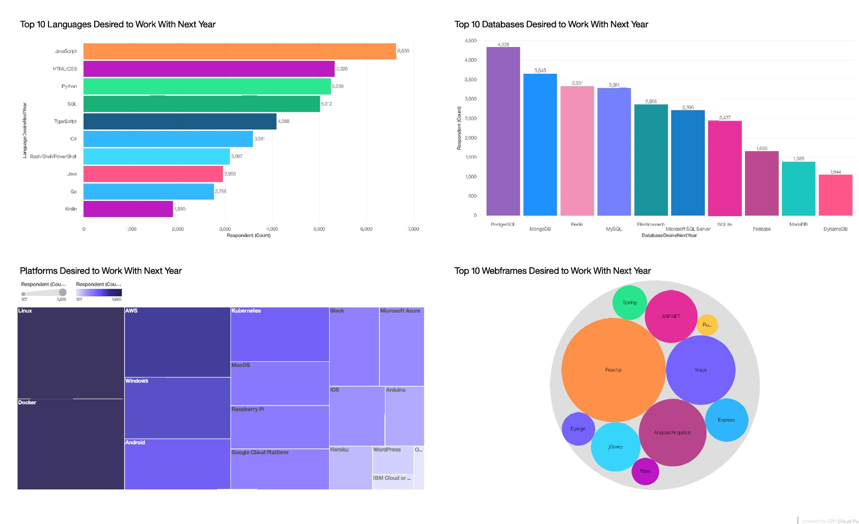
DASHBOARD TAB 2 – Future Technology Trend

Slide 16
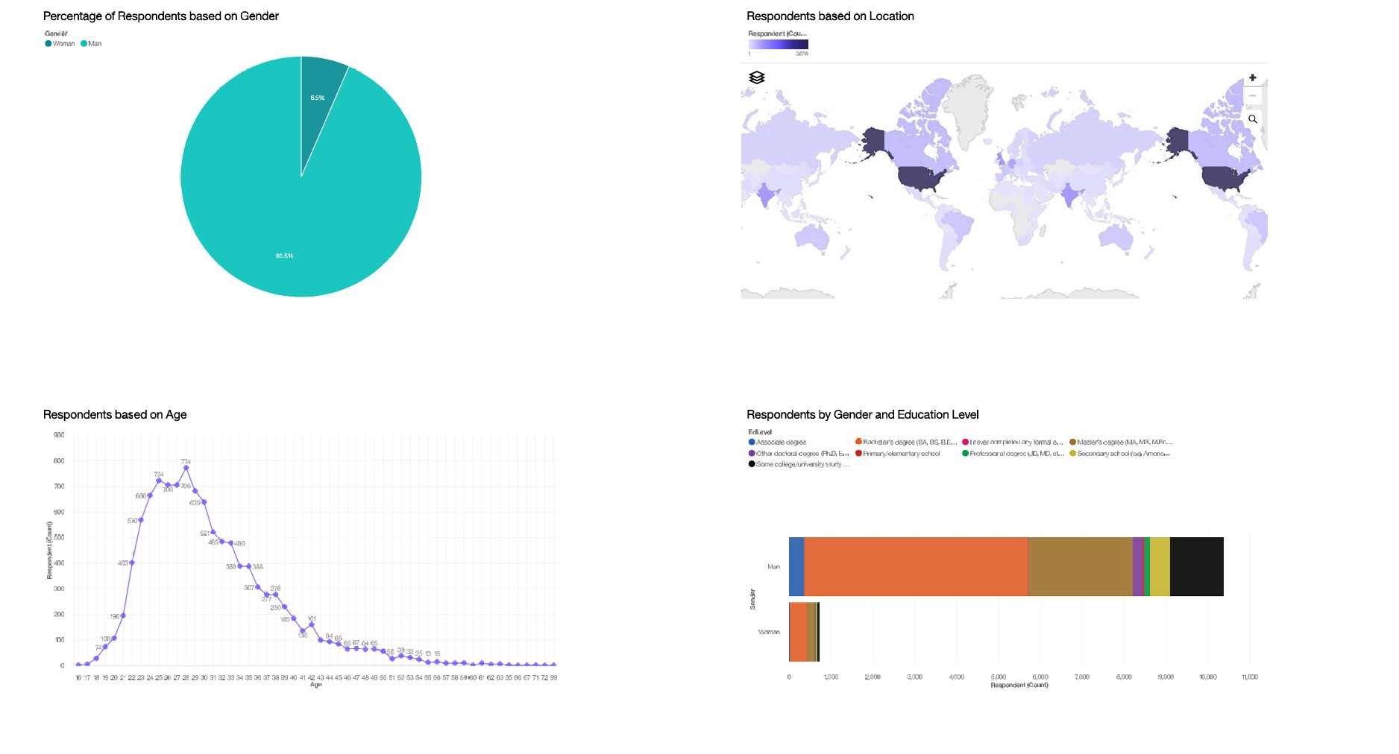
DASHBOARD TAB 3 – Demographics

Slide 17
DISCUSSION
Must-Have Skills and Desirable Future Trends:
Languages are gaining significant popularity
JavaScript
Python
HTML/CSS
SQL
TypeScrip
Databases which are becoming more popular options
PostgreSQL
MongoDB
Redis
MySQL
Elasticsearch
Popular IDEs:
React.js
Angular/Angular.js
Vue.js
jQuery
ASP.NET

Slide 18
OVERALL FINDINGS & IMPLICATIONS
Findings
Top Desired Programming Languages:
JavaScript, Python, HTML/CSS, SQL, TypeScript
Top Desired Databases:
PostgreSQL, MongoDB, Redis, MySQL, Elasticsearch
Popular IDEs:
React.js, Angular/Angular.js, Vue.js, jQuery, ASP.NET
The trends shows a drastic changes in Desire for next year programming languages, Database and IDEs
Implications
Future Skills Requirements implements:
Programming Language:
JavaScripts, Python, HTML/CSS,SQL, TypeScript
Database:
PostgreSQL, MongoDB,Redis, MySQL, Elasticsearch
IDEs:
React.js, Angular/Angular.js,Vue.js , jquery & ASP.net
There are a few Databases that are also increasingly desire such like DynamoBd
The numbers of Skills requirements to be able to be competitive in the IT industry has been changing in the vast development and redefine of current technology

Slide 19

CONCLUSION
Unbiased Data Analysis:
Open source data from Stack Overflow helps avoid data bias.
Shift in Technology Trends:
Changes in current technology usage highlight the need for updated skills.
Updated Skill Requirements:
Programming Languages:
JavaScript, Python, HTML/CSS, SQL, TypeScript
Databases:
PostgreSQL, MongoDB, Redis, MySQL, Elasticsearch
IDEs:
React.js, Angular/Angular.js, Vue.js, jQuery, ASP.NET
Key Takeaway:
To remain competitive, IT professionals must adapt to evolving trends in programming languages, databases, and IDEs.

Slide 20

APPENDIX
file named popular-languages.csv
Language | Average Annual Salary
Python | $114,383
Java | $101,013
R | $92,037
Javascript | $110,981
Swift | $130,801
C++ | $113,865
C# | $88,726
PHP | $84,727
SQL | $84,793
Go | $94,082

Slide 21
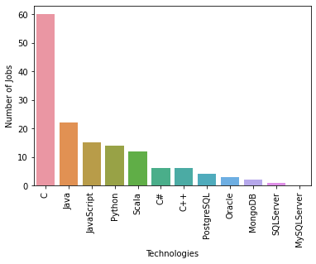
JOB POSTINGS
In Module 1 you have collected the job posting data using Job API in a file named “job-postings.xlsx”. Present that data using a bar chart here. Order the bar chart in the descending order of the number of job postings.

Slide 22
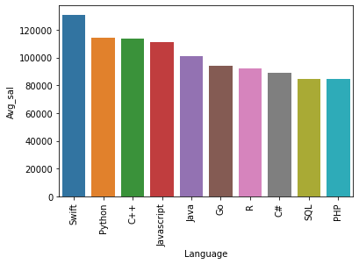
POPULAR LANGUAGES
In Module 1 you have collected the job postings data using web scraping in a file named “popular-languages.csv”. Present that data using a bar chart here. Order the bar chart in the descending order of salary.

