Slide 1
Java Collections
Jeremy Hawks – CIT 360

Slide 2
Collections in Java
A collection is a group of individual objects represented as a single unit
The Collection Framework defines several classes and interfaces to represent a group of objects as a single unit
The Collection interface (java.util.Collection) and Map interface (java.util.Map) are the two main “root” interfaces
Prior to the Collection Framework, grouping of objects was done in Arrays, Vectors, or Hashtables, but there was no common interface and was difficult as each had a different method for accessing members.

Slide 3
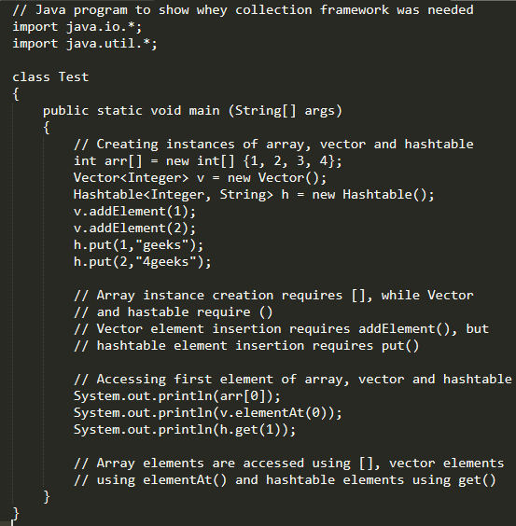

Non-Collection Example
Notice that there is no standard member access interface and that it is difficult to write algorithms that work for all kinds of Collections.

Slide 4
Advantages of Collection Framework
Consistent API with a basic set of interfaces like Collection, Set, List, or Map and all classes (ArrayList, LinkedList, Vector, etc.) implement these interfaces and have some common set of methods
Reduces programming effort as you do not need to worry about the design of the Collection as much
Increases program speed and quality by providing high-performance implementations of useful data structures and algorithms

Slide 5
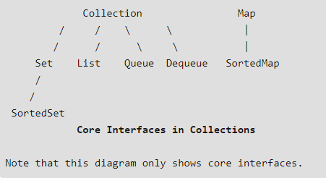
Hierarchy of Collection Framework (1)

Slide 6
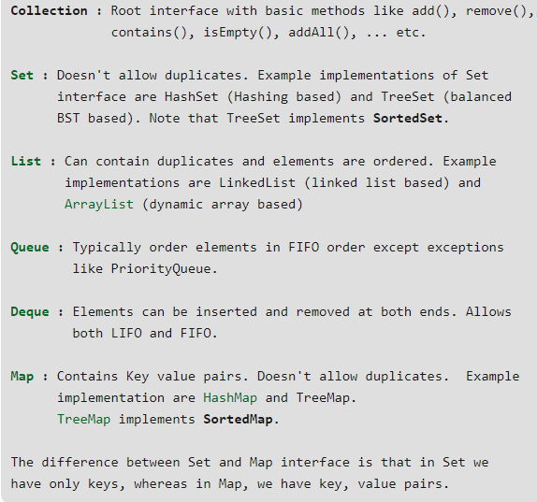
Hierarchy of Collection Framework (2)

Slide 7
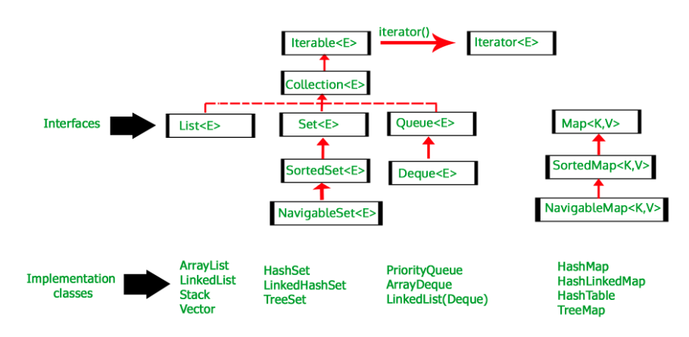
Hierarchy of Collection Framework (3)

