Slide 1
Threads, Executors, Runnables
Jeremy Hawks – CIT 360

Slide 2
Parallel Processing Options
Threads
Oldest option using the java.lang.Thread class
Runnable
Newer option using java.lang.Runnable is more modular and thus easier to create and maintain
Executors
Newest option using java.util.concurrent.Executors creates multi-threaded applications and contains pools of threads and uses Runnables

Slide 3

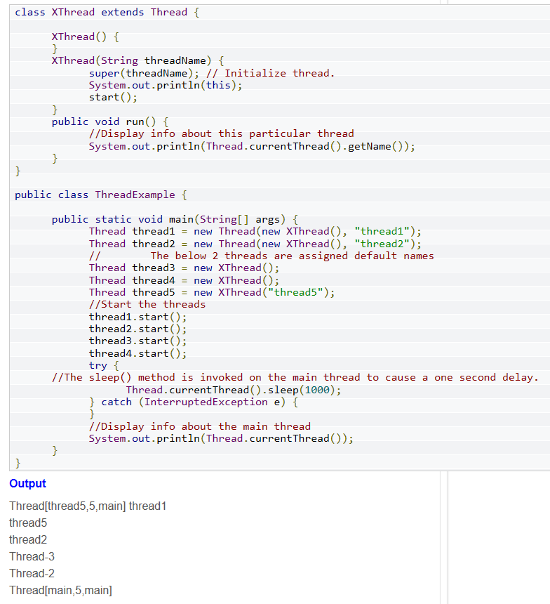
Threads
A class extending the Thread class overrides the run() method
This subclass may call a Thread constructor explicitly in its constructors to initialize the thread, using the super() call.
The start() method inherited from the Thread class is invoked on the object of the class to make the thread eligible for running

Slide 4
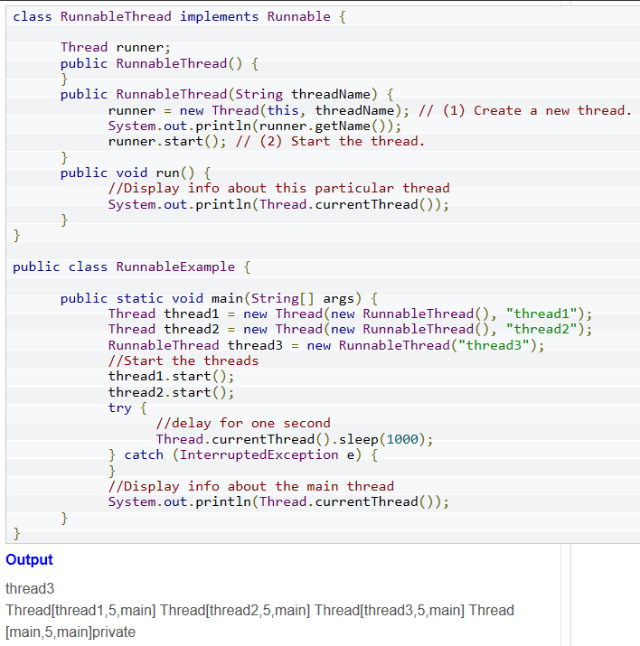
Runnable
A class implements the Runnable interface, providing the run() method that will be executed by the thread (a Runnable object)
An object of Thread class is created by passing a Runnable object as an argument in the Thread constructor. The Thread object now has a Runnable object that implements the run() method
The start() method is invoked on the Thread object and runs immediately after a thread has been spawned
The thread ends when the run() method ends, either by normal completion or by throwing an uncaught exception

Slide 5
Executors (pt. 1)
The java.util.concurrent package defines three executor interfaces: Executor, ExecutorService, ScheduledExecutorService
The Executor interface accepts Runnable objects.
The ExecutorService interface provides a more versatile submit method. It accepts both Runnable and Callable objects which allow the task to return a value and provides a number of methods for managing the shutdown of the executor.
The ScheduledExecutorService interface adds the ability to schedule an ExecutorService after a specified delay.

Slide 6
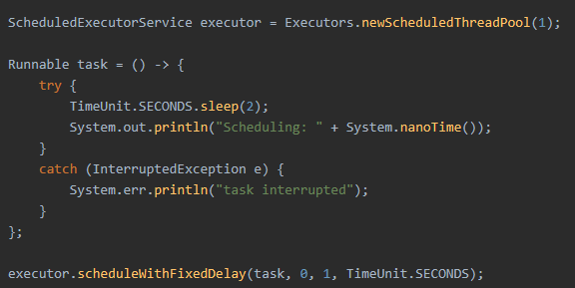
Executors (pt. 2)
Most executor implementations use thread pools which consist of worker threads which exist separately from the Runnable and Callable tasks it executes and is often used to multi-task
Thread objects use a significant amount of memory. Worker threads minimize this improving performance in large scale projects
Fixed thread pools have the advantage of degrading gracefully

