Slide 1
Application Controller Pattern
Jeremy Hawks – CIT 360

Slide 2
APC - Why Do We Need It?
We need to perform checks to validate If-Else statements in our code
Sometimes the If-Else statements are very complex and may include both string and integer checks
String checks are very resource intensive and are usually performed after integer checks, but sometimes it is necessary to perform the string checks first to prevent the false passing of the integer checks
That conflict is why the Application Controller Pattern was designed

Slide 3
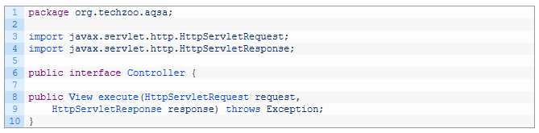
Application Controller Pattern (controller)
Start with a controller interface

Slide 4

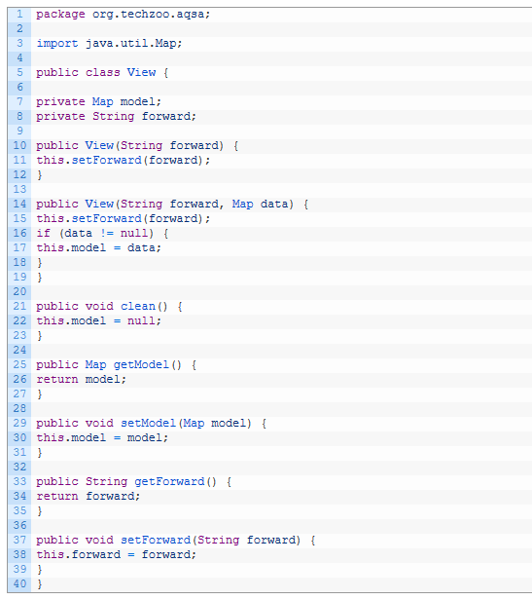
Application Controller Pattern (view)
View.java is a wrapper view resolver to return from the controller’s execute method

Slide 5
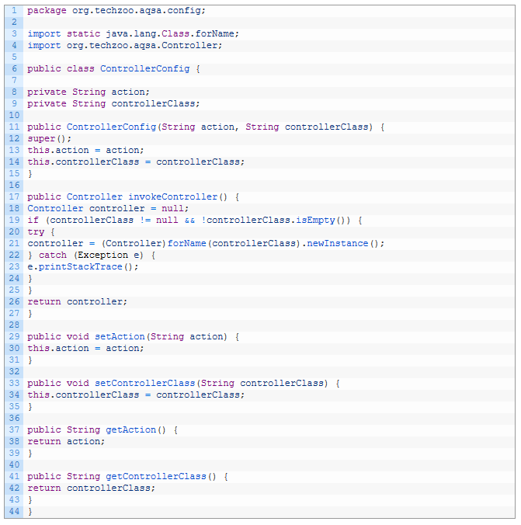
APC (controller config)
ControllerConfig is used to hold the controller’s action with its class name

Slide 6
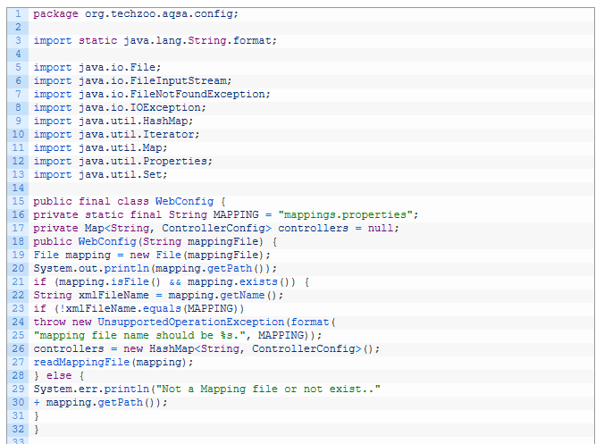
APC (web config pt. 1)
WebConfig is used to manage all of the controllers configured in property files. This class will read and make available all controller objects to the main servlet

Slide 7
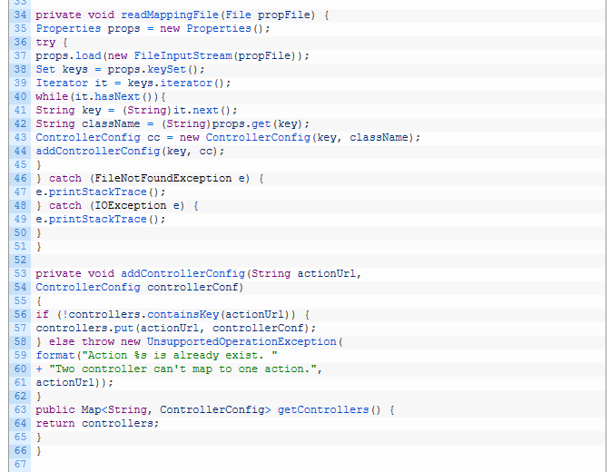
APC (web config pt. 2)
This is the rest of the WebConfig code

Slide 8
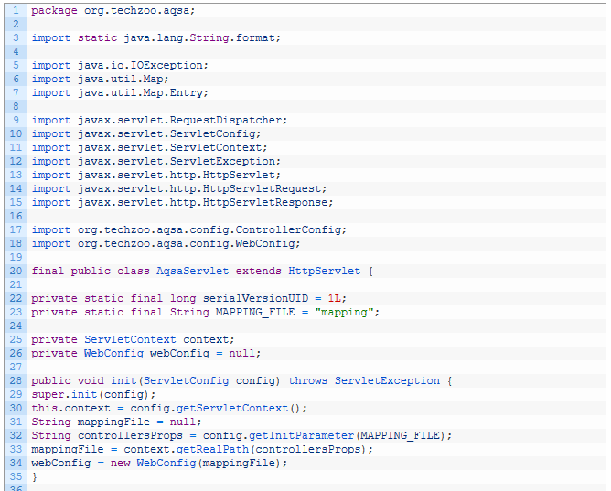
APC (Front Controller servlet pt. 1)
Last is the Front Controller servlet (AqsaServlet) which is a centralized control in the application, a single entry point which manages the protocol handling, request navigation and view dispatching.

Slide 9
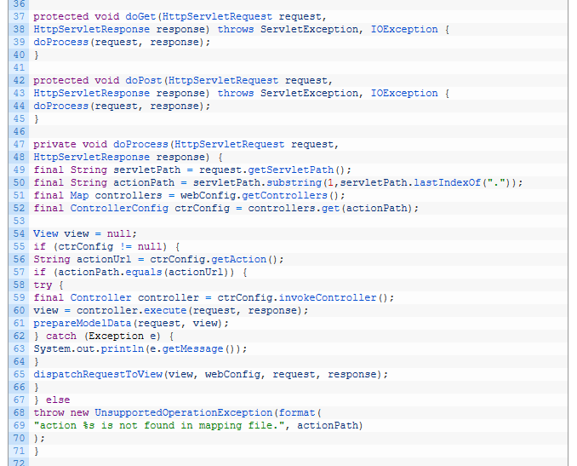
APC (Front Controller servlet pt. 2)
Part two of the front controller servlet code

Slide 10
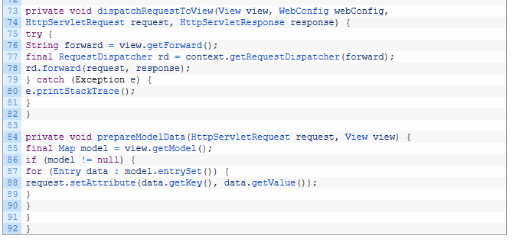
APC (Front Controller servlet pt. 3)
Part three of the front controller servlet code

Slide 11
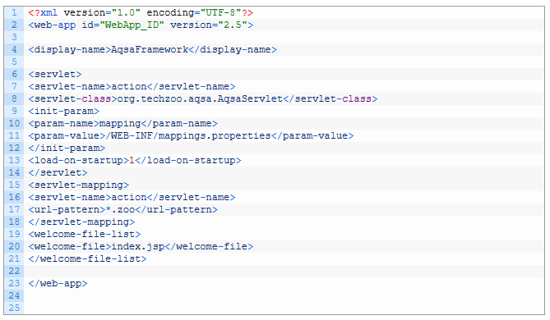
APC (web.xml and controller config)
Web.xml and controller config property files will look similar to:
And #Mapping file contains the key value pair of
Login=com.xpert.controller.LoginController
Register=com.xpert.controller.RegistrationController

Slide 12
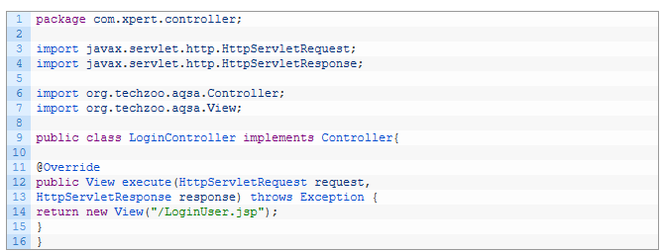
APC (simple controller to test with)

