Slide 1
MVC Model, View, Controller
By Jeremy Hawks for CIT 360

Slide 2
The History of MVC (pt. 1)
Without MVC most coding is done in single files linking to content and possibly a CSS file
For example, a website might consist of multiple html files. Each webpage consists of a single html file. It might link to various content like images and databases, but most of the code and design of the webpage is contained in those single html files.
With the advent of CSS the design of the website was split out to a separate file that is shared with multiple html pages. Changes to the CSS file automatically impact all linked html pages.

Slide 3
The History of MVC (pt. 2)
MVC was actually first used at the Xerox Palo Alto Research Center (PARC) in the 70’s in Smalltalk-76 for desktop computing by Trygve Reenskaug
It was first expressed as a general concept in a 1988 article of The Journal of Object Technology
MVC became popular for use with web applications after the introduction of NeXT’s WebObjects in 1996 (originally written in Objective-C which was largely derived from Smalltalk)
MVC became popular with Java developers when WebObjects was ported to Java, especially after frameworks like Spring (in 2002), Django (in 2005) and Rails (also in 2005 were released)

Slide 4
The History of MVC (pt. 3)
Even though it was originally developed for desktop computing, it has been widely adopted as an architecture for web applications in major programming languages.
Several web frameworks have been created that enforce the pattern
Software frameworks do vary in their interpretation, mainly in the way that the MVC responsibilities are divided between the client and server
Django, Rails, ans ASP.NET has clients send hyperlinks or form submissions to the server which processes nearly the entire model and returns an updated webpage or other document to the client
AngularJS, EmberJS, JavaScriptMVC and Backbone allow partial execution on the client.

Slide 5
What is MVC?
MVC stands for Model, View, Controller
Its goal is to separate the various parts of an application (the data, the display, and the code that accepts input and converts it to commands for the data or display.
This separation allows teams to collaborate on a project and work concurrently on different pieces of the application. The front-end and back-end can be assigned to different groups and can be developed and tested without the impacting the other team

Slide 6
The Components of MVC
Model
This is the applications data and logical structure and is independent of the user interface
View
This is any form of output to the end user. It could be the result of a calculation, the presentation of a chart or diagram, or the graphical display of a site or game
Controller
This is what accepts input from the client and converts it to instructions for the model or view

Slide 7
Pros of MVC
Concurrent development by multiple developers working separately on the model, controller, and views
Logical grouping of related actions on a controller and views for a specific model are grouped together
Loosely coupled system where it is easy to separate the models, views, and controllers
Ease of modification as updating one component typically does not require updating either of the other two
Models can have multiple views

Slide 8
Cons of MVC
Code navigability can be difficult as navigation in the framework can be complex due to the multiple layers of abstraction and it requires users to be familiar with the MVC process
Multi-artifact consistency due to the splitting of a feature into three components and the need for developers to keep multiple representations consistent
High learning curve due to developers needing to be skilled in multiple technologies

Slide 9

How MVC Works

Slide 10
MVC Rules
Users interact with View objects
View objects and Controller objects talk to each other
Different Controller objects talk to each other
Controller objects talk to Model Objects
No other forms of communication between objects are allowed

Slide 11
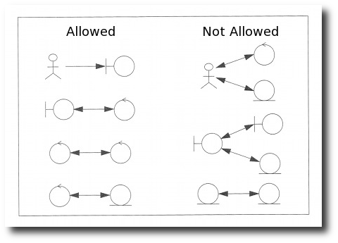
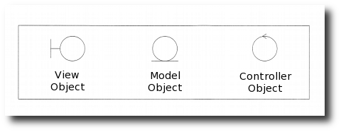
MVC Allowed / Not Allowed Diagram

Slide 12
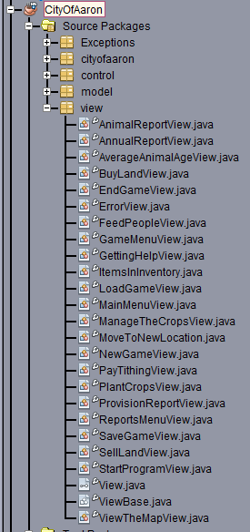
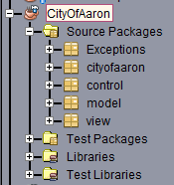
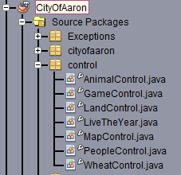
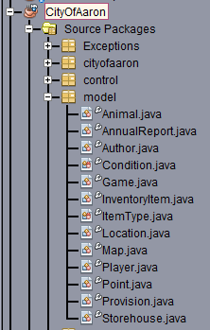
Sample MVC Structure

Slide 13
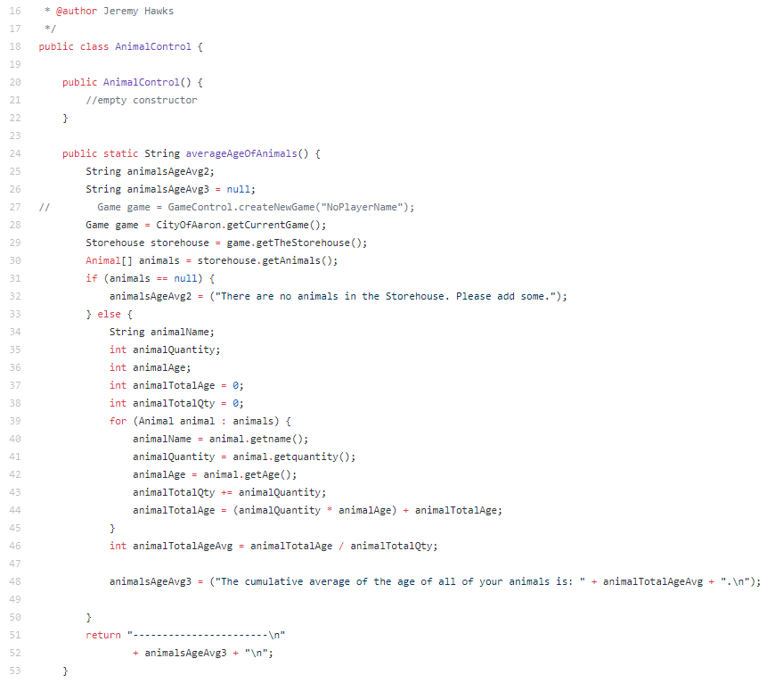
Sample Control
https://github.com/MgaLawin/CityOfAaron-JH-CT-DM/blob/master/CityOfAaron/src/control/AnimalControl.java

Slide 14
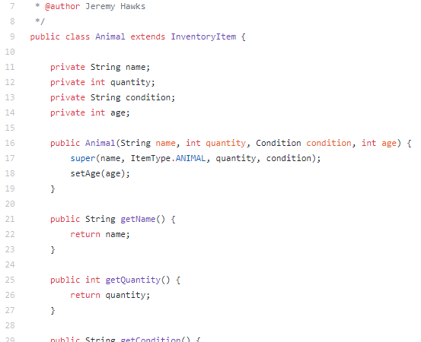
Sample Model
https://github.com/MgaLawin/CityOfAaron-JH-CT-DM/blob/master/CityOfAaron/src/model/Animal.java

Slide 15
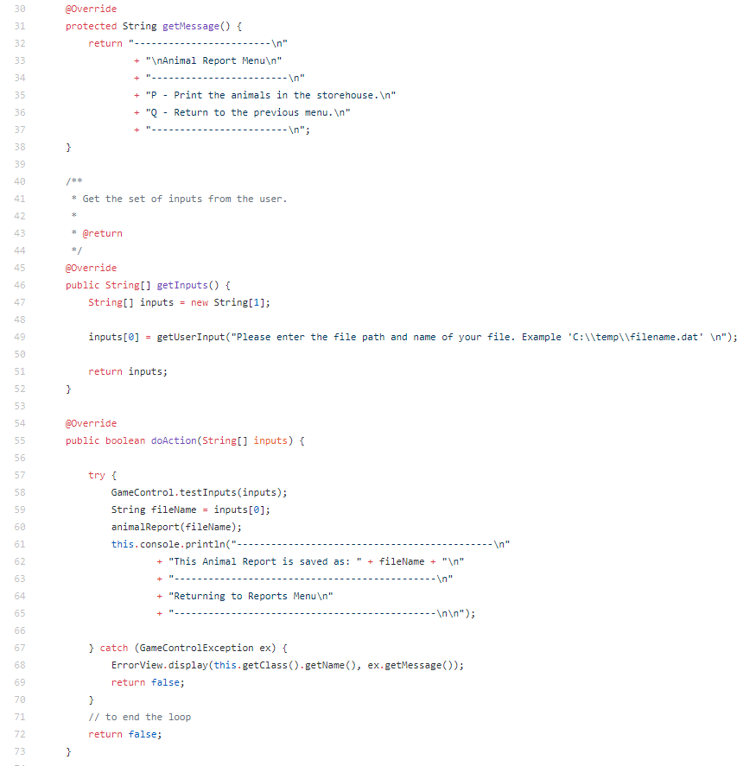
Sample View
https://github.com/MgaLawin/CityOfAaron-JH-CT-DM/blob/master/CityOfAaron/src/view/AnimalReportView.java

