Slide 1
Hibernate
Jeremy Hawks – CIT 360

Slide 2
Hibernate
Hibernate ORM is an object-relational mapping tool for Java. It provides a framework for mapping an object-oriented domain model to a relational database.
It is freely distributed under the GNU Lesser General Public License 2.1
Primary feature is mapping from Java classes to database tables, and mapping from Java data types to SQL data types
Also provides data query and retrieval. It generates SQL calls and relieves the dev from the manual handling and object conversion of the result set

Slide 3
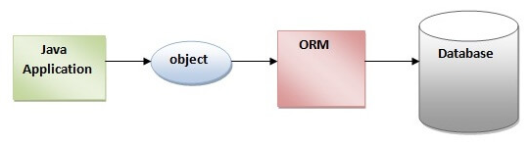
ORM Tool diagram
An ORM tool simplifies the data creation, data manipulation and data access and internally uses the JDBC API to interact with the database.

Slide 4

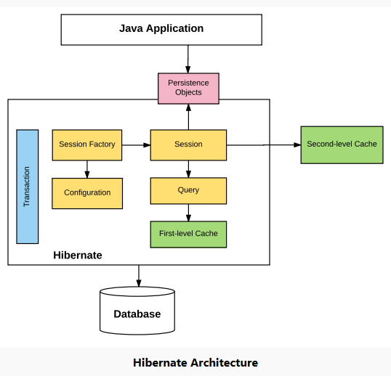
Hibernate Diagram (pt. 1)
Configuration – generally written in hibernate.properties or hibernate.cfg.xml files
Session Factory – Any user application requests Session Factory for a session object. Uses the files listed above to instantiate the session object appropriately
Session – Represents the interaction between the application and the database at any point in time by the org.hibernate.Session class. The instance can be retrieved from the SessionFactory bean

Slide 5
Hibernate Diagram (pt. 2)
Query – allows the application to query the database for one or more stored objects. Hibernate provides different techniques to query a database, including NamedQuery and Criteria API
First-level Cache – represents the default cache used by the Hibernate Session Object while interacting with the database. Also called as session cache and caches objects within the current session. All requests from the Session object to the database must pass through the first-level cache or session cache. The first-level cache is available with the session object until the Session object is live.

Slide 6
Hibernate Diagram (pt. 3)
Transaction – enables you to achieve data consistency and rollback incase something unexpected happens
Persistent objects – are plain old Java objects which get persisted as one of the rows in the related table in the database by hibernate. They can be configured in configurations files (hibernate.cfg.xml or hibernate.properties) or annotated with @Entity annotation.
Second-level cache – is used to store objects across sessions. Needs to be explicitly enabled and you must provide the cache provider for a second-level cache. One of the most common providers is EhCache.

Slide 7
Hibernate Example without IDE
Follow this process
Create the Persistent class
Create the mapping file for Persistent class
Create the Configuration file
Create the class that retrieves or stores the persistent object
Load the jar file
Run the first hibernate application by using the command prompt

Slide 8
Create the Persistent class
A simple Persistent class should follow some rules
A no-arg constructor - to create the instance of the Persistent class by newInstance() method
Provide an identifier property – assign an attribute as id. This attribute behaves as a primary key in database
Declare getter and setter methods – the Hibernate recognizes the method by getter and setter method names by default
Prefer non-final class – Hibernate uses the concept of proxies that depends on the persistent class. The application programmer will not be able to use proxies for lazy association fetching

Slide 9
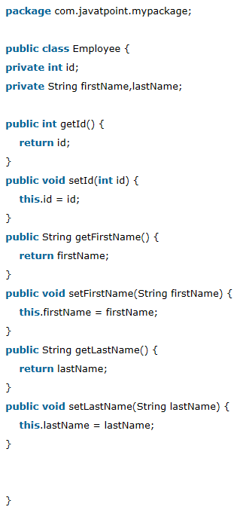
Persistent class example
Employee.java

Slide 10
Create the mapping file for Persistent class
Hibernate-mapping – is the root element in the mapping file that contains all the mapping elements
Class – is the sub-element of the hibernate-mapping element. It specifies the Persistent class
Id – is the sub-element of the class. It specifies the primary key attribute in the class
Generator – is the sub-element of the id. Used to generate the primary key.
Property – is the sub-element of the class that specifies the property name of the Persistent class

Slide 11
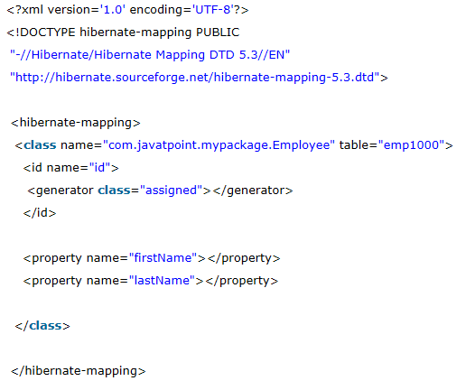
Mapping file example
Employee.hbm.xml

Slide 12
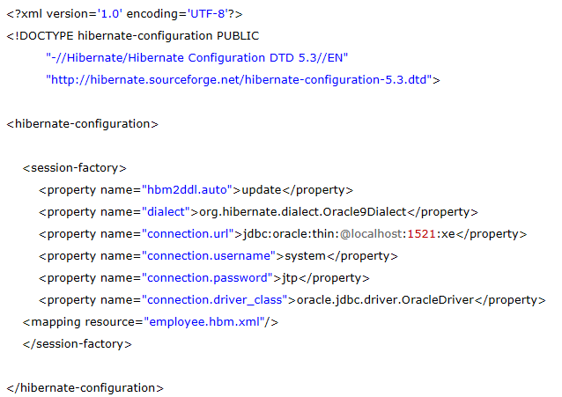
Create the Configuration file
Hibernate.cfg.xml

Slide 13
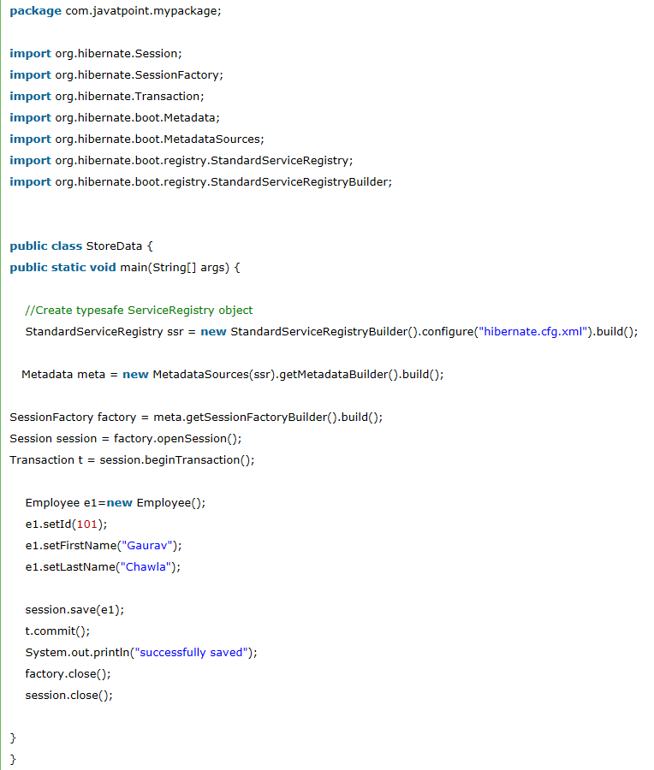
Create the class to retrieve or store the object
In this class we are simple storing the employee object in the database

Slide 14
Run the Hibernate application without an IDE
Install a database (e.g., Oracle10g)
Load the jar files for hibernate (e.g., hibernate5.jar). It is best to put these jar files inside both the public and private JRE folders
Run the StoreData class by:
java com.javatpoint.mypackage.StoreData

