Slide 1
QCJSON & JSON
Jeremy Hawks – CIT 360

Slide 2

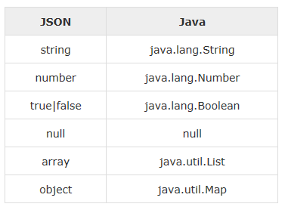
Environment and mapping entities
Prior to encoding or decoding JSON using Java, you need to install any of the available JSON modules (e.g., JSON.simple) and have added the location of the json-simple-1.1.1.jar file to the environment variable CLASSPATH
JSON.simple maps entities from left to right while decoding or parsing, and maps entities from right to left while encoding
On decoding the default concrete class of java.util.List is org.json.simple.JSONArray and the default concrete class of java.util.Map is org.json.simple.JSONObject

Slide 3
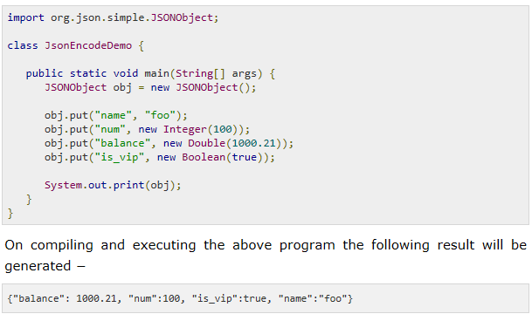
Encoding JSON in Java
The following is a simple example to encode a JSON object using Java JSONObject which is a subclass of java.util.HashMap.
No ordering is provided. If you need the strict ordering of elements, us JSONValue.toJSONString (map) method with ordered map implementation such as java.util.LinkedHashMap.

Slide 4
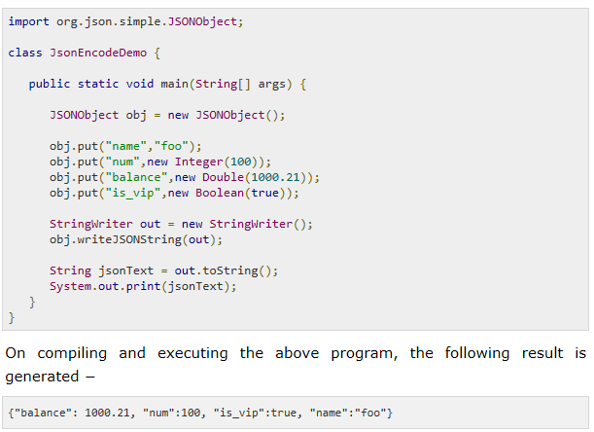
Encoding JSON in Java Example
The following is another example that shows a JSON object streaming using Java JSONObject

Slide 5
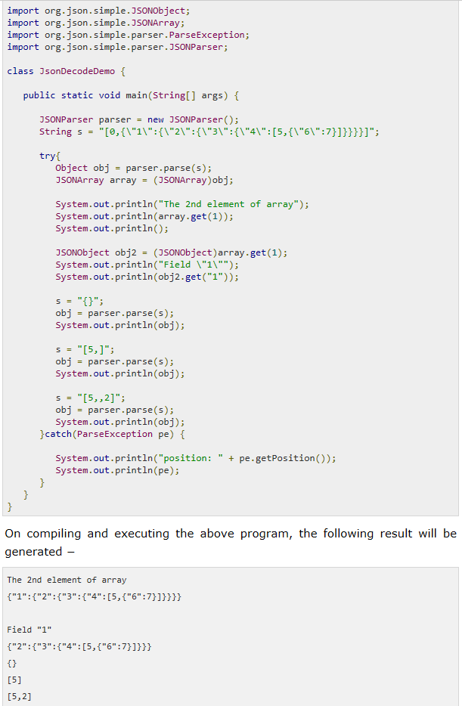
Decoding JSON in Java
The following example makes use of JSONObject and JSONArray where JSONObject is a java.util.Map and JSONArray is a java.util.List, so you can access them with standard operations of Map or List

