Slide 1
Servlets
Jeremy Hawks – CIT 360

Slide 2
Descripton
Servlet technology is used to create web applications using the Java language
Web applications are helper applications that reside on web servers and build dynamic web pages.
A dynamic web page could be anything with content that automatically adjusts. For example a page that randomly chooses a picture to display or a page that displays the current time.
Web applications made using Servlet are secured, scalable, and robust

Slide 3
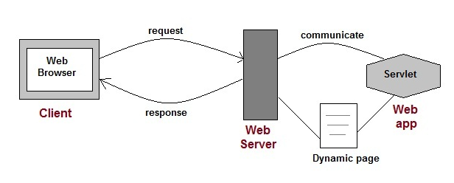
Diagram

Slide 4

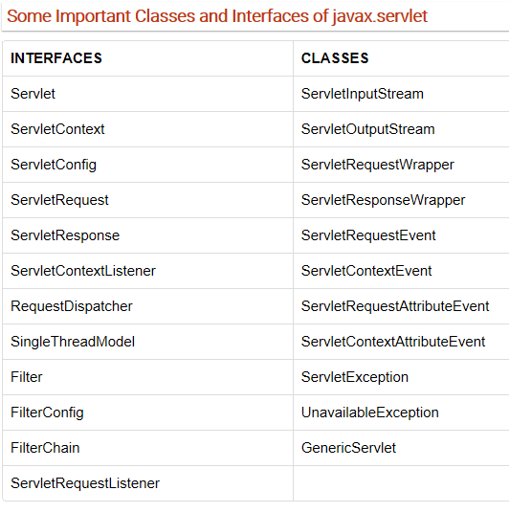
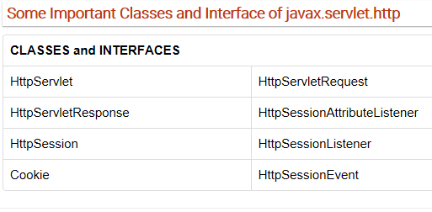
Servlet API
The Servlet API consists of two important packages that encapsulate all of the important classes and interface, namely: javax.servlet & javax.servlet.http

Slide 5
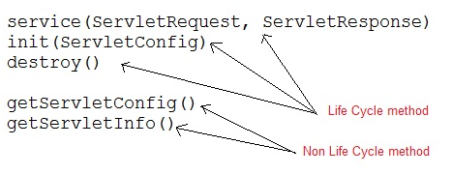
Servlet Interface
The Servlet Interface provide five methods. Three of these methods are Servlet life cycle methods and the other two are non-life cycle methods.

Slide 6
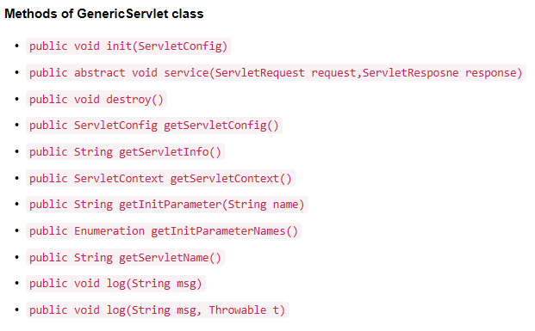
GenericServlet Class
GenericServlet is an abstract class that provides implementation of most of the basic servlet methods, such as:

Slide 7
HttpServlet class
HttpServlet is an abstract class that gives implementation of various service() methods of the Servlet interface.
To create a servlet, we should create a class that extends HttpServlet abstract class. The Servlet class must not override the service() mthod. The Servlet class will only override the doGet() and/or doPost() methods.
The service() method of HttpServlet class listens to the Http methods (GET, POST, etc.) from request stream and invokes doGet() or doPost() methods based on Http method type.

Slide 8
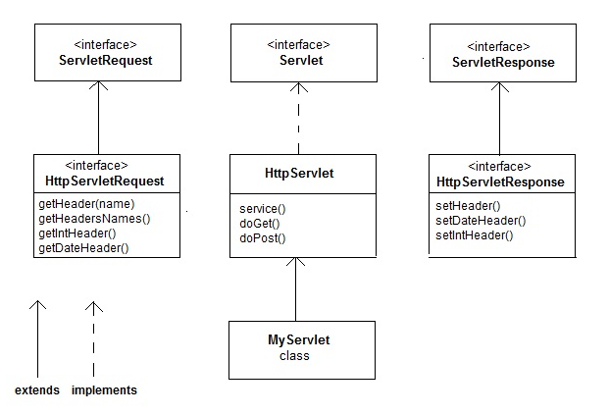
HttpServlet class Diagram

Slide 9
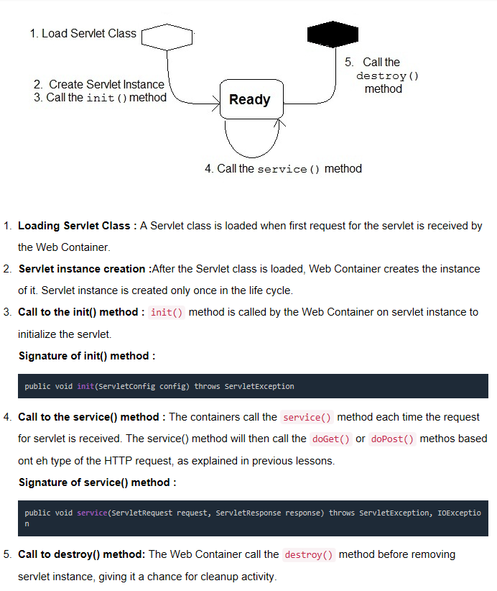
Servlet Life Cycle

Slide 10
Create a Servlet Application in Netbeans IDE
Open Netbeans IDE, Select File > New Project
Select Java Web > Web Application and click Next
Name the project and click Next then click Finish
The directory structure is created, open Source Package and right-click on default packages > New > Servlet
Name the Servlet class file
Change the method definitions and write your code in the Servlet class
Create an HTML file, right-click on Web Pages > New > HTML and write some code
Edit web.xml file with the url-pattern and servlet-name
Run the application by right-clicking on your project and selecting: Run

Slide 11
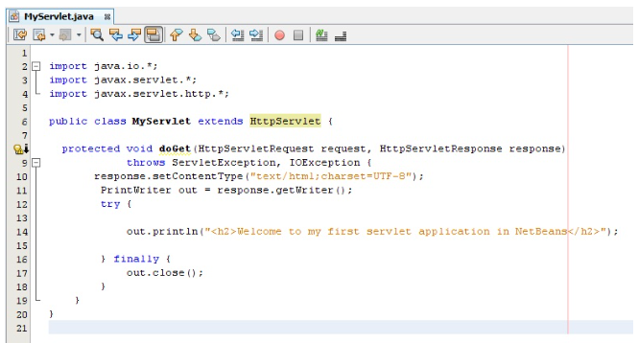
Sample Servlet Class Code

Slide 12
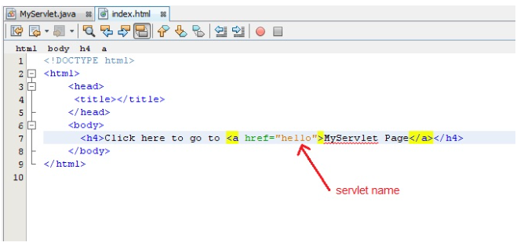
Sample HTML Code

Slide 13
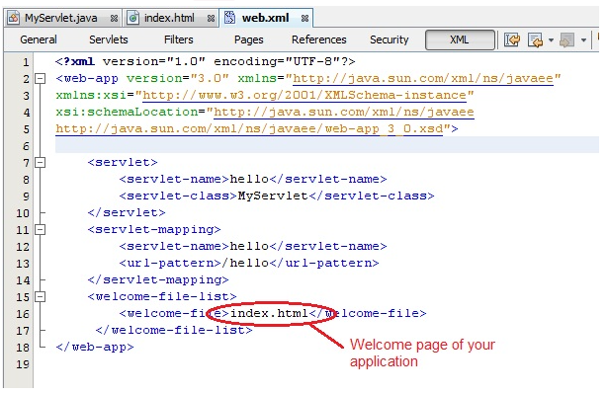
Sample web.xml file

