Slide 1
JUnit Tests
Jeremy Hawks – CIT 360

Slide 2
Description
JUnit is a simple framework to write repeatable tests in Java.
It is an instance of the xUnit architecture for unit testing frameworks
Testing is the process of checking the functionality of an application to ensure it runs as per requirements.
Unit testing is done by developers
Unit testing tests a single entity (class or method)
Unit testing helps assure a quality product is delivered to customers

Slide 3
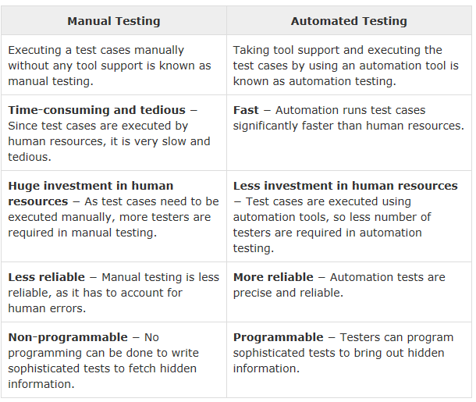
Testing Options – Manual vs. Automated

Slide 4
JUnit Features
Open source framework which is used for writing and running tests
Provides annotations to identify test methods
Provides assertions for testing expected results
Provides test runners for running tests
JUnit tests allow you to write codes faster, with increased quality
JUnit is elegantly simple, less complex, and takes less time
JUnit tests can be run automatically, check their own results and provide immediate feedback. No need to manually comb through a report of test results
JUnit tests can be organized into test suites containing test cases and other suites
JUnit shows test progress in a bar that is green if running ok and red when a test fails

Slide 5
What is a Unit Test Case
A Unit Test Case is a part of code that ensures another part of code (method) works as expected.
A formal written unit test case is characterized by a known input and an expected output, which is worked out before the test is executed. The known input should test a precondition and the expected output should test a post-condition.
There must be at least two unit test cases for each requirement – one positive and one negative. If a requirement has sub-requirements, each sub-requirement must have at least two test cases, again, one positive and one negative.

Slide 6
Requirements
JDK 1.5 or above
Java properly installed for the OS you are working on
JAVA_HOME environment variable points to Java base directory
Java compiler locations appended to the System Path
JUnit archive file extracted to the appropriate location
JUNIT_HOME environment variable points to JUNIT base directory
CLASSPATH environment variable points to the JUNIT jar location

Slide 7
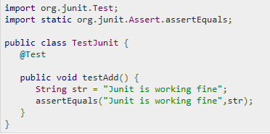
Test JUnit Setup (pt. 1)
Create a java class file name TestJunit in C:\>JUNIT_WORKSPACE

Slide 8
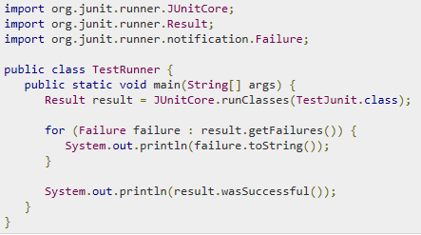
Test JUnit Setup (pt. 2)
Create a java class file name TestRunner in C:\>JUNIT_WORKSPACE to execute tests

Slide 9
Verify the Result
Compile the classes using the javac compiler as follows:
C:\JUNIT_WORKSPACE>javac TestJunit.java TestRunner.java
Run the Test Runner to see the results as follows:
C:\JUNIT_WORKSPACE>java TestRunner
Verify the output
true

