Slide 1
System Level Tests
Jeremy Hawks – CIT 360

Slide 2
Description (pt. 1)
System Level Testing (aka system testing and system integration testing) is the process in which a QA (Quality Assurance) team evaluates how the various components of an application interact together in the full, integrated system or application.
It verifies that an application performs tasks as designed (black box testing), focusing on the functionality of the application. For example, it might check that every kind of user input produces the intended output across the application.
The QA team gauges if the application meets all requirements, including technical, business, and functional requirements utilizing a variety of tests such as performance, usability, load testing and functional tests.

Slide 3
Description (pt. 2)
The QA team determines if a test case corresponds to each of an application’s most crucial requirements and user stories.
The individual test cases determine the overall test coverage for an application and help catch critical defects of functionality prior to release.
The QA team logs and tabulates each defect per requirement.
Each type of system test reports relevant metrics including:
Performance testing: speed, average, stability and peak response times
Load testing: throughput, number of users, latency
Usability testing: user error rates, task success rate, time to complete a task, user satisfaction

Slide 4
Description (pt. 3)
System testing examines every component of an application to make sure they work as a complete and unified whole.
A QA team typically conducts system testing after it checks individual modules with functional or user-story testing and then each component is tested via integration testing.
If a software build achieves the desired result in system testing, it gets a final check via acceptance testing prior to going into production.
An app-dev team logs all defects, and establishes what kinds and amount of defects are tolerable.

Slide 5
Software Testing Heirarchy
The following tests are in chronological order and should be performed prior to deployment of software:
Unit testing – testing performed on each module or block of code during development. Usually done by the programmer who writes the code.
Integration testing – testing done before, during, and after integration of a new module into the main software package. Involves testing each individual module. One piece of software may contain multiple modules which are often developed by different programmers. It is crucial to test each module’s effect on the entire program.
System testing – testing done by a professional testing agent on the completed software product before it is introduced to the market.
Acceptance testing – beta testing of the product done by the actual end users.

Slide 6
Common Types of System Testing (pt. 1)
Usability testing – mainly focuses on the user’s ease to use the application, flexibility in handling controls and ability of the system to meet its objectives.
Load testing – is necessary to know that a software solution will perform under real-life loads.
Regression testing – involves testing done to make sure none of the changes made over the course of the development process have caused new bugs. It also makes sure no old bugs appear from the addition of new software modules over time.

Slide 7
Common Types of System Testing (pt. 2)
Recovery testing – is done to demonstrate a software solution is reliable, trustworthy and can successfully recover from possible crashes.
Migration testing – is done to ensure that the software can be moved from older system infrastructures to current system infrastructures without any issues.
Functional testing – involves trying to think of any possible missing functions. Testers might make a list of additional functionalities that a product could have to improve it during functional testing.
Hardware/Software testing – is when the testers focuses their attention on the interactions between the hardware and software during system testing.

Slide 8
What Types of Test Should Testers Run? (pt. 1)
Who the tester works for – is a major factor in determining the types of tests to run. Large companies run different tests than medium or small companies.
Time available for testing – while all available test types could be run, time is often the limiting factor in choosing which tests are most relevant and will provide the most useful information for a particular solution.

Slide 9
What Types of Test Should Testers Run? (pt. 2)
Resources available to the tester – some resources are unavailable for use during testing. For example, only a large company might have expensive automated testing equipment available.
Software tester’s education – there is a learning curve for each type of software testing available. Some of the testing software requires training prior to use.
Testing budget – money becomes a factor not just for smaller companies and individuals, but large companies as well.

Slide 10
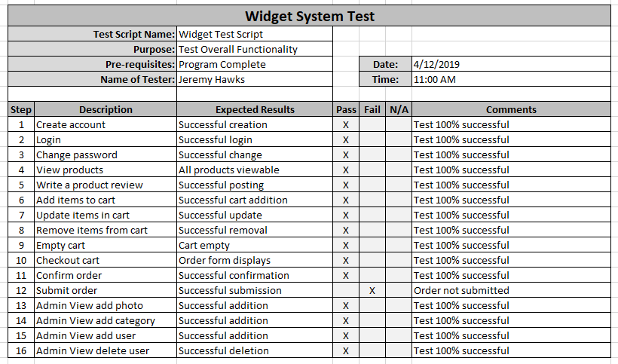
Example log file

