Slide 1
Use Case Diagrams
Jeremy Hawks – CIT 360

Slide 2
Description
Use Case Diagrams are one of five types of diagrams available to model the dynamic nature of a system
Use Case Diagrams are used to model the system and subsystem of an application.
A single Use Case Diagram captures a particular functionality of a system.
To model the entire system, a number of Use Case Diagrams are used.

Slide 3
Purpose of Use Case Diagrams
Use Case Diagrams are used to gather the requirements of a system including internal and external influences. These requirements are primarily design requirements. Hence, when a system is analyzed to gather its functionalities, use cases are prepared and actors are identified.
Typical purposes of Use Case Diagrams are:
Used to gather the requirements of a system
Used to get an outside view of a system
Identify the external and internal factors influencing the system
Show the interaction among the requirements as actors

Slide 4
How to Draw a Use Case Diagram (pt. 1)
Use cases are system functionalities written in an organized manner
Use cases consists of actors which can be anything that interacts with the system (e.g., human user, internal or external program)
When planning you need to have the following identified:
Functionalities to be represented as a use case
Actors
Relationships among the use cases and actors

Slide 5
How to Draw a Use Case Diagram (pt. 2)
The use case name is important. It should identify the functionalities performed.
Give a suitable name for actors
Show relationships and dependencies clearly in the diagram
Do not try to include all types of relationships, as the main purpose of the diagram is to identify the requirements
Use notes whenever required to clarify some important points

Slide 6
Where to Use a Use Case Diagram
Use case diagrams can be used for:
Requirement analysis and high level design
Model the context of a system
Reverse engineering
Forward engineering

Slide 7
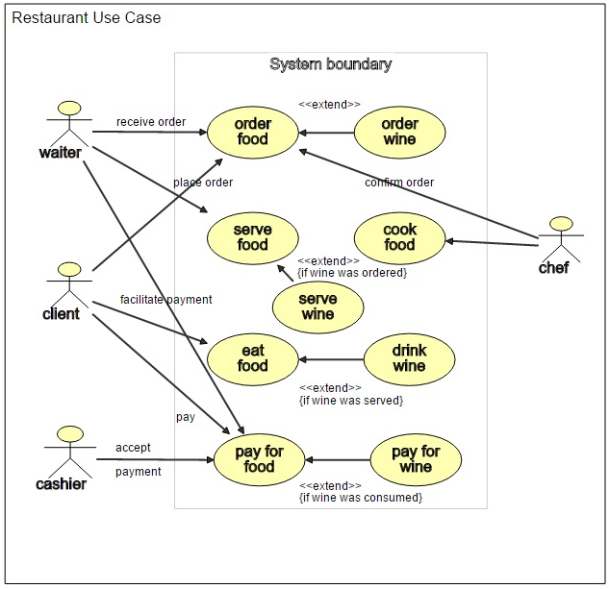
Use Case Diagram Example 1

Slide 8
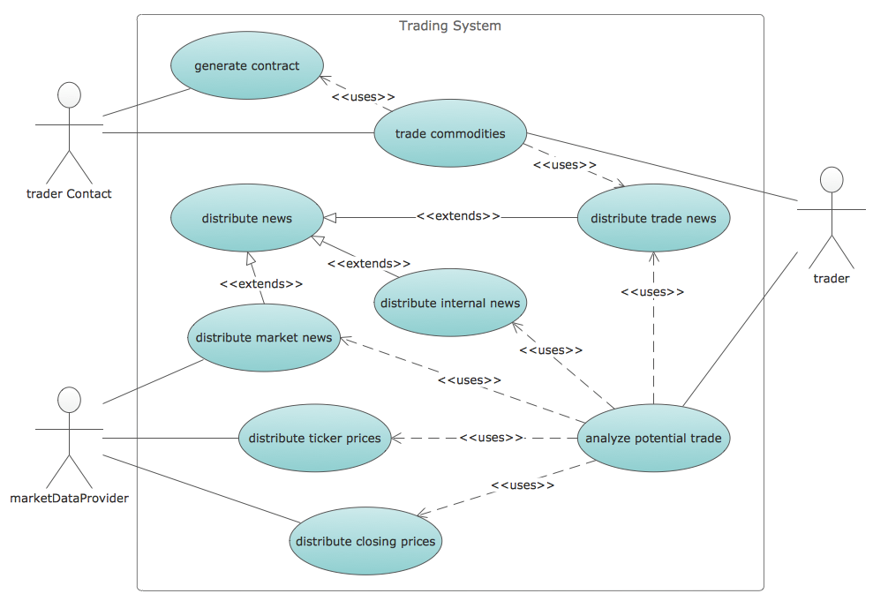
Use Case Diagram Example 2

