Slide 1
Use Case Documents
Jeremy Hawks – CIT 360

Slide 2
Description
Each use case “bubble” should be documented separately
The documents should be written with a medium level of detail
The documents should be targeted at the customer’s management team.
The documents should not describe the inner workings of the application

Slide 3
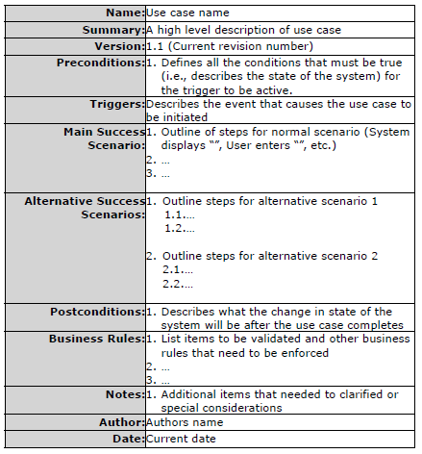
Sample Use Case Document Template

Slide 4
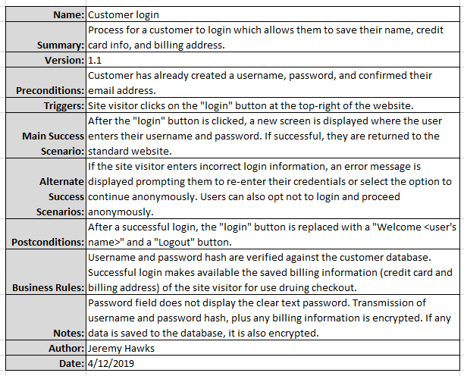
Sample Use Case Document

