Slide 1
State Diagrams
Jeremy Hawks

Slide 2
Purpose of State (Chart) Diagrams
State Diagrams are used to help developers understand or visualize complex or unusual behaviors of a system
They depict behavior of an entire system, a sub-system, or a single object in a system.
State Diagrams are not required, but are often useful

Slide 3



Elements of a State Diagram pt.1
Initial State: the starting point or first activity of the flow, also called the “pseudo state”. This state has no variables describing it further and no activities.
State: represents the state of object at an instant in time. There will be multiple of these in a diagram. One for each state of the object being described.
Transition: An arrow indicating the object to transition form one state to another. The trigger event and action are written beside the arrow separated by a slash.
Transitions that occur because the state completed an activity are called “triggerless”
If an event has to occur after the completion of an event or action, then it is called the “guard condition” and is depicted by square brackets around the description of the event/action
State Name
State Variable
Action

Slide 4


Elements of a State Diagram pt.2
History States: an “H” enclosed in a circle is used to indicate when an object goes into a trance or wait state, and on the occurrence of a certain event, go back to the state it was I when it went into that wait state (its last active state).
Signal: When an event causes a message/trigger to be sent to a state that causes a transition, then that event is called a “signal” and is depicted with “<<Signal>>” above the action/event and transition arrow.
Final State: The end of the state diagram is shown by a bull’s eye and is called the “final state”. It is another “pseudo state” because it does not have any variable or action described.

Slide 5
Recommendations for State Diagrams
Create state diagrams when the business logic is very complex or needs greater understanding by the developer to be coded perfectly
Arange the states and transitions to minimize crossing of lines. Crossed lines are sources of confusion and may detract from the meaning of the diagram

Slide 6
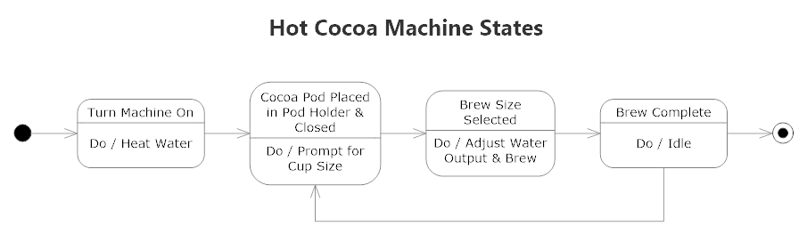
Simple Example of a State Diagram #1

Slide 7
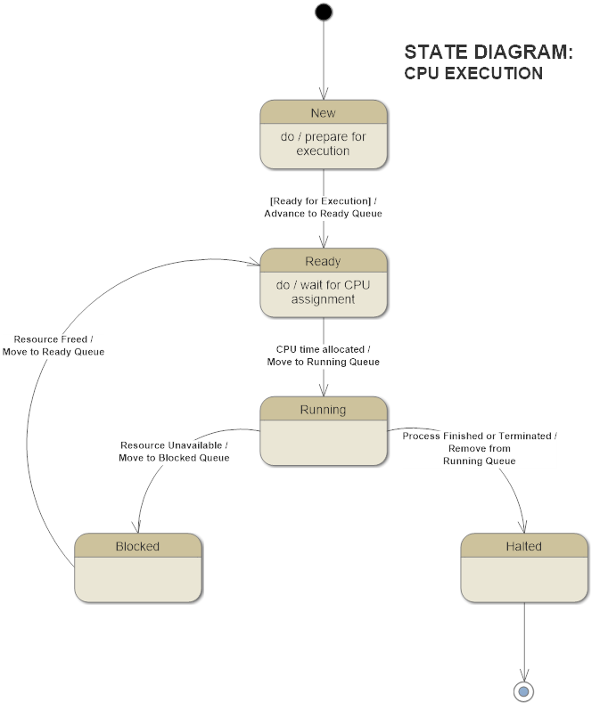
Simple Example of a State Diagram #2

Slide 8
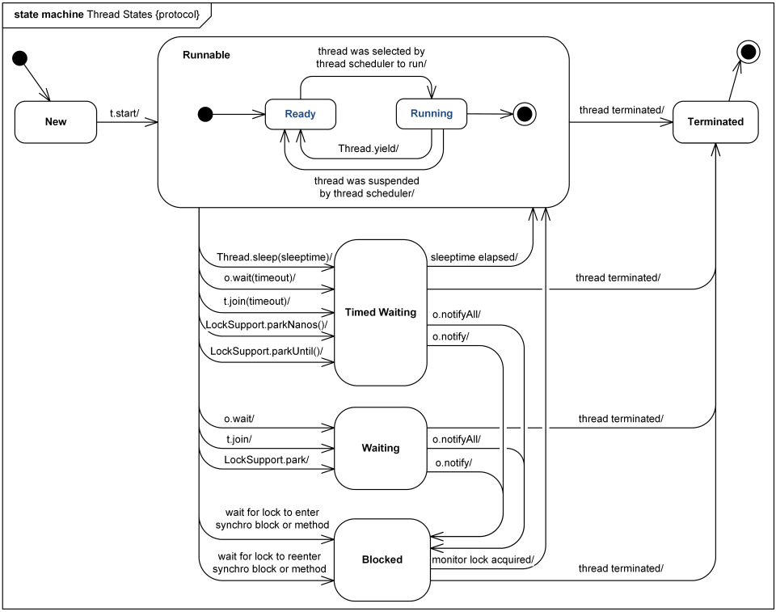
JAVA Thread States and Life Cycle

