Slide 1
Sequence Diagrams
Jeremy Hawks – CIT 360

Slide 2
Description (pt. 1)
UML sequence diagrams typically show some sequence of method invocations that achieve some specific purpose (for example, calculating the total cost of a sale transaction).
Objects that participate in the sequence and exist at the start of the sequence, are spread across the top of the diagram in the usual UML notation for an object.
Time is imagined as running vertically from top to bottom of the diagram.
Each object has a lifeline running vertically down the page, immediately below its rectangle.

Slide 3
Description (pt. 2)
Method invocations are drawn as solid lines with open arroheads from the lifeline of the calling object to the lifeline of the receiving object.
An object’s lifeline is widened whenever one of its methods is being executed.
These activation bars may be nested to show that another method of the object has been invoked as part of the execution of the previous method.
Optionally, returns from methods may be shown as a dotted line with an open arrowhead.

Slide 4
Description (pt. 3)
When iteration over a collection of objects is needed, an asterisk precedes the method name with an optional condition inside square brackets.
Reverse engineering sequence diagrams from existing source code can help developers new to the code understand how it works.
Sequence diagrams can be used to help developers communicate to client representatives the way the software works.
Sequence diagrams are also often used to help analyze requirements or document the design of a feature in a process.

Slide 5

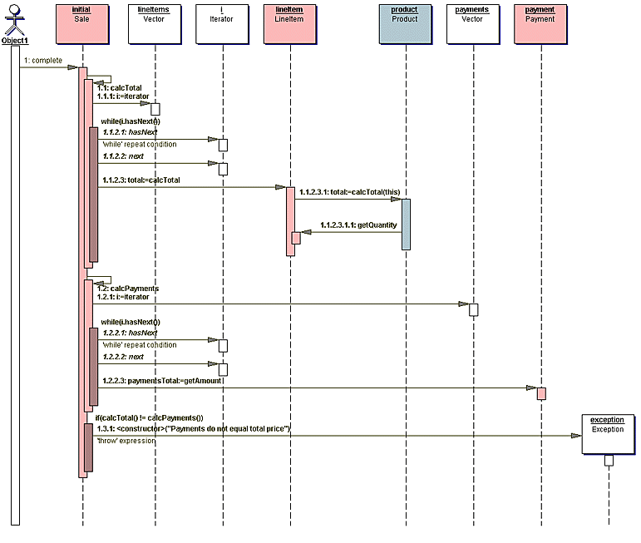
Sample Sequence Diagram
This is a sample Sequence Diagram for completing a sale.

