Slide 1

Final Exam : Capstone Project
Koumba Esther 25714
Group E

Slide 2

Education
Global Trends in Literacy and
School Enrollment
https://data.uis.unesco.org

Slide 3

II-Problem Statement
Can global literacy and enrollment trends reveal gaps in education access across countries and genders?
This addresses a real-world challenge using big data: identifying disparities in education over time.

Slide 4
III-Dataset Identification
Dataset Title: Global Literacy Rates and School Enrollment
Source Link: https://data.uis.unesco.org
Numbers of rows and columns: 18 and 6
Data Structure: ☒ Structured (CSV, Excel)
Data Status: ☐ Clean ☒ Requires Preprocessing

Slide 5
Methodology
Cleaning: Removed empty columns (qualifier, magnitude), renamed for clarity
EDA: Visualized distributions by year, country, gender
Modeling: Simple linear regression to analyze literacy trends
Tools Used: Python (Pandas, Matplotlib), Power BI

Slide 6
Results
Findings:
Literacy rates improved over time globally
Gender gaps still exist in some regions
Some countries lag behind in both youth and adult literacy
Key Visuals: Line chart, bar chart, map (Power BI)

Slide 7
Recommendations
Focus literacy improvement programs on low-performing countries
Prioritize gender equity in education policies
Use data-driven monitoring tools like dashboards for policy planning
🔮 Future Work
Include school enrollment indicators in the same model
Apply advanced ML models (e.g., clustering by country performance)
Integrate real-time data or more recent years
Explore additional demographics: rural vs. urban, income level, etc.

Slide 8

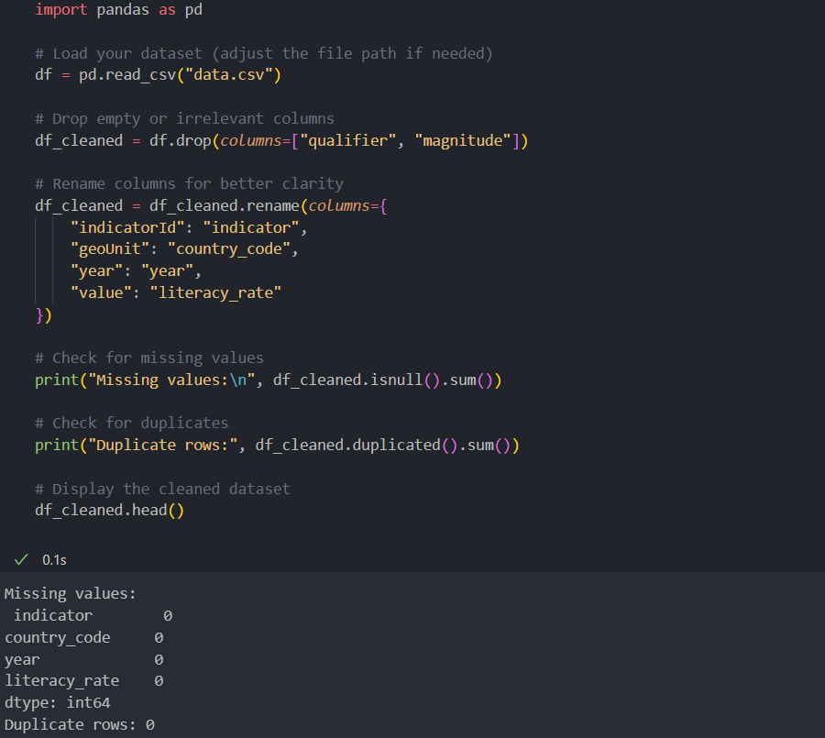
Part 2: Python Analysis Tasks
This step handles missing values by identifying them, removes unnecessary columns, and renames the important ones to make them readable. If no missing values or duplicates are found, we’re ready to proceed with EDA next. Let me know once you're done running this

Slide 9
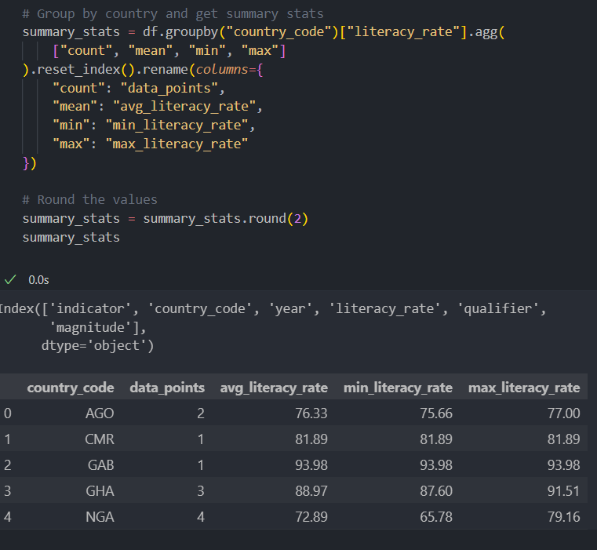
What this EDA step tells you:
How many data points each country has.
The average, minimum, and maximum literacy rates by country.
It helps you spot countries with unusually low or high literacy values or those lacking enough data.

Slide 10
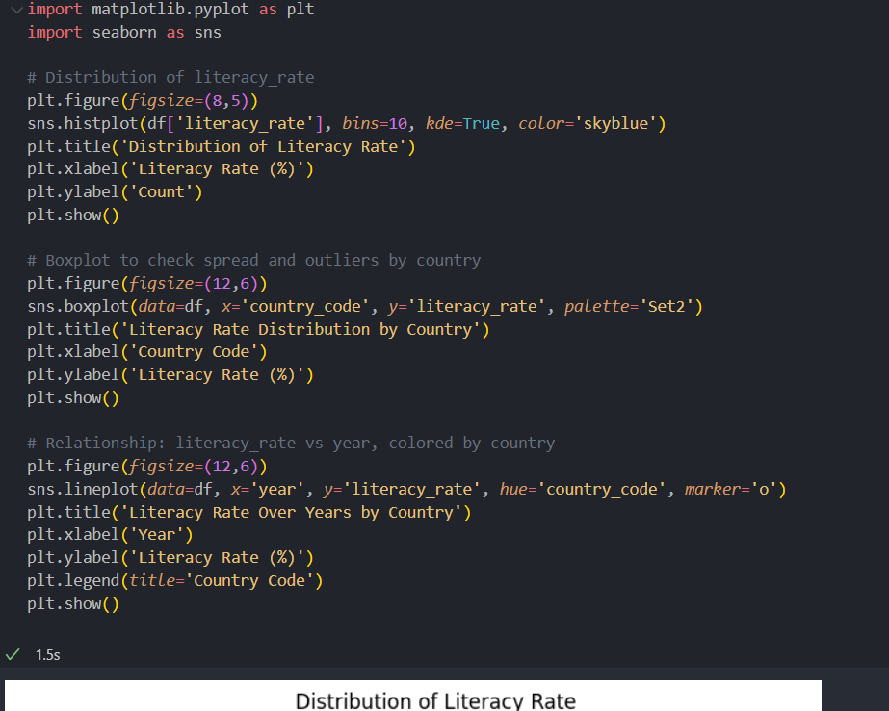
Visual Analysis of Literacy Rates
This code creates three key graphs:
Histogram – Shows how literacy rates are spread overall (most common values).
Boxplot by Country – Compares literacy rates between countries and shows outliers.
Line Chart Over Time – Tracks how literacy rates change over the years in each country.
These visuals help us quickly see patterns, differences between countries, and trends over time.

Slide 11
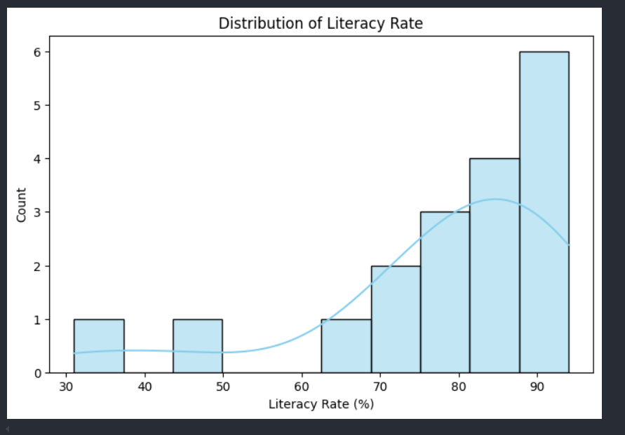

Slide 12
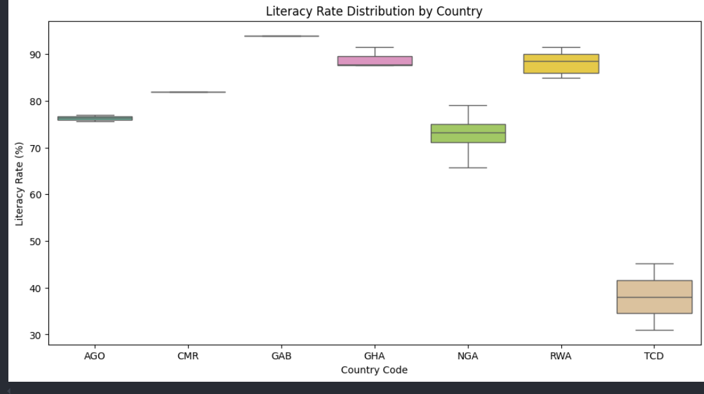

Slide 13
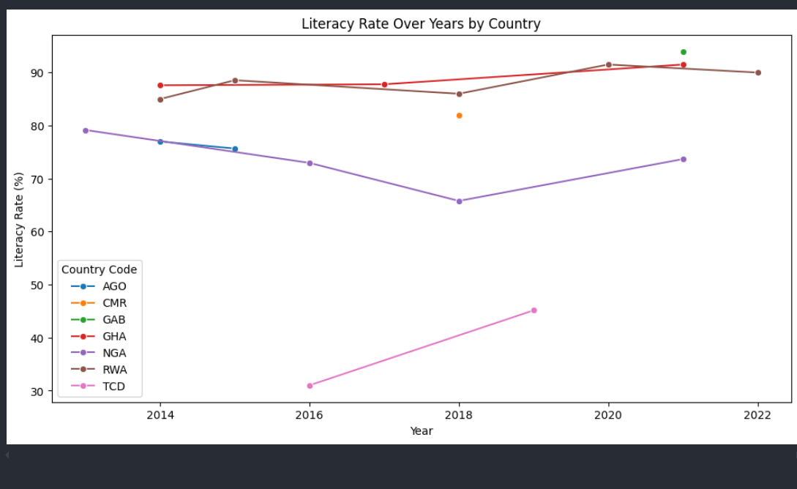

Slide 14
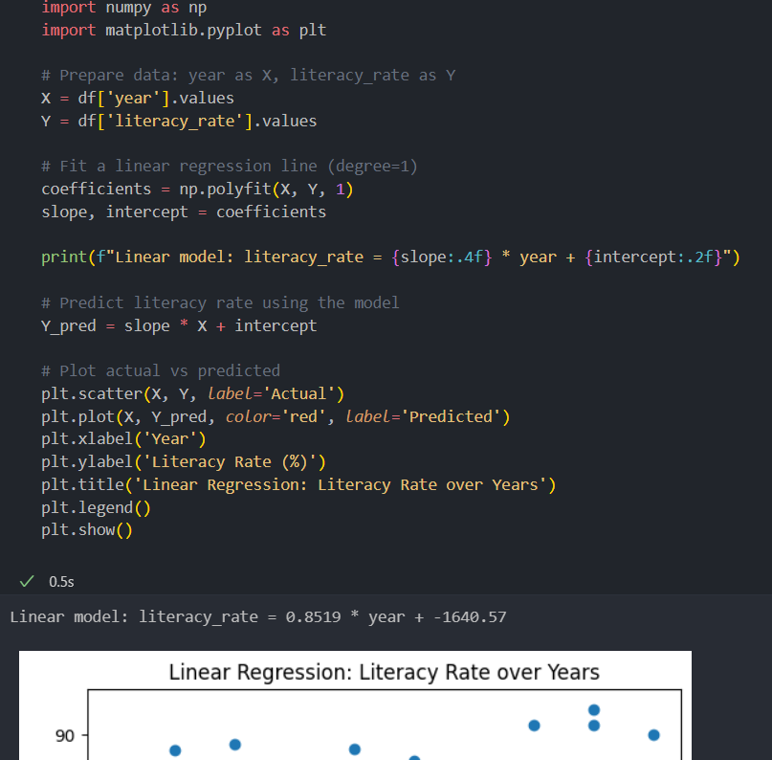
Linear Trend of Literacy Rate Over Time
This code fits a linear regression model to predict how literacy rates change over the years.
It calculates a trend line showing whether literacy is increasing or decreasing over time.
The plot compares actual values (dots) to the predicted trend (red line).
This helps us understand the overall direction of literacy rate changes globally.

Slide 15
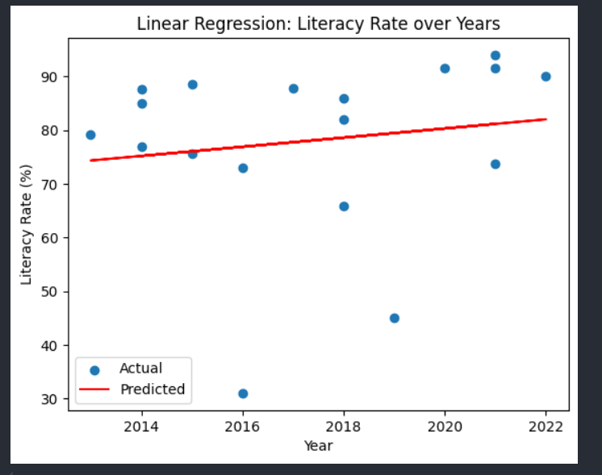

Slide 16
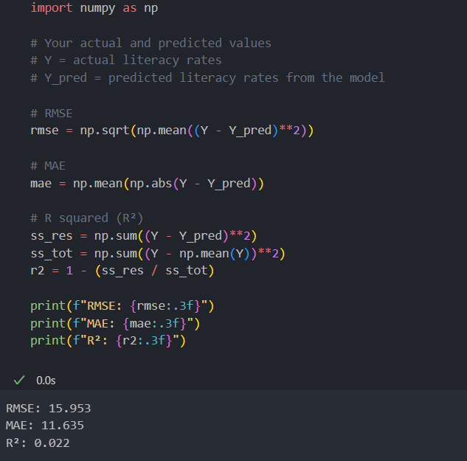
Evaluating the Regression Model
This code checks how well the linear model fits the data using three metrics:
RMSE (Root Mean Squared Error): Measures how far predictions are from actual values.
MAE (Mean Absolute Error): Shows the average size of prediction errors.
R² (R-squared): Shows how well the model explains the variation in literacy rates (closer to 1 = better fit).
These values tell us if our model is reliable for predicting literacy trends.

Slide 17
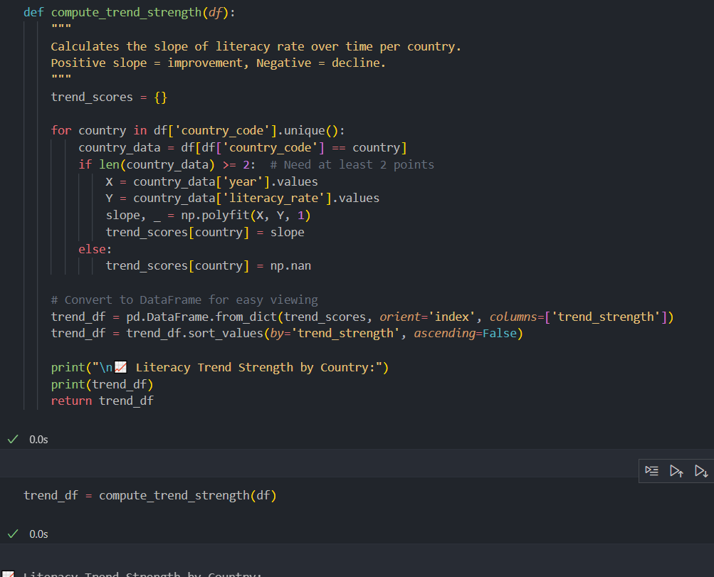

Slide 18
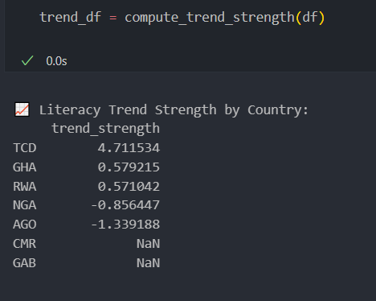
Country-wise Literacy Trend Analysis
This function calculates the literacy trend for each country:
It computes the slope of literacy rate over time (per country).
A positive slope means literacy is improving.
A negative slope means literacy is declining.
The result is a ranked list of countries based on how strongly their literacy rates are changing over time.

Slide 19
Conclusion
Through data analysis and visualization, we discovered that global literacy rates have improved over time, but inequalities still exist between countries and genders.
Using Python and Power BI, we identified countries with low literacy and found that girls and women are still more affected in some regions.
This shows that data can help reveal hidden gaps in education access, and guide smarter, more targeted solutions.

