Slide 1


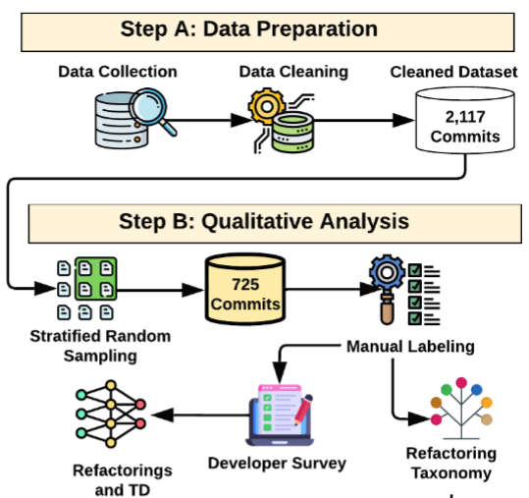

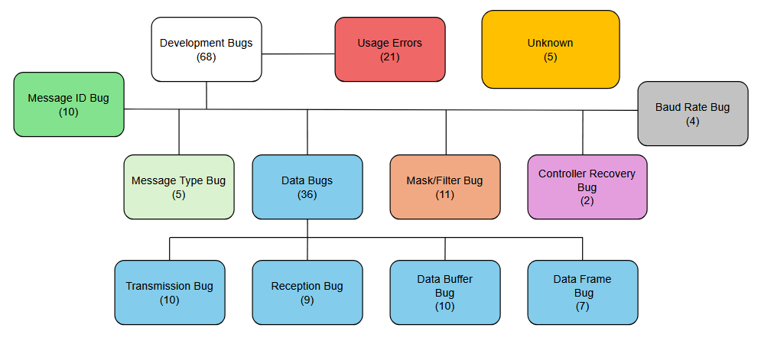
Patterns and Pitfalls: Empirical Insights into CAN Bus Bugs in Open-Source Repositories
Michael Gharbieh, Dr. Foyzul Hassan, Dr. Bruce Maxim
College of Engineering and Computer Science
University of Michigan-Dearborn
INTRODUCTION
METHODS
TABLES & FIGURES
CAN (Controller Area Network) protocol is the dominant intra-vehicle communications protocol in automotive applications¹.
While the protocol itself is standardized by bodies like ISO (International Standards Organization) and SAE (Society of Automotive Engineers), development tools vary wildly.
Lack of standard development tools can lead to confusion when working with different software vendor APIs (Application Protocol Interfaces) or ECU (Electronic Control Unit) Suppliers
Resources to unify different development tools may increase productivity and foster innovation through market competition by increasing accessibility and ease of development for CAN systems
Open-source projects with the tag “can bus” were scraped from Github and Gitlab.
Multi-level filtering was applied on the commits of collected repositories. First with automatic filtering, searching for commits that (attempted to) fix bug(s). Those results were then further filtered automatically to restrict to commits that contained CAN related fixes.
A random sample was applied on the remaining repositories for manual verification. The random sample was then categorized by the type of bug (Fig. 1)
An AST (Abstract Syntax Tree) was generated for the source code which the commits were working on to be used for common pattern prediction. (For SURE elaborate more on empirical part)
Figure 1: Approach Overview (This one is sample, you have to update for your projects)
SCAN HERE TO LEARN MORE
SCAN HERE TO LEARN MORE
PURPOSE STATEMENT
Results
The purpose of this project was to develop a static analysis tool to boost productivity for development and debugging of CAN related applications in various usage scenarios, irrespective of APIs or development tools used.
Include summary of empirical analysis outcome a bullet point
l
Figure 2: Taxonomy of bug categories with bug count per category
SKILL: [SKILL HERE]
This is filler text
l
Conclusion & Future Work
Discuss summary of the work and include some future work directions that we want to develop statis analyzer for detecting these problems.
l
REFERENCES
1. https://www.ni.com/en/shop/seamlessly-connect-to-third-party-devices-and-supervisory-system/controller-area-network--can--overview.html?srsltid=AfmBOorKEd5Qlz_YtJ_5vTBd-zO9C4jf6WamtYoeP_-IHzGqsyo0bknL

