Slide 1
Code Gladiator Round-2 code submission
Methran GS
Baskar SR

Slide 2
Debugging Tools:
Compiler: g++ 9.20 (GNU GCC)
IDEs: CodeLite, Clion and GDB online
Debugger: CodeLite Debugger + GDB online debugger

Slide 3
Project files
CALC.h - Header for CALC.c, PUSHPOP.c, READTOKN.c
CALC.c - Main driver file
PUSHPOP.c - Implementation of push and pop function
READTOKN.c - Implementation of reading characters and tokenizing them
Project Description:
A simple C program to perform basic arithmetic operations on top-most two elements in a stack,
Pop element[top] and element[top – 1] and perform operation, push the result into the stack.
Output the element on the top of the stack, when ‘ = ‘ is encountered.
Supported operations: +, -, *, /, =

Slide 4
Debugging process
Expected behavior:
INPUT ACTION
2 push 2
18 push 18
+ pop 18, pop 2, push result (18 + 2)
= output element on top of stack (20)
5 push 5
/ pop 5, pop 20, push result (20 / 5)
= output element on top of stack (4)

Slide 5
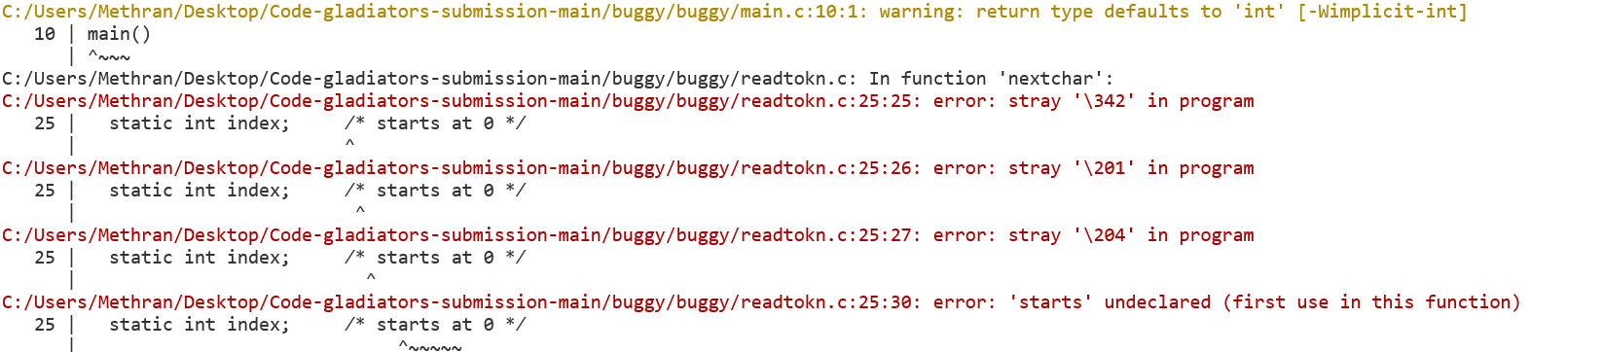
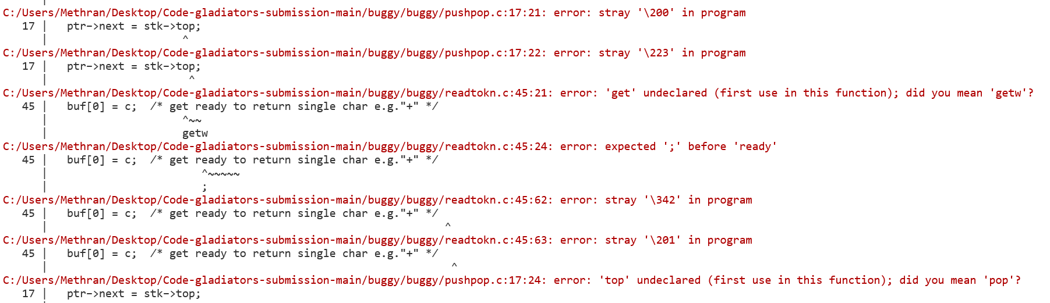
Initial run:
Compilation failed with 55 errors and 6 warning

Slide 6
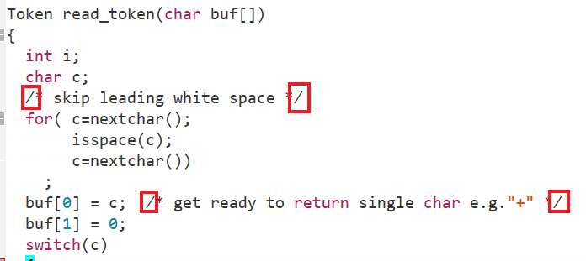
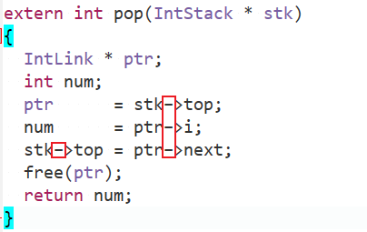
Debugging process
Illegal characters are marked in the above images
Fixed all stray error by replacing the illegal characters.
Modified programming style according to preference
Added uniform spacing to improve readability
Removed redundant code

Slide 7


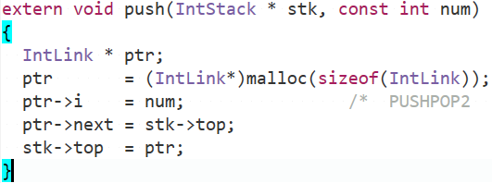
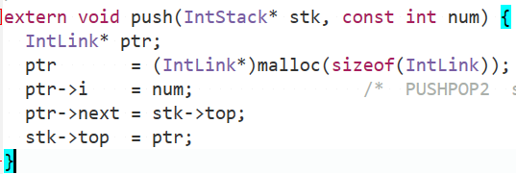
Debugging process
Styling changes
Compiled successfully (0 Error and 0 Warnings)

Slide 8
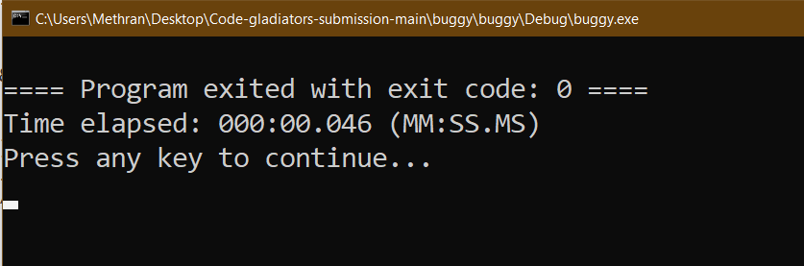
Output:
Program did not produce expected output.
Ran debugger and set breakpoints at suspected parts.
Program flow had no interruptions.
Verified that all the operations were performed successfully
Verified that the result was copied to buf_out in calc.c
Noticed that buf_out was not printed after copying

Slide 9
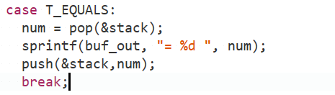
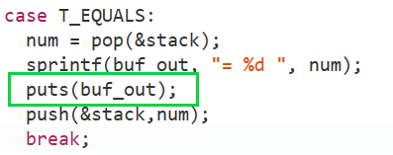
Debugging process
Added puts(buf_out) to T_EQUALS block in driver function
Final Run:

Slide 10
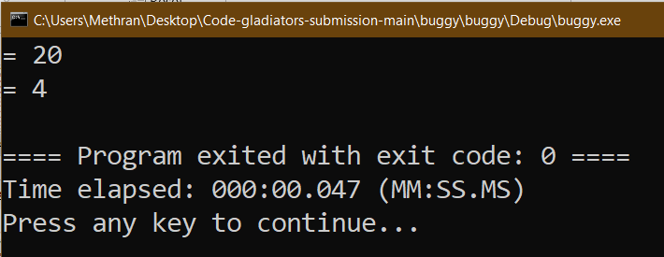
Output:
Expected output is produced.
Checked the program output with custom expressions
Checked the program under different circumstances
Verified the output

