Slide 1
Code Gladiator Final code submission
Methran GS
Baskar SR

Slide 2
Debugging Tools:
Compiler: g++ 9.20 (GNU GCC)
IDEs: CodeLite, Clion and GDB online
Debugger: CodeLite Debugger + GDB online debugger

Slide 3
PROGRAM-1
Description:
The skeleton of a Aurochs has been found. Investigation shows the bones have lost 58% of the
carbon-14 that was available when the Aurochs died. How old is the skeleton?

Slide 4
Project files:
Main.c – Main driver function
Summary:
used exponential equation P(t) = P₀eᵏᵗ
where,
P₀ -> Original mass
P(t) -> Mass at half-life
e -> Euler's constant
k -> Decay constant
t -> Time

Slide 5
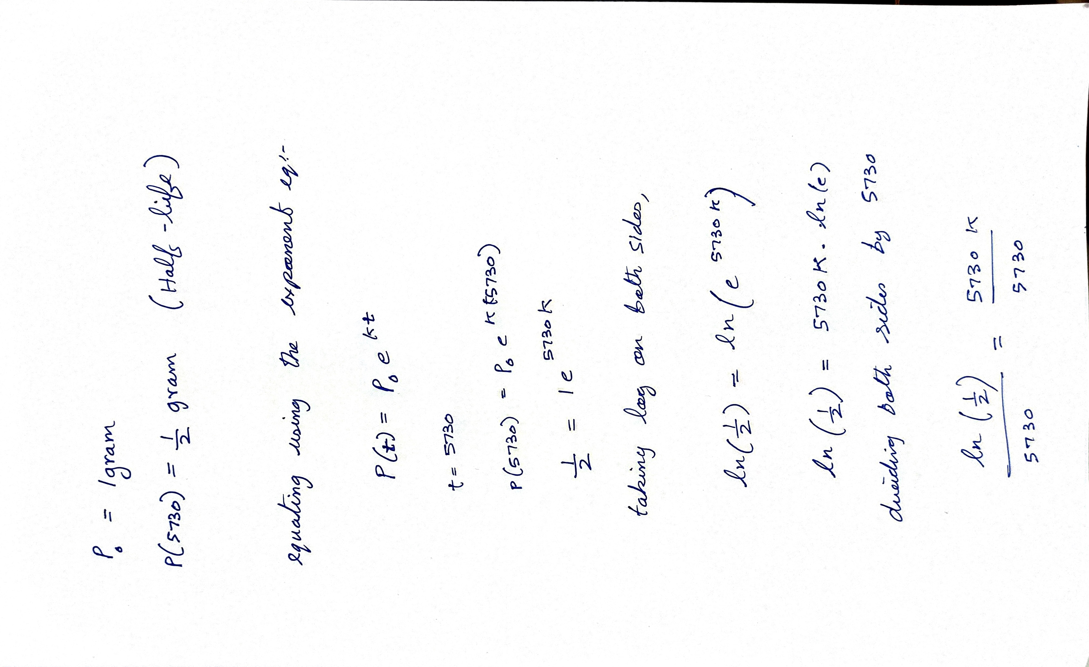
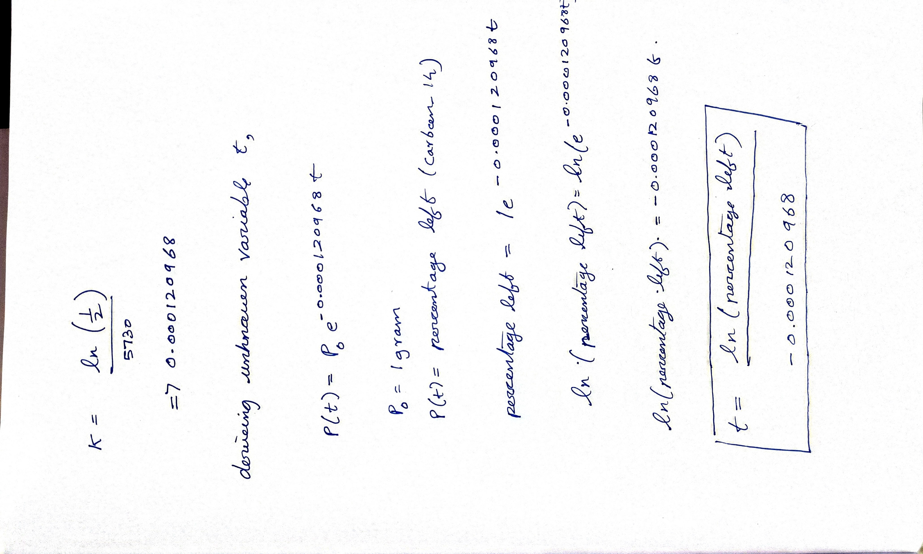

Slide 6
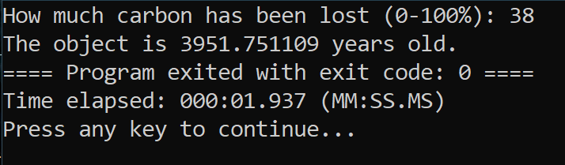
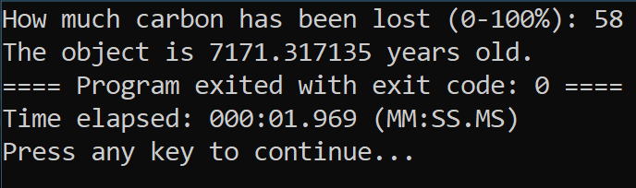
Output:

Slide 7
Program-2
Description:
Animate an emoji face according to the emotion taken as the user input which appears at random
position on screen.
The Program will run forever until the user enters Exit code.
Each time a user enters an emotion an emoji for that emotion appears at a random position on
screen.

Slide 8
Project files
main.c - Main driver file
Emoji_template.h - Templates for 5 emoji
Read_emoji.h - Implementation of read emoji function
Utility_functions.h - Implementation of gotoxy and clearscreen
Draw.h - Implementation of draw function which writes the output

Slide 9
Working of the project:
A string a read from the input buffer
Based on the string, the loop function is called with appropriate parameter
In the loop function, random number are seeded using srand with time(O)
Draw function is called by passing the parameter char array
In which, X and Y are fixed on the output console and the emoji is drawn onto the screen.
The loop function executes until n is pressed (getch() and kbhit())
If not terminated, Sleep() is called to preserve the output for viewing

Slide 10
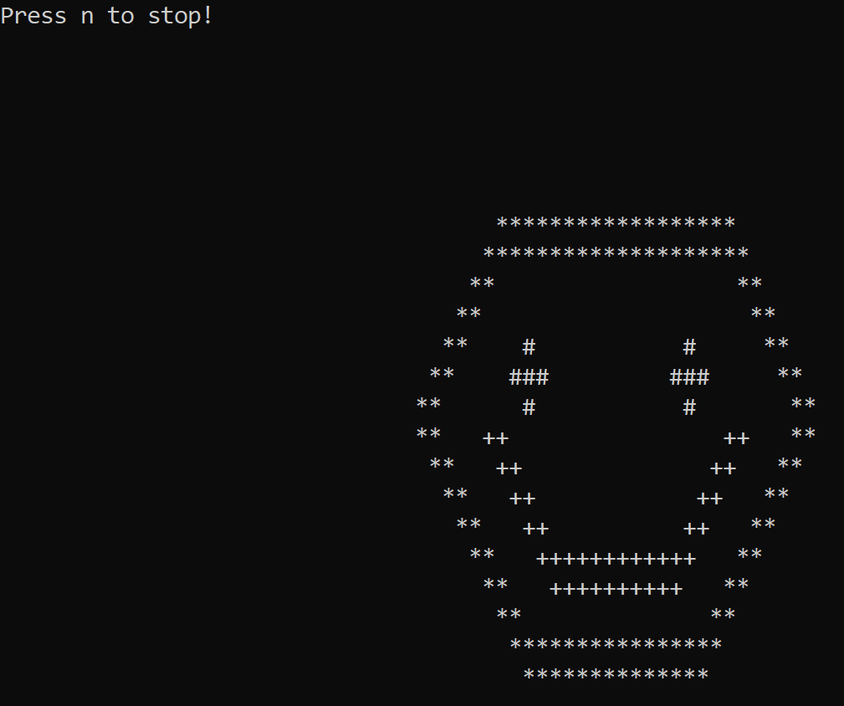
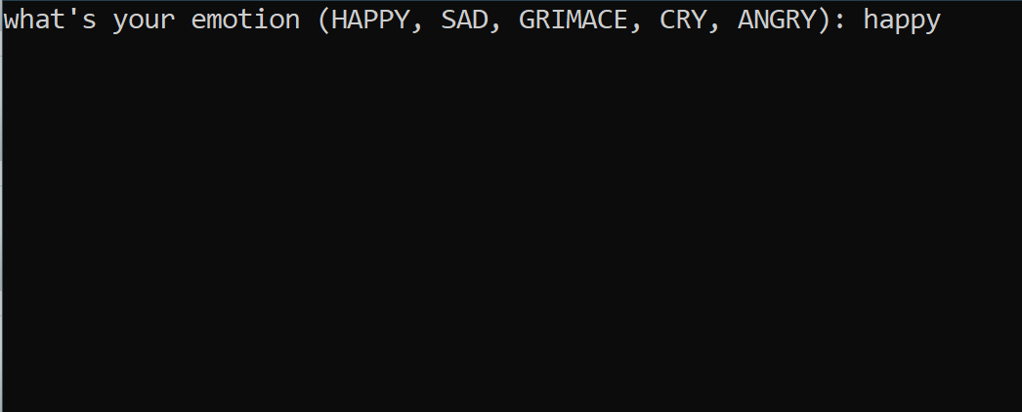
Output:

