Slide 1

Civil Engineering project river flood
Mia Hajjar
Hady Souaiby
Jerome Chaker
Yoanna Maroun

Slide 2
Plan
01
Introduction and problem statement
04
Models and training
02
Data collection and sources
Results and evaluation
05
03
Levfeature engineering and methodology
06
System architecture and conclusion

Slide 3
Introduction & Problem
01
02
03
Real-time flood risk prediction system
Focus: river gauge stations in the US
Flooding = major natural disaster
04
05
Need for accurate & fast predictions
Key Question
can we predict whether a river will flood tomorrow?

Slide 4
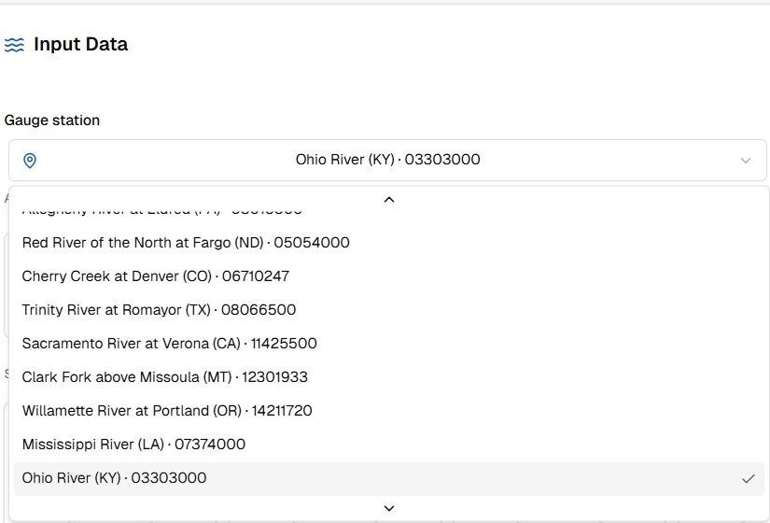
Project Overview
End-to-end Machine Learning pipeline
Uses real government data (USGS + NOAA)
Covers 11 river stations
Outputs predictions via: REST API and Interactive dashboard

Slide 5
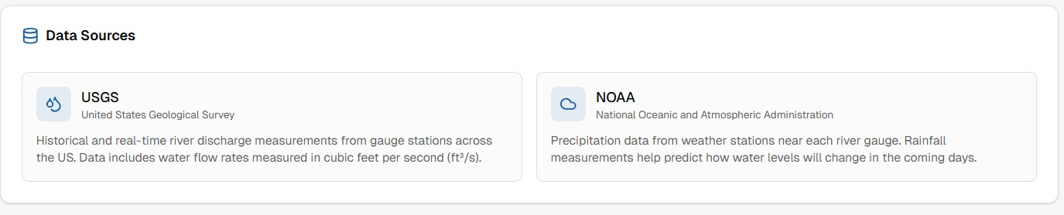
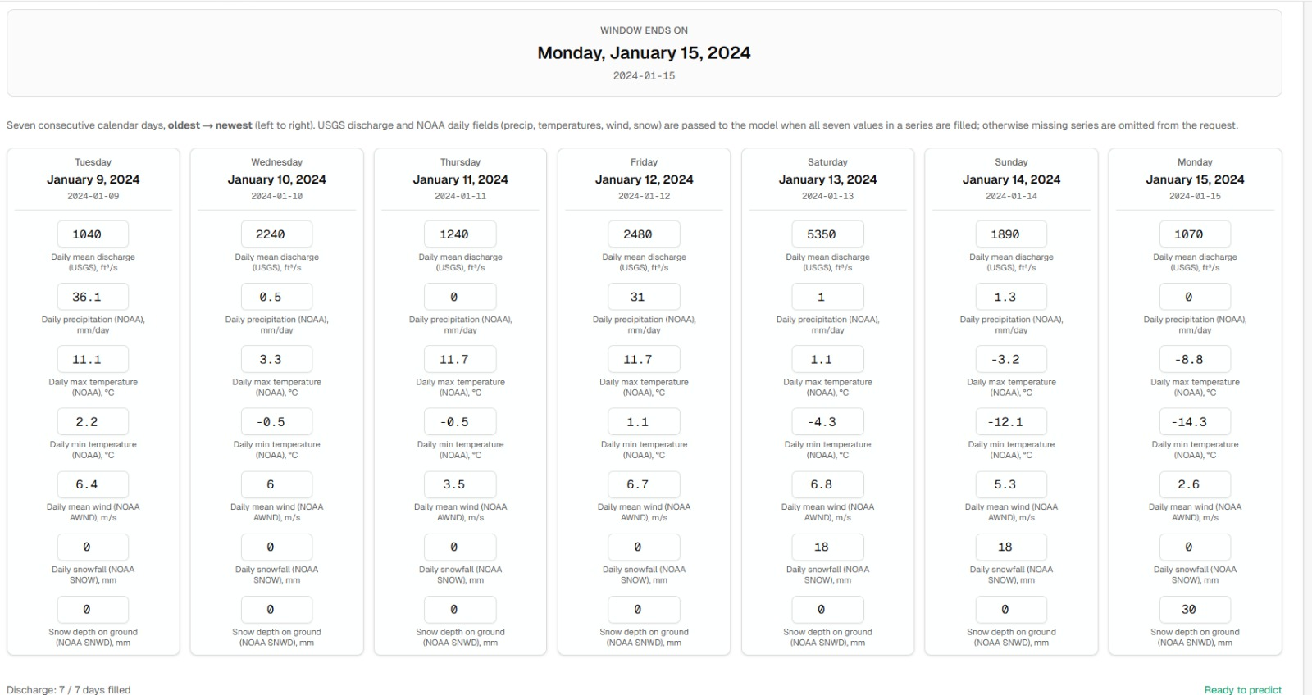
Data Sources
01
02
USGS
NOAA
River discharge (2018-2026)
Weather data:
-Precipitation
-wind
-temperature
-snowfall

Slide 6
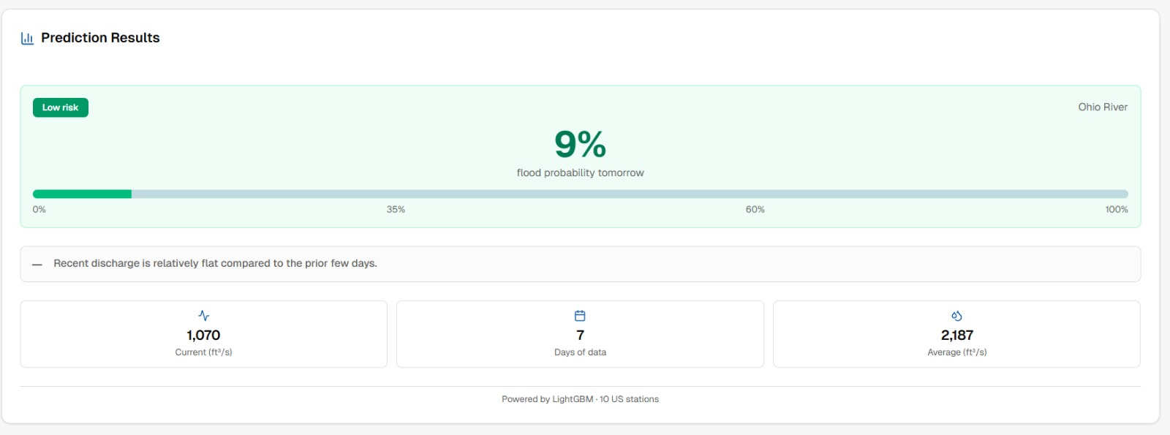
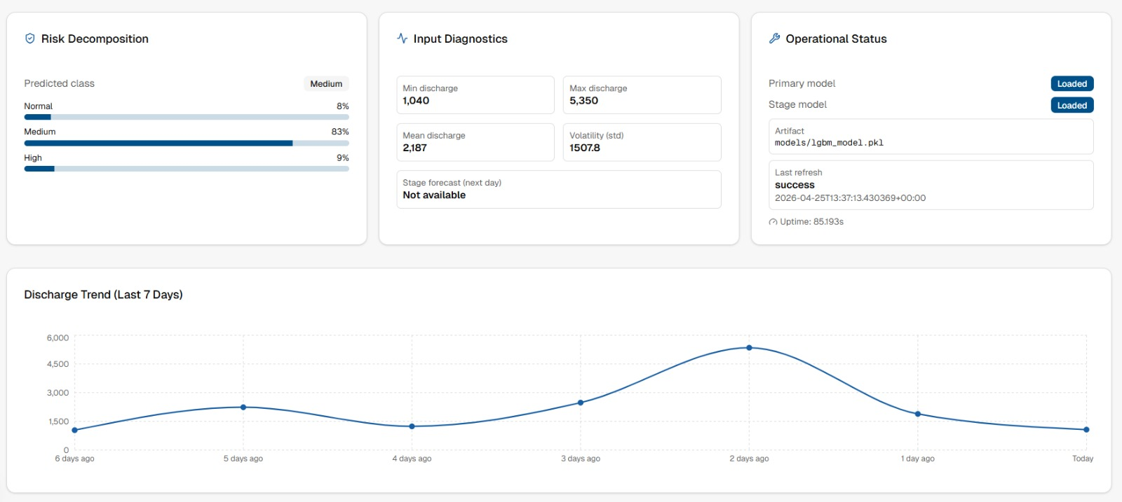

Slide 7
Target & Risk Levels
3-class classification:
Normal (< 75%)
Medium (75%–90%)
High (> 90%) → flood risk
Thresholds different per river
Example:
Potomac: 28,540 cfs
Cherry Creek: 211 cfs

Slide 8
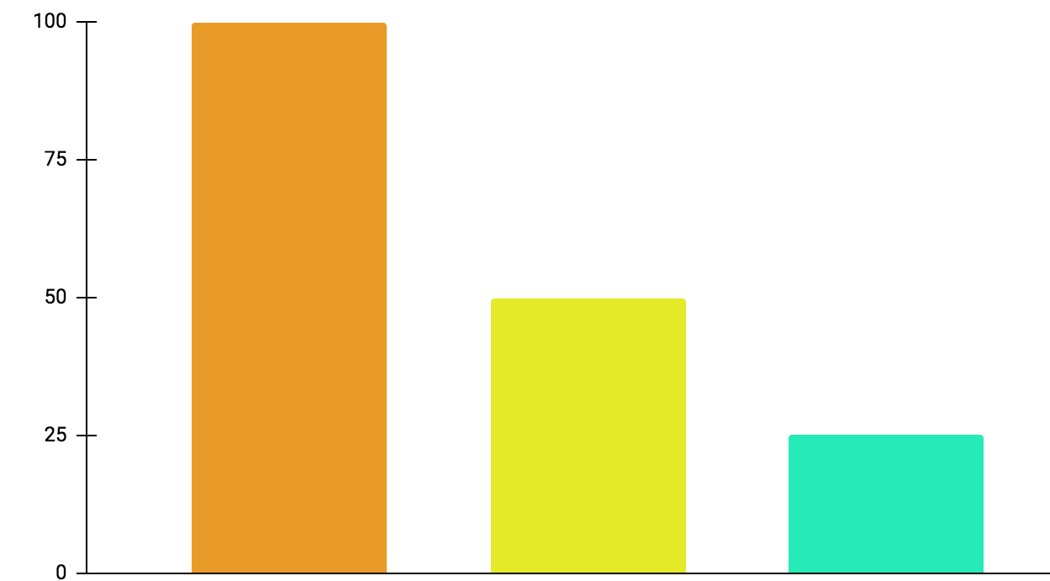
Feature Engineering
01
38 engineered features:
02
Data split:
Discharge history (lags)
Rolling averages
Seasonal patterns
Weather variables
03
No random shuffle (time series logic)
75%
15%
15%

Slide 9
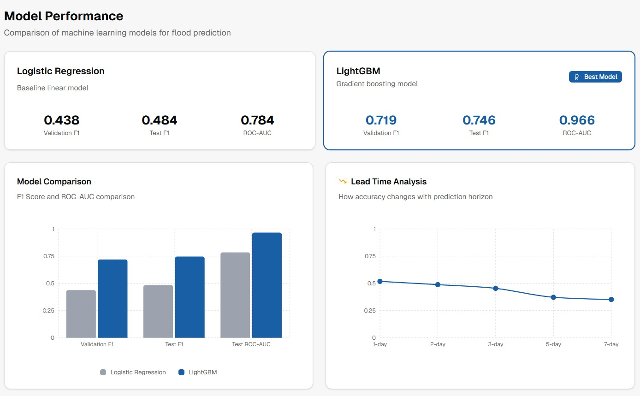
Models
Baseline
Advanced
LightGBM
300 trees
Learning rate =0.05
Handles class imbalance
Logistic Regression
LightGBM

Slide 10
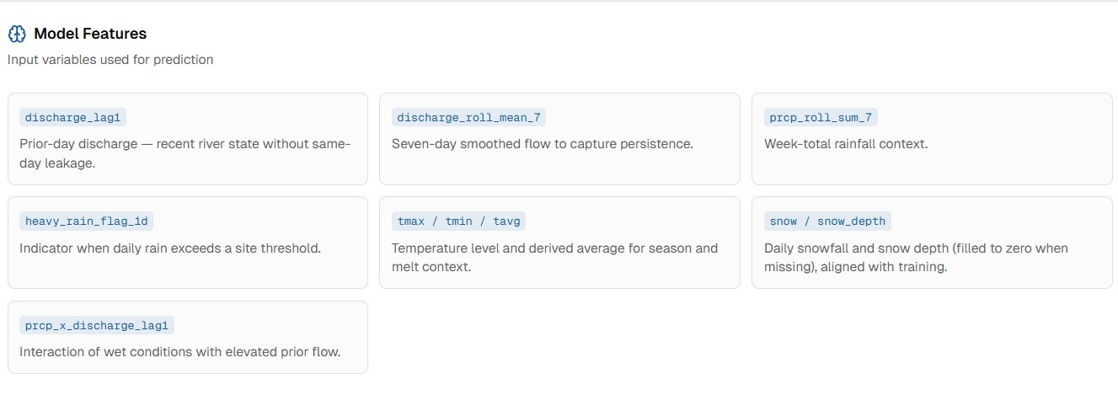
Lead-Time Results
Prediction accuracy
Best reliability
1 day: 0.686 (best)
3 days: 0.481
7 days: 0.224
1–2 days ahead

Slide 11
System Architecture
01
Backend:
Python
Endpoints:
02
Health (status)
Latest (recent data)
Predict (risk levels)
Predict-stage (water level)

Slide 12
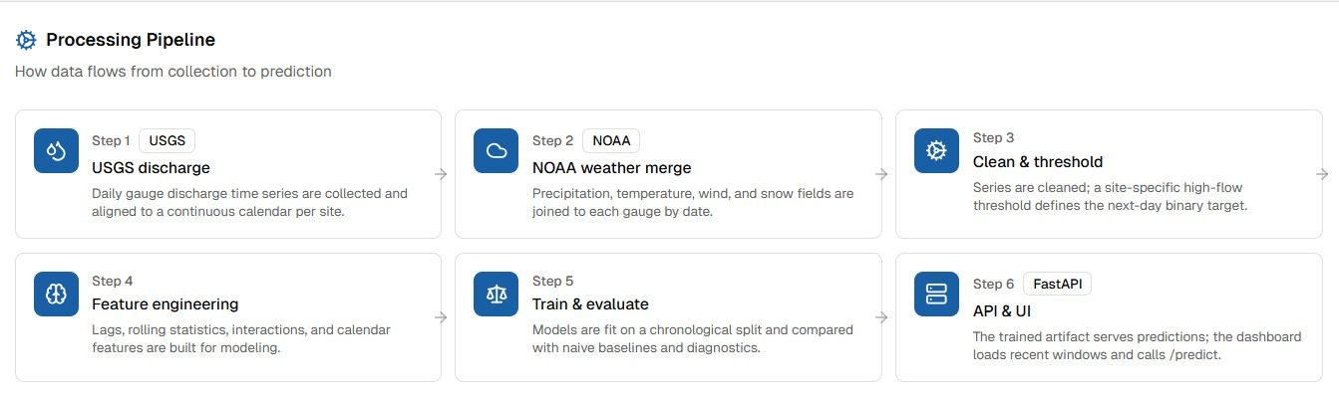
Dashboard
Built with Next.js
Features:
01
Station selection
02
Real-time data loading
03
Flood probability display
04
Charts & diagnostics
02
Stage forecast

Slide 13
Monitoring
01
Detects data drift
02
Alerts when retraining needed
03
Ensures model reliability over time

Slide 14
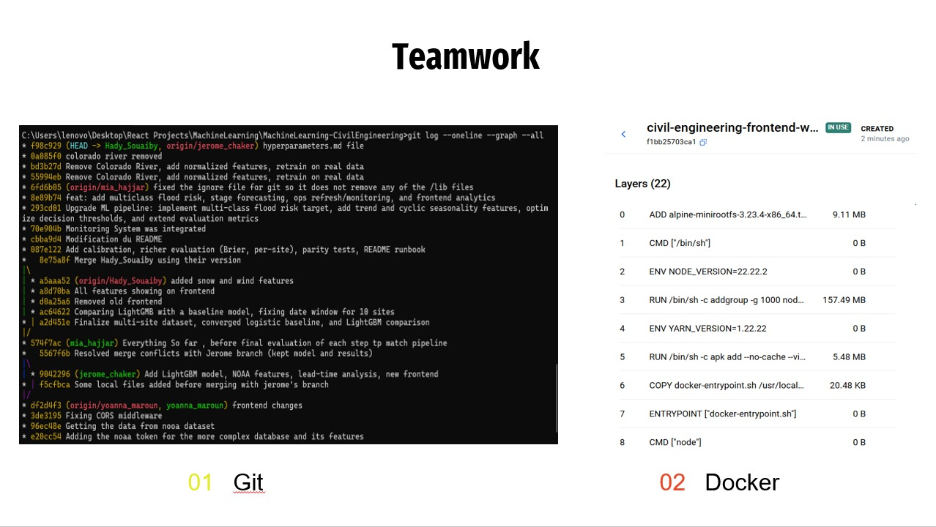

Slide 15
Conclusion
Covers 9 river stations
5
Useful for engineers and emergency planning
4
Real-time system deployed
3
Reliable next-day predictions
2
LightGBM model performs well
1

