Slide 1
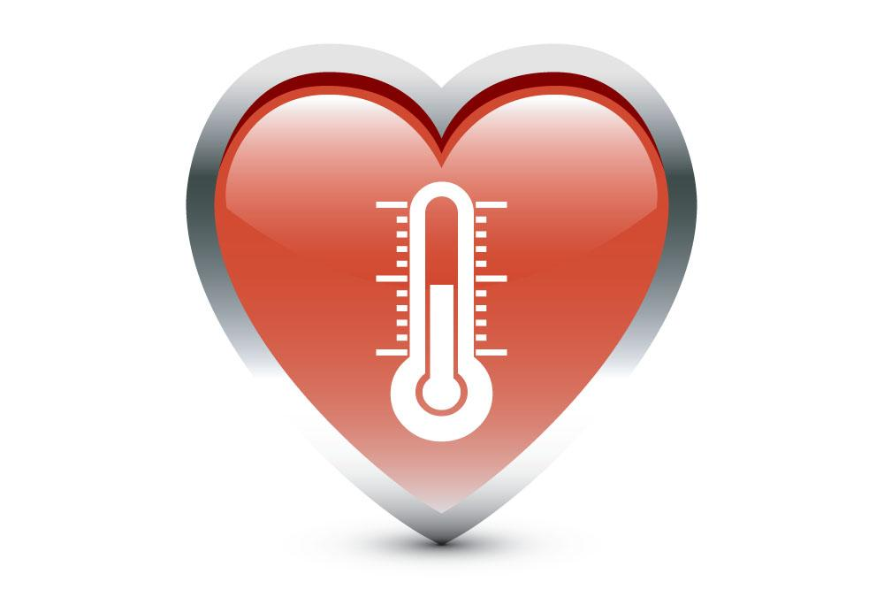
Wireless Health Monitoring System
MUHANNAD ALGHAMDI
GONGYAO REN
ABDUL BAQI

Slide 2
Introduction
With the advent of modern technology and connected devices, it has been made possible to remotely sense, analyze and control various instruments and sensing devices for different purposes.
The objective of this project is also connect the doctor with patient for continuous health monitoring remotely.
The proposed device will sense the temperature from human body and send it to doctors or Artificial Intelligent machines over the internet.

Slide 3
Project Goals
The current project is intended to connect doctors with patients via a health monitoring device embedded on patient’s body. Following are the goals and objectives of current project.
To install LM35 temperature sensing device in the circuit and integrate it with Arduino platform.
Include local connectivity options such as Bluetooth and WLAN connectivity.
Develop local to WLAN and vice versa switching automatically in case of error connecting internet.
Integrate device battery monitoring system with notification for low battery levels.
The goal is to create an embedded system which can measure and store body temperature and heart rate for doctors to evaluate current condition of patients

Slide 4
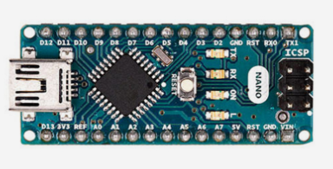
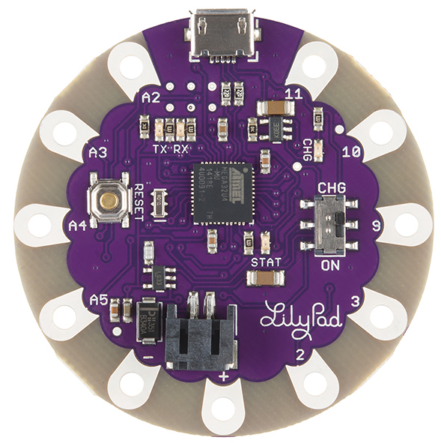
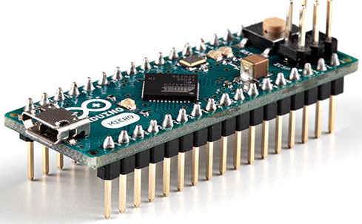
Micro-controller
Arduino Nano
Nano is a small and complete board.
It works with other components and it has enough pins.
It has a DC power jack and works with Mini-USB cable.
Arduino Lilypad USB Arduino Micro
limited pins.
Not enough Voltage.
problem with IDE.
not work with HM-10 BLE module.

Slide 5
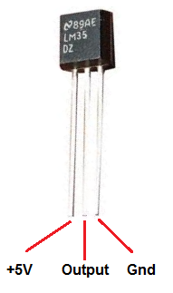
LM35 Temperature Sensor
The operating temperature range is from -55°C to 150°C.
The output voltage varies by 10 mV in response to every °C rise/fall in ambient temperature.
It’s not responses fast because it’s need time to convert mV to temperature.

Slide 6
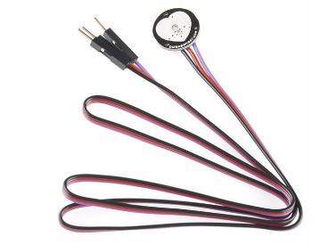
SEN-11574 Pulse Sensor
Small size, very light and easy to attach on fingertip or earlobe to measure heartbeat.
Reading is accurate, very cheap and easy to get.
It transmits light through fingertip to detect flowing blood to get heartbeat.

Slide 7
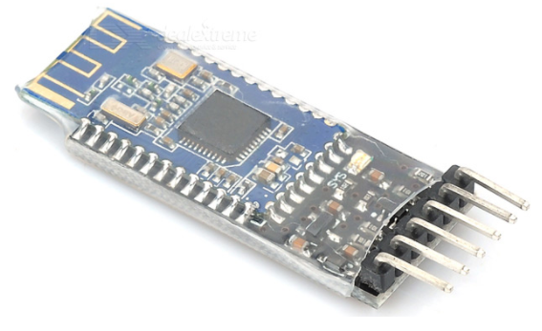
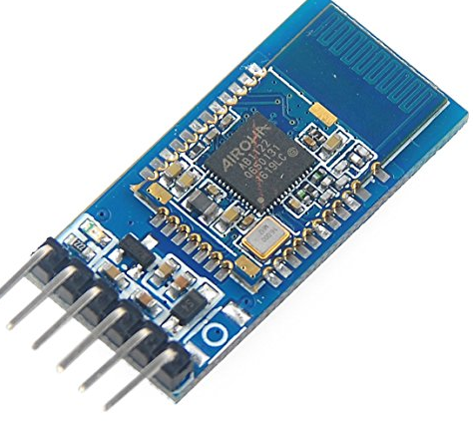
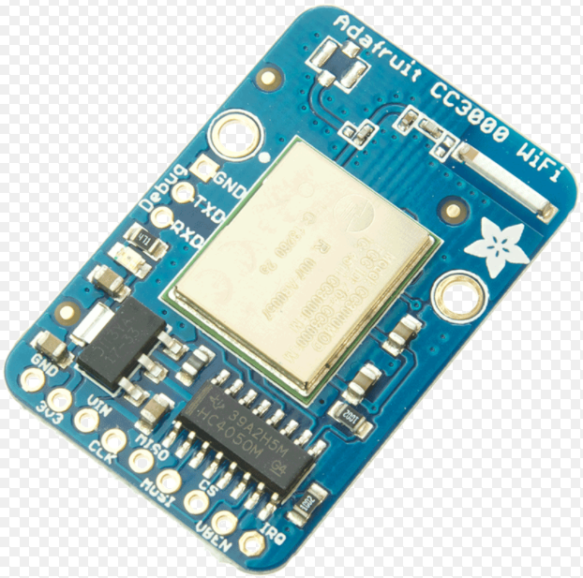
HM-10 BLE Bluetooth Module
It works with both Android device and IOS device.
It has BLE (Bluetooth low energy) system and Bluetooth 4.0. It cost lower energy instead of wifi module.
It transmits data very fast.
HC-06 Bluetooth Module
It’s not working with IOS device.
Adafruit CC3000 wifi Module
Data transmits slow.
Cost a lot of power.

Slide 8
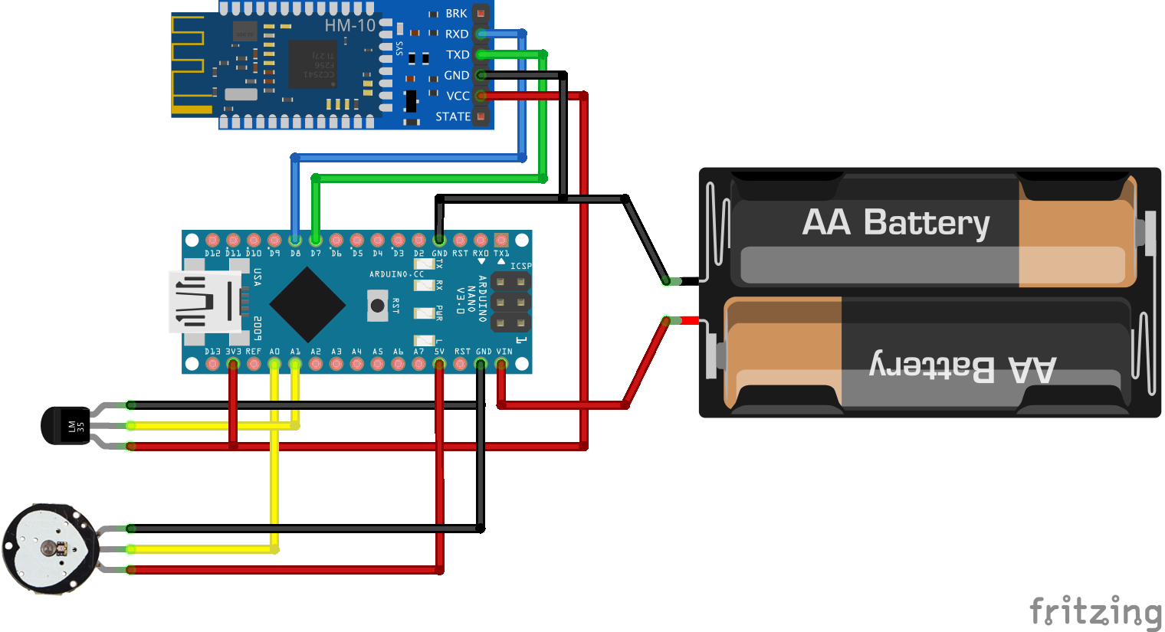

Device Design

Slide 9
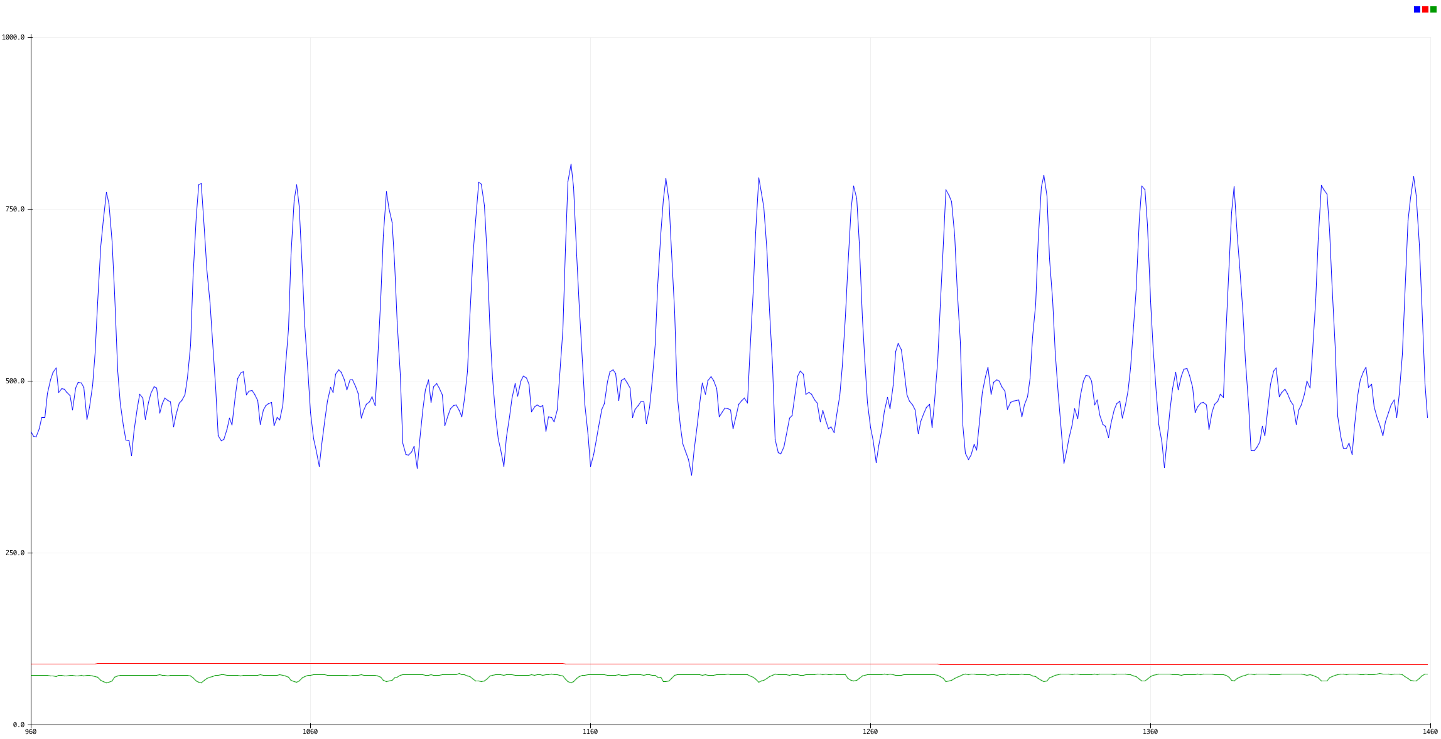
Result Analysis
Data Signal
Body Temperature
Heart Rate
Normal | The average normal temperature is 98.6°F (37°C).
Abnormal | Hypothermia: 95°F (35°C) or below.
 | High fever: 103°F (39.5°C) or above.
Normal | Normal resting heart rate is between 60 and 100 BPM.
Abnormal | If heart rate is closer to 60 bpm or lower.
At risk | If heart rate is closer to 150 bpm or higher.

Slide 10
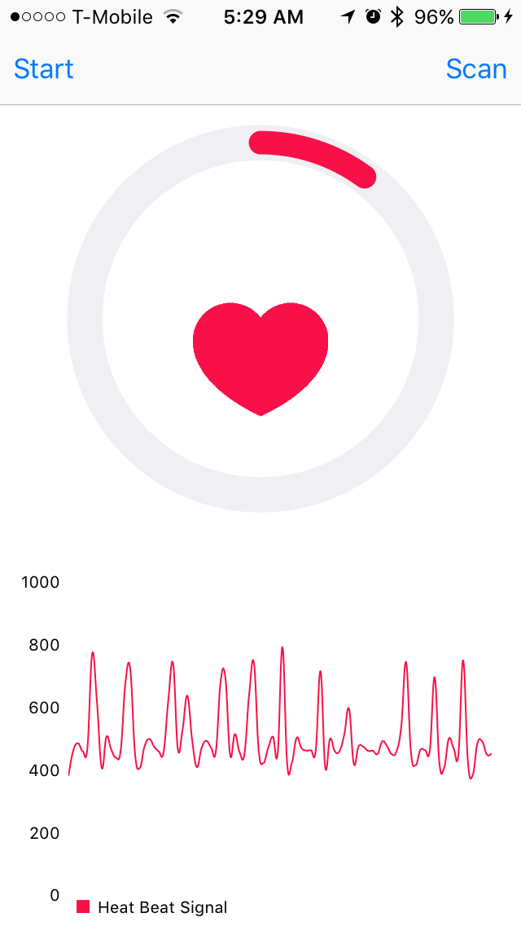
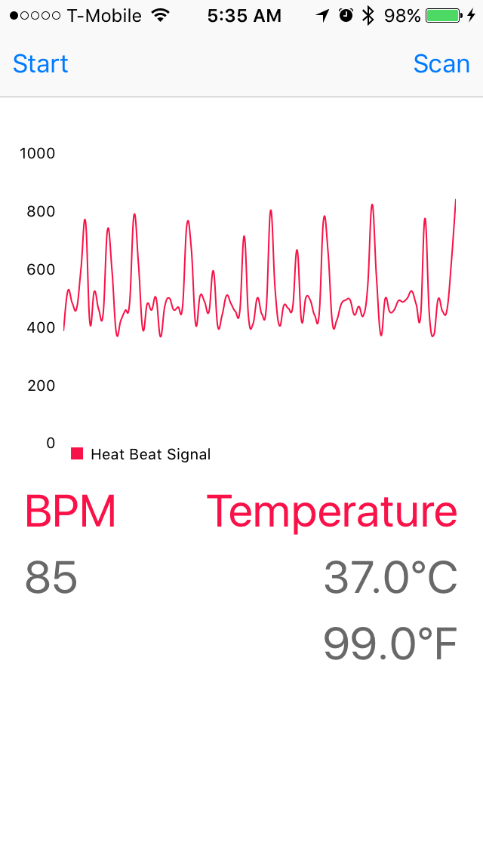
iPhone App

Slide 11
Future Work
As the projects has only two sensors, it will be needing more sensors to calculate other status like blood pressure so in that case in the future, it should have plugs in each sensor as many as required.
Also bluetooth module is only allowed one paired device every time. It is not convenient to collect data from multiple nodes like in a hospital. In the future, it should convert to other wireless communication method allowed access to multiple nodes to collect data like wifi or others.
It would be better if it can collect data through wifi from multiple nodes and upload them to a server. Then if user is outside of wifi communication range, user still can check data collection from server by mobile device.

