Slide 1
Wireless Sensor Network of Human Body Temperature Monitoring System
CSE 208 Introduction of Computer Engineering Design
Fall 2016
Gongyao Ren
Muhannad Alghamdi
Abdulbaqi

Slide 2
Overview (Introduction)
Body temperature is a skin condition can be measrued by thermomters and could be categorized by severval standards, such as: normal, hyperthermia, hypothermia.
For example, in hospital a baby is born prematurely, body temperature monitoring should be done usually every 3 hours by nurses or doctors and stays in the range of 36.5-37.5ºC.
The system can measure a patient’s body temperature and send them to a PC for doctor or nurse, when a patient’s body temperature is out of range the user can get an alarm notice.

Slide 3
Human Body Temperature
There are 2 types of body heat:
1) Core temperature: is the temperature of internal tissues.
2) Surface temperature: is temperature will increase or decrease as a response to the environment.
For our system we decide to use surface temperature.

Slide 4
Human Body Temperature
Type of Body Temperature | Hypothermia (°C) | Normal (°C) | Hyperthermia (°C)
Skin | <32.9 | 33 - 37 | >37.1
armpit | <34.6 | 34.7 - 37.3 | >37.8
ear | <35.7 | 35.8 - 38 | >38.1
Comparison between temperature types:
Skin is an easy location to take body temperature as a type of surface temperature and we are using this in our system.

Slide 5
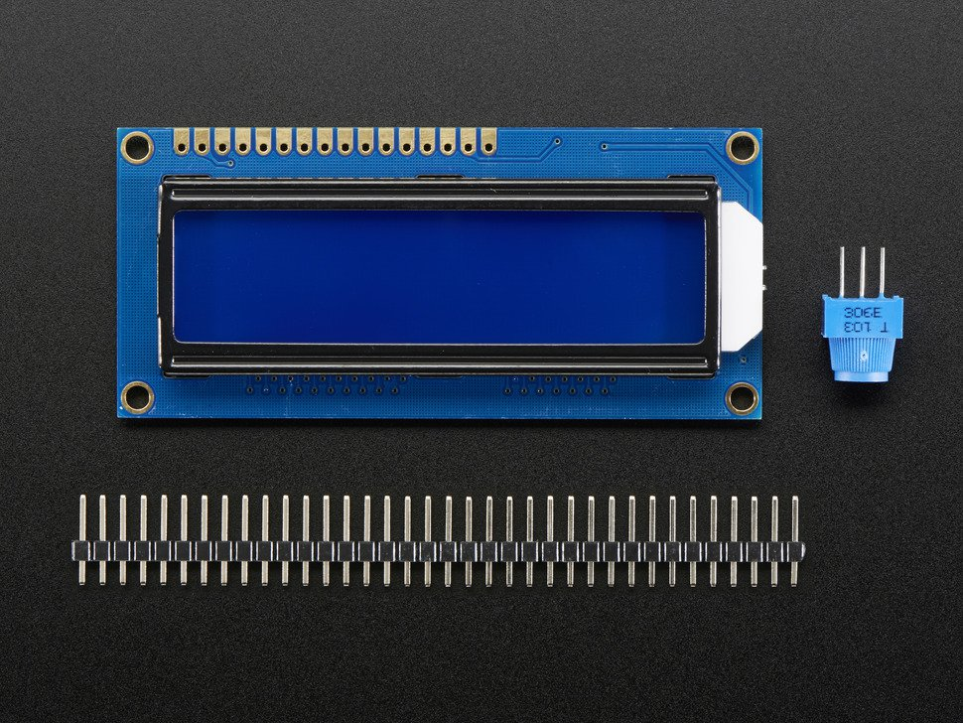
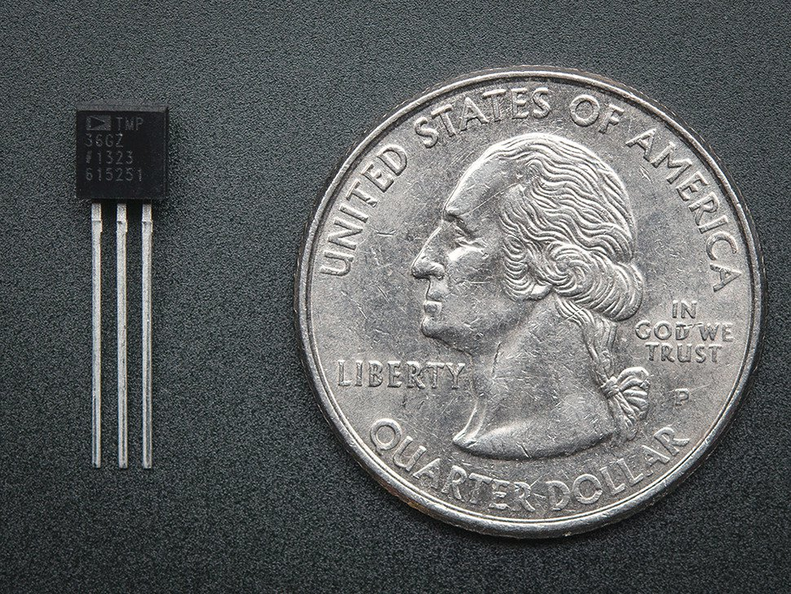
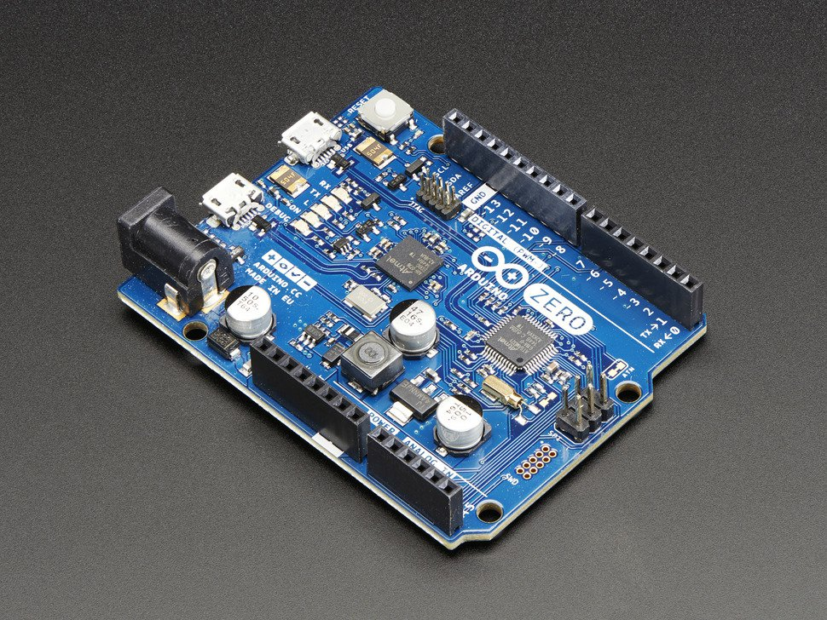
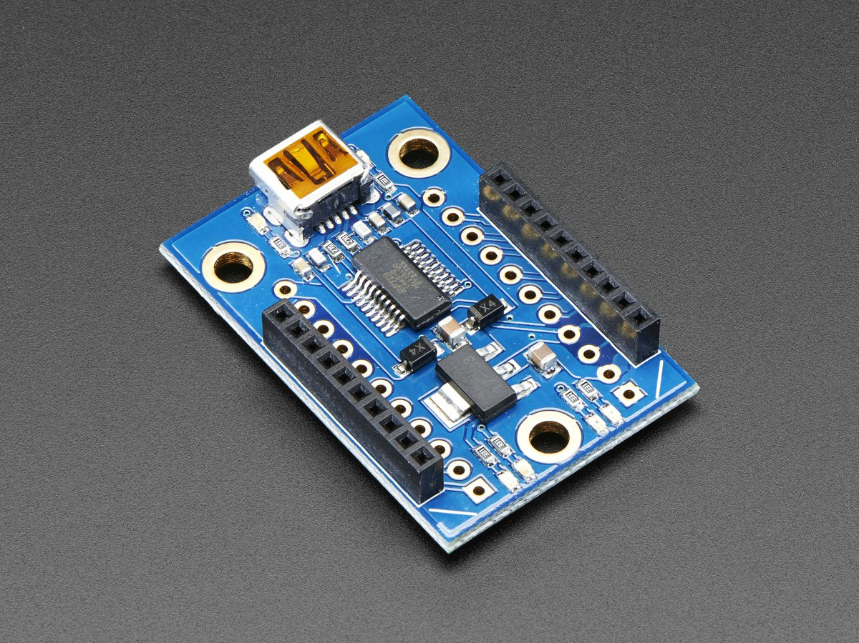
Hardware Equipment
ZigBee(Xbee ZB)
Sensor LM35
System Controller
LCD

Slide 6
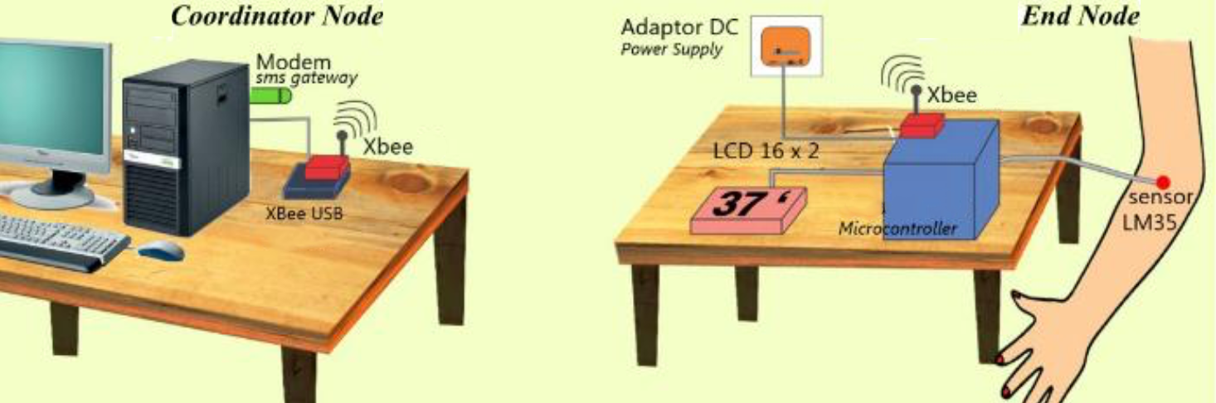
Design of The System

Slide 7
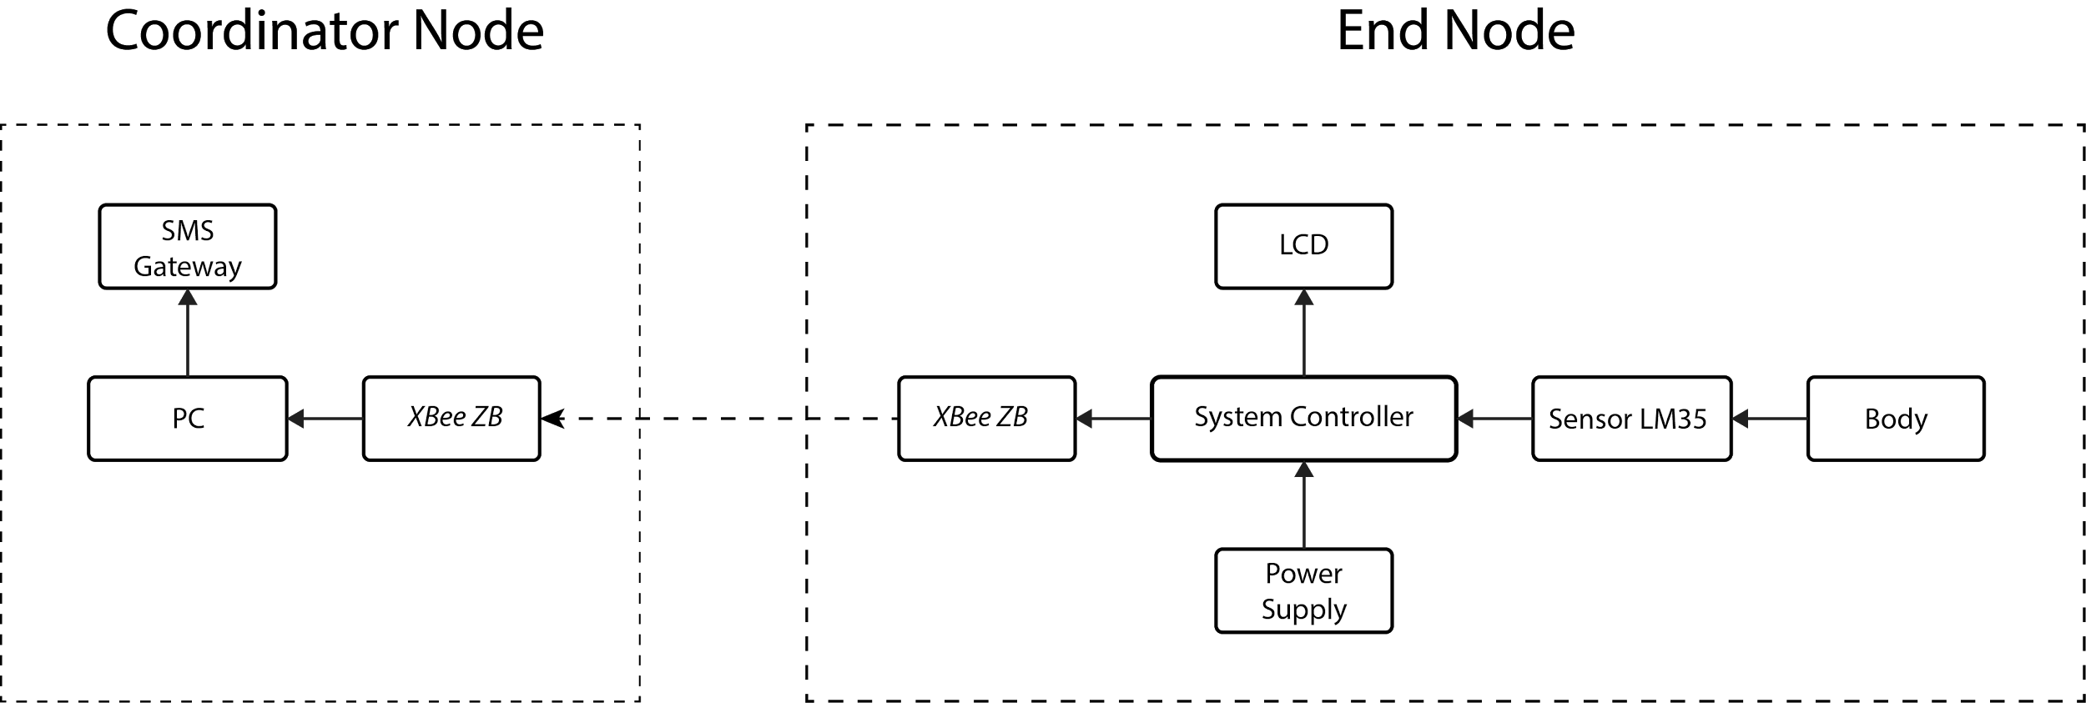
Block Diagram

Slide 8
Problem Approach
How is temperature value from the developed monitoring system compared with actual temperature value?
What is the furthest distance between nodes in ZigBee network when sending data?

Slide 9
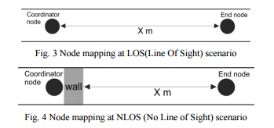
Testing Scenario
1. Accuracy Testing Scenario
Digital thermometer is using as a benchmark for the accuracy of the developed body temperature monitoring system.
2. Distance Testing Scenario

Slide 10
Conclusion
Results
Reliability and Capabality
Any question

