Slide 1
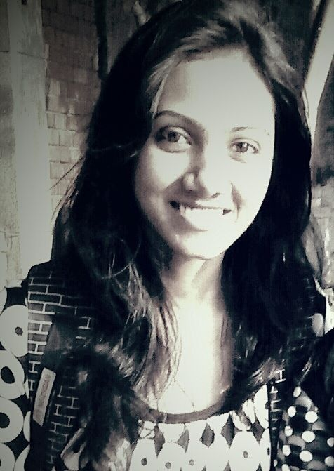

Hi, My name is
Kanika Murarka
(@a2batic)
Opensource

Slide 2
Why I Started?
My journey towards Linux started in 2011, when My windows OS crashed due to Virus and Blue screen errors and I decided to switch to Linux based OS.
After some times I even removed the dual booted windows and never installed it back.
It was a difficult decision for me, because I love to do graphics and was good with software like Adobe photoshop, Adobe illustrator and CorelDraw and gaming too :p.
Then I found the alternatives ‘Gimp and Inkspace’ for graphics which were good enough for me.

Slide 3

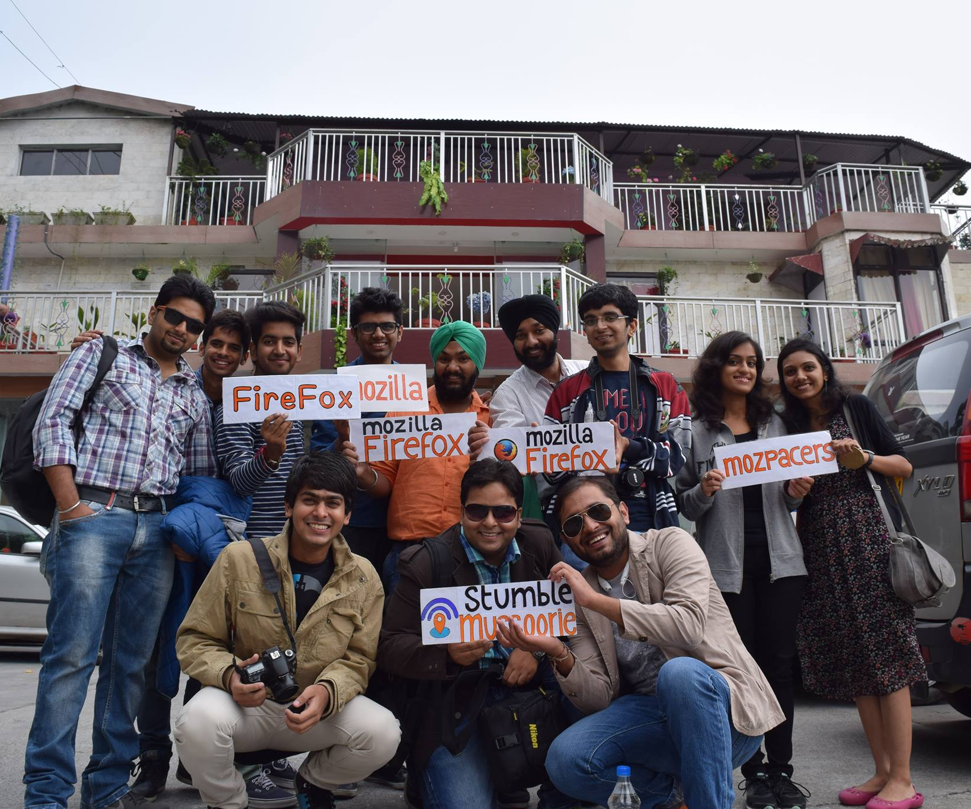
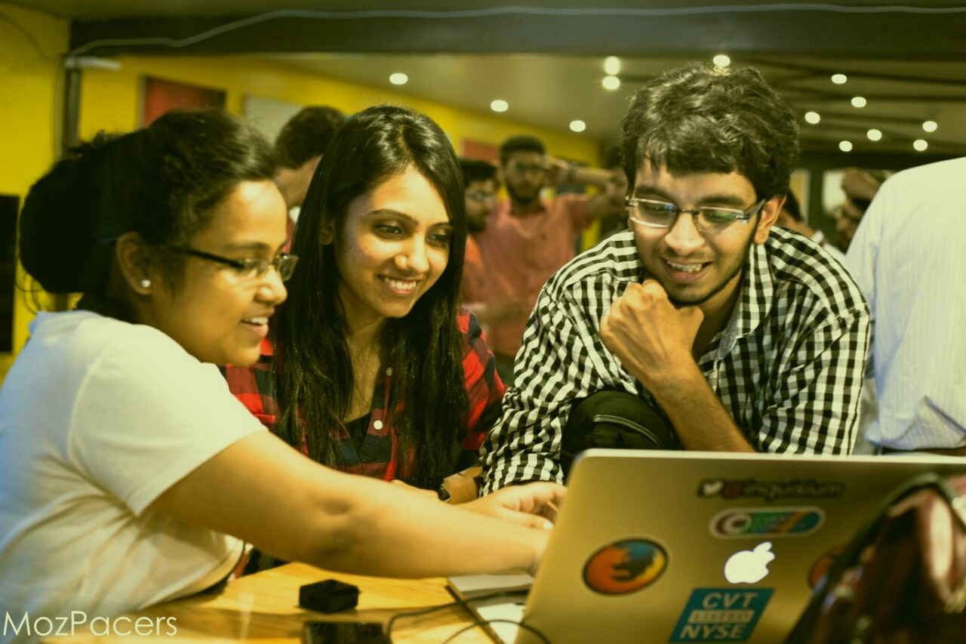
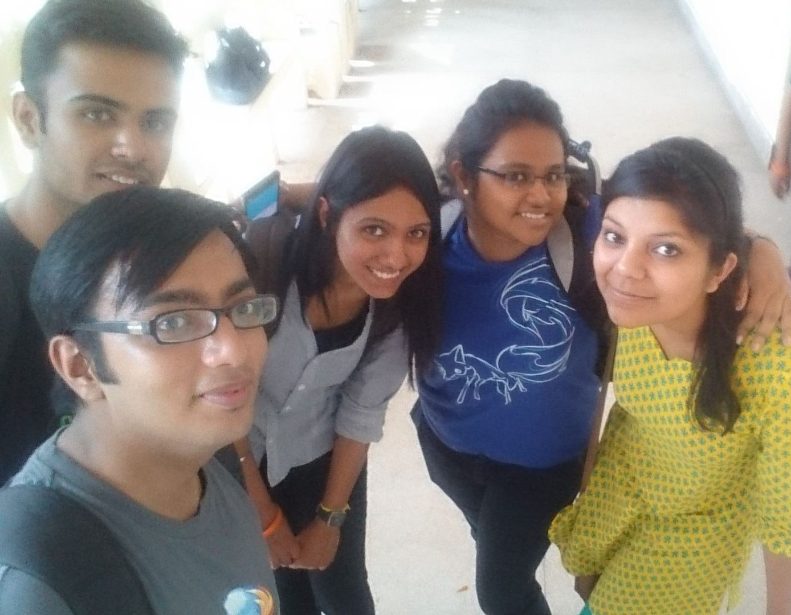
First step towards Open Source..
I got to know Open Source closely when I started attending events of Mozilla by Mozilla Delhi, IN.
I did the following things as part of Mozilla Delhi:-
Contributed to website of community for front-end and graphics
Volunteered for talks in the events like Women In Mozilla(WoMoz) at one of the reputed institutes for Women empowerment in FOSS
Helped people to understand ‘how the web works’

Slide 4


..then I started learning Python
I wanted to explore back-end as well so, I started with python.
I contributed in 2 open source projects using python- PyDSA and Qutebrowser.
PyDSA is an Open Source Python Data Structure and Algorithms Library for Educational purpose for the beginners learning Data Structures and Algorithms through python, they will easily be able to see the implementation of various common Data Structures and Algorithms and compare their performance
Qutebrowser is a keyboard-focused browser with a minimal GUI. It’s based on Python, PyQt5 and QtWebKit and free software, licensed under the GPL.It was inspired by other browsers/addons like dwb and Vimperator/Pentadactyl.

Slide 5

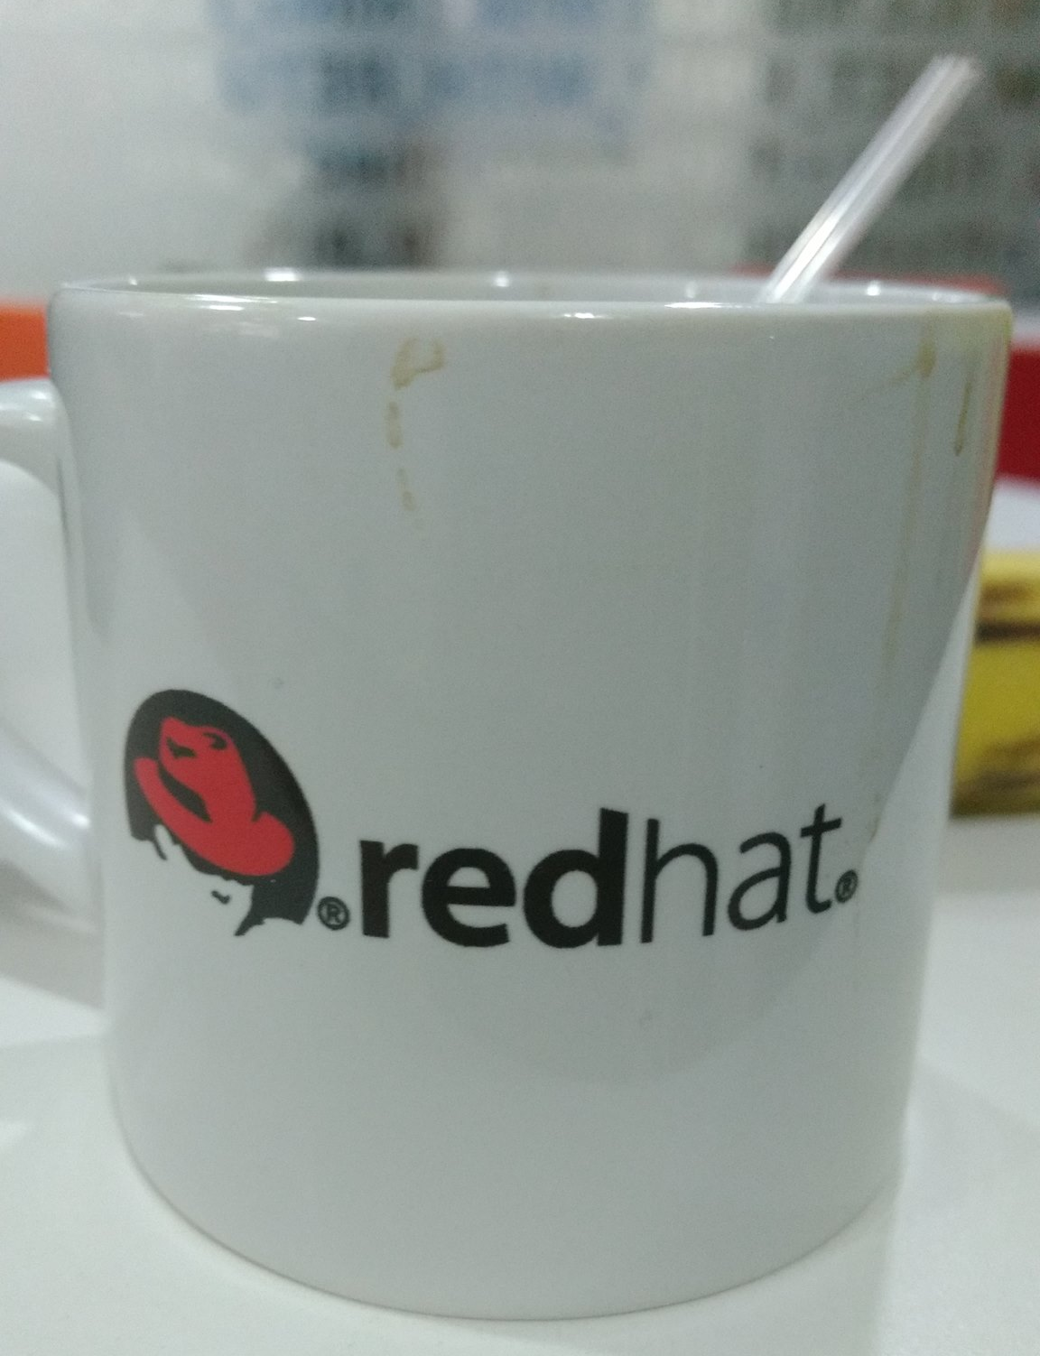
Latest Contribution
Recently, I started contributing to Fedora project through Fedora QA. I started with Release Validation testing manually by setting up virtual machine for Fedora 24. While contributing, I applied for the internship for Fedora QA in Red Hat and got selected.
Now I am doing my internship at Red Hat, Bangalore. I hope to become a valuable member for open source by contributing to it and spreading it .

Slide 6
Things I like about
Open source
Its OPEN and FREE
No gender biasing
No discrimination an the basis of Age, country, Religion, ONLY HOW MUCH YOU WORK MATTERS
Their are no strict boundaries, you can contribute to any team.
Best way of LEARNING things
Notes:
<number>

Slide 7
Let’s Make a Difference
I think open source has played a significant role in bringing more women into tech. Programs/communities like Fedora Women, Outreachy, Rails Girls summer of Code, Women In Mozilla, Python Ladies, Women Who Code and many more have really boosted up the confidence in a woman to take up Computer Science as there main stream.
I am also helping many new contributors to contribute in Open source projects in the field they wish to.

Slide 8
My Contact
Mail : kmurarka@redhat.com
IRC : #kmurarka

