Slide 1



定理描述：
$$Y=\left[\begin{matrix}\begin{matrix}Y_{i_{1}j_{1}} \\ Y_{i_{2}j_{2}} \\ Y_{i_{3}j_{3}}\end{matrix} \\ \begin{matrix}Y_{i_{4}j_{4}} \\ Y_{i_{5}j_{5}} \\ ⋮\end{matrix} \\ \begin{matrix}Y_{i_{k}j_{k}} \\ ⋮ \\ Y_{i_{m}j_{m}}\end{matrix}\end{matrix}\right]$$
$$Y=\left[\begin{matrix}\begin{matrix}\begin{matrix}Y_{11} & Y_{12} & Y_{13} \\ Y_{21} & Y_{22} & Y_{23} \\ Y_{31} & Y_{32} & Y_{33}\end{matrix} & \begin{matrix}⋯ & Y_{1n} \\ ⋯ & Y_{2n} \\ ⋯ & Y_{3n}\end{matrix} \\ \begin{matrix}⋮ & ⋮ & ⋮ \\ Y_{n1} & Y_{n2} & Y_{n3}\end{matrix} & \begin{matrix}⋱ & ⋮ \\ ⋯ & Y_{nn}\end{matrix}\end{matrix} & 0 \\ 0 & \begin{matrix}ξ_{1} & & \\ & ξ_{2} & \\ & & \begin{matrix}⋱ & \\ & ξ_{m}\end{matrix}\end{matrix}\end{matrix}\right]$$
元素排序
自变量
元素个数
$$m=\frac{n∗\left(n+1\right)}{2}$$

Slide 2

















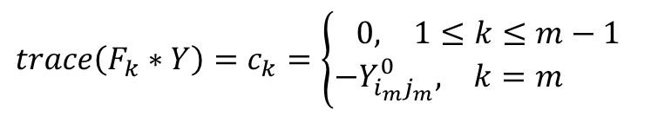
只有保序约束的目标函数
$$Y=\left[\begin{matrix}\begin{matrix}Y_{i_{1}j_{1}} \\ Y_{i_{2}j_{2}} \\ Y_{i_{3}j_{3}}\end{matrix} \\ \begin{matrix}Y_{i_{4}j_{4}} \\ Y_{i_{5}j_{5}} \\ ⋮\end{matrix} \\ \begin{matrix}Y_{i_{k}j_{k}} \\ ⋮ \\ Y_{i_{m}j_{m}}\end{matrix}\end{matrix}\right]$$
$$F_{0}=\left[0\right]$$
$$Y=\left[\begin{matrix}\begin{matrix}Y_{12} \\ Y_{23} \\ Y_{22}\end{matrix} \\ \begin{matrix}⋮ \\ Y_{i_{k}j_{k}} \\ Y_{i_{k+1}j_{k+1}}\end{matrix} \\ \begin{matrix}⋮ \\ Y_{nn} \\ Y_{33}\end{matrix}\end{matrix}\right]$$
$$Y=\left[\begin{matrix}\begin{matrix}\begin{matrix}Y_{11} & Y_{12} & Y_{13} \\ Y_{21} & Y_{22} & Y_{23} \\ Y_{31} & Y_{32} & Y_{33}\end{matrix} & \begin{matrix}⋯ & Y_{1n} \\ ⋯ & Y_{2n} \\ ⋯ & Y_{3n}\end{matrix} \\ \begin{matrix}⋮ & ⋮ & ⋮ \\ Y_{n1} & Y_{n2} & Y_{n3}\end{matrix} & \begin{matrix}⋱ & ⋮ \\ ⋯ & Y_{nn}\end{matrix}\end{matrix} & 0 \\ 0 & \begin{matrix}ξ_{1} & & \\ & ξ_{2} & \\ & & \begin{matrix}⋱ & \\ & ξ_{m}\end{matrix}\end{matrix}\end{matrix}\right]$$
$$F_{1}=\left[\begin{matrix}\begin{matrix}\begin{matrix}0 & −0.5 & 0 \\ −0.5 & 0 & +0.5 \\ 0 & +0.5 & 0\end{matrix} & \begin{matrix}⋯ & 0 \\ ⋯ & 0 \\ ⋯ & 0\end{matrix} \\ \begin{matrix}⋮ & ⋮ & ⋮ \\ 0 & 0 & 0\end{matrix} & \begin{matrix}⋱ & ⋮ \\ ⋯ & 0\end{matrix}\end{matrix} & 0 \\ 0 & \begin{matrix}−1 & & \\ & 0 & \\ & & \begin{matrix}⋱ & \\ & 0\end{matrix}\end{matrix}\end{matrix}\right]$$
元素排序
自变量
$$trace\left(F_{1}∗Y\right)=−Y_{12}+Y_{23}−ξ_{1}=0↔Y_{23}−Y_{12}=ξ_{1}>0↔Y_{12}<Y_{23}$$
元素个数
$$m=\frac{n∗\left(n+1\right)}{2}$$
$$F_{2}=\left[\begin{matrix}\begin{matrix}\begin{matrix}0 & 0 & 0 \\ 0 & +1 & −0.5 \\ 0 & −0.5 & 0\end{matrix} & \begin{matrix}⋯ & 0 \\ ⋯ & 0 \\ ⋯ & 0\end{matrix} \\ \begin{matrix}⋮ & ⋮ & ⋮ \\ 0 & 0 & 0 \end{matrix} & \begin{matrix}⋱ & ⋮ \\ ⋯ & 0\end{matrix}\end{matrix} & 0 \\ 0 & \begin{matrix}0 & & \\ & −1 & \\ & & \begin{matrix}⋱ & \\ & 0\end{matrix}\end{matrix}\end{matrix}\right]$$
目标函数
一个例子
$$\max_{Y}{trace\left(F_{0}∗Y\right)}$$
约束条件
$$−Y_{i_{k}j_{k}}+Y_{i_{k+1}j_{k+1}}−ξ_{k}=0$$
$$trace\left(F_{k}∗Y\right)=0, 1≤k≤m−1$$
$$trace\left(F_{k}∗Y\right)=−Y_{i_{m}j_{m}}^{0}, k=m$$
$$trace\left(F_{2}∗Y\right)=−Y_{23}+Y_{22}−ξ_{2}=0↔Y_{22}−Y_{23}=ξ_{2}>0↔Y_{23}<Y_{22}$$
$$ξ_{k}>0$$
$$⋮$$
$$Y∈S^{++}$$
$$F_{m}=\left[\begin{matrix}\begin{matrix}\begin{matrix}0 & 0 & 0 \\ 0 & 0 & 0 \\ 0 & 0 & −1\end{matrix} & \begin{matrix}⋯ & 0 \\ ⋯ & 0 \\ ⋯ & 0\end{matrix} \\ \begin{matrix}⋮ & ⋮ & ⋮ \\ 0 & 0 & 0 \end{matrix} & \begin{matrix}⋱ & ⋮ \\ ⋯ & 0\end{matrix}\end{matrix} & 0 \\ 0 & \begin{matrix}0 & & \\ & 0 & \\ & & \begin{matrix}⋱ & \\ & −1\end{matrix}\end{matrix}\end{matrix}\right]$$
$$Y_{1:n;1:n}∈S^{++}$$
SDP对偶问题
$$\max_{Y}{trace\left(F_{0}∗Y\right)}$$
$$trace\left(F_{k}∗Y\right)=c_{k}=\left\{\begin{aligned}\begin{matrix}0, & 1≤k≤m−1\end{matrix} \\ \begin{matrix}−Y_{i_{m}j_{m}}^{0}, & k=m \end{matrix}\end{aligned}\right.$$
$$Y∈S^{++}$$
$$trace\left(F_{m}∗Y\right)=−Y_{33}−ξ_{m}=−Y_{i_{m}j_{m}}^{0}↔Y_{33}<Y_{i_{m}j_{m}}^{0}$$

Slide 3
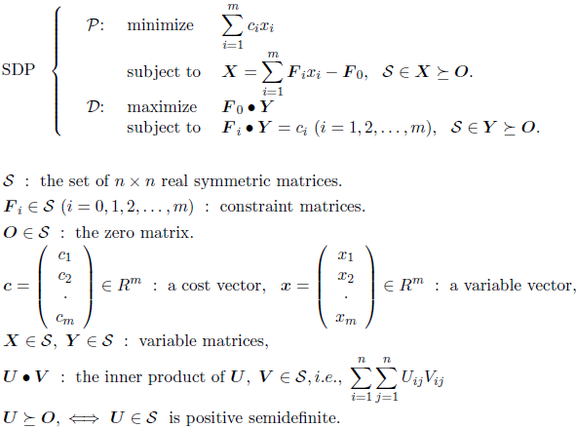

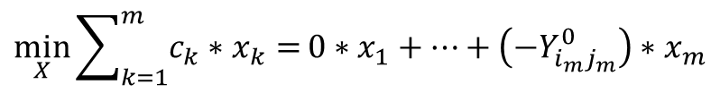

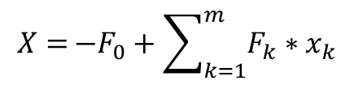
只有保序约束的目标函数
$$Y=\left[\begin{matrix}\begin{matrix}Y_{i_{1}j_{1}} \\ Y_{i_{2}j_{2}} \\ Y_{i_{3}j_{3}}\end{matrix} \\ \begin{matrix}Y_{i_{4}j_{4}} \\ Y_{i_{5}j_{5}} \\ ⋮\end{matrix} \\ \begin{matrix}Y_{i_{k}j_{k}} \\ ⋮ \\ Y_{i_{m}j_{m}}\end{matrix}\end{matrix}\right]$$
SDPA(Semi-Definite Programming Algorithm User’s Manual – Version 6.00)：原问题与对偶问题的转化
$$Y=\left[\begin{matrix}\begin{matrix}\begin{matrix}Y_{11} & Y_{12} & Y_{13} \\ Y_{21} & Y_{22} & Y_{23} \\ Y_{31} & Y_{32} & Y_{33}\end{matrix} & \begin{matrix}⋯ & Y_{1n} \\ ⋯ & Y_{2n} \\ ⋯ & Y_{3n}\end{matrix} \\ \begin{matrix}⋮ & ⋮ & ⋮ \\ Y_{n1} & Y_{n2} & Y_{n3}\end{matrix} & \begin{matrix}⋱ & ⋮ \\ ⋯ & Y_{nn}\end{matrix}\end{matrix} & 0 \\ 0 & \begin{matrix}ξ_{1} & & \\ & ξ_{2} & \\ & & \begin{matrix}⋱ & \\ & ξ_{m}\end{matrix}\end{matrix}\end{matrix}\right]$$
元素排序
自变量
元素个数
$$m=\frac{n∗\left(n+1\right)}{2}$$
目标函数
$$\max_{Y}{trace\left(F_{0}∗Y\right)}$$
约束条件
$$−Y_{i_{k}j_{k}}+Y_{i_{k+1}j_{k+1}}−ξ_{k}=0$$
$$trace\left(F_{k}∗Y\right)=0, 1≤k≤m−1$$
$$trace\left(F_{k}∗Y\right)=−Y_{i_{m}j_{m}}^{0}, k=m$$
$$ξ_{k}>0$$
$$Y∈S^{++}$$
$$Y_{1:n;1:n}∈S^{++}$$
SDP对偶问题
$$\max_{Y}{trace\left(F_{0}∗Y\right)}$$
SDP原问题
$$\min_{X}{\sum_{k=1}^{m}{c_{k}∗x_{k}}=}0∗x_{1}+⋯+\left(−Y_{i_{m}j_{m}}^{0}\right)∗x_{m}$$
$$trace\left(F_{k}∗Y\right)=c_{k}=\left\{\begin{aligned}\begin{matrix}0, & 1≤k≤m−1\end{matrix} \\ \begin{matrix}−Y_{i_{m}j_{m}}^{0}, & k=m \end{matrix}\end{aligned}\right.$$
$$X={−F_{0}+\sum_{k=1}^{m}{F_{k}∗x_{k}}}$$
$$Y∈S^{++}$$
$$F_{k}∈S$$
$$X∈S^{++}$$

Slide 4
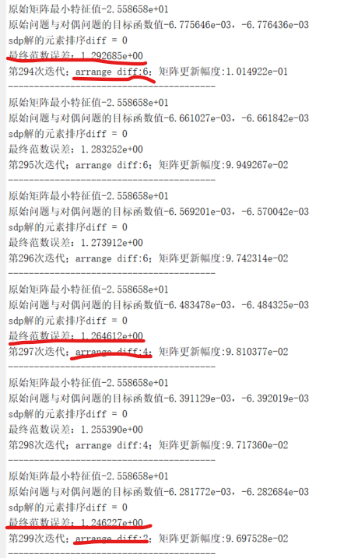
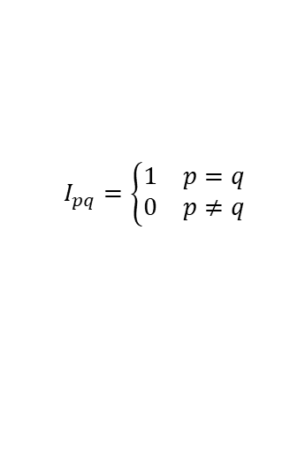

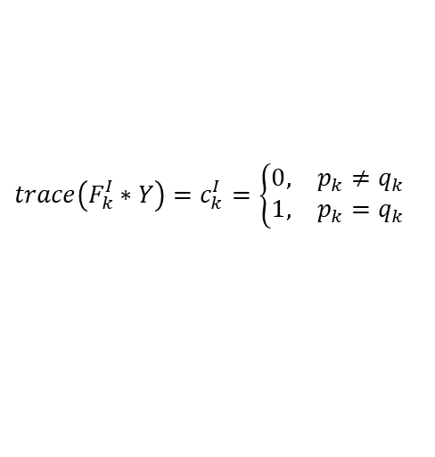







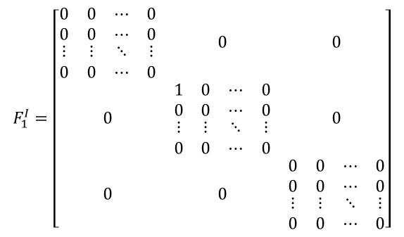


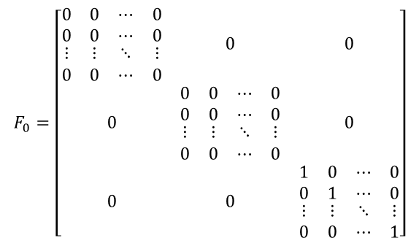
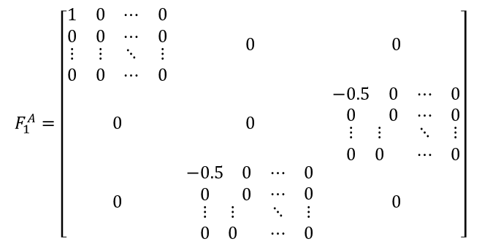




只有范数约束的目标函数
$$F_{0}=\left[\begin{matrix}\begin{matrix}\begin{matrix}0 & 0 \\ 0 & 0\end{matrix} & \begin{matrix}⋯ & 0 \\ ⋯ & 0\end{matrix} \\ \begin{matrix}⋮ & ⋮ \\ 0 & 0\end{matrix} & \begin{matrix}⋱ & ⋮ \\ ⋯ & 0\end{matrix}\end{matrix} & 0 & 0 \\ 0 & \begin{matrix}\begin{matrix}0 & 0 \\ 0 & 0\end{matrix} & \begin{matrix}⋯ & 0 \\ ⋯ & 0\end{matrix} \\ \begin{matrix}⋮ & ⋮ \\ 0 & 0\end{matrix} & \begin{matrix}⋱ & ⋮ \\ ⋯ & 0\end{matrix}\end{matrix} & 0 \\ 0 & 0 & \begin{matrix}\begin{matrix}1 & 0 \\ 0 & 1\end{matrix} & \begin{matrix}⋯ & 0 \\ ⋯ & 0\end{matrix} \\ \begin{matrix}⋮ & ⋮ \\ 0 & 0\end{matrix} & \begin{matrix}⋱ & ⋮ \\ ⋯ & 1\end{matrix}\end{matrix}\end{matrix}\right]$$
$$F_{1}^{I}=\left[\begin{matrix}\begin{matrix}\begin{matrix}0 & 0 \\ 0 & 0\end{matrix} & \begin{matrix}⋯ & 0 \\ ⋯ & 0\end{matrix} \\ \begin{matrix}⋮ & ⋮ \\ 0 & 0\end{matrix} & \begin{matrix}⋱ & ⋮ \\ ⋯ & 0\end{matrix}\end{matrix} & 0 & 0 \\ 0 & \begin{matrix}\begin{matrix}1 & 0 \\ 0 & 0\end{matrix} & \begin{matrix}⋯ & 0 \\ ⋯ & 0\end{matrix} \\ \begin{matrix}⋮ & ⋮ \\ 0 & 0\end{matrix} & \begin{matrix}⋱ & ⋮ \\ ⋯ & 0\end{matrix}\end{matrix} & 0 \\ 0 & 0 & \begin{matrix}\begin{matrix}0 & 0 \\ 0 & 0\end{matrix} & \begin{matrix}⋯ & 0 \\ ⋯ & 0\end{matrix} \\ \begin{matrix}⋮ & ⋮ \\ 0 & 0\end{matrix} & \begin{matrix}⋱ & ⋮ \\ ⋯ & 0\end{matrix}\end{matrix}\end{matrix}\right]$$
$$Y=\left[\begin{matrix}\begin{matrix}\begin{matrix}Y_{11} & Y_{12} \\ Y_{21} & Y_{22}\end{matrix} & \begin{matrix}⋯ & Y_{1n} \\ ⋯ & Y_{2n}\end{matrix} \\ \begin{matrix}⋮ & ⋮ \\ Y_{n1} & Y_{n2}\end{matrix} & \begin{matrix}⋱ & ⋮ \\ ⋯ & Y_{nn}\end{matrix}\end{matrix} & 0 & 0 \\ 0 & \begin{matrix}\begin{matrix}I_{11} & I_{12} \\ I_{21} & I_{22}\end{matrix} & \begin{matrix} ⋯ & I_{1n} \\ ⋯ & I_{2n}\end{matrix} \\ \begin{matrix}⋮ & ⋮ \\ I_{n1} & I_{n2}\end{matrix} & \begin{matrix} ⋱ & ⋮ \\ ⋯ & I_{nn}\end{matrix}\end{matrix} & \begin{matrix}\begin{matrix}A_{11} & A_{12} \\ A_{21} & A_{22}\end{matrix} & \begin{matrix}⋯ & A_{1n} \\ ⋯ & A_{2n}\end{matrix} \\ \begin{matrix}⋮ & ⋮ \\ A_{n1} & A_{n2}\end{matrix} & \begin{matrix}⋱ & ⋮ \\ ⋯ & A_{nn}\end{matrix}\end{matrix} \\ 0 & \begin{matrix}\begin{matrix}A_{11} & A_{12} \\ A_{21} & A_{22}\end{matrix} & \begin{matrix}⋯ & A_{1n} \\ ⋯ & A_{2n}\end{matrix} \\ \begin{matrix}⋮ & ⋮ \\ A_{n1} & A_{n2}\end{matrix} & \begin{matrix}⋱ & ⋮ \\ ⋯ & A_{nn}\end{matrix}\end{matrix} & \begin{matrix}\begin{matrix}Z_{11} & Z_{12} \\ Z_{21} & Z_{22}\end{matrix} & \begin{matrix}⋯ & Z_{1n} \\ ⋯ & Z_{2n}\end{matrix} \\ \begin{matrix}⋮ & ⋮ \\ Z_{n1} & Z_{n2}\end{matrix} & \begin{matrix}⋱ & ⋮ \\ ⋯ & Z_{nn}\end{matrix}\end{matrix}\end{matrix}\right]$$
自变量
$$F_{1}^{A}=\left[\begin{matrix}\begin{matrix}\begin{matrix}1 & 0 \\ 0 & 0\end{matrix} & \begin{matrix}⋯ & 0 \\ ⋯ & 0\end{matrix} \\ \begin{matrix}⋮ & ⋮ \\ 0 & 0\end{matrix} & \begin{matrix}⋱ & ⋮ \\ ⋯ & 0\end{matrix}\end{matrix} & 0 & 0 \\ 0 & 0 & \begin{matrix}\begin{matrix}−0.5 & 0 \\ 0 & 0\end{matrix} & \begin{matrix}⋯ & 0 \\ ⋯ & 0\end{matrix} \\ \begin{matrix}⋮ & ⋮ \\ 0 & 0\end{matrix} & \begin{matrix}⋱ & ⋮ \\ ⋯ & 0\end{matrix}\end{matrix} \\ 0 & \begin{matrix}\begin{matrix}−0.5 & 0 \\ 0 & 0\end{matrix} & \begin{matrix}⋯ & 0 \\ ⋯ & 0\end{matrix} \\ \begin{matrix}⋮ & ⋮ \\ 0 & 0\end{matrix} & \begin{matrix}⋱ & ⋮ \\ ⋯ & 0\end{matrix}\end{matrix} & 0\end{matrix}\right]$$
目标函数
$$\max_{Y}{−trace\left(F_{0}∗Y\right)=trace\left(−F_{0}∗Y\right)=−trace\left(Z\right)}$$
$$\min_{Y_{1:n;1:n}∈S^{++}}{{\left|Y_{1:n;1:n}−Y_{1:n;i:n}^{0}\right|}_{F}^{2}}$$
$$A_{ij}=Y_{ij}−Y_{ij}^{0}↔$$
$$Y_{ij}−A_{ij}=Y_{ij}^{0}$$
$$trace\left(Z\right)≥trace\left({\left(Y_{1:n;1:n}−Y_{1:n;i:n}^{0}\right)}^{2}\right)={\left|Y_{1:n;1:n}−Y_{1:n;i:n}^{0}\right|}_{F}^{2}$$
约束条件
$$I_{pq}=\left\{\begin{aligned}\begin{matrix}1 & p=q\end{matrix} \\ \begin{matrix}0 & p≠q\end{matrix}\end{aligned}\right.$$
$$Z−\left(Y_{1:n;1:n}−Y_{1:n;i:n}^{0}\right)∗\left(Y_{1:n;1:n}−Y_{1:n;i:n}^{0}\right)∈S^{++}$$
$$\left[\begin{matrix}I & A \\ A & Z\end{matrix}\right]∈S^{++}$$
$$Z−A∗I^{−1}∗A∈S^{++}$$
$$F_{2}^{A}=\left[\begin{matrix}\begin{matrix}\begin{matrix}0 & 0.5 \\ 0.5 & 0\end{matrix} & \begin{matrix}⋯ & 0 \\ ⋯ & 0\end{matrix} \\ \begin{matrix}⋮ & ⋮ \\ 0 & 0\end{matrix} & \begin{matrix}⋱ & ⋮ \\ ⋯ & 0\end{matrix}\end{matrix} & 0 & 0 \\ 0 & 0 & \begin{matrix}\begin{matrix}0 & −0.25 \\ −0.25 & 0\end{matrix} & \begin{matrix}⋯ & 0 \\ ⋯ & 0\end{matrix} \\ \begin{matrix}⋮ & ⋮ \\ 0 & 0 \end{matrix} & \begin{matrix}⋱ & ⋮ \\ ⋯ & 0\end{matrix}\end{matrix} \\ 0 & \begin{matrix}\begin{matrix}0 & −0.25 \\ −0.25 & 0\end{matrix} & \begin{matrix}⋯ & 0 \\ ⋯ & 0\end{matrix} \\ \begin{matrix}⋮ & ⋮ \\ 0 & 0\end{matrix} & \begin{matrix}⋱ & ⋮ \\ ⋯ & 0\end{matrix}\end{matrix} & 0\end{matrix}\right]$$
$$Y_{1:n;1:n}∈S^{++}$$
$$Y∈S^{++}$$
SDP对偶问题
$$\max_{Y}{trace\left(−F_{0}∗Y\right)}$$
$$trace\left(F_{k}^{I}∗Y\right)=c_{k}^{I}=\left\{\begin{aligned}\begin{matrix}0, & p_{k}≠q_{k}\end{matrix} \\ \begin{matrix}1, & p_{k}=q_{k}\end{matrix}\end{aligned}\right.$$
$$trace\left(F_{k}^{A}∗Y\right)=c_{k}^{A}=Y_{i_{k}j_{k}}^{0}$$
$$Y∈S^{++}$$
$$F_{k}^{I}∈S$$
$$F_{k}^{A}∈S$$

Slide 5






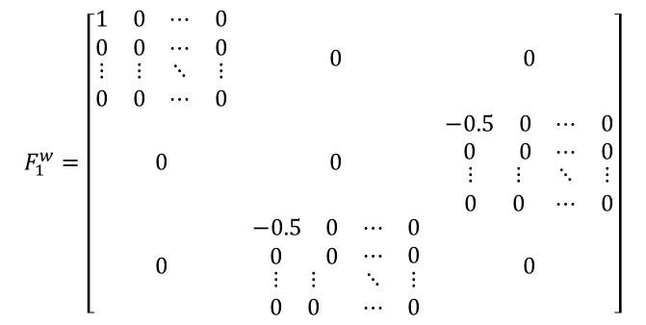





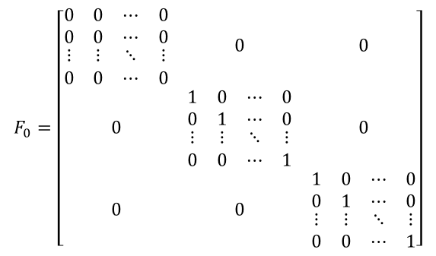
只有低秩约束的目标函数
$$F_{0}=\left[\begin{matrix}\begin{matrix}\begin{matrix}0 & 0 \\ 0 & 0\end{matrix} & \begin{matrix}⋯ & 0 \\ ⋯ & 0\end{matrix} \\ \begin{matrix}⋮ & ⋮ \\ 0 & 0\end{matrix} & \begin{matrix}⋱ & ⋮ \\ ⋯ & 0\end{matrix}\end{matrix} & 0 & 0 \\ 0 & \begin{matrix}\begin{matrix}1 & 0 \\ 0 & 1\end{matrix} & \begin{matrix}⋯ & 0 \\ ⋯ & 0\end{matrix} \\ \begin{matrix}⋮ & ⋮ \\ 0 & 0\end{matrix} & \begin{matrix}⋱ & ⋮ \\ ⋯ & 1\end{matrix}\end{matrix} & 0 \\ 0 & 0 & \begin{matrix}\begin{matrix}1 & 0 \\ 0 & 1\end{matrix} & \begin{matrix}⋯ & 0 \\ ⋯ & 0\end{matrix} \\ \begin{matrix}⋮ & ⋮ \\ 0 & 0\end{matrix} & \begin{matrix}⋱ & ⋮ \\ ⋯ & 1\end{matrix}\end{matrix}\end{matrix}\right]$$
$$Y=\left[\begin{matrix}\begin{matrix}\begin{matrix}Y_{11} & Y_{12} \\ Y_{21} & Y_{22}\end{matrix} & \begin{matrix}⋯ & Y_{1n} \\ ⋯ & Y_{2n}\end{matrix} \\ \begin{matrix}⋮ & ⋮ \\ Y_{n1} & Y_{n2}\end{matrix} & \begin{matrix}⋱ & ⋮ \\ ⋯ & Y_{nn}\end{matrix}\end{matrix} & 0 & 0 \\ 0 & \begin{matrix}\begin{matrix}U_{11} & U_{12} \\ U_{21} & U_{22}\end{matrix} & \begin{matrix} ⋯ & U_{1n} \\ ⋯ & U_{2n}\end{matrix} \\ \begin{matrix}⋮ & ⋮ \\ U_{n1} & U_{n2}\end{matrix} & \begin{matrix} ⋱ & ⋮ \\ ⋯ & U_{nn}\end{matrix}\end{matrix} & \begin{matrix}\begin{matrix}W_{11} & W_{12} \\ W_{21} & W_{22}\end{matrix} & \begin{matrix}⋯ & W_{1n} \\ ⋯ & W_{2n}\end{matrix} \\ \begin{matrix}⋮ & ⋮ \\ W_{n1} & W_{n2}\end{matrix} & \begin{matrix}⋱ & ⋮ \\ ⋯ & W_{nn}\end{matrix}\end{matrix} \\ 0 & \begin{matrix}\begin{matrix}W_{11} & W_{12} \\ W_{21} & W_{22}\end{matrix} & \begin{matrix}⋯ & W_{1n} \\ ⋯ & W_{2n}\end{matrix} \\ \begin{matrix}⋮ & ⋮ \\ W_{n1} & W_{n2}\end{matrix} & \begin{matrix}⋱ & ⋮ \\ ⋯ & W_{nn}\end{matrix}\end{matrix} & \begin{matrix}\begin{matrix}V_{11} & V_{12} \\ V_{21} & V_{22}\end{matrix} & \begin{matrix}⋯ & V_{1n} \\ ⋯ & V_{2n}\end{matrix} \\ \begin{matrix}⋮ & ⋮ \\ V_{n1} & V_{n2}\end{matrix} & \begin{matrix}⋱ & ⋮ \\ ⋯ & V_{nn}\end{matrix}\end{matrix}\end{matrix}\right]$$
自变量
$$F_{1}^{w}=\left[\begin{matrix}\begin{matrix}\begin{matrix}1 & 0 \\ 0 & 0\end{matrix} & \begin{matrix}⋯ & 0 \\ ⋯ & 0\end{matrix} \\ \begin{matrix}⋮ & ⋮ \\ 0 & 0\end{matrix} & \begin{matrix}⋱ & ⋮ \\ ⋯ & 0\end{matrix}\end{matrix} & 0 & 0 \\ 0 & 0 & \begin{matrix}\begin{matrix}−0.5 & 0 \\ 0 & 0\end{matrix} & \begin{matrix}⋯ & 0 \\ ⋯ & 0\end{matrix} \\ \begin{matrix} ⋮ & ⋮ \\ 0 & 0\end{matrix} & \begin{matrix}⋱ & ⋮ \\ ⋯ & 0\end{matrix}\end{matrix} \\ 0 & \begin{matrix}\begin{matrix}−0.5 & 0 \\ 0 & 0\end{matrix} & \begin{matrix}⋯ & 0 \\ ⋯ & 0\end{matrix} \\ \begin{matrix}⋮ & ⋮ \\ 0 & 0\end{matrix} & \begin{matrix}⋱ & ⋮ \\ ⋯ & 0\end{matrix}\end{matrix} & 0\end{matrix}\right]$$
目标函数
$$\max_{Y}{−trace\left(F_{0}∗Y\right)=trace\left(−F_{0}∗Y\right)=−trace\left(U\right)−trace\left(V\right)}$$
约束条件
$$trace\left(F_{k}^{W}∗Y\right)=c_{k}^{w}=0$$
$$W_{ij}=Y_{ij}↔$$
$$Y_{ij}−W_{ij}=0$$
$$\left[\begin{matrix}U & W \\ W & V\end{matrix}\right]∈S^{++}$$
$$F_{2}^{w}=\left[\begin{matrix}\begin{matrix}\begin{matrix}0 & 0.5 \\ 0.5 & 0\end{matrix} & \begin{matrix}⋯ & 0 \\ ⋯ & 0\end{matrix} \\ \begin{matrix}⋮ & ⋮ \\ 0 & 0\end{matrix} & \begin{matrix}⋱ & ⋮ \\ ⋯ & 0\end{matrix}\end{matrix} & 0 & 0 \\ 0 & 0 & \begin{matrix}\begin{matrix}0 & −0.25 \\ −0.25 & 0\end{matrix} & \begin{matrix}⋯ & 0 \\ ⋯ & 0\end{matrix} \\ \begin{matrix}⋮ & ⋮ \\ 0 & 0 \end{matrix} & \begin{matrix}⋱ & ⋮ \\ ⋯ & 0\end{matrix}\end{matrix} \\ 0 & \begin{matrix}\begin{matrix}0 & −0.25 \\ −0.25 & 0\end{matrix} & \begin{matrix}⋯ & 0 \\ ⋯ & 0\end{matrix} \\ \begin{matrix}⋮ & ⋮ \\ 0 & 0\end{matrix} & \begin{matrix}⋱ & ⋮ \\ ⋯ & 0\end{matrix}\end{matrix} & 0\end{matrix}\right]$$
$$Y_{1:n;1:n}∈S^{++}$$
$$Y∈S^{++}$$
SDP对偶问题
$$\max_{Y}{trace\left(−F_{0}∗Y\right)}$$
$$trace\left(F_{k}^{W}∗Y\right)=c_{k}^{w}=0$$
$$Y∈S^{++}$$
$$F_{k}^{W}∈S$$

Slide 6


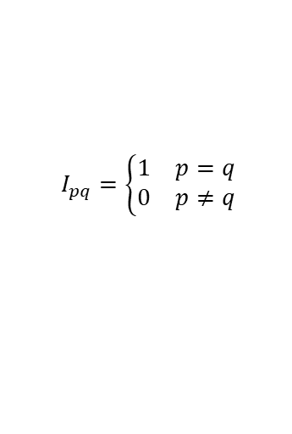

保序约束+范数约束+低秩约束的目标函数
$$Y=\left[\begin{matrix}\begin{matrix}\begin{matrix}\begin{matrix}Y_{11} & Y_{12} & Y_{13} \\ Y_{21} & Y_{22} & Y_{23} \\ Y_{31} & Y_{32} & Y_{33}\end{matrix} & \begin{matrix}⋯ & Y_{1n} \\ ⋯ & Y_{2n} \\ ⋯ & Y_{3n}\end{matrix} \\ \begin{matrix}⋮ & ⋮ & ⋮ \\ Y_{n1} & Y_{n2} & Y_{n3}\end{matrix} & \begin{matrix}⋱ & ⋮ \\ ⋯ & Y_{nn}\end{matrix}\end{matrix} & 0 \\ 0 & \begin{matrix}\begin{matrix}\begin{matrix}I_{11} & I_{12} \\ I_{21} & I_{22}\end{matrix} & \begin{matrix} ⋯ & I_{1n} \\ ⋯ & I_{2n}\end{matrix} \\ \begin{matrix}⋮ & ⋮ \\ I_{n1} & I_{n2}\end{matrix} & \begin{matrix} ⋱ & ⋮ \\ ⋯ & I_{nn}\end{matrix}\end{matrix} & \begin{matrix}\begin{matrix}A_{11} & A_{12} \\ A_{21} & A_{22}\end{matrix} & \begin{matrix}⋯ & A_{1n} \\ ⋯ & A_{2n}\end{matrix} \\ \begin{matrix}⋮ & ⋮ \\ A_{n1} & A_{n2}\end{matrix} & \begin{matrix}⋱ & ⋮ \\ ⋯ & A_{nn}\end{matrix}\end{matrix} \\ \begin{matrix}\begin{matrix}A_{11} & A_{12} \\ A_{21} & A_{22}\end{matrix} & \begin{matrix}⋯ & A_{1n} \\ ⋯ & A_{2n}\end{matrix} \\ \begin{matrix}⋮ & ⋮ \\ A_{n1} & A_{n2}\end{matrix} & \begin{matrix}⋱ & ⋮ \\ ⋯ & A_{nn}\end{matrix}\end{matrix} & \begin{matrix}\begin{matrix}Z_{11} & Z_{12} \\ Z_{21} & Z_{22}\end{matrix} & \begin{matrix}⋯ & Z_{1n} \\ ⋯ & Z_{2n}\end{matrix} \\ \begin{matrix}⋮ & ⋮ \\ Z_{n1} & Z_{n2}\end{matrix} & \begin{matrix}⋱ & ⋮ \\ ⋯ & Z_{nn}\end{matrix}\end{matrix}\end{matrix}\end{matrix} & 0 \\ 0 & \begin{matrix}\begin{matrix}\begin{matrix}\begin{matrix}U_{11} & U_{12} \\ U_{21} & U_{22}\end{matrix} & \begin{matrix} ⋯ & U_{1n} \\ ⋯ & U_{2n}\end{matrix} \\ \begin{matrix}⋮ & ⋮ \\ U_{n1} & U_{n2}\end{matrix} & \begin{matrix} ⋱ & ⋮ \\ ⋯ & U_{nn}\end{matrix}\end{matrix} & \begin{matrix}\begin{matrix}W_{11} & W_{12} \\ W_{21} & W_{22}\end{matrix} & \begin{matrix}⋯ & W_{1n} \\ ⋯ & W_{2n}\end{matrix} \\ \begin{matrix}⋮ & ⋮ \\ W_{n1} & W_{n2}\end{matrix} & \begin{matrix}⋱ & ⋮ \\ ⋯ & W_{nn}\end{matrix}\end{matrix} \\ \begin{matrix}\begin{matrix}W_{11} & W_{12} \\ W_{21} & W_{22}\end{matrix} & \begin{matrix}⋯ & W_{1n} \\ ⋯ & W_{2n}\end{matrix} \\ \begin{matrix}⋮ & ⋮ \\ W_{n1} & W_{n2}\end{matrix} & \begin{matrix}⋱ & ⋮ \\ ⋯ & W_{nn}\end{matrix}\end{matrix} & \begin{matrix}\begin{matrix}V_{11} & V_{12} \\ V_{21} & V_{22}\end{matrix} & \begin{matrix}⋯ & V_{1n} \\ ⋯ & V_{2n}\end{matrix} \\ \begin{matrix}⋮ & ⋮ \\ V_{n1} & V_{n2}\end{matrix} & \begin{matrix}⋱ & ⋮ \\ ⋯ & V_{nn}\end{matrix}\end{matrix}\end{matrix} & 0 \\ 0 & \begin{matrix}ξ_{1} & & \\ & ξ_{2} & \\ & & \begin{matrix}⋱ & \\ & ξ_{m}\end{matrix}\end{matrix}\end{matrix}\end{matrix}\right]$$
自变量
$$I_{pq}=\left\{\begin{aligned}\begin{matrix}1 & p=q\end{matrix} \\ \begin{matrix}0 & p≠q\end{matrix}\end{aligned}\right.$$
$$Y_{ij}−W_{ij}=0$$
$$Y_{ij}−A_{ij}=Y_{ij}^{0}$$
$$−Y_{i_{k}j_{k}}+Y_{i_{k+1}j_{k+1}}−ξ_{k}=0$$

Slide 7

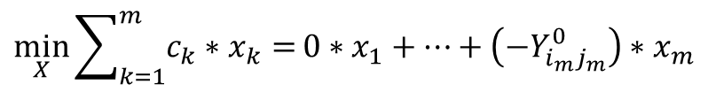

保序约束+范数约束+低秩约束的目标函数
$$F_{0} =\left[\begin{matrix}\begin{matrix}\begin{matrix}\begin{matrix}0 & 0 \\ 0 & 0\end{matrix} & \begin{matrix}⋯ & 0 \\ ⋯ & 0\end{matrix} \\ \begin{matrix}⋮ & ⋮ \\ 0 & 0\end{matrix} & \begin{matrix}⋱ & ⋮ \\ ⋯ & 0\end{matrix}\end{matrix} & 0 & 0 \\ 0 & \begin{matrix}\begin{matrix}0 & 0 \\ 0 & 0\end{matrix} & \begin{matrix}⋯ & 0 \\ ⋯ & 0\end{matrix} \\ \begin{matrix}⋮ & ⋮ \\ 0 & 0\end{matrix} & \begin{matrix}⋱ & ⋮ \\ ⋯ & 0\end{matrix}\end{matrix} & 0 \\ 0 & 0 & \begin{matrix}\begin{matrix}−1 & 0 \\ 0 & −1\end{matrix} & \begin{matrix}⋯ & 0 \\ ⋯ & 0\end{matrix} \\ \begin{matrix}⋮ & ⋮ \\ 0 & 0\end{matrix} & \begin{matrix}⋱ & ⋮ \\ ⋯ & −1\end{matrix}\end{matrix}\end{matrix} & 0 \\ 0 & \begin{matrix}\begin{matrix}\begin{matrix}\begin{matrix}−1 & 0 \\ 0 & −1\end{matrix} & \begin{matrix}⋯ & 0 \\ ⋯ & 0\end{matrix} \\ \begin{matrix}⋮ & ⋮ \\ 0 & 0\end{matrix} & \begin{matrix}⋱ & ⋮ \\ ⋯ & −1\end{matrix}\end{matrix} & 0 \\ 0 & \begin{matrix}\begin{matrix}−1 & 0 \\ 0 & −1\end{matrix} & \begin{matrix}⋯ & 0 \\ ⋯ & 0\end{matrix} \\ \begin{matrix}⋮ & ⋮ \\ 0 & 0\end{matrix} & \begin{matrix}⋱ & ⋮ \\ ⋯ & −1\end{matrix}\end{matrix}\end{matrix} & 0 \\ 0 & \begin{matrix}0 & & \\ & 0 & \\ & & \begin{matrix}⋱ & \\ & 0\end{matrix}\end{matrix}\end{matrix}\end{matrix}\right]$$
自变量
$$\min_{X}{\sum_{k=1}^{m}{c_{k}∗x_{k}}=}0∗x_{1}+⋯+\left(−Y_{i_{m}j_{m}}^{0}\right)∗x_{m}$$
$$\max_{Y}{+trace\left(F_{0}∗Y\right)}$$

Slide 8


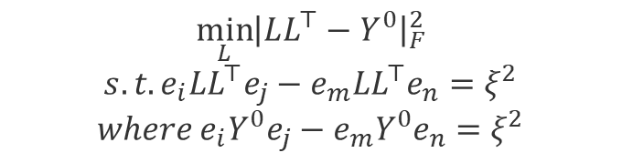




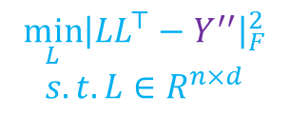



论文阅读：
Arrange2Vec的关键问题及进展
问:把n个单词保序嵌入到d维空间中，d最低可以是多少? 答: d最大是n。猜测d可以任意小。d控制了时间复杂度。
$${\min_{L}\left|LL^{⊤}−Y^{0}\right|}_{F}^{2}$$
$$s.t. e_{i}LL^{⊤}e_{j}−e_{m}LL^{⊤}e_{n}=ξ^{2}$$
$$where e_{i}Y^{0}e_{j}−e_{m}Y^{0}e_{n}=ξ^{2}$$
$$S_{n×n}^{++}$$
$$LMI(Y^{0})$$
$$Y^{0}$$
上述Formulation是非凸优化问题
$$S_{3×3}^{++}$$
$$S_{d×d}^{++}$$
投影算法：
$$\min_{Y}{{\left|Y−Y^{′}\right|}_{F}^{2}}$$
$$s.t.LMI(Y^{0}), Y∈S^{++}$$
$$Y$$
$$Y^{′}=LL^{⊤}$$
$$LL^{⊤}$$
$${\min_{L}\left|LL^{⊤}−Y^{′′}\right|}_{F}^{2}$$
$$s.t. L∈R^{n×d}$$
$$Y^{′′}=Y$$

Slide 9







只有保序约束的目标函数
$$Y=\left[\begin{matrix}\begin{matrix}Y_{i_{1}j_{1}} \\ Y_{i_{2}j_{2}} \\ Y_{i_{3}j_{3}}\end{matrix} \\ \begin{matrix}Y_{i_{4}j_{4}} \\ Y_{i_{5}j_{5}} \\ ⋮\end{matrix} \\ \begin{matrix}Y_{i_{k}j_{k}} \\ ⋮ \\ Y_{i_{m}j_{m}}\end{matrix}\end{matrix}\right]$$
$$F_{0}=\left[0\right]$$
$$Y=\left[\begin{matrix}\begin{matrix}Y_{12} \\ Y_{23} \\ Y_{22}\end{matrix} \\ \begin{matrix}⋮ \\ Y_{i_{k}j_{k}} \\ Y_{i_{k+1}j_{k+1}}\end{matrix} \\ \begin{matrix}⋮ \\ Y_{nn} \\ Y_{33}\end{matrix}\end{matrix}\right]$$
$$Y=\left[\begin{matrix}\begin{matrix}\begin{matrix}Y_{11} & Y_{12} & Y_{13} \\ Y_{21} & Y_{22} & Y_{23} \\ Y_{31} & Y_{32} & Y_{33}\end{matrix} & \begin{matrix}⋯ & Y_{1n} \\ ⋯ & Y_{2n} \\ ⋯ & Y_{3n}\end{matrix} \\ \begin{matrix}⋮ & ⋮ & ⋮ \\ Y_{n1} & Y_{n2} & Y_{n3}\end{matrix} & \begin{matrix}⋱ & ⋮ \\ ⋯ & Y_{nn}\end{matrix}\end{matrix} & 0 \\ 0 & \begin{matrix}ξ_{1} & & \\ & ξ_{2} & \\ & & \begin{matrix}⋱ & \\ & ξ_{m}\end{matrix}\end{matrix}\end{matrix}\right]$$
$$F_{1}=\left[\begin{matrix}\begin{matrix}\begin{matrix}0 & −0.5 & 0 \\ −0.5 & 0 & +0.5 \\ 0 & +0.5 & 0\end{matrix} & \begin{matrix}⋯ & 0 \\ ⋯ & 0 \\ ⋯ & 0\end{matrix} \\ \begin{matrix}⋮ & ⋮ & ⋮ \\ 0 & 0 & 0\end{matrix} & \begin{matrix}⋱ & ⋮ \\ ⋯ & 0\end{matrix}\end{matrix} & 0 \\ 0 & \begin{matrix}−1 & & \\ & 0 & \\ & & \begin{matrix}⋱ & \\ & 0\end{matrix}\end{matrix}\end{matrix}\right]$$
元素排序
自变量
$$trace\left(F_{1}∗Y\right)=−Y_{12}+Y_{23}−ξ_{1}=0↔Y_{23}−Y_{12}=ξ_{1}>0↔Y_{12}<Y_{23}$$
元素个数
$$m=\frac{n∗\left(n+1\right)}{2}$$
$$F_{2}=\left[\begin{matrix}\begin{matrix}\begin{matrix}0 & 0 & 0 \\ 0 & +1 & −0.5 \\ 0 & −0.5 & 0\end{matrix} & \begin{matrix}⋯ & 0 \\ ⋯ & 0 \\ ⋯ & 0\end{matrix} \\ \begin{matrix}⋮ & ⋮ & ⋮ \\ 0 & 0 & 0 \end{matrix} & \begin{matrix}⋱ & ⋮ \\ ⋯ & 0\end{matrix}\end{matrix} & 0 \\ 0 & \begin{matrix}0 & & \\ & −1 & \\ & & \begin{matrix}⋱ & \\ & 0\end{matrix}\end{matrix}\end{matrix}\right]$$
一个例子
目标函数
$$\min_{Y}{trace\left(F_{0}∗Y\right)}$$
约束条件
$$−Y_{i_{k}j_{k}}+Y_{i_{k+1}j_{k+1}}−ξ_{k}=0$$
$$trace\left(F_{i}∗Y\right)=0$$
$$trace\left(F_{2}∗Y\right)=−Y_{23}+Y_{22}−ξ_{2}=0↔Y_{22}−Y_{23}=ξ_{2}>0↔Y_{23}<Y_{22}$$
$$ξ_{k}>0$$
$$⋮$$
$$Y∈S^{++}$$
$$F_{m}=\left[\begin{matrix}\begin{matrix}\begin{matrix}0 & 0 & 0 \\ 0 & 0 & 0 \\ 0 & 0 & −1\end{matrix} & \begin{matrix}⋯ & 0 \\ ⋯ & 0 \\ ⋯ & 0\end{matrix} \\ \begin{matrix}⋮ & ⋮ & ⋮ \\ 0 & 0 & 0 \end{matrix} & \begin{matrix}⋱ & ⋮ \\ ⋯ & 0\end{matrix}\end{matrix} & 0 \\ 0 & \begin{matrix}0 & & \\ & 0 & \\ & & \begin{matrix}⋱ & \\ & 1\end{matrix}\end{matrix}\end{matrix}\right]$$
$$Y_{1:n;1:n}∈S^{++}$$
$$trace\left(F_{2}∗Y\right)=−Y_{23}+Y_{22}−ξ_{2}=0↔Y_{22}−Y_{23}=ξ_{2}>0↔Y_{23}<Y_{22}$$

Slide 10



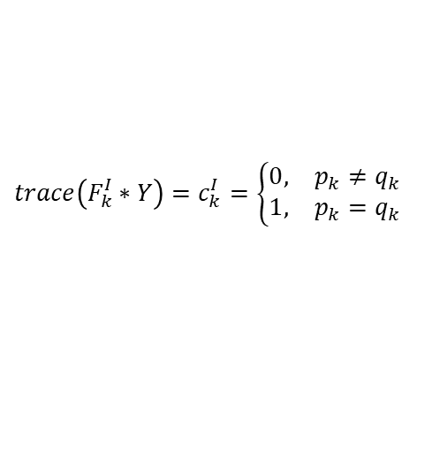
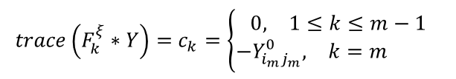
保序约束+范数约束+低秩约束的目标函数
$$Y=\left[\begin{matrix}\begin{matrix}\begin{matrix}\begin{matrix}Y_{11} & Y_{12} & Y_{13} \\ Y_{21} & Y_{22} & Y_{23} \\ Y_{31} & Y_{32} & Y_{33}\end{matrix} & \begin{matrix}⋯ & Y_{1n} \\ ⋯ & Y_{2n} \\ ⋯ & Y_{3n}\end{matrix} \\ \begin{matrix}⋮ & ⋮ & ⋮ \\ Y_{n1} & Y_{n2} & Y_{n3}\end{matrix} & \begin{matrix}⋱ & ⋮ \\ ⋯ & Y_{nn}\end{matrix}\end{matrix} & 0 \\ 0 & \begin{matrix}ξ_{1} & & \\ & ξ_{2} & \\ & & \begin{matrix}⋱ & \\ & ξ_{m}\end{matrix}\end{matrix}\end{matrix} & 0 \\ 0 & \begin{matrix}\begin{matrix}\begin{matrix}\begin{matrix}I_{11} & I_{12} \\ I_{21} & I_{22}\end{matrix} & \begin{matrix} ⋯ & I_{1n} \\ ⋯ & I_{2n}\end{matrix} \\ \begin{matrix}⋮ & ⋮ \\ I_{n1} & I_{n2}\end{matrix} & \begin{matrix} ⋱ & ⋮ \\ ⋯ & I_{nn}\end{matrix}\end{matrix} & \begin{matrix}\begin{matrix}A_{11} & A_{12} \\ A_{21} & A_{22}\end{matrix} & \begin{matrix}⋯ & A_{1n} \\ ⋯ & A_{2n}\end{matrix} \\ \begin{matrix}⋮ & ⋮ \\ A_{n1} & A_{n2}\end{matrix} & \begin{matrix}⋱ & ⋮ \\ ⋯ & A_{nn}\end{matrix}\end{matrix} \\ \begin{matrix}\begin{matrix}A_{11} & A_{12} \\ A_{21} & A_{22}\end{matrix} & \begin{matrix}⋯ & A_{1n} \\ ⋯ & A_{2n}\end{matrix} \\ \begin{matrix}⋮ & ⋮ \\ A_{n1} & A_{n2}\end{matrix} & \begin{matrix}⋱ & ⋮ \\ ⋯ & A_{nn}\end{matrix}\end{matrix} & \begin{matrix}\begin{matrix}Z_{11} & Z_{12} \\ Z_{21} & Z_{22}\end{matrix} & \begin{matrix}⋯ & Z_{1n} \\ ⋯ & Z_{2n}\end{matrix} \\ \begin{matrix}⋮ & ⋮ \\ Z_{n1} & Z_{n2}\end{matrix} & \begin{matrix}⋱ & ⋮ \\ ⋯ & Z_{nn}\end{matrix}\end{matrix}\end{matrix} & 0 \\ 0 & \begin{matrix}\begin{matrix}\begin{matrix}U_{11} & U_{12} \\ U_{21} & U_{22}\end{matrix} & \begin{matrix} ⋯ & U_{1n} \\ ⋯ & U_{2n}\end{matrix} \\ \begin{matrix}⋮ & ⋮ \\ U_{n1} & U_{n2}\end{matrix} & \begin{matrix} ⋱ & ⋮ \\ ⋯ & U_{nn}\end{matrix}\end{matrix} & \begin{matrix}\begin{matrix}W_{11} & W_{12} \\ W_{21} & W_{22}\end{matrix} & \begin{matrix}⋯ & W_{1n} \\ ⋯ & W_{2n}\end{matrix} \\ \begin{matrix}⋮ & ⋮ \\ W_{n1} & W_{n2}\end{matrix} & \begin{matrix}⋱ & ⋮ \\ ⋯ & W_{nn}\end{matrix}\end{matrix} \\ \begin{matrix}\begin{matrix}W_{11} & W_{12} \\ W_{21} & W_{22}\end{matrix} & \begin{matrix}⋯ & W_{1n} \\ ⋯ & W_{2n}\end{matrix} \\ \begin{matrix}⋮ & ⋮ \\ W_{n1} & W_{n2}\end{matrix} & \begin{matrix}⋱ & ⋮ \\ ⋯ & W_{nn}\end{matrix}\end{matrix} & \begin{matrix}\begin{matrix}V_{11} & V_{12} \\ V_{21} & V_{22}\end{matrix} & \begin{matrix}⋯ & V_{1n} \\ ⋯ & V_{2n}\end{matrix} \\ \begin{matrix}⋮ & ⋮ \\ V_{n1} & V_{n2}\end{matrix} & \begin{matrix}⋱ & ⋮ \\ ⋯ & V_{nn}\end{matrix}\end{matrix}\end{matrix}\end{matrix}\end{matrix}\right]$$
自变量
$$trace\left(F_{k}^{ξ}∗Y\right)=c_{k}=\left\{\begin{aligned}\begin{matrix}0, & 1≤k≤m−1\end{matrix} \\ \begin{matrix}−Y_{i_{m}j_{m}}^{0}, & k=m \end{matrix}\end{aligned}\right.$$
$$trace\left(F_{k}^{I}∗Y\right)=c_{k}^{I}=\left\{\begin{aligned}\begin{matrix}0, & p_{k}≠q_{k}\end{matrix} \\ \begin{matrix}1, & p_{k}=q_{k}\end{matrix}\end{aligned}\right.$$
$$trace\left(F_{k}^{A}∗Y\right)=c_{k}^{A}=Y_{i_{k}j_{k}}^{0}$$
$$trace\left(F_{k}^{W}∗Y\right)=c_{k}^{w}=0$$

Slide 11





只有保序约束的目标函数
$$Y=\left[\begin{matrix}\begin{matrix}Y_{i_{1}j_{1}} \\ Y_{i_{2}j_{2}} \\ Y_{i_{3}j_{3}}\end{matrix} \\ \begin{matrix}Y_{i_{4}j_{4}} \\ Y_{i_{5}j_{5}} \\ ⋮\end{matrix} \\ \begin{matrix}Y_{i_{k}j_{k}} \\ ⋮ \\ Y_{i_{m}j_{m}}\end{matrix}\end{matrix}\right]$$
$$Y=\left[\begin{matrix}\begin{matrix}Y_{12} \\ Y_{23} \\ Y_{i_{3}j_{3}}\end{matrix} \\ \begin{matrix}Y_{i_{4}j_{4}} \\ Y_{i_{5}j_{5}} \\ ⋮\end{matrix} \\ \begin{matrix}Y_{i_{k}j_{k}} \\ ⋮ \\ Y_{i_{m}j_{m}}\end{matrix}\end{matrix}\right]$$
$$Y=\left[\begin{matrix}\begin{matrix}\begin{matrix}Y_{11} & Y_{12} & Y_{13} \\ Y_{21} & Y_{22} & Y_{23} \\ Y_{31} & Y_{32} & Y_{33}\end{matrix} & \begin{matrix}⋯ & Y_{1n} \\ ⋯ & Y_{2n} \\ ⋯ & Y_{3n}\end{matrix} \\ \begin{matrix}⋮ & ⋮ & ⋮ \\ Y_{n1} & Y_{n2} & Y_{n3}\end{matrix} & \begin{matrix}⋱ & ⋮ \\ ⋯ & Y_{nn}\end{matrix}\end{matrix} & 0 \\ 0 & \begin{matrix}ξ_{1} & & \\ & ξ_{2} & \\ & & \begin{matrix}⋱ & \\ & ξ_{m}\end{matrix}\end{matrix}\end{matrix}\right]$$
元素排序
一个例子
自变量
元素个数
$$m=\frac{n∗\left(n+1\right)}{2}$$
$$F_{0}=\left[0\right]$$
目标函数
$$\min_{Y}{trace\left(F_{0}∗Y\right)}$$
$$F_{1}=\left[\begin{matrix}\begin{matrix}\begin{matrix}0 & +0.5 & 0 \\ +0.5 & 0 & −0.5 \\ 0 & −0.5 & 0\end{matrix} & \begin{matrix}⋯ & 0 \\ ⋯ & 0 \\ ⋯ & 0\end{matrix} \\ \begin{matrix}⋮ & ⋮ & ⋮ \\ 0 & 0 & 0\end{matrix} & \begin{matrix}⋱ & ⋮ \\ ⋯ & 0\end{matrix}\end{matrix} & 0 \\ 0 & \begin{matrix}−1 & & \\ & 0 & \\ & & \begin{matrix}⋱ & \\ & 0\end{matrix}\end{matrix}\end{matrix}\right]$$
约束条件
$$−Y_{i_{k}j_{k}}+Y_{i_{k+1}j_{k+1}}−ξ_{k}=0$$
$$trace\left(F_{i}∗Y\right)=0$$
$$ξ_{k}>0$$
$$Y∈S^{++}$$
$$Y_{1:n;1:n}∈S^{++}$$
$$F_{1}=\left[\begin{matrix}\begin{matrix}\begin{matrix}0 & +0.5 & 0 \\ +0.5 & 0 & −0.5 \\ 0 & −0.5 & 0\end{matrix} & \begin{matrix}⋯ & 0 \\ ⋯ & 0 \\ ⋯ & 0\end{matrix} \\ \begin{matrix}⋮ & ⋮ & ⋮ \\ 0 & 0 & 0\end{matrix} & \begin{matrix}⋱ & ⋮ \\ ⋯ & 0\end{matrix}\end{matrix} & 0 \\ 0 & \begin{matrix}−1 & & \\ & 0 & \\ & & \begin{matrix}⋱ & \\ & 0\end{matrix}\end{matrix}\end{matrix}\right]$$

