Slide 1
SQL Final Project
IPL AUCTION
Motive
Developing auction strategy for new IPL franchise by analyzing past IPL data to create a strong and balanced squad.
Bidding on batters
-Task 1 to 3----------------------------------------2 to 7
Bidding on bowlers
-Task 4 to 6----------------------------------------8 to 13
Additional Questions
-Questions 1 to 10------------------------------14 to 22

Slide 2
Bidding on batters
Task 1:-
Your first priority is to get 2-3 players with high S.R who have faced at least 500 balls.And to do that you have to make a list of 10 players you want to bid in the auction so that when you try to grab them in auction you should not pay the amount greater than you have in the purse for a particular player.
Query:-
select batsman,
count(ball)as total_balls,sum(batsman_runs) as total_batsman_runs,
(sum(batsman_runs)*100.0)/count(ball) as Strike_rate
from ipl_ball
where extras_type!='wides'
group by batsman
having count(ball)>=500
order by strike_rate desc limit 10;

Slide 3
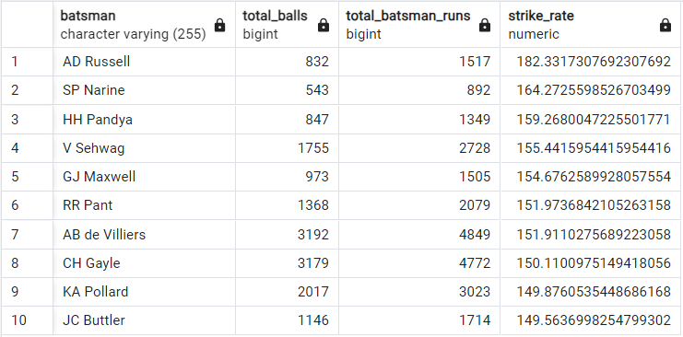
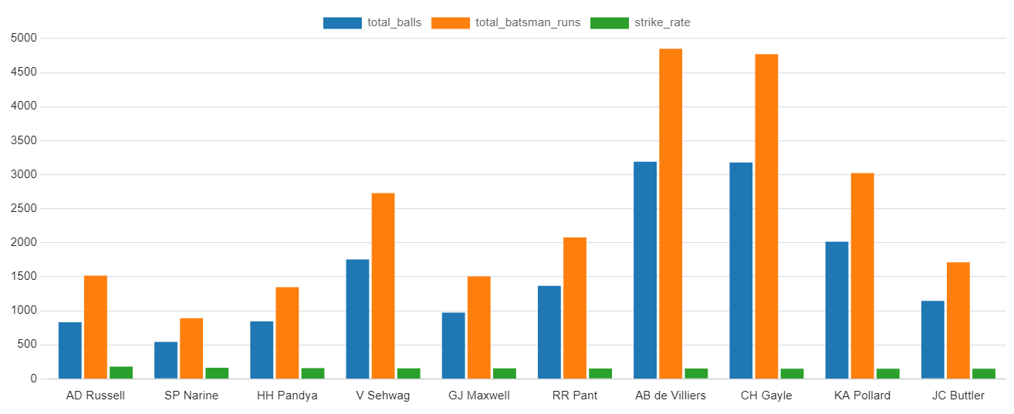
Output:-

Slide 4
Task 2:-
Now you need to get 2-3 players with good Average who have played more the 2 ipl seasons.And to do that you have to make a list of 10 players you want to bid in the auction so that when you try to grab them in auction you should not pay the amount greater than you have in the purse for a particular player.
Query:-
select distinct batsman,
sum(batsman_runs) as total_runs,
sum(is_wicket) as total_wickets,
count(distinct(extract(year from match_date))) as seasons,
sum(batsman_runs)*1.0/sum(is_wicket) as average
from deliveries_v03
group by batsman having count(distinct(extract(year from match_date)))>2
order by average desc limit 10;

Slide 5
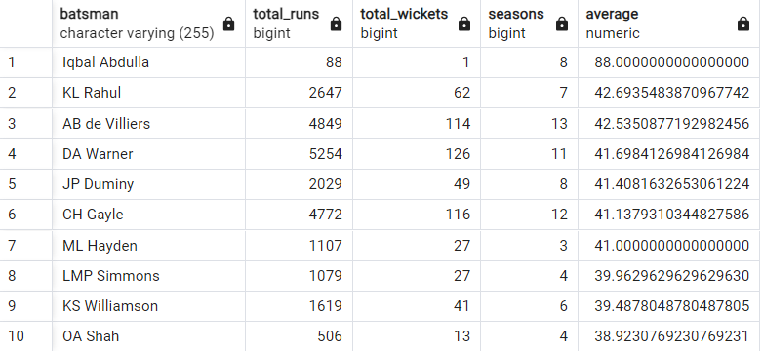
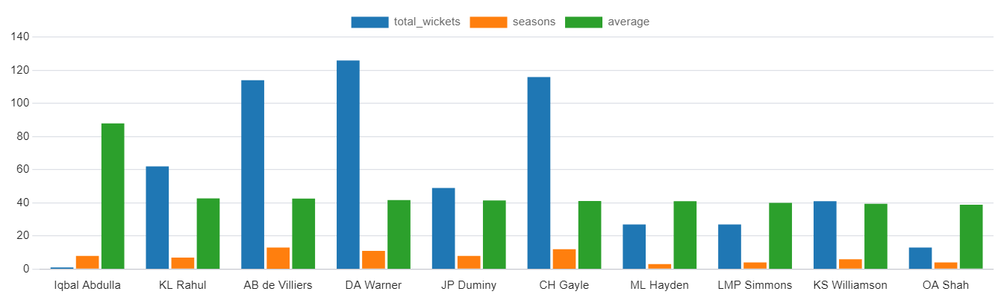
Output:-

Slide 6
Task 3:-
Now you need to get 2-3 Hard-hitting players who have scored most runs in boundaries and have played more the 2 ipl season. To do that you have to make a list of 10 players you want to bid in the auction so that when you try to grab them in auction you should not pay the amount greater than you have in the purse for a particular player..
Query:-
select batsman,
(sum(case when batsman_runs=4 then batsman_runs when batsman_runs=6 then batsman_runs else 0 end))as batsman_boundaries,
sum(batsman_runs) as batsman_total_runs,
sum(total_runs) as total_runs,
count(distinct(extract(year from match_date))) as seasons,
(sum(case when batsman_runs=4 then batsman_runs when batsman_runs=6 then batsman_runs else 0 end) * 1.0) / sum(total_runs) *100.0 as boundary_percentage
from deliveries_v03
group by batsman having count(distinct(extract(year from match_date)))>2
order by boundary_percentage desc limit 10;

Slide 7
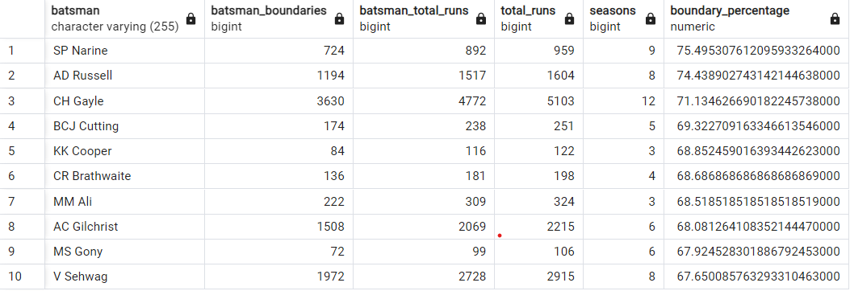
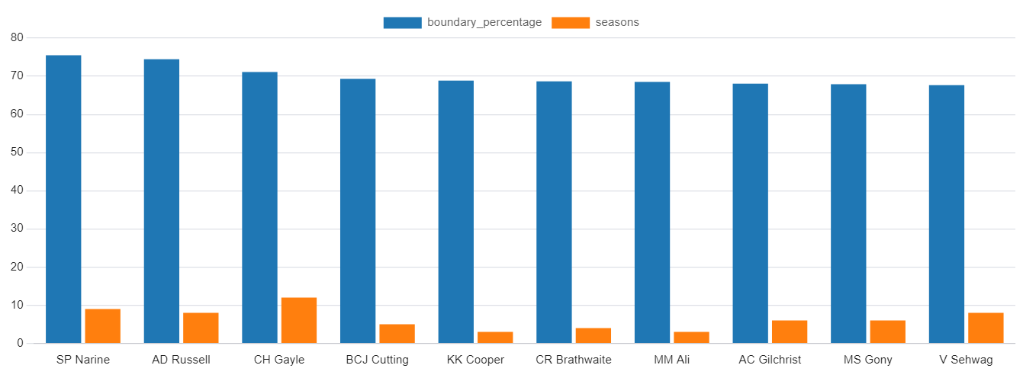
Output:-

Slide 8
Bidding on bowlers
Task 4:-
Your first priority is to get 2-3 bowlers with good economy who have bowled at least 500 balls in IPL so far.To do that you have to make a list of 10 players you want to bid in the auction so that when you try to grab them in auction you should not pay the amount greater than you have in the purse for a particular player.
Query:-
select bowler,
sum(total_runs) as total_runs,
count(ball),
sum(total_runs)/(count(ball)/6.0) as economy_rate
from deliveries_v03
group by bowler having count(ball)>500
order by economy_rate asc limit 10;

Slide 9
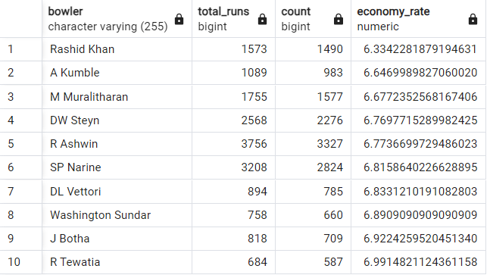
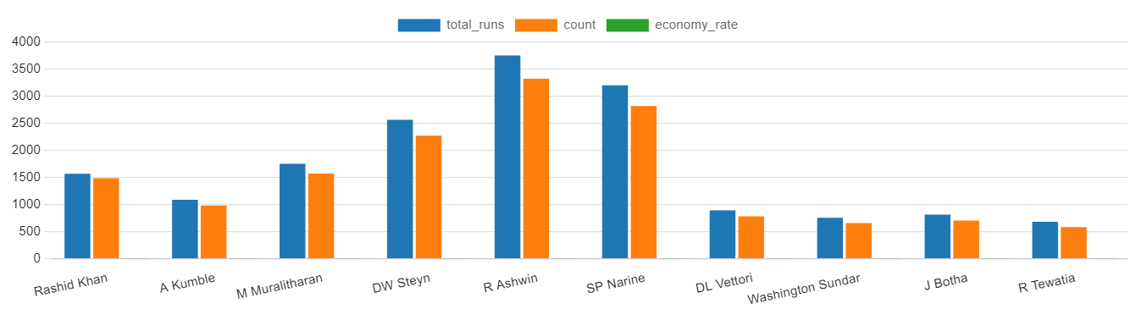
Output:-

Slide 10
Task 5:-
Now you need to get 2-3 bowlers with the best strike rate and who have bowled at least 500 balls in IPL so far.To do that you have to make a list of 10 players you want to bid in the auction so that when you try to grab them in auction you should not pay the amount greater than you have in the purse for a particular player.
Query:-
select bowler,
count(ball),
sum(is_wicket),
(count(ball)*1.0/sum(is_wicket)) as strike_rate
from deliveries_v03
group by bowler having count(ball)>500
order by strike_rate limit 10;

Slide 11
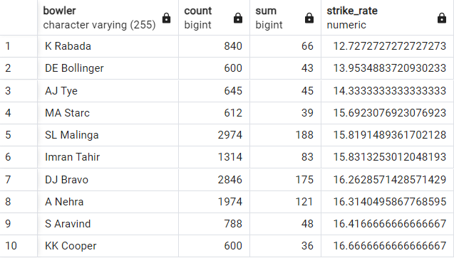
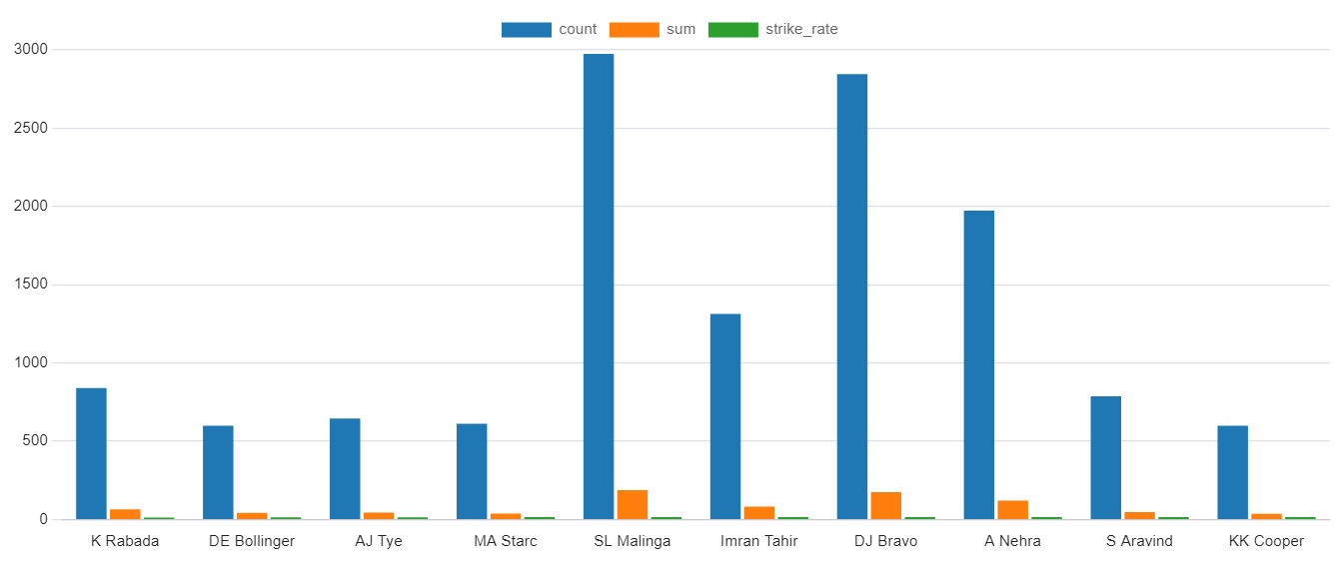
Output:-

Slide 12
Task 6:-
Now you need to get 2-3 All_rounders with the best batting as well as bowling strike rate and who have faced at least 500 balls in IPL so far and have bowled minimum 300 balls.To do that you have to make a list of 10 players you want to bid in the auction so that when you try to grab them in auction you should not pay the amount greater than you have in the purse for a particular player.
Query:-
select a.*,b.* from (select batsman, count(ball)as total_balls, sum(batsman_runs) as total_batsman_runs, (sum(batsman_runs)*100.0)/count(ball) as batting_Strike_rate from deliveries_v03 group by batsman having count(ball)>=500 order by batting_strike_rate desc ) as a Inner join (select bowler, count(ball), sum(is_wicket), (count(ball)*1.0/sum(is_wicket)) as bowler_strike_rate from deliveries_v03 group by bowler having count(ball)>300 order by bowler_strike_rate) as b on a.batsman=b.bowler;

Slide 13
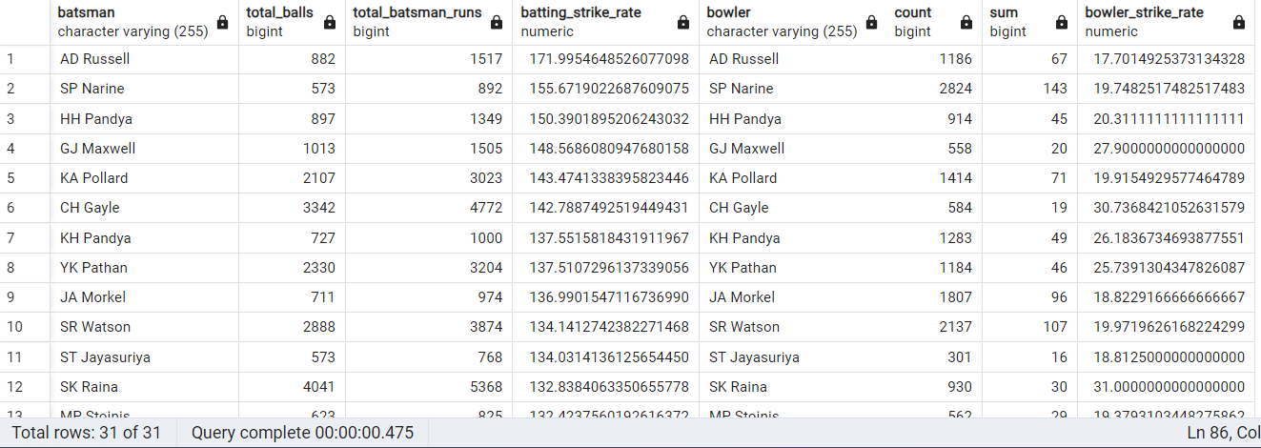
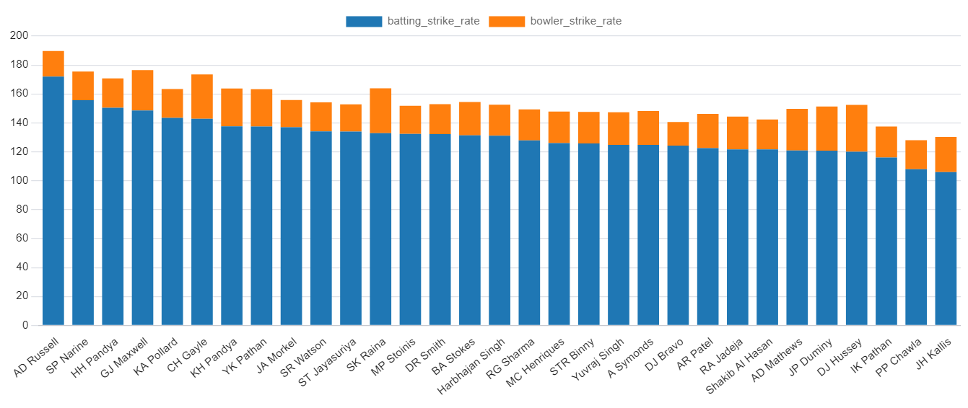
Output:-

Slide 14
Bidding On Batters In Ipl Auction
Bidding On Bowlers In Ipl Auction

Slide 15
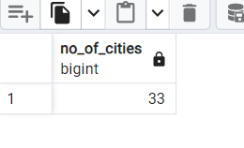
Additional Questions
NOTE:-Deliveries is the table created using the IPL_Ball data whereas the Matches table has been created using the IPL_Matches data
1.Get the count of cities that have hosted an IPL match.
Query:-
select count(distinct city) as No_of_cities from matches;
Output:-

Slide 16
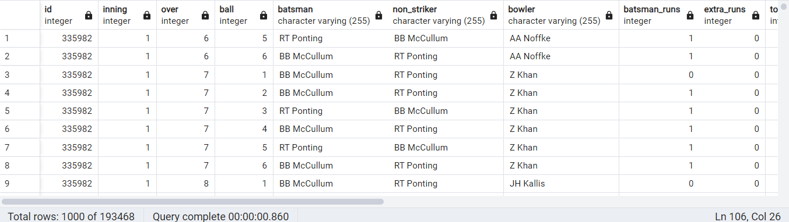
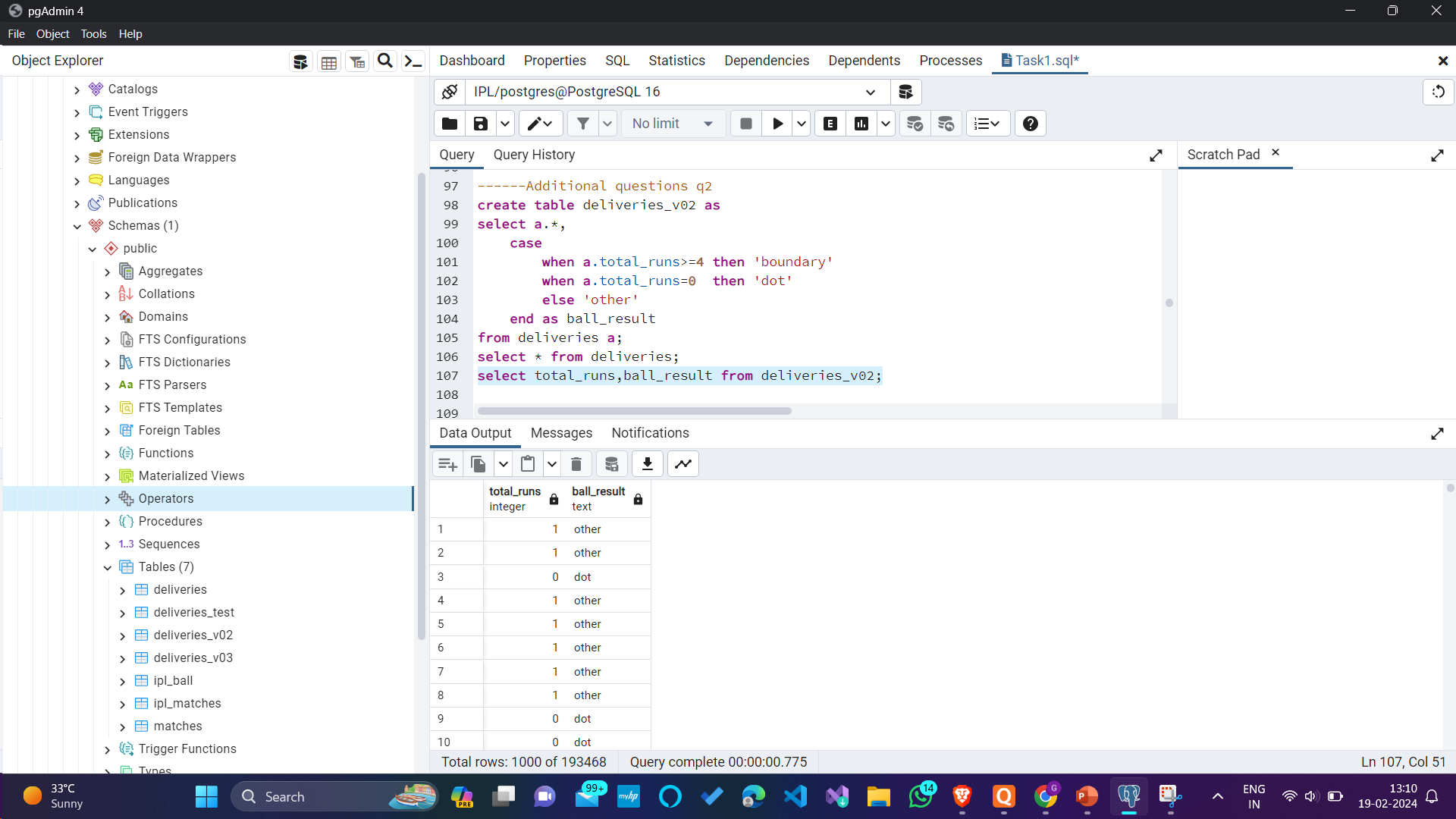
2. Create table deliveries_v02 with all the columns of the table ‘deliveries’ and an additional column ball_result containing values boundary, dot or other depending on the total_run (boundary for >= 4, dot for 0 and other for any other number)
Query:-
create table deliveries_v02 as
select a.*,case when a.total_runs>=4 then 'boundary' when a.total_runs=0 then 'dot' else 'other' end as ball_result from deliveries a;
--select * from deliveries;
--select total_runs,ball_result from deliveries_v02;

Slide 17
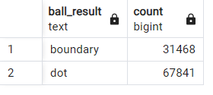

3.Write a query to fetch the total number of boundaries and dot balls from the deliveries_v02 table.
Query:-
select ball_result,count(ball_result) from deliveries_v02 group by ball_result having ball_result in ('boundary','dot’);
Output:-

Slide 18
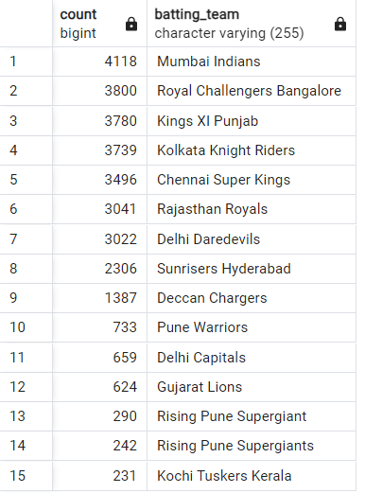
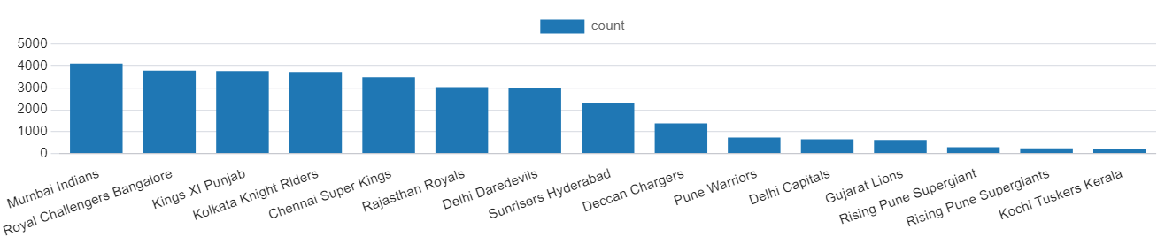
4. Write a query to fetch the total number of boundaries scored by each team from the deliveries_v02 table and order it in descending order of the number of boundaries scored.
Query:-
select count(ball_result),batting_team from deliveries_v02 where ball_result='boundary' group by batting_team order by count(ball_result) desc;
Output:-

Slide 19
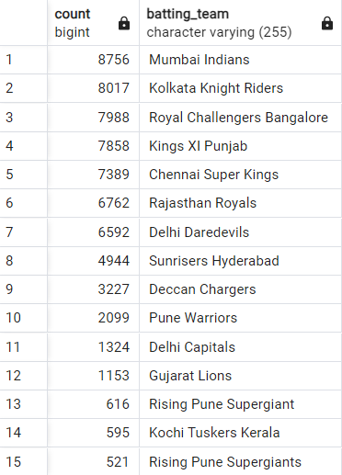
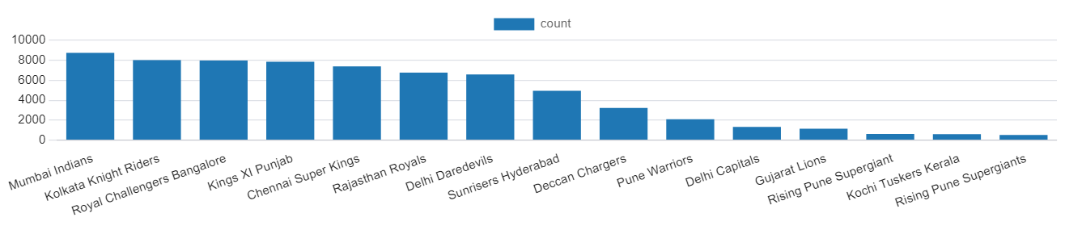
5.Write a query to fetch the total number of dot balls bowled by each team and order it in descending order of the total number of dot balls bowled
Query:-
select count(ball_result),batting_team from deliveries_v02 where ball_result='dot' group by batting_team order by count(ball_result) desc;
Output:-

Slide 20

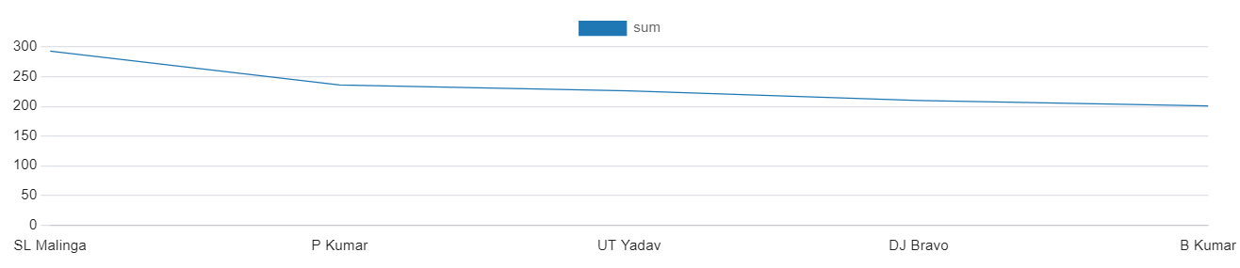
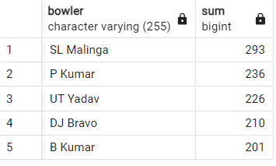
6. Write query to fetch the total number of dismissals by dismissal kinds where dismissal kind is not NA
Query:-
select count(dismissal_kind) from deliveries_v02 where dismissal_kind!=‘NA’;
Output:-
7 . Write a query to get the top 5 bowlers who conceded maximum extra runs from the deliveries table
Query:-
select bowler,sum(extra_runs) from deliveries group by bowler order by sum(extra_runs) desc limit 5;
Output:-

Slide 21
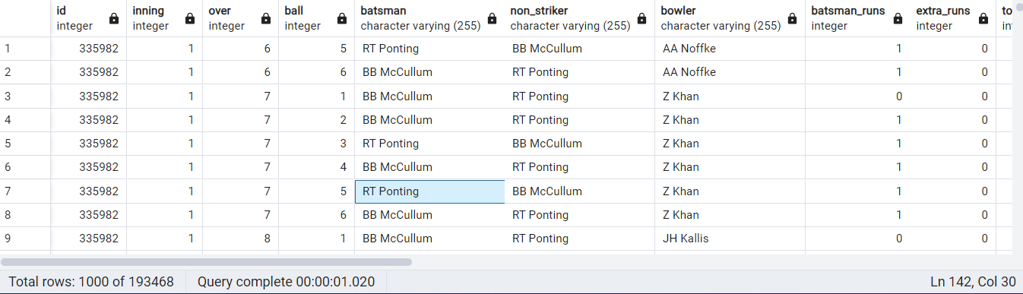
8.Write a query to create a table named deliveries_v03 with all the columns of deliveries_v02 table and two additional column (named venue and match_date) of venue and date from table matches
Query:-
create table deliveries_v03 as select a.*,b.venue as match_venue,b.dates as match_date from deliveries_v02 as a left join matches as b on a.id=b.id;
--select * from deliveries_v03;

Slide 22
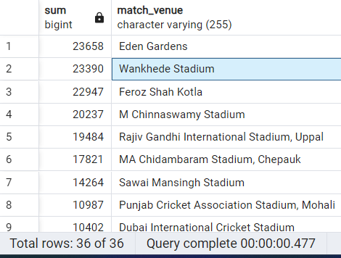
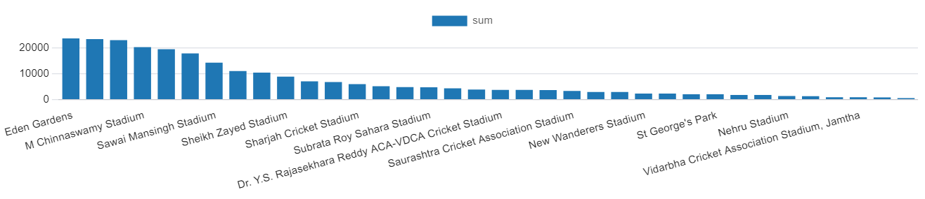
9.Write a query to fetch the total runs scored for each venue and order it in the descending order of total runs scored.
Query:-
select sum(total_runs),match_venue from deliveries_v03 group by match_venue order by sum(total_runs) desc;
Output:-

Slide 23
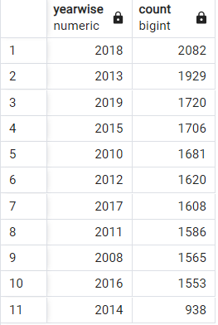
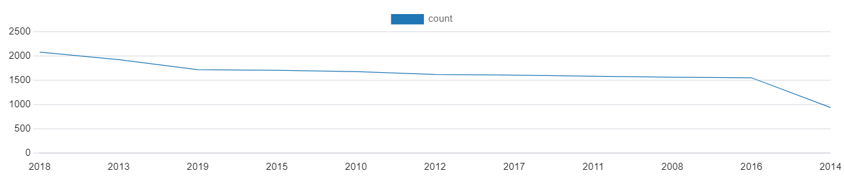
10.Write a query to fetch the year-wise total runs scored at Eden Gardens and order it in the descending order of total runs scored.
Query:-
select distinct extract (year from match_date) as yearWise,count(total_runs) from deliveries_v03 where match_venue='Eden Gardens' group by yearWise order by count (total_runs) desc;
Output:-

Slide 24



