Slide 1
Audiobooks Store Project
Predictive Analytics for Customer Repurchases in Audiobook Retail

Slide 2
Introduction
Welcome to my presentation on the machine learning algorithm designed to predict customer repurchases for our audiobook store. This innovative solution leverages past customer data through a deep neural network (DNN), providing robust insights into future buying behaviors to enhance customer retention and boost sales.

Slide 3
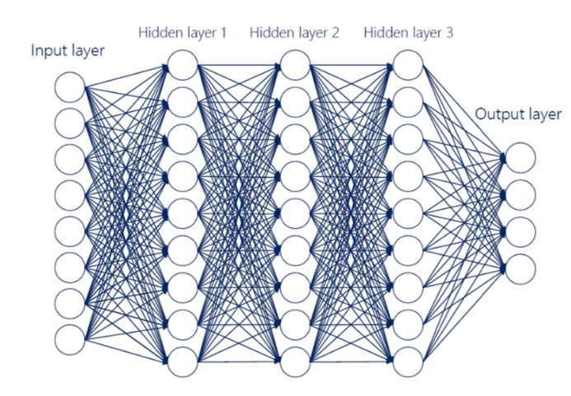
Deep Neural Network (DNN)

Slide 4
Key Highlights:
Objective: Predict whether a customer will make another purchase based on their previous interactions with our store
Data Used: Historical customer data, including purchase history, listening patterns, and demographic information.
Benefits: Improved marketing strategies, personalized customer experiences, and increased customer loyalty.

Slide 5
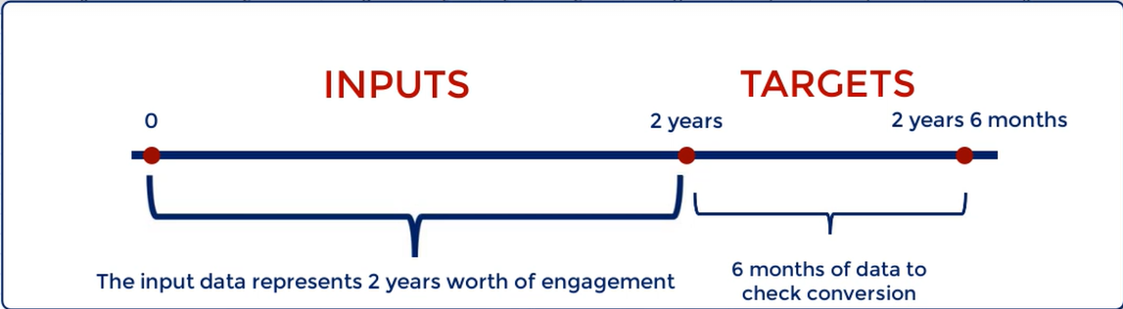
Inputs and targets
Target 1 : the customer has purchased again
Target 0 : the customer has not purchased again

Slide 6
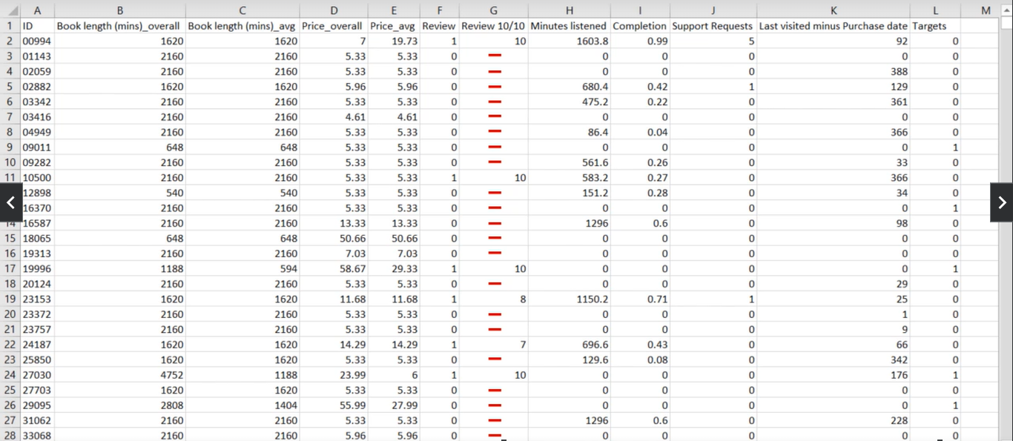
Dataset

Slide 7
How steps was done:
Preprocess the data:
Balance the data
Standardize and shuffle the data
Split the data into train, validation and test
Save the data into a tensor friendly format
Create the machine learning algorithm

Slide 8
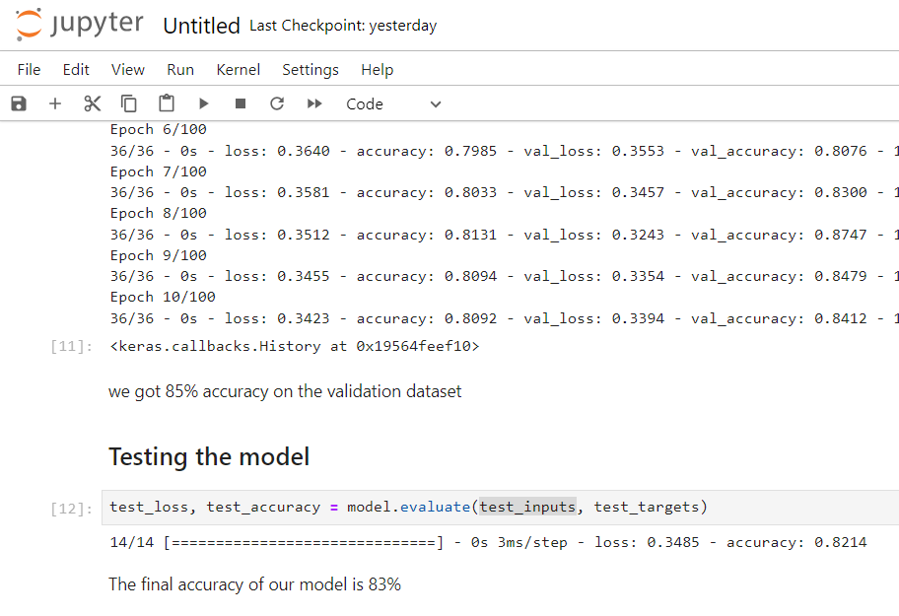
Accuracy of the model
We’ve got a 83% accuracy, which mean if we pass a new data to the model that’s contain past data about some customers, it will 83% successfully predict if theses customers will buy again from our store or not in the upcoming 6 months.

