Slide 1
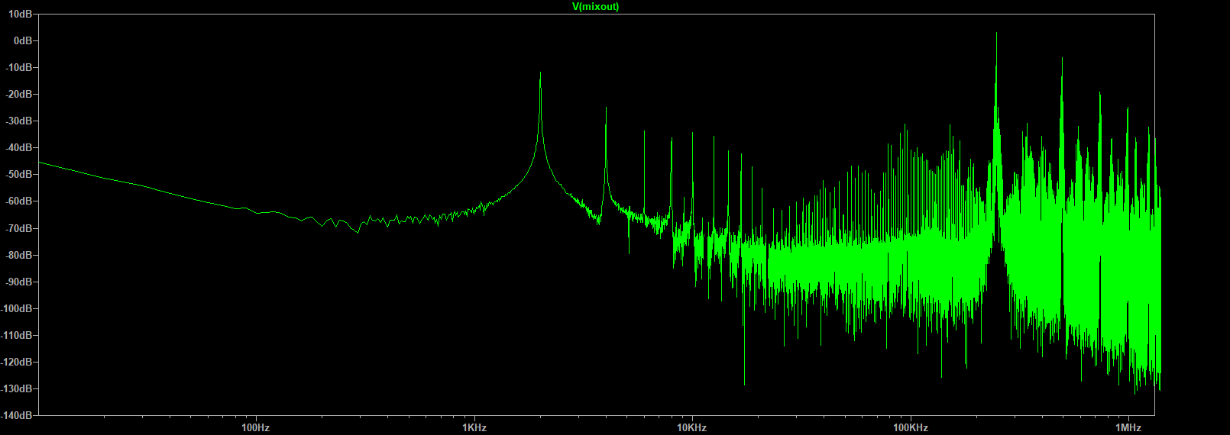
LOCAL & PITCH (230kHz, 232kHz)
PITCH + LOCAL (462kHz)
PITCH-LOCAL (2kHz)
1-3 harmonics (4, 6, 8kHz)

