Slide 1
SKILL DEVELOPMENT PROJECT I • ICT 1108
EduPulse
An Integrated Student Growth, Wellness & Community Tracking System
Group Name : Track Forge (Group 4)
Project Mentor : Mr. Husny Mohamed – Lecturer (Probationary)
Dept. of ICT, Faculty of Technology, Rajarata University of Sri Lanka

Slide 2
Introduction
02
▪ EduPulse is a web-based platform where students track academic, athletic & community life in one place.
– What: A single dashboard combining study analysis, sports logging & a campus community hub.
– Motivation: University life = studies + sports + clubs, but tools today are scattered.
▪ Importance:
– Replaces paper timetables, alarms & WhatsApp groups with one centralized platform.
– Encourages a healthy study–health–community balance and better time management.
EduPulse | ICT 1108 | Group 4 - Track Forge

Slide 3
Problem Statement
03
▪ Students have no single system to manage studies, sports & community activities.
▪ Study time is not tracked – hard to see which subjects are being neglected.
▪ Sports are planned informally and often skipped with no record.
▪ Event details are scattered across many channels – deadlines & events get missed.
▪ Result: poor time management and an unbalanced learning–life routine.
▪ Need: one simple, secure platform to plan, track & get reminders in real time.
EduPulse | ICT 1108 | Group 4 - Track Forge

Slide 4
Aims & Objectives
04
Aim: Develop a web-based system that helps students plan, record & visualize their academic, athletic and community engagements in one unified platform.
Objectives
▪ Build a central dashboard: overview of all activities, calendar & reminders.
▪ Provide secure accounts with view, edit & logout while protecting data.
▪ Create role-based logins for Students, Community Admins & System Admins.
▪ Integrate a manual study focus timer & subject-wise study loggers.
▪ Build an athletic logging interface for exercise schedules & durations.
▪ Design a hub for club management, group registrations & event sign-ups.
EduPulse | ICT 1108 | Group 4 - Track Forge

Slide 5
Methodology
05
Waterfall Approach (7 Phases)
Languages & Tools
▪ Frontend: HTML5, CSS3, JavaScript
▪ Backend: PHP (procedural)
▪ Database: MySQL
▪ IDE: Visual Studio Code
▪ Design: Figma
▪ Version Control: Git & GitHub
▪ Testing: Manual + Chrome DevTools
▪ Requirement Gathering
▪ UI / UX Design (wireframes)
▪ Frontend Development
▪ Backend & Database Integration
▪ Authentication & Role Access
▪ Testing, then Documentation
EduPulse | ICT 1108 | Group 4 - Track Forge

Slide 6
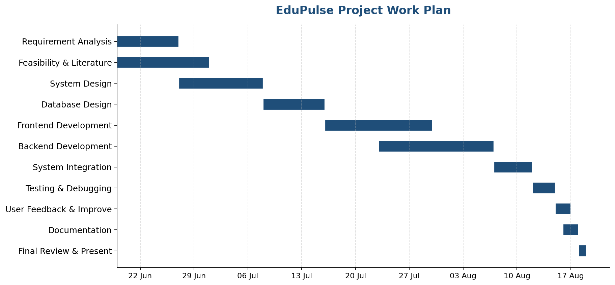
Work Plan
06
Gantt chart – tasks scheduled from 19 Jun to 18 Aug 2026
EduPulse | ICT 1108 | Group 4 - Track Forge

Slide 7
Group List
07
Name | Registration ID | Index No.
M.R.M. Asfak | ITT/2024/011 | 2696
M.A.M. Ahsan | ITT/2024/009 | 2694
M.A.F. Askiya | ITT/2024/012 | 2697
M.N. Hamna | ITT/2024/043 | 2728
A.K.M. Bandara | ITT/2024/015 | 2700
P.R.N. Lakshani | ITT/2024/060 | 2745
EduPulse | ICT 1108 | Group 4 - Track Forge

Slide 8
Thank You
Questions & Discussion

