Slide 1
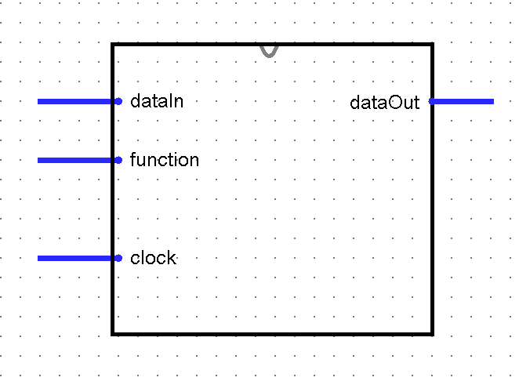
Main processor
8
8
9

Slide 2
Main processor data path & control block
dataIn
8
6
Data Path
8
dataOut
function
9
Control signals
3
Control unit
clock

Slide 3
Register file
3
Ra
dataA
8
3
Rb
dataB
8
3
Rw
clock
WE
dataW
8

Slide 4
ALU
8
dataA
ALUout
8
8
dataB
selOp
3

Slide 5
4x1 MUX
8
dataIn
8
dataA
8
ALUout
8
8
dataOut
dataB
disSrc
2

Slide 6
dataIn
8
3
Ra
dataA
8
8
3
8
8
dataOut
Rb
dataB
3
Rw
clock
3
WE
dataW
2
selOp
distSrc
regWrite

Slide 7
Control unit
3
Op
regWrite
selOp
3
destSrc
2
clock

Slide 8
3-bits
3-bits
3-bits
opcode
Reg-A
Address
Reg-B
Address
9-bits function format

