Slide 1
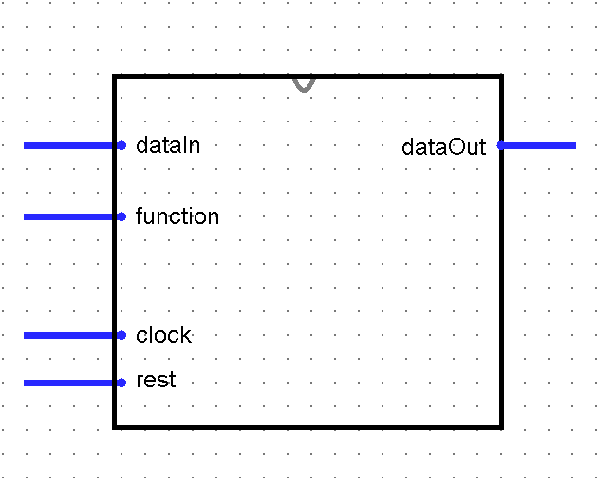
Main processor
8
8
9

Slide 2
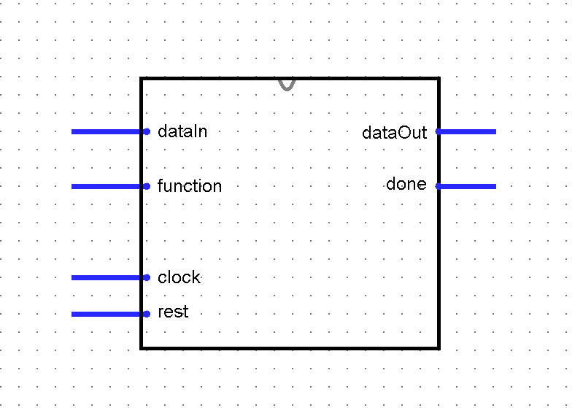
Main processor
8
8
9
Data Path
Register file
Control unit
3
Ra
dataA
8
3
Rb
dataB
8
3
Rw
clock
WE
dataW
8

Slide 3
Register file
3
Ra
dataA
8
3
Rb
dataB
8
3
Rw
clock
WE
dataW
8

Slide 4
ALU
8
dataA
ALUout
8
8
dataB
selOp
3

Slide 5
4x1 MUX
8
dataIn
8
dataA
8
ALUout
8
8
dataOut
dataB
disSrc
2

Slide 6
datapath
dataIn
8
3
Ra
dataA
8
8
3
8
8
dataOut
Rb
dataB
3
Rw
clock
3
WE
dataW
2
selOp
disSrc
regWrite

Slide 7
Control unit
3
Op
regWrite
selOp
3
destSrc
2
clock

